Slide 1
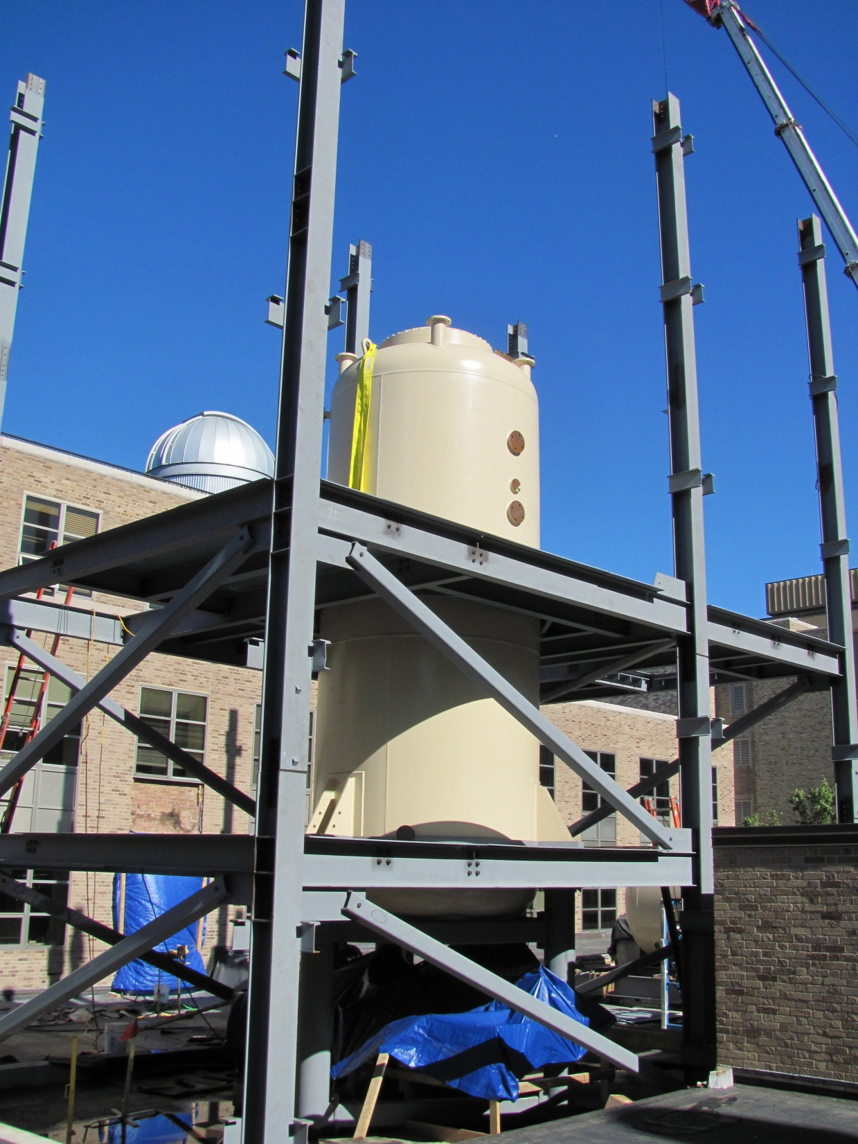
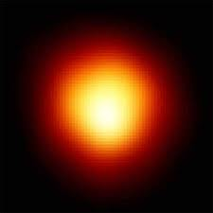
Challenges & Limits of Experiments with Small Accelerators
Michael Wiescher
Joint Institute of Nuclear Astrophysics
University of Notre Dame
Stellar nucleosynthesis
Experimental challenges
Developments above ground
Accelerators underground

Slide 2
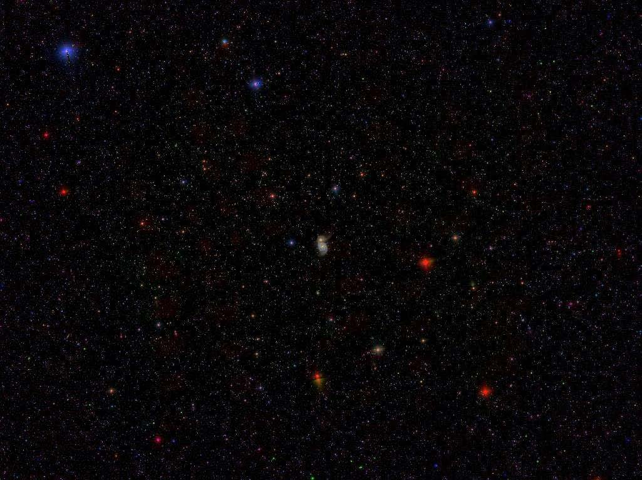
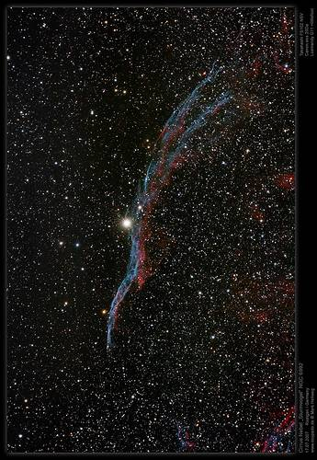
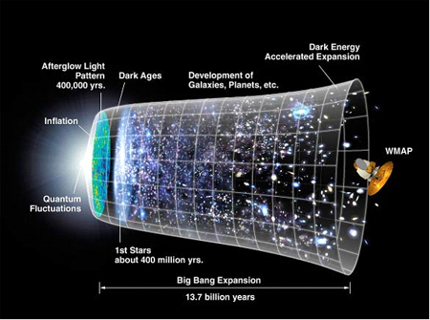
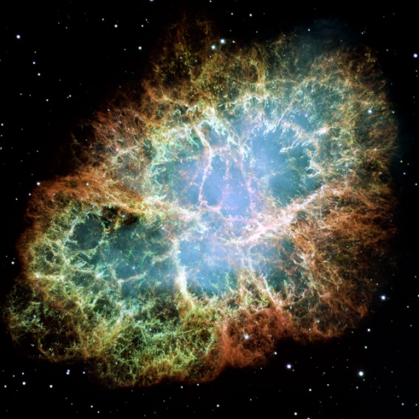
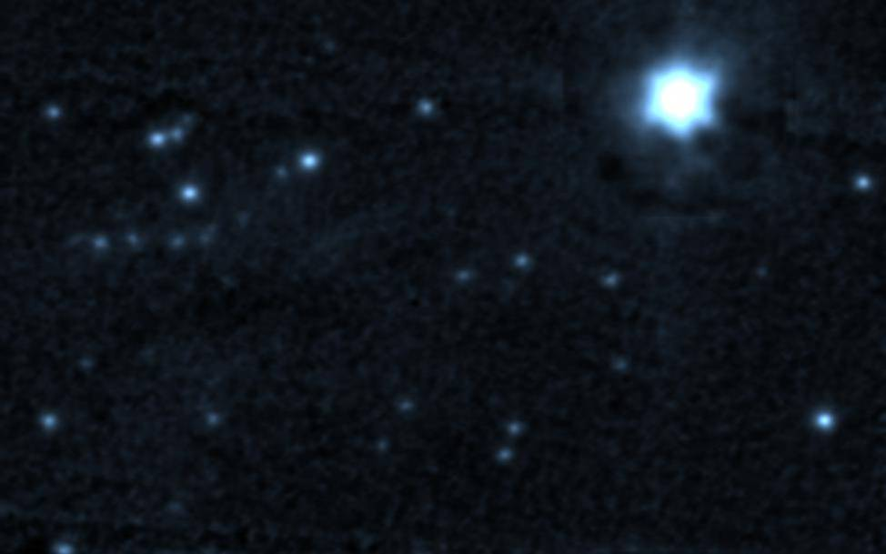
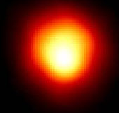
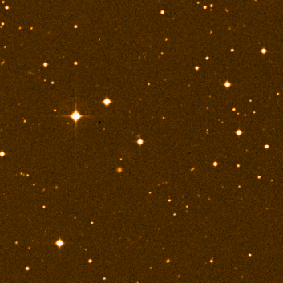
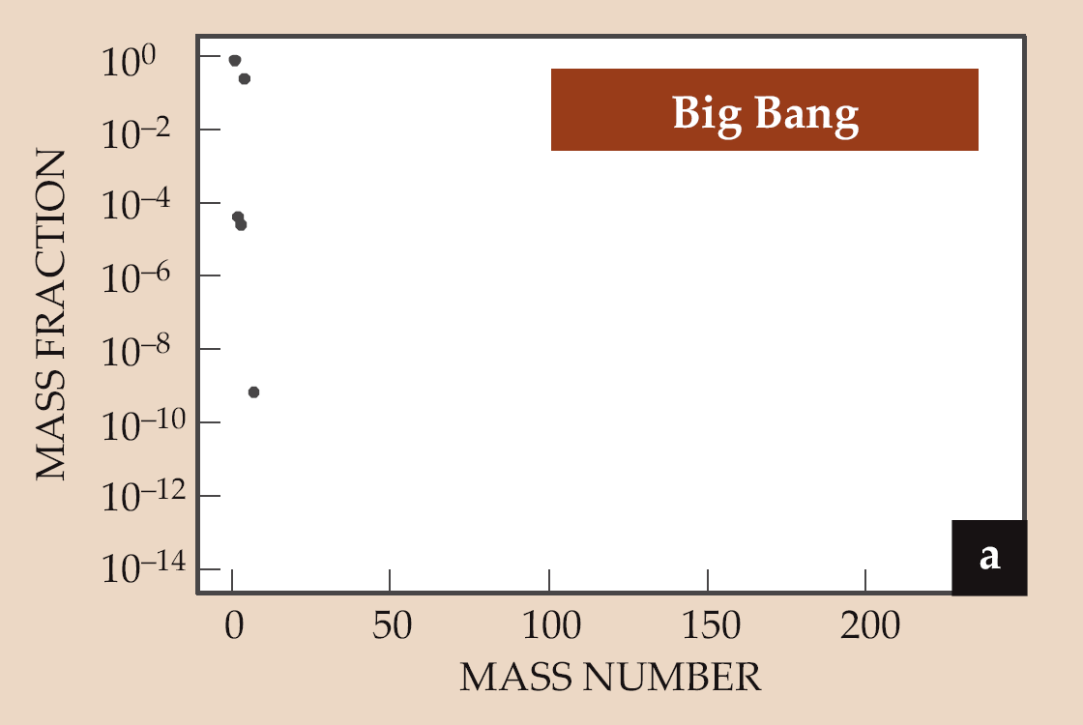
Galactic Chemical Evolution
Sr

Slide 3
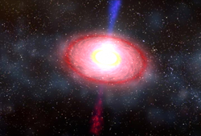
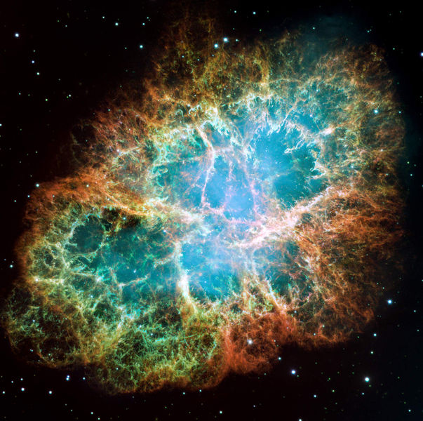
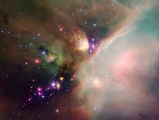
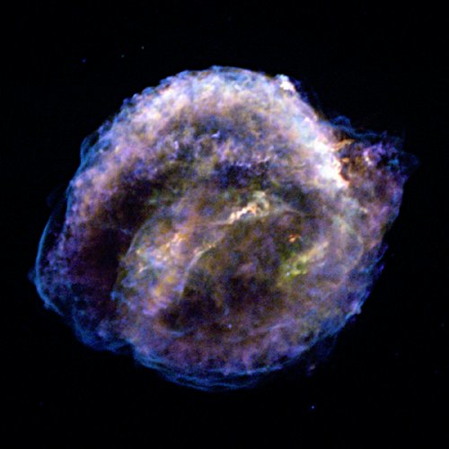
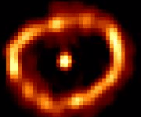
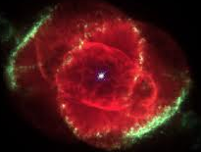
Short XRB
hot CNO cycles
αp-process
rp-process
EC rates
pycnonuclear fusion
Neutron
Star
Galactic
Chemical Evolution
SN Ia
screening
C, O fusion
He-induced reactions
electron capture
Star formation
SN II
r process
νp process
p process
EC rates
radioactivity
(²⁶Al, ⁴⁴Ti, ⁵⁶Ni, ⁶⁰Fe)
Stellar Observations:
large samples to
see individual events
understand trends
Nova
hot CNO cycles
Ne-Ca burning
Star
pp-chains
CNO cycles
Red Giant
He-burning
neutron sources
s-process
C, O fusion rates
White
Dwarf
Planetary
Nebula

Slide 4
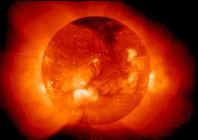
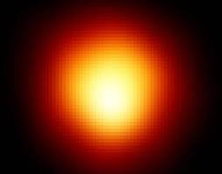
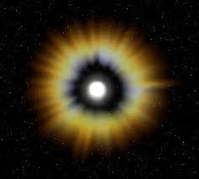
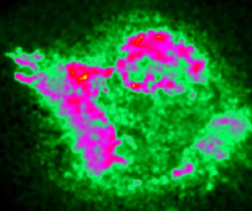
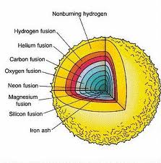
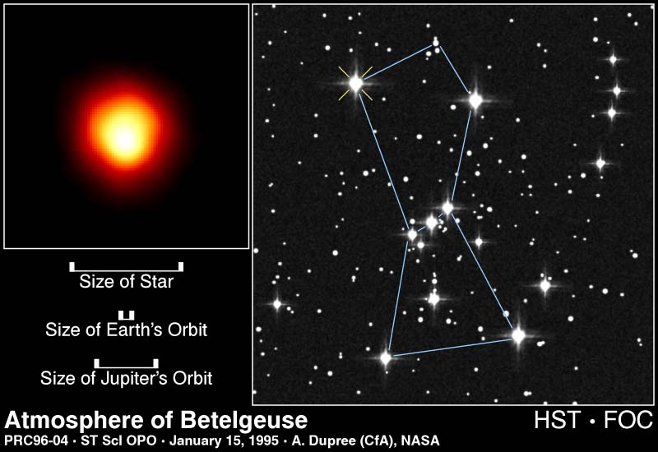
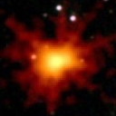
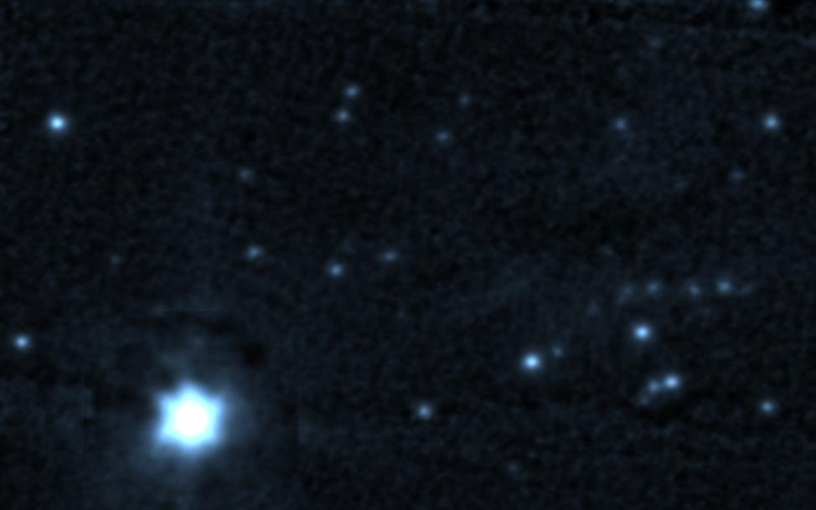
Low energy reactions in stars
Hydrogen Burning: ⁴He, ¹⁴N
Helium Burning: ¹²C, ¹⁶O, ²²Ne, n, s-nuclei
Carbon Burning: ¹⁶O, ²⁰Ne, ²⁴Mg ... s-nuclei
Ne-, O-, Si-Burning: ⁵⁶Fe but shell distributions
10
Si-ignition
O-ignition
Ne-ignition
9
C-ignition
log (T_{c})
He-ignition
8
Seed material
For explosive nucleosynthesis and observational signatures !
H-ignition
7
0
2
4
4
6
8
10
log (ρ_{c})

Slide 5
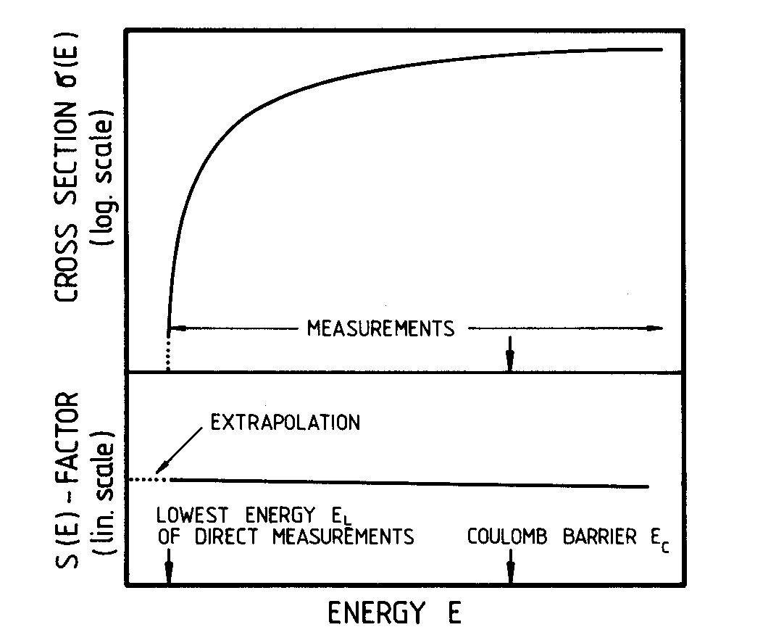

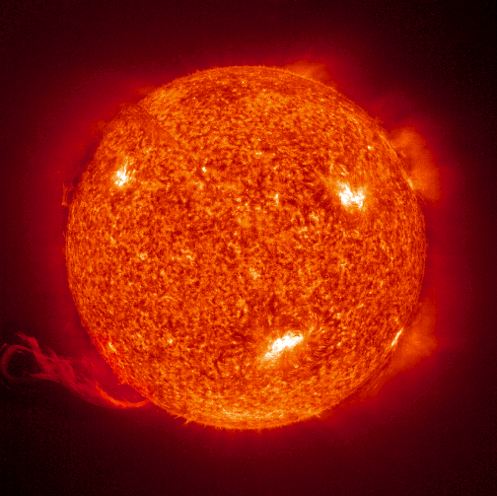
Stellar Reaction Rates
Characterize the engine of stars; determine energy production, fuel synthesis, seed production, new signatures for observations
MB distribution
background

Slide 6
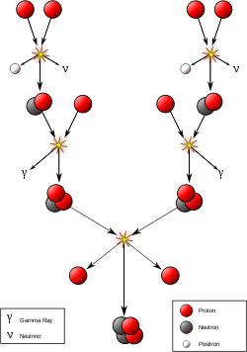
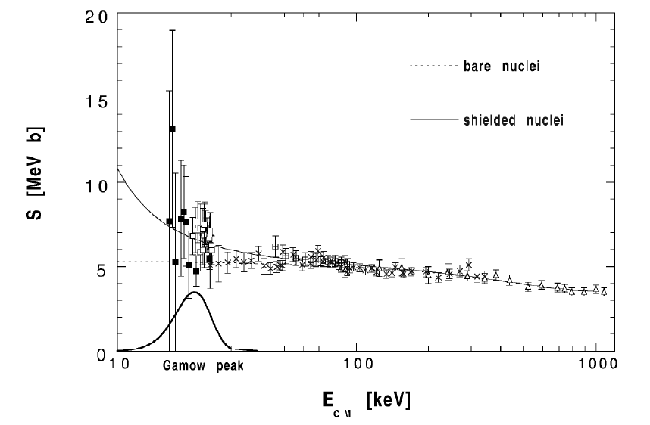
³He(³He,2p)⁴He a unique Accomplishment
LUNA I collaboration
³He(³He,2p)⁴He
First (and only) measurement at Gamow energies, indicate strong electron screening effects, which require additional experimental studies using complementary techniques! New results from the OMEGA laser plasma facility!

Slide 7
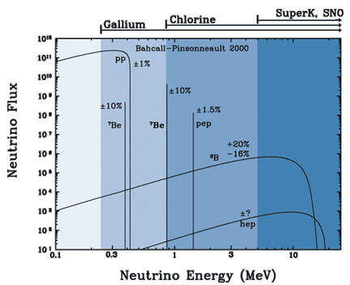
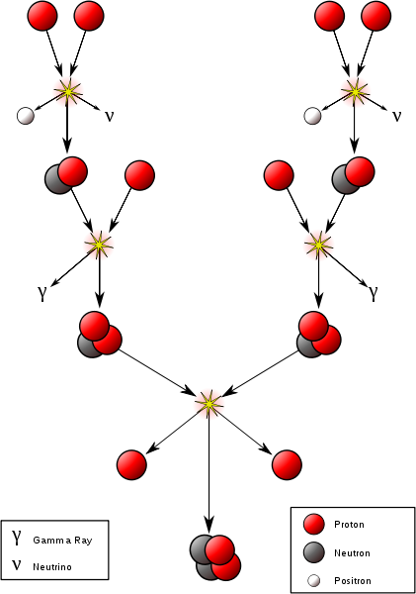
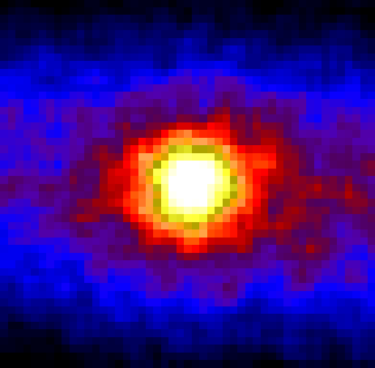
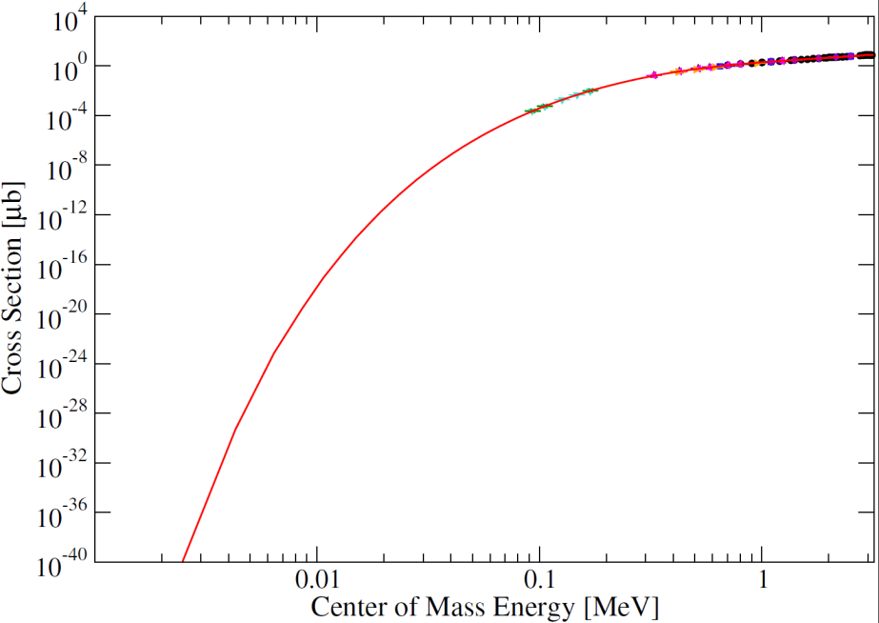
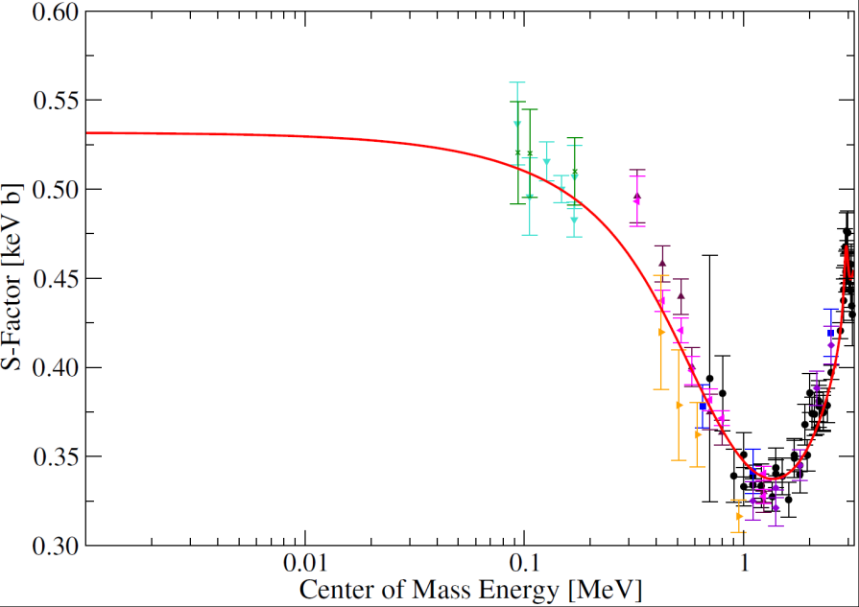
³He(α,γ)⁷Be, Trigger of Solar Neutrinos
³He
⁴He
18%
e⁻
¹H
⁷Be
pp-III
pp-II
⁸B
⁷Li
¹H
e⁻
⁸Be
⁴He
⁴He
³He(α,γ)⁷Be
⁴He
⁴He

Slide 8
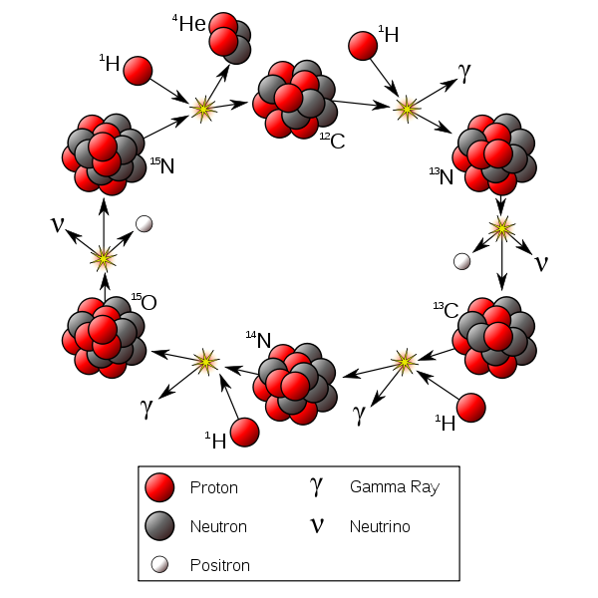
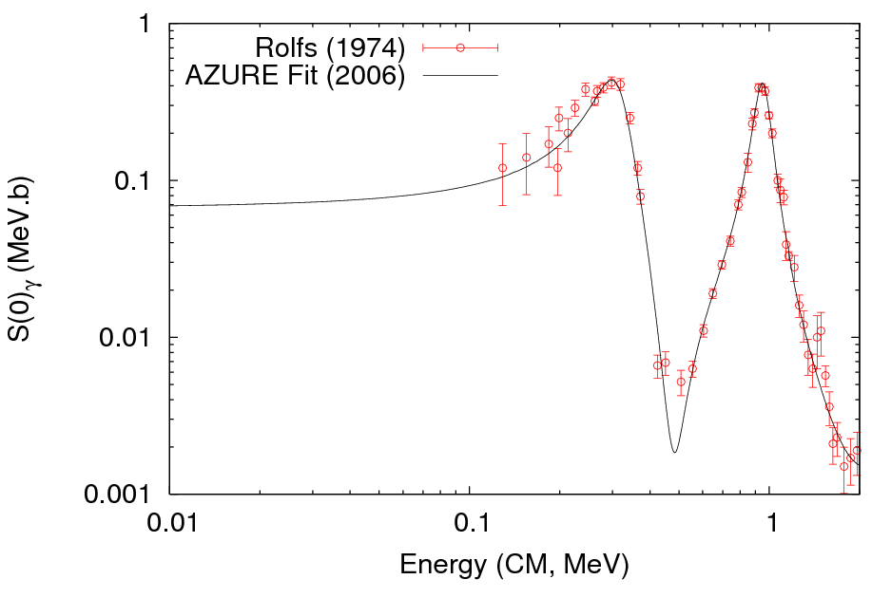
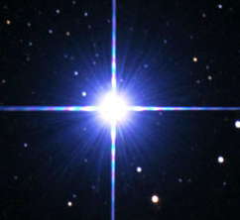
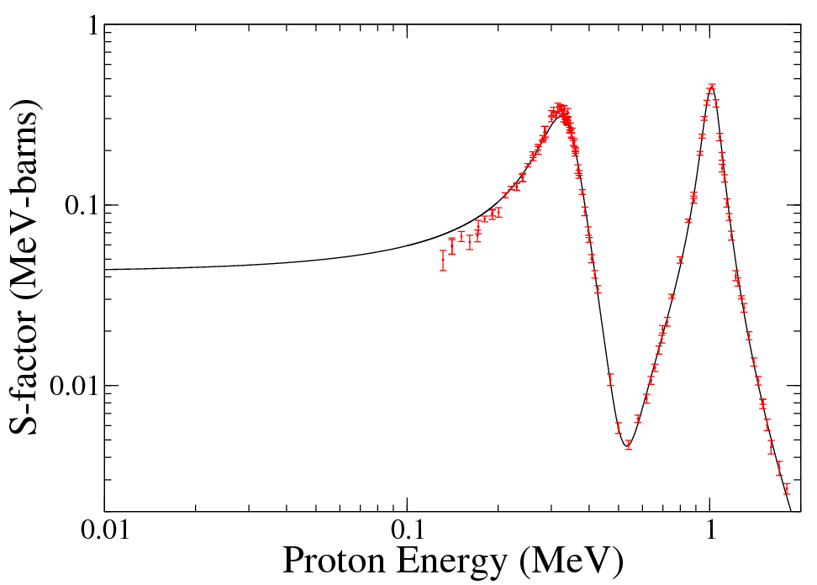
¹⁵N(p,γ)¹⁶O, Unexpected Uncertainties
¹⁶O
¹⁵N(p,γ)¹⁶O
Factor 2 reduction
(at least!)

Slide 9
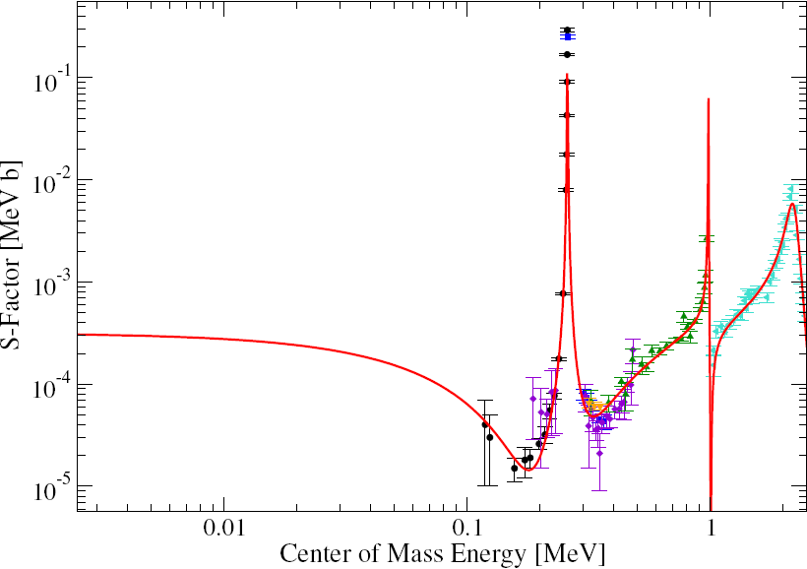
¹⁴N(p,γ)¹⁵O, the CNO Clock
solar CNO neutrino production
age analysis of globular clusters
²²Ne & n production in red giants
consequences for s-process and
p-process nucleosynthesis in SN II
and for flame front propagation in
SN Ia
Stellar
Energy
Range
¹⁴N(p,γ)¹⁵O

Slide 10
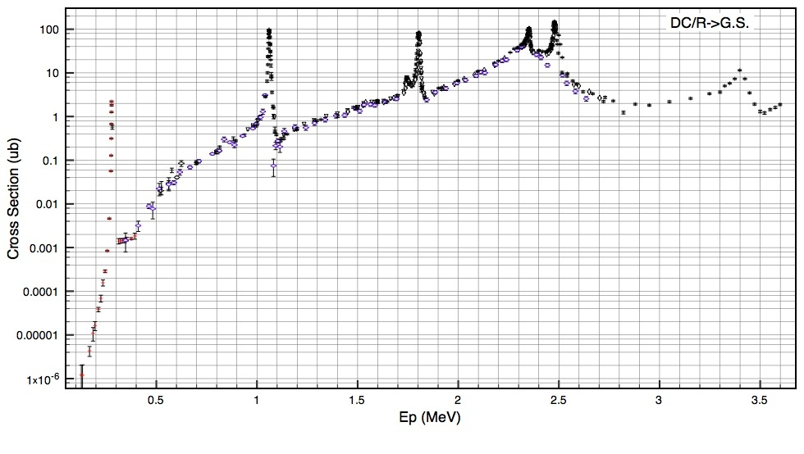
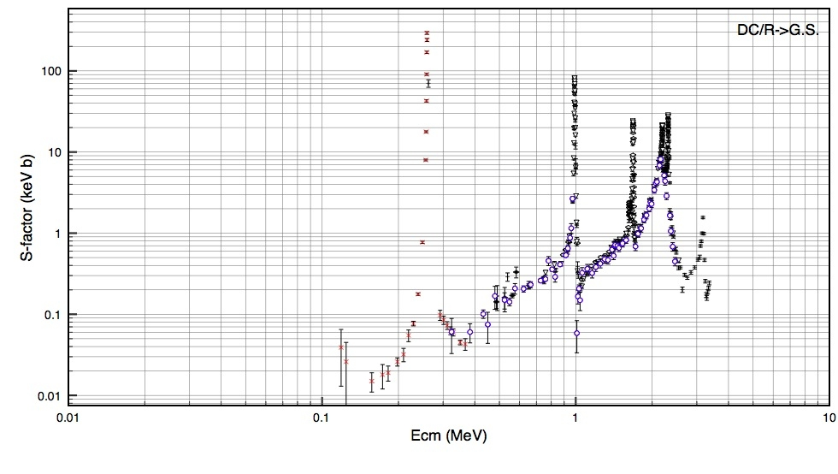
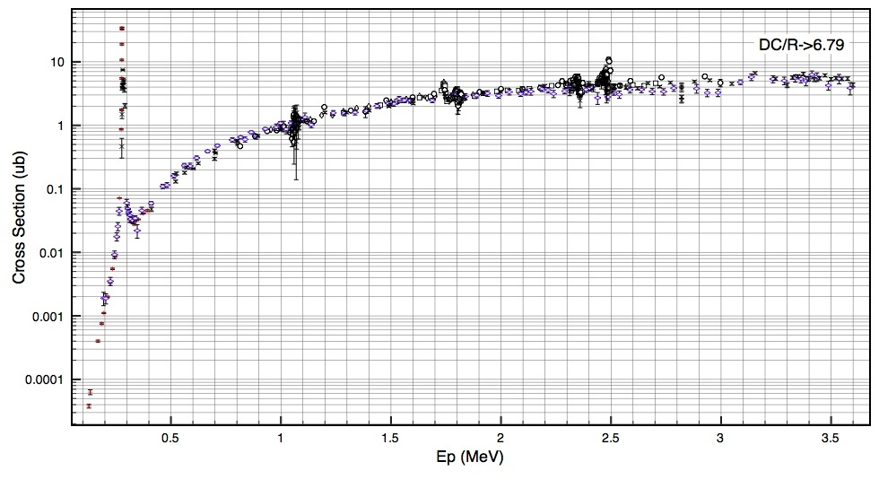
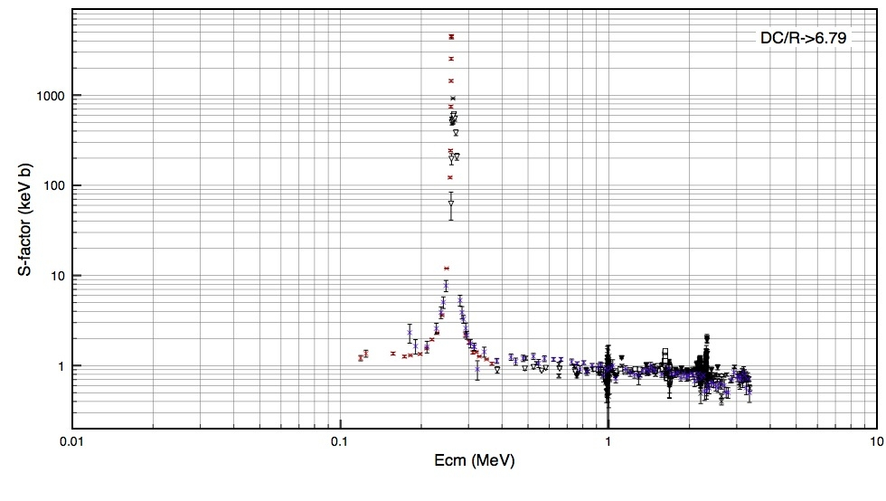
New measurements to improve data situation
R-matrix analysis underway

Slide 11



Reactions in stellar Helium burning
¹²C(α,γ)¹⁶O as part of the energy producing reaction chain ⁴He(2α,γ)¹²C(α,γ)¹⁶O
²²Ne(α,n)²⁵Mg as part of the neutron producing reaction chain: ¹⁴N(α,γ)¹⁸F(β⁺ν)¹⁸O(α,γ)²²Ne(α,n)²⁵Mg or ²²Ne(α,γ)²⁶Mg for s-process nucleosynthesis!

Slide 12
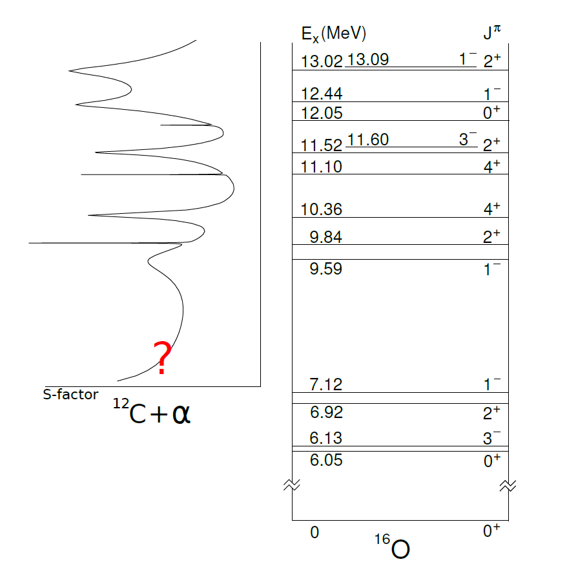
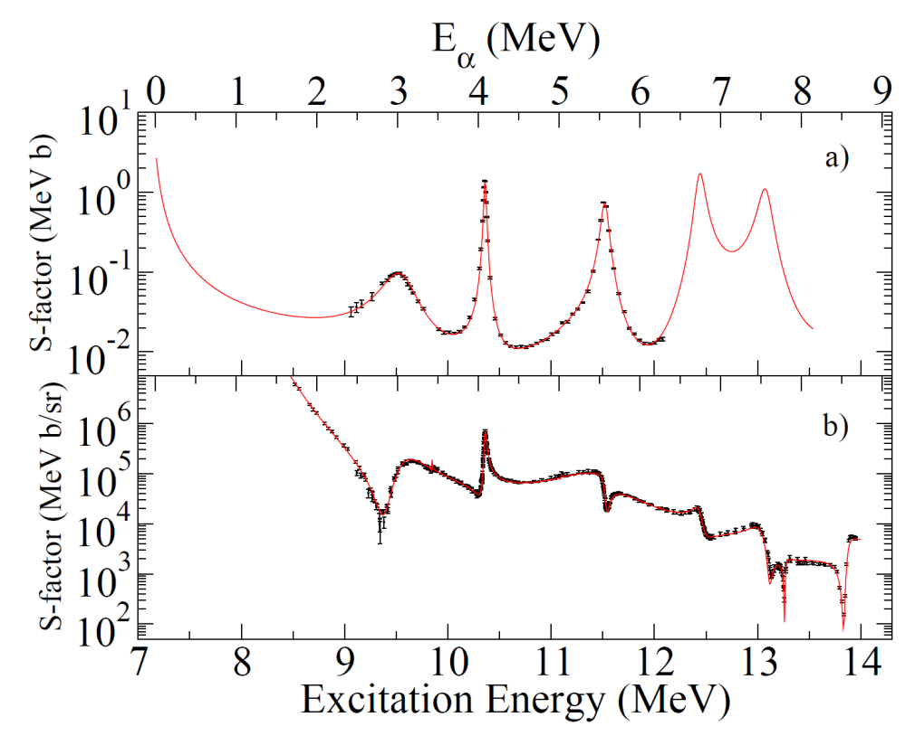
¹²C(a,γ)¹⁶O, the Holy Grail
Level and interference components from various transitions are reflected in the total cross section (S-factor) structure!
Uncertainty in low energy extrapolation is helped by a multichannel analysis of reaction ¹²C(α,γ) and scattering ¹²C(α,α)!

Slide 13
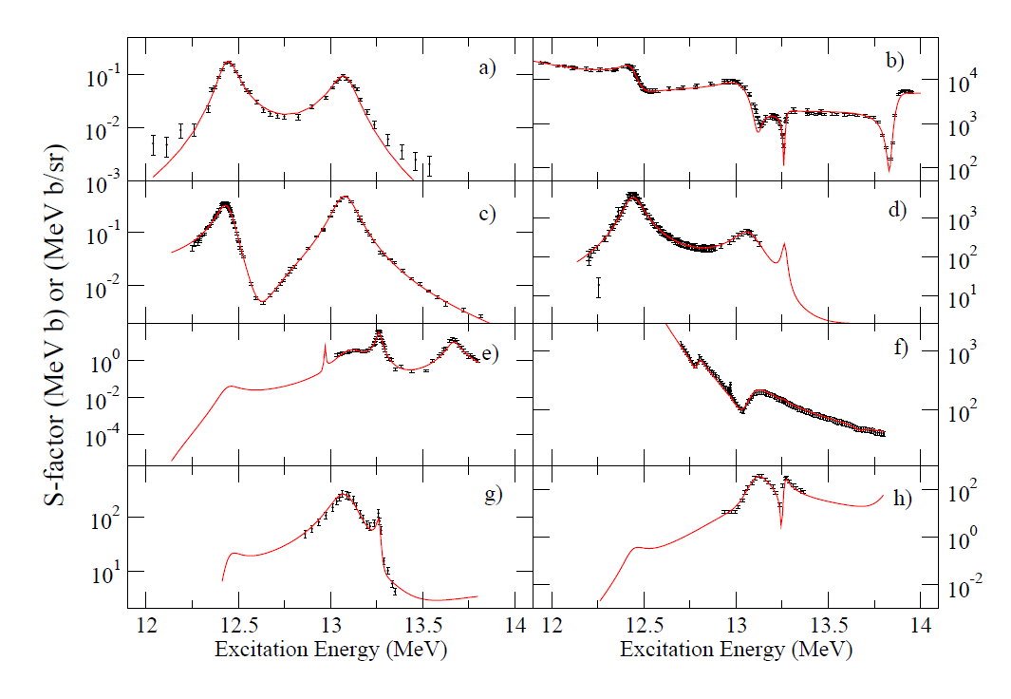
Multi-channel multi-level R-matrix fit for ¹⁶O compound system
¹²C(α,γ₀)¹⁶O
¹²C(α,α₀)¹²C
¹⁵N(p,γ₀)¹⁶O
¹⁵N(p,α₀)¹²C
¹⁵N(p,α₁)¹²C
¹⁵N(p,p)¹⁵N
¹²C(α,α₁)¹²C
¹²C(α,p)¹⁵N

Slide 14
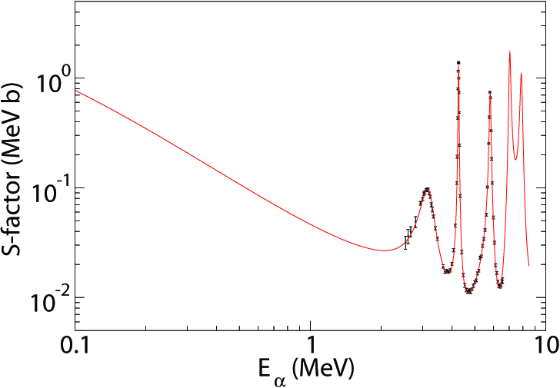
Nucleosynthesis in He burning
¹²C(α,γ)¹⁶O
Total cross section data only
The reaction determines the ¹²C/¹⁶O ratio in our universe! It also defines the late stellar evolution of massive stars, determines white dwarf matter, and the ignition of supernovae type Ia, the standard candle for cosmological predictions.

Slide 15
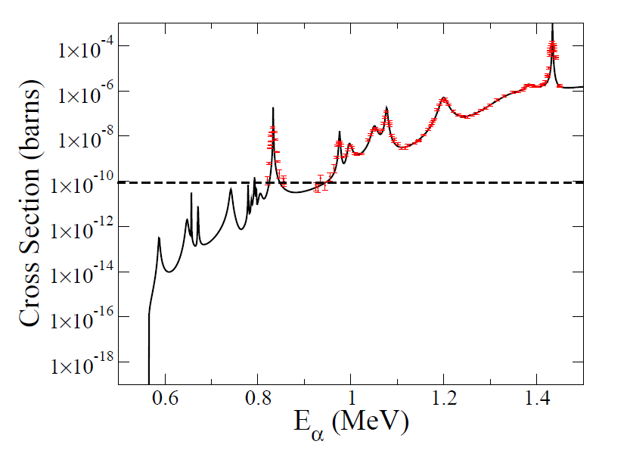
Uncertainties in the ²²Ne+α reaction rates
Extrapolation to lower energies
Impact of the ²²Ne(α,γ) branch
628 keV resonance
Q_{(α,n)}=-0.48 MeV
Lowest observed resonance at 830 keV, 2⁺ state at 11.31 MeV!
Biggest uncertainty 628 keV resonance J=1 state at 11.15 MeV,
recent ²²Ne(γ,γ’) and ²²Ne(p,p’) demonstrated J^{π}=1⁺ spin parity

Slide 16
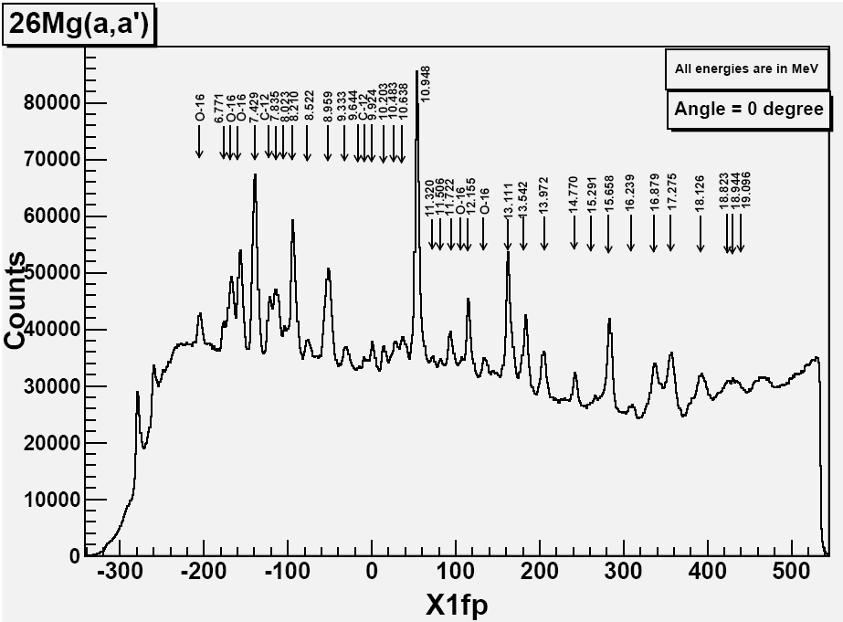
Complementary measurements
With “monoenergetic” gamma beams at HIγS
n - threshold
²²Ne(γ,γ’)²²Ne’
α - threshold

Slide 17
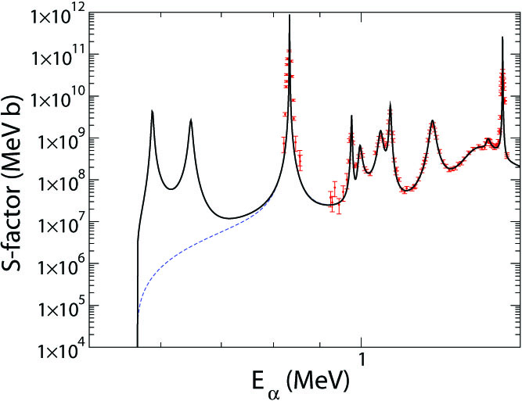
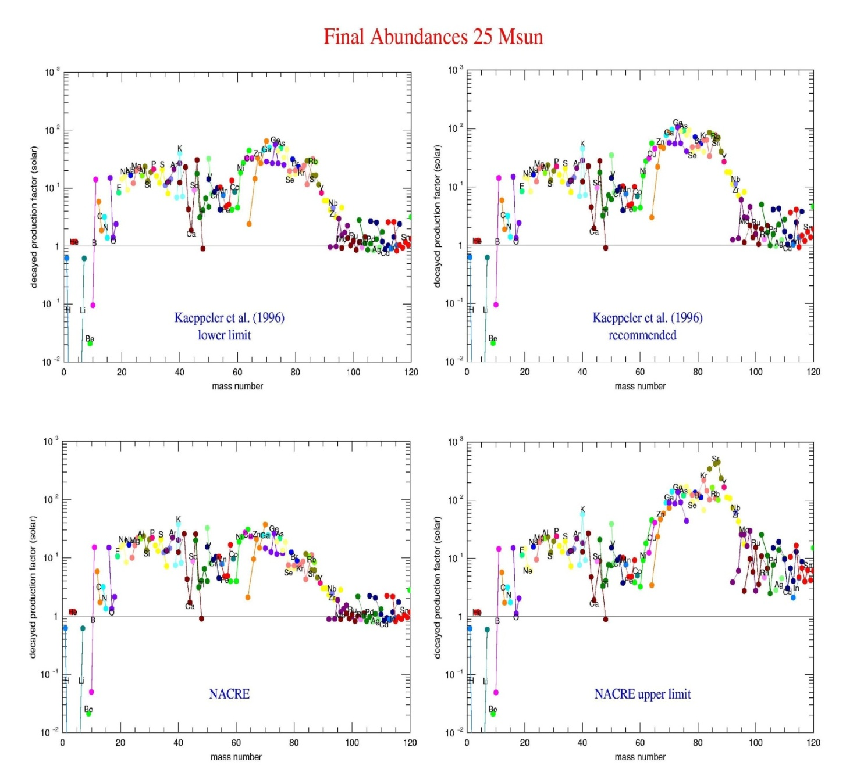

Remaining uncertainty
²²Ne(α,n) lower limit
Production relative to solar abundance
²²Ne(α,n)²⁵Mg
²²Ne(α,n) upper limit
Mass number
Neutron flux triggers the s-process, producing heavy elements in the mass 100 range! This affects early star nucleosynthesis LEPP process and r-process predictions and interpretations. It also affects p-process seed abundance and p-process predictions.

Slide 18
Cross section measurements at small accelerators
Forward kinematics: light ion beams on heavy target with analysis of ensuing radiation. Detection of reaction yield is handicapped by natural and beam induced radiation picked up by detector system
Inverse kinematics: heavy ion beams on light target with selection of heavy reaction recoils. Detection of recoils is handicapped by limitations in acceptance and rejection power of recoil separator

Slide 19



LUNA, the first accelerator underground
Successful forward kinematics studies at the underground accelerator LUNA (Gran Sasso)
³He(³He,2p)⁴He
³He(α,γ)⁷Be
¹⁴N(p,γ)¹⁵O
¹⁵N(p,γ)¹⁶O
¹⁷O(p,γ)¹⁷F
²⁵Mg(p,γ)²⁶Al
LUNA 2
(2000→…)
400 kV

Slide 20

Inverse kinematics with recoil separators
Number of successful measurements using inverse kinematics
with DRAGON (TRIUMF) and ERNA (Bochum)
³He(α,γ)⁷Be
¹²C(α,γ)¹⁶O
¹⁷O(α,γ)²¹Ne
⁴⁰Ca(α,γ)⁴⁴Ti

Slide 21



New Initiatives from St. George to ...
Strong Gradient Electro-magnetic Online Recoil separator for capture Gamma ray Experiments
Predicted rejection ratio R<10⁻¹⁵
HIPPO jet gas target System (HIgh Pressure POint-like gas target)

Slide 22



Status of St. George System
Fully aligned, vacuum testing complete, field testing complete, power testing complete

Slide 23



Beam Optics Simulation for ²²Ne+α
²²Ne(α,γ) 0.472 MeV
²²Ne(α,γ) 0.677 MeV
reaction product
primary beam
²²Ne(α,n) 0.677 MeV
Separation of primary beam and reaction recoils possible with full acceptance of St. GEORGE separator.
First experiments planned summer 2012 after the completion of the new heavy ion accelerator Sta. ANA
Beam optic tests are waiting for new accelerator

Slide 24

Heavy Ion Accelerator at Notre Dame
Sta. ANA: Stable beam Accelerator for Nuclear Astrophysics
6 MV Pelletron accelerator with ECR source at terminal for high (2⁺-3⁺) charge state beams
Construction 2010-11
Operation start 2012

Slide 25


Digging underground

Slide 26







Delivery of Sta. ANA

Slide 27






Status of Sta. ANA
Support and beam line arrangements
Building the column
First beam projected by end of February 2012

Slide 28




Background Reduction Underground
Environmental Radioactivity
CR induced neutron spectrum
CR induced γ spectrum
underground gamma spectrum
(Gran Sasso)
underground neutron spectrum
(KURF, Soudan)
up to 5 orders of magnitude reduction

Slide 29




The International Situation
in the underground accelerator business
New projects:
Andes, Argentina-Chile
INO, Saha Institute, Kolkata, India

Slide 30






Accelerators Underground
Felsenkeller Dresden: German Initiative
Gran Sasso, LUNA-MV
India Neutrino Observatory INO, with FRENA accelerator (Saha Institute)
KURF, West Virginia a US possibility
Andes Lab, Agua Negra, Argentina Chile
CJPL China
Canfranc, Spain, a European – Spanish French proposal

Slide 31


The Laboratory Concept and Accelerator Opportunities
30 mA tandem accelerator (TESQ) for Boron Neutron Capture Therapy BNCT, is being developed at TANDAR. The design could be could be further developed in an underground environment for providing intense proton, alpha, and carbon beams at the energies of stellar burning:
E_{p}=50-500 keV,
E_{α}=300-1600 keV
E_{12C}=2.0-6.0 MeV .

Slide 32




The Andes Laboratory Configuration
Taking advantage of the newly proposed highway tunnel connecting Argentina and Chile replacing the Agua Negra pass road over the Andes

Slide 33

Goals and Projections for a new US Underground Accelerator Laboratory?
Wide energy range for covering all stellar burning
phases, hydrogen, helium, and carbon burning
High beam currents to extend measurements towards
lower energies close to the Gamow range
High density target with high power capabilities
(confined gas jet & solid targets) to enhance luminosity
Advanced detector design for active background
rejection & event identification

Slide 34





US Proposal of DIANA
US proposal of DIANA
Approx. Cavity Dimensions:
Length: 45 m
Width: 20 m
Max. Height: 20 m
Dual/DUSEL Ion Accelerator for Nuclear Astrophysics
MID-LEVEL
Requirement
with easy access
for equipment and material

Slide 35


DIANA Design
Technical achievements:
New acceleration tube design
SC solenoid beam guide system
High density jet confinement
E=10keV-3.0MeV
I=0.5mA to 10mA
ρ=10¹⁹prt/cm²
p, α, HI beams
100 x LUNA luminosity

Slide 36






Equipment Development by university consortium, CSM, ND, UNC, WMU
Target systems
Detector arrays
Shielding

Slide 37



Yield and Count Rate Estimates
Beam intensity: 10mA, target density 10¹⁸ g/cm² gas jet
¹⁵N(p,γ)¹⁶O
³He(α,γ)⁷Be
Improvements of up to 3 orders of magnitude due to increase in luminosity compared to data from LUNA underground laboratory!

Slide 38





Yield and Count Rate Estimates
Beam intensity: 1mA, target density 10¹⁸ g/cm² gas jet
Improvements by more than 4 orders of magnitude compared to present data taken at above ground laboratories (Dynamitron Laboratory, U. Stuttgart)

Slide 39


DIANA Facility Concept
Within a downscaled DUSEL (SURF) project configuration
DIANA
20mx24mx50m
Dual accelerator design to cover entire energy range for intense H, He, C beams.
LAr
WCD

Slide 40

Development Plans
Towards full experimental program
Multiple Phase Implementation:
Low energy accelerator construction 2013-2015
Low energy accelerator tests 2015-2016
High energy accelerator construction 2015-2016
Low energy accelerator system installation 2017
High energy accelerator system installation 2017

Slide 41
Acknowledgements
Manoel Couder
Andreas Best
Antonios Kontos
Alberto Lemut
Adrian Hodginson
Paul Vetter
Uwe Greife
Art Champagne
Christian Iliadis
Chris Howard
Michael Famiano
Daniela Leitner
Daniel Winklehner
Notre Dame
LBNL
CSM
UNC
WMU
MSU

Slide 42






DIANA – Shielding
Neutron Distribution
Worst case scenario ¹³C(α,n) with N_{n}=10⁸ neutrons
$F_{n}$=10⁻⁵n/s/cm²
$F_{n}$=10³n/s/cm²
$F_{n}$=1-10n/s/cm²
$F_{n}$=10⁻⁵n/s/cm²

Slide 43



Alternative Plans, Alternative Locations
DIANA revisited:
KURF, Virginia
Soudan, Minnesota
WIPP, New Mexico

Slide 44



KURF: flexibility, accessibility, local support environment
Lack of infrastructure, development hard to estimate additional costs
Soudan: existing infrastructure, take-over of existing lab space, on-site experience
Accessibility, estimated $2M of additional costs for MINOS removal
WIPP: existing infra-structure, accessibility, reduced background
Administrative hurdles, environmental issues

