Slide 1

Experimental facilities for reaction studies in
Nuclear Astrophysics in Cologne
L. Netterdon, M. Elvers, J. Endres, A. Hennig*,
A. Sauerwein*, F. Schlüter, and A. Zilges
Institut für Kernphysik, Universität zu Köln
496th WE-Heraeus Seminar on
„Astrophysics with modern small-scale accelerators“
Bad Honnef, February 08th, 2012
Supported by the DFG under contract DFG (ZI 510/5-1, INST 216/544-1)
*Member of the Bonn-Cologne Graduate School of Physics and Astronomy

Slide 2
Outline
Motivation
Counting setup for activation measurements
  Example: ¹⁶⁸Yb(α,n)
In-beam spectroscopy @ HORUS
  Example: ⁹²Mo(p,γ), ⁹²Mo(α,γ)
CologneAMS
Summary

Slide 3
Motivation
measurement of ion-induced reactions
experimental difficulties due to:
measurement at energies below the Coulomb barrier for heavy nuclei
e.g. for ¹⁶⁸Yb(α,γ): E_{Gamow} ≈ 7 – 11 MeV << E_{coul} ≈ 24 MeV

Slide 4
Motivation
measurement of ion-induced reactions
experimental difficulties due to:
measurement at energies below the Coulomb barrier for heavy nuclei
e.g. for ¹⁶⁸Yb(α,γ): E_{Gamow} ≈ 7 – 11 MeV << E_{coul} ≈ 24 MeV
σ ≈ 0.1 – 100 μb
very sensitive determination of small cross sections needed
activation / in-beam / AMS

Slide 5
Motivation
measurement of ion-induced reactions
experimental difficulties due to:
measurement at energies below the Coulomb barrier for heavy nuclei
e.g. for ¹⁶⁸Yb(α,γ): E_{Gamow} ≈ 7 – 11 MeV << E_{coul} ≈ 24 MeV
σ ≈ 0.1 – 100 μb
very sensitive determination of small cross sections needed
activation / in-beam / AMS

Slide 6
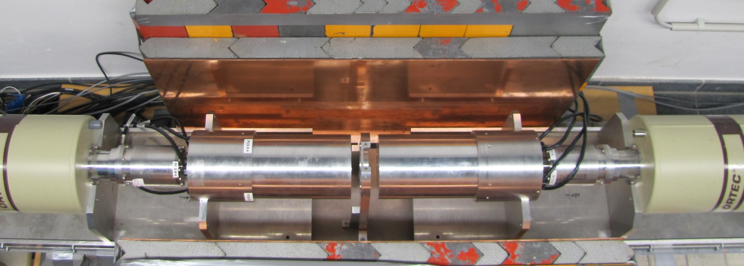
Counting Setup
2 HPGe clover detectors
passive background suppression by Cu and Pb
low natural background
covers large solid angle

Slide 7
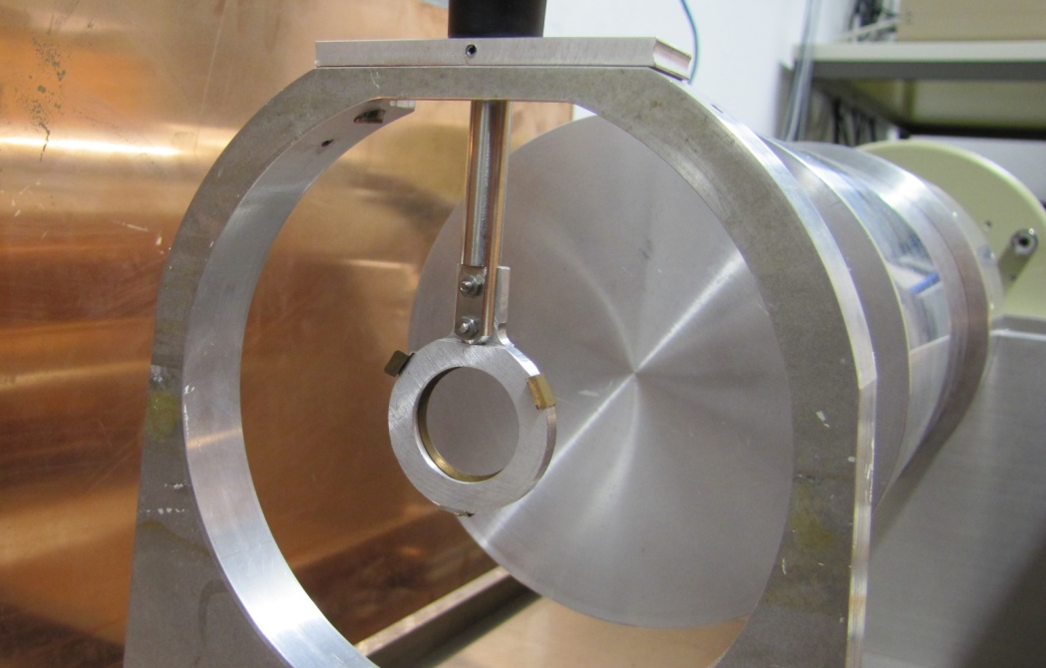
Counting Setup
2 HPGe clover detectors
passive background suppression by Cu and Pb
low natural background
covers large solid angle

Slide 8
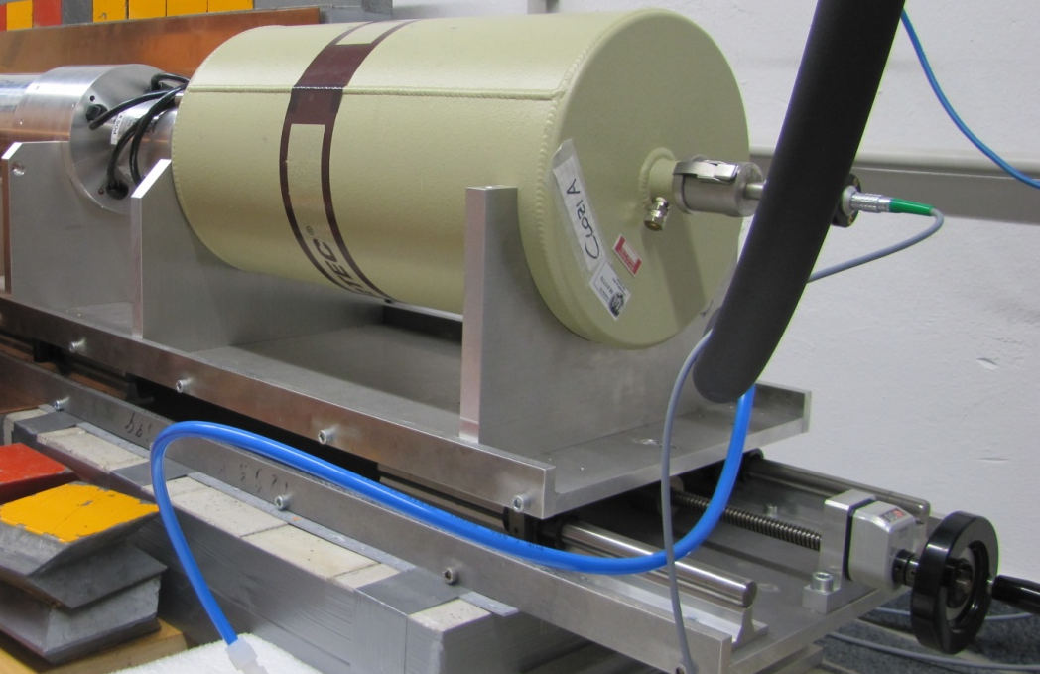

Counting Setup
2 HPGe clover detectors
passive background suppression by Cu and Pb
low natural background
covers large solid angle
different target geometries possible
accurate target positioning to 0.1 mm

Slide 9
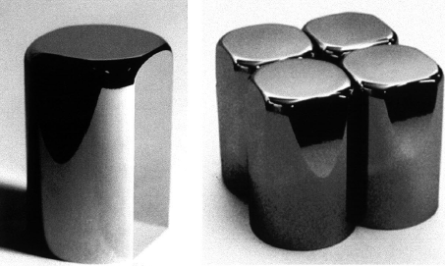
Clover detectors
4 independent crystals
rel. efficiency of 120 %
G. Duchêne et al.,
NIM A 432 (1999) 90-110

Slide 10
Clover detectors
4 independent crystals
rel. efficiency of 120 %
advantages:
  higher count rates
  reduced summing effects
  Compton polarimetry
  add-back algorithms
  claim γγ coincidences between crystals
  and detectors
G. Duchêne et al.,
NIM A 432 (1999) 90-110

Slide 11
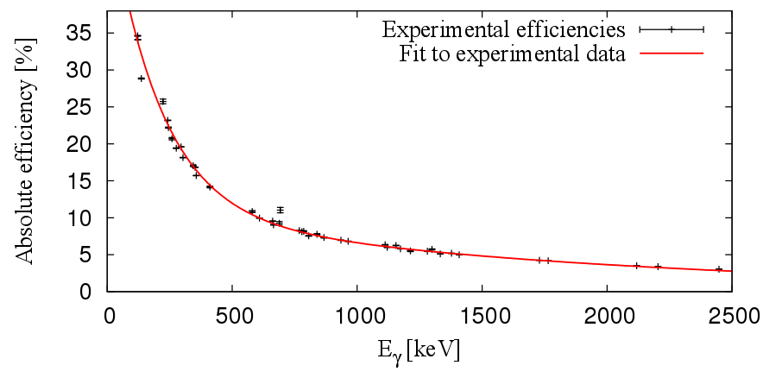
Counting Setup
absolute photopeak efficiency @ 1332 keV ≈ 5 %
distance to end cap: 13 mm

Slide 12
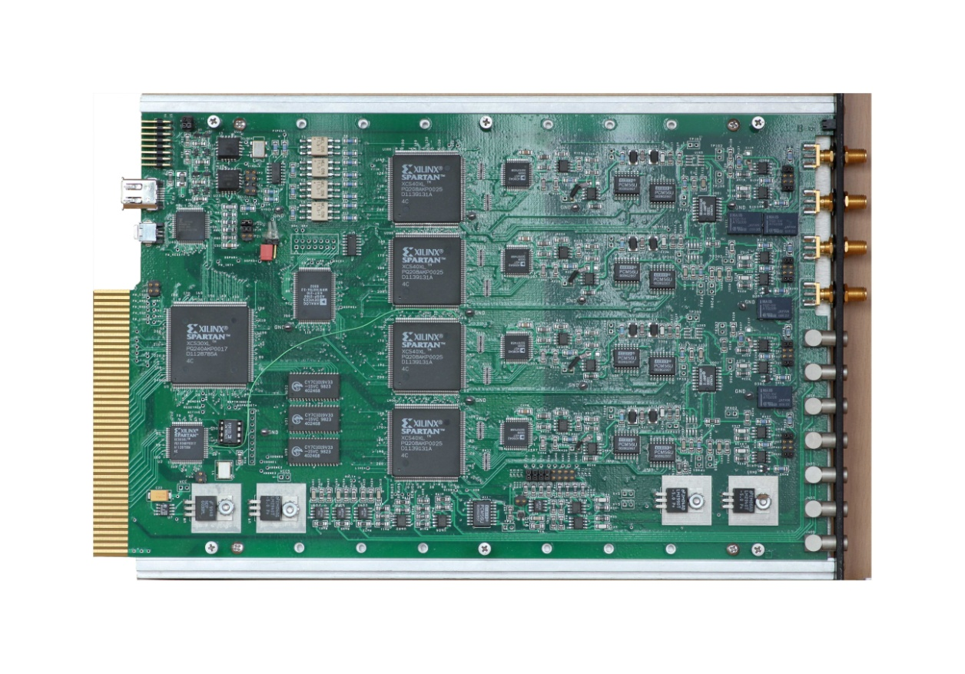
Data acquisition
Trigger / Filter FPGA
ADC
4 inputs
digital data acquisition
XIA DGF-4C modules
14-bit pipeline ADC
sampling of preamplifier
output at 80 MHz
listmode data
DSP
System FPGA
4 BGO Veto inputs
XIA LLC, User‘s Manual Digital Gamma Finder DGF-4C
Revision F, Version 4.03

Slide 13
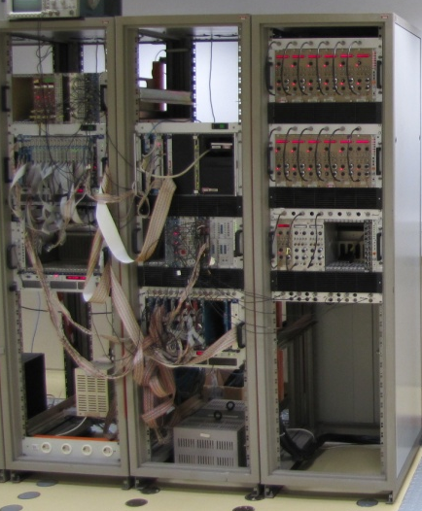
Data acquisition
digital data acquisition
XIA DGF-4C modules
14-bit pipeline ADC
sampling of preamplifier
output at 80 MHz
listmode data
2 m
1.8 m

Slide 14
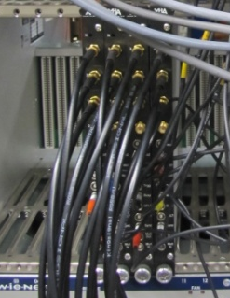
Data acquisition
digital data acquisition
XIA DGF-4C modules
14-bit pipeline ADC
sampling of preamplifier
output at 80 MHz
listmode data
cost / space saving
very good energy resolution
higher count rates
20 cm
6 cm

Slide 15
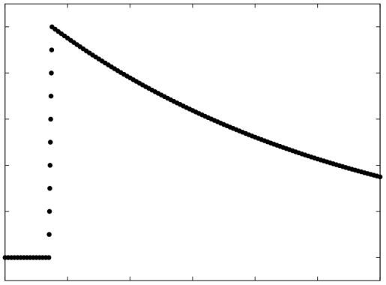
Digitizer – basic design
Detector
ADC
Pipeline ADC

Slide 16
Digitizer – basic design
Detector
What to do?
?
ADC
Pipeline ADC

Slide 17
Digitizer – basic design
Detector
What to do?
?
ADC
Pipeline ADC
write every trace to hard disk for offline analysis
≈ 500 GB / hour / channel

Slide 18
Digitizer – basic design
Detector
What to do?
?
ADC
Pipeline ADC
write every trace to hard disk for offline analysis
≈ 500 GB / hour / channel
signal processing in hardware using combination of
Field Programmable Gate Array (FPGA)
Digital Signal Processor (DSP)

Slide 19
Digitizer – basic design
Detector
ADC
Pipeline ADC
FPGA
Field Programmable Gate Array
→ applies filter algorithms
DSP
Digital Signal Processor
→ determines energy and time

Slide 20
Signal processing - requirements
Trigger: select signals of interest
Timing: when did the event occur relative to others?
Pile-Up: reject events, if they were too close to determine energy
Energy: calculate difference between maximum and baseline

Slide 21
Signal processing - requirements
Trigger: select signals of interest
Timing: when did the event occur relative to others?
Pile-Up: reject events, if they were too close to determine energy
Energy: calculate difference between maximum and baseline

Slide 22
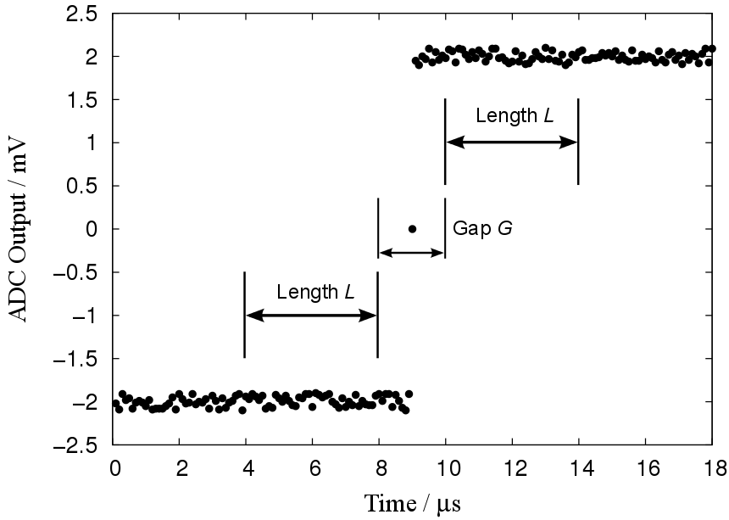
Trapezoidal filter algorithm
XIA LLC, User‘s Manual Digital Gamma Finder DGF-4C Revision F, Version 4.03

Slide 23
Trapezoidal filter algorithm
V
S
5
4
3
2
1
0
1
t
L=5
G=3
0
t
S₁
S₂
S = S₂ – S₁ = 0

Slide 24
Trapezoidal filter algorithm
V
S
5
4
3
2
1
0
1
t
L=5
G=3
0
t
S₁
S₂
S = S₂ – S₁ = 0

Slide 25
Trapezoidal filter algorithm
V
S
5
4
3
2
1
0
1
t
0
t
S₁
S₂
S = S₂ – S₁ = 0

Slide 26
Trapezoidal filter algorithm
V
S
5
4
3
2
1
0
1
t
0
t
S₁
S₂
S = S₂ – S₁ = 1

Slide 27
Trapezoidal filter algorithm
V
S
5
4
3
2
1
0
1
t
0
t
S₁
S₂
S = S₂ – S₁ = 2

Slide 28
Trapezoidal filter algorithm
V
S
5
4
3
2
1
0
1
t
0
t
S₁
S₂
S = S₂ – S₁ = 3

Slide 29
Trapezoidal filter algorithm
V
S
5
4
3
2
1
0
1
t
0
t
S₁
S₂
S = S₂ – S₁ = 4

Slide 30
Trapezoidal filter algorithm
V
S
5
4
3
2
1
0
1
t
0
t
S₁
S₂
S = S₂ – S₁ = 5

Slide 31
Trapezoidal filter algorithm
V
S
5
4
3
2
1
0
1
t
0
t
S₁
S₂
S = S₂ – S₁ = 5

Slide 32
Trapezoidal filter algorithm
V
S
5
4
3
2
1
0
1
t
0
t
S₁
S₂
S = S₂ – S₁ = 5

Slide 33
Trapezoidal filter algorithm
V
S
5
4
3
2
1
0
1
t
0
t
S₁
S₂
S = S₂ – S₁ = 5

Slide 34
Trapezoidal filter algorithm
V
S
5
4
3
2
1
0
1
t
0
t
S₁
S₂
S = S₂ – S₁ = 0

Slide 35
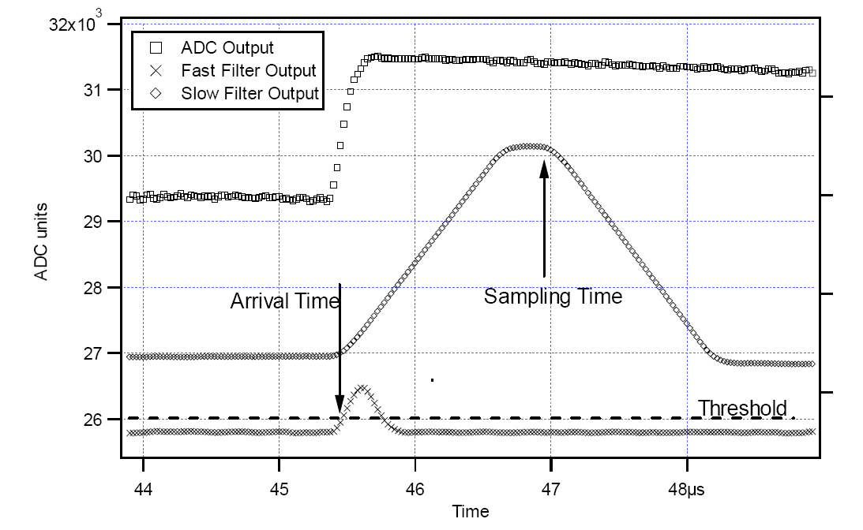
Fast and slow filter algorithm
fast filter → time determination
slow filter → energy determination
XIA LLC, User‘s Manual Digital Gamma Finder DGF-4C Revision F, Version 4.03

Slide 36
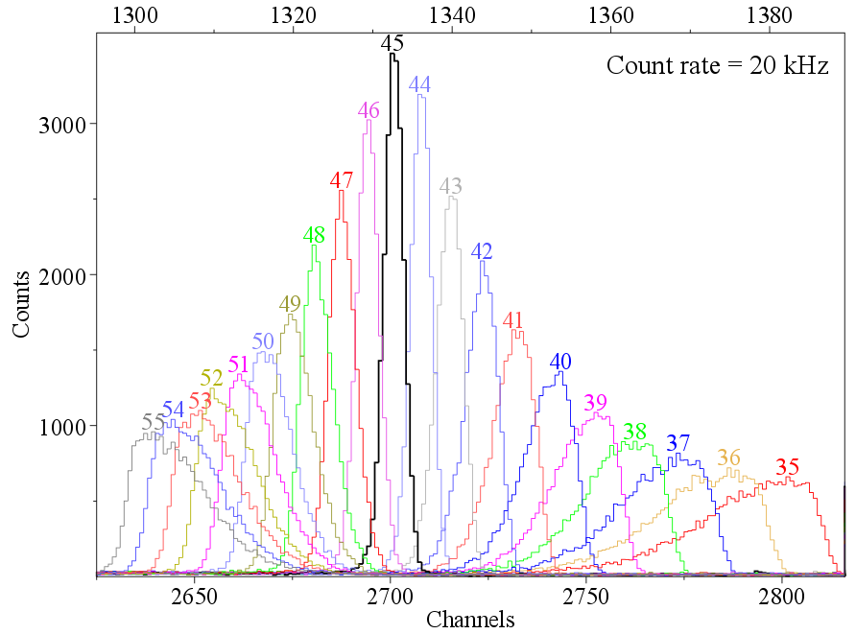
Energy resolution
time constant τ most important for good energy resolution
adjust τ parameter to get best peak shape and resolution
τ =
courtesy of N. Warr

Slide 37
Activation measurement of ¹⁶⁸Yb(α,n)
motivation: improvement of reaction network at ¹⁶⁸Yb
¹⁷⁰Hf
¹⁷¹Hf
¹⁷²Hf
¹⁷³Hf
¹⁶⁹Lu
¹⁷⁰Lu
¹⁷¹Lu
¹⁷²Lu
¹⁶⁸Yb
¹⁶⁹Yb
¹⁷⁰Yb
¹⁷¹Yb

Slide 38
Activation measurement of ¹⁶⁸Yb(α,n)
motivation: improvement of reaction network at ¹⁶⁸Yb
problems:
  ¹⁷²Hf(γ,α) needs unstable target
¹⁷⁰Hf
¹⁷¹Hf
¹⁷²Hf
¹⁷³Hf
(γ,α)
¹⁶⁹Lu
¹⁷⁰Lu
¹⁷¹Lu
¹⁷²Lu
¹⁶⁸Yb
¹⁶⁹Yb
¹⁷⁰Yb
¹⁷¹Yb

Slide 39
Activation measurement of ¹⁶⁸Yb(α,n)
motivation: improvement of reaction network at ¹⁶⁸Yb
problems:
  ¹⁷²Hf(γ,α) needs unstable target
  ¹⁶⁸Yb(α,γ):
    low cross section
    weak & low-energetic
    γ transitions
¹⁷⁰Hf
¹⁷¹Hf
¹⁷²Hf
¹⁷³Hf
(α,γ)
¹⁶⁹Lu
¹⁷⁰Lu
¹⁷¹Lu
¹⁷²Lu
¹⁶⁸Yb
¹⁶⁹Yb
¹⁷⁰Yb
¹⁷¹Yb

Slide 40
Activation measurement of ¹⁶⁸Yb(α,n)
motivation: improvement of reaction network at ¹⁶⁸Yb
problems:
  ¹⁷²Hf(γ,α) needs unstable target
  ¹⁶⁸Yb(α,γ):
    low cross section
    weak & low-energetic
    γ transitions
¹⁷⁰Hf
¹⁷¹Hf
¹⁷²Hf
¹⁷³Hf
(α,n)
¹⁶⁹Lu
¹⁷⁰Lu
¹⁷¹Lu
¹⁷²Lu
¹⁶⁸Yb
¹⁶⁹Yb
¹⁷⁰Yb
¹⁷¹Yb
measure¹⁶⁸Yb(α,n) to improve α+¹⁶⁸Yb OMP

Slide 41
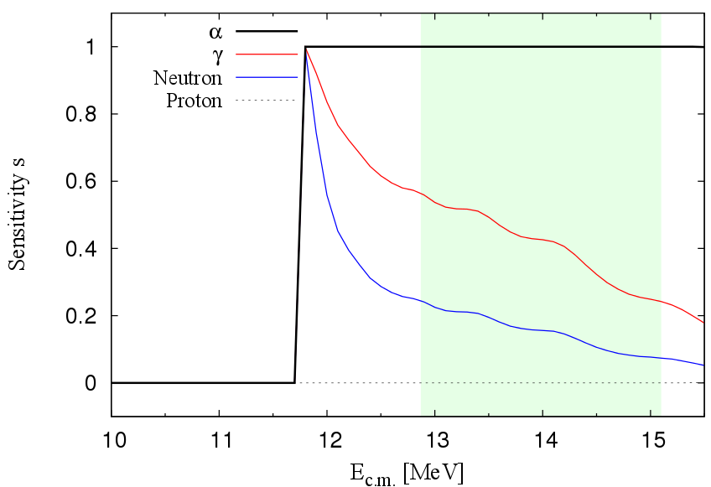
Activation measurement of ¹⁶⁸Yb(α,n)
motivation: improvement of reaction network at ¹⁶⁸Yb
T. Rauscher, NON-SMOKER^{WEB},5.8.1dw
¹⁷⁰Hf
¹⁷¹Hf
¹⁷²Hf
¹⁷³Hf
(α,n)
¹⁶⁹Lu
¹⁷⁰Lu
¹⁷¹Lu
¹⁷²Lu
¹⁶⁸Yb
¹⁶⁹Yb
¹⁷⁰Yb
¹⁷¹Yb
cross section sensitive to γ and neutron width

Slide 42
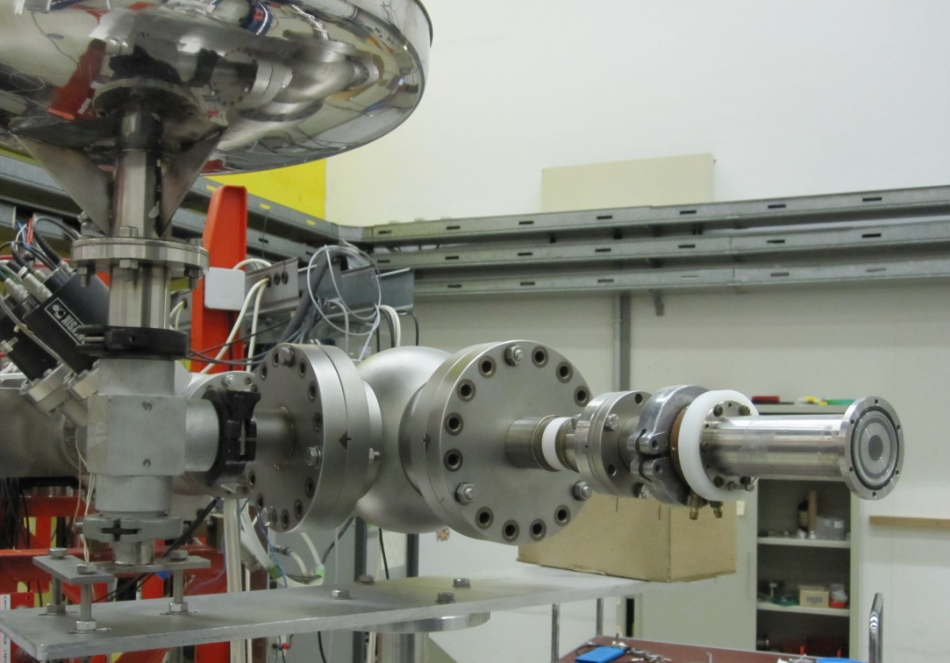
Experimental setup @ PTB Braunschweig
α-beam

Slide 43
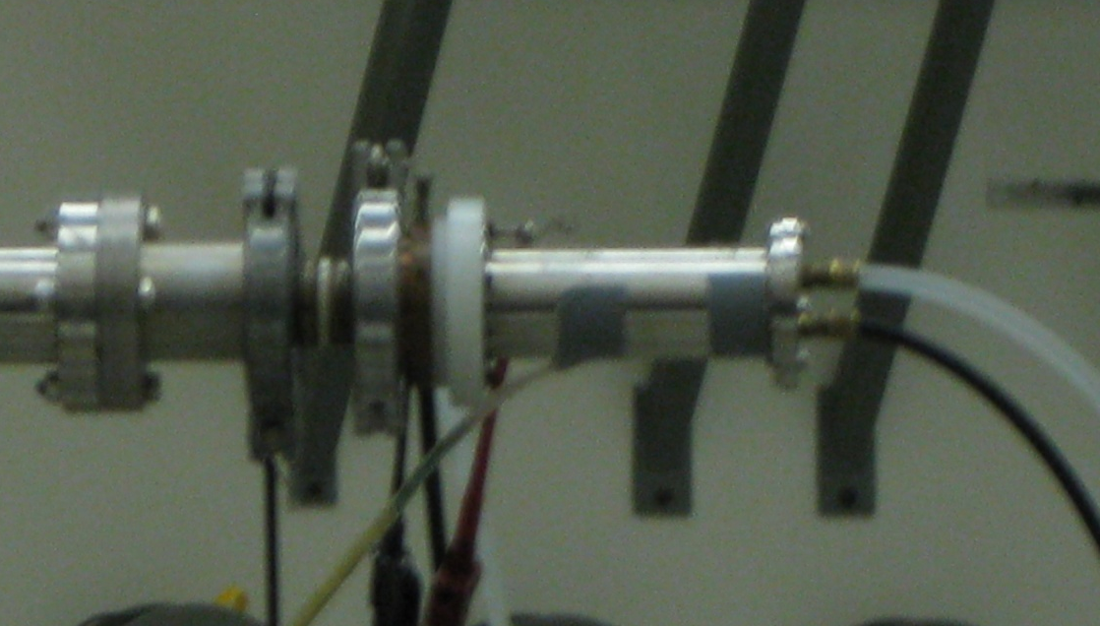
Experimental setup @ PTB Braunschweig
U = -300V
α-beam
Water cooling
Target
α-beam
Cooling trap
E_{α} = 12.9 MeV – 15.1 MeV
activation period ≈ 5 h – 20 h
current ≈ 600 nA
target thickness ≈ 230 – 450

Slide 44
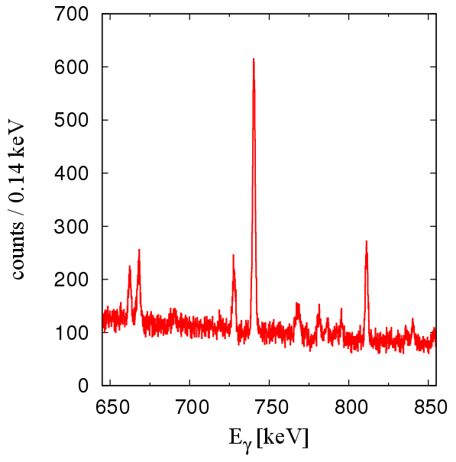
Activation measurement of ¹⁶⁸Yb(α,n)
¹⁶⁸Yb(α,n)
740 keV
667 keV
¹⁷¹Hf
¹⁷¹Lu
T_{1/2} = 8.24 d
840 keV
ε
935 keV
835 keV
840
740
667
168 keV
95 keV
≈ 5 ms
g.s.
¹⁷¹Yb
E_{α} = 14.55 MeV
counting period ≈ 23 h

Slide 45
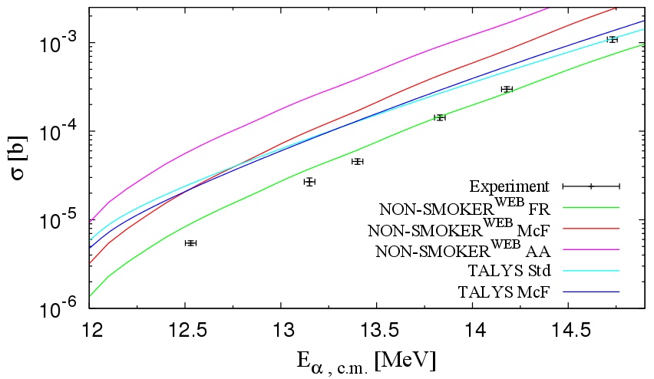
Results: ¹⁶⁸Yb(α,n)¹⁷¹Hf
PRELIMINARY
T. Rauscher, NON-SMOKER^{WEB},5.8.1dw
A.J. Koning, S. Hilaire and M.C. Duijvestijn,TALYS-1.2
no calculation reproduces energy dependence correctly
overprediction of cross sections up to one order of magnitude

Slide 46

Limitations of activation technique
(α,γ) not accessible
Activation technique not applicable
in many cases because of
stable reaction products
inconvenient half-lives
weak γ intensities
Only 20% of stable nuclei accessible
In-beam / AMS technique to overcome limitations

Slide 47
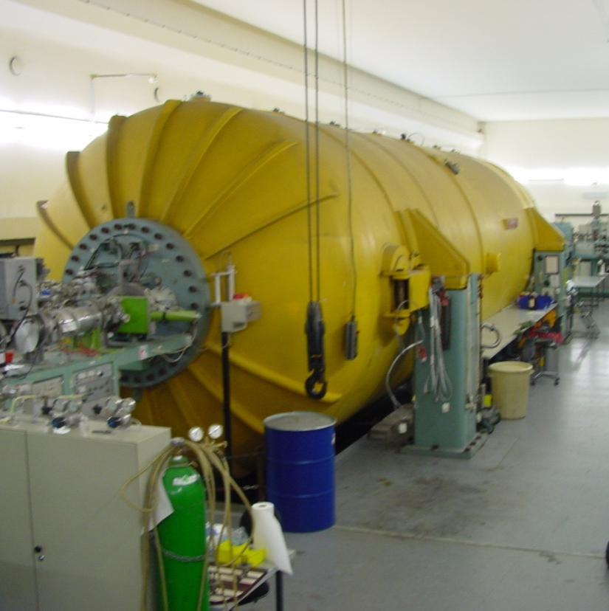
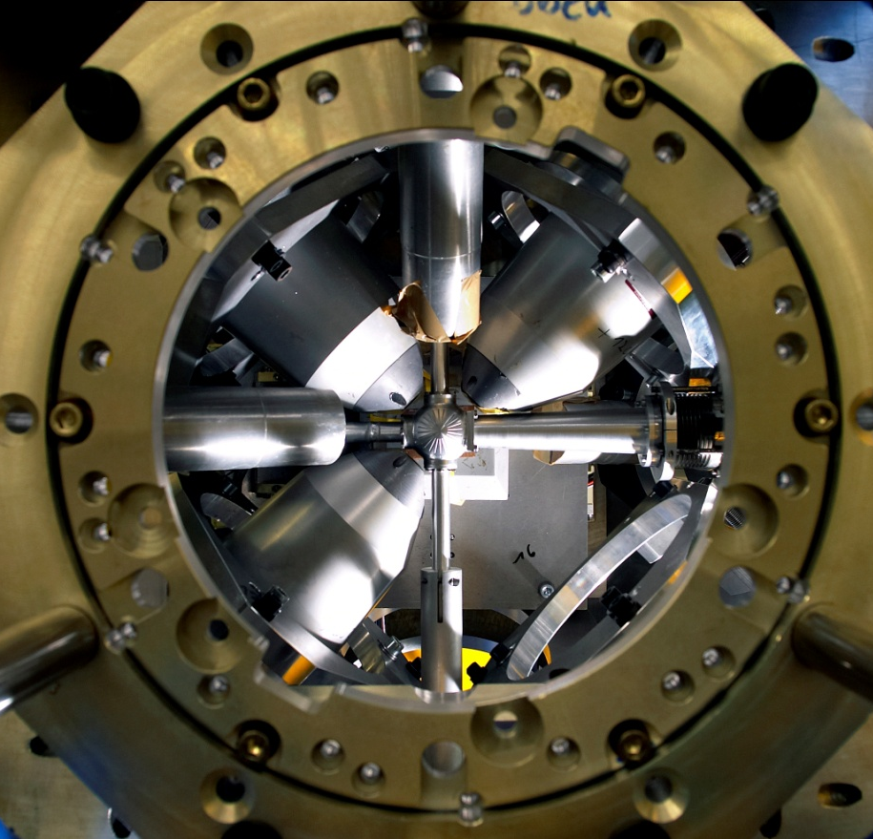
Tandem accelerator in Cologne
10 MV Tandem ion accelerator
beam intensities up to 1 µA (p) / ≈ few 100 nA (α-particles)
restart in spring 2012 after complete refurbishment
high efficiency HPGe detector array HORUS for in-beam
γ spectroscopy

Slide 48
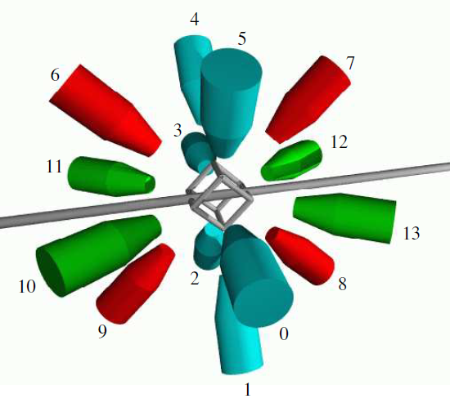
In-beam measurements @ HORUS
array of 14 HPGe detectors
up to 6 equipped with BGO shields
absolute photopeak efficiency @ 1332 keV:
≈ 2 %
determination of angular distributions
coincidence techniques for background suppression
digital data acquisition in preparation

Slide 49
In-beam measurements @ HORUS
Test experiment for ⁹²Mo(p,γ)
activation measurement can be performed simultaneously
comparison with existing data from an activation experiment possible
(T. Sauter et al., PRC 55 (1997) 3127)
⁹⁴Ru
⁹⁵Ru
⁹⁶Ru
⁹⁷Ru
⁹³Tc
⁹⁴Tc
⁹⁵Tc
⁹⁶Tc
ε, β⁺
(p,γ)
⁹²Mo
⁹³Mo
⁹⁴Mo
⁹⁵Mo
T_{1/2}(⁹³Tc^{g}) =2.75 h
E_{p} = 2.8 – 3.3 MeV
Gamow window: 1.6 – 3.6 MeV
current ≈ 200 pnA

Slide 50
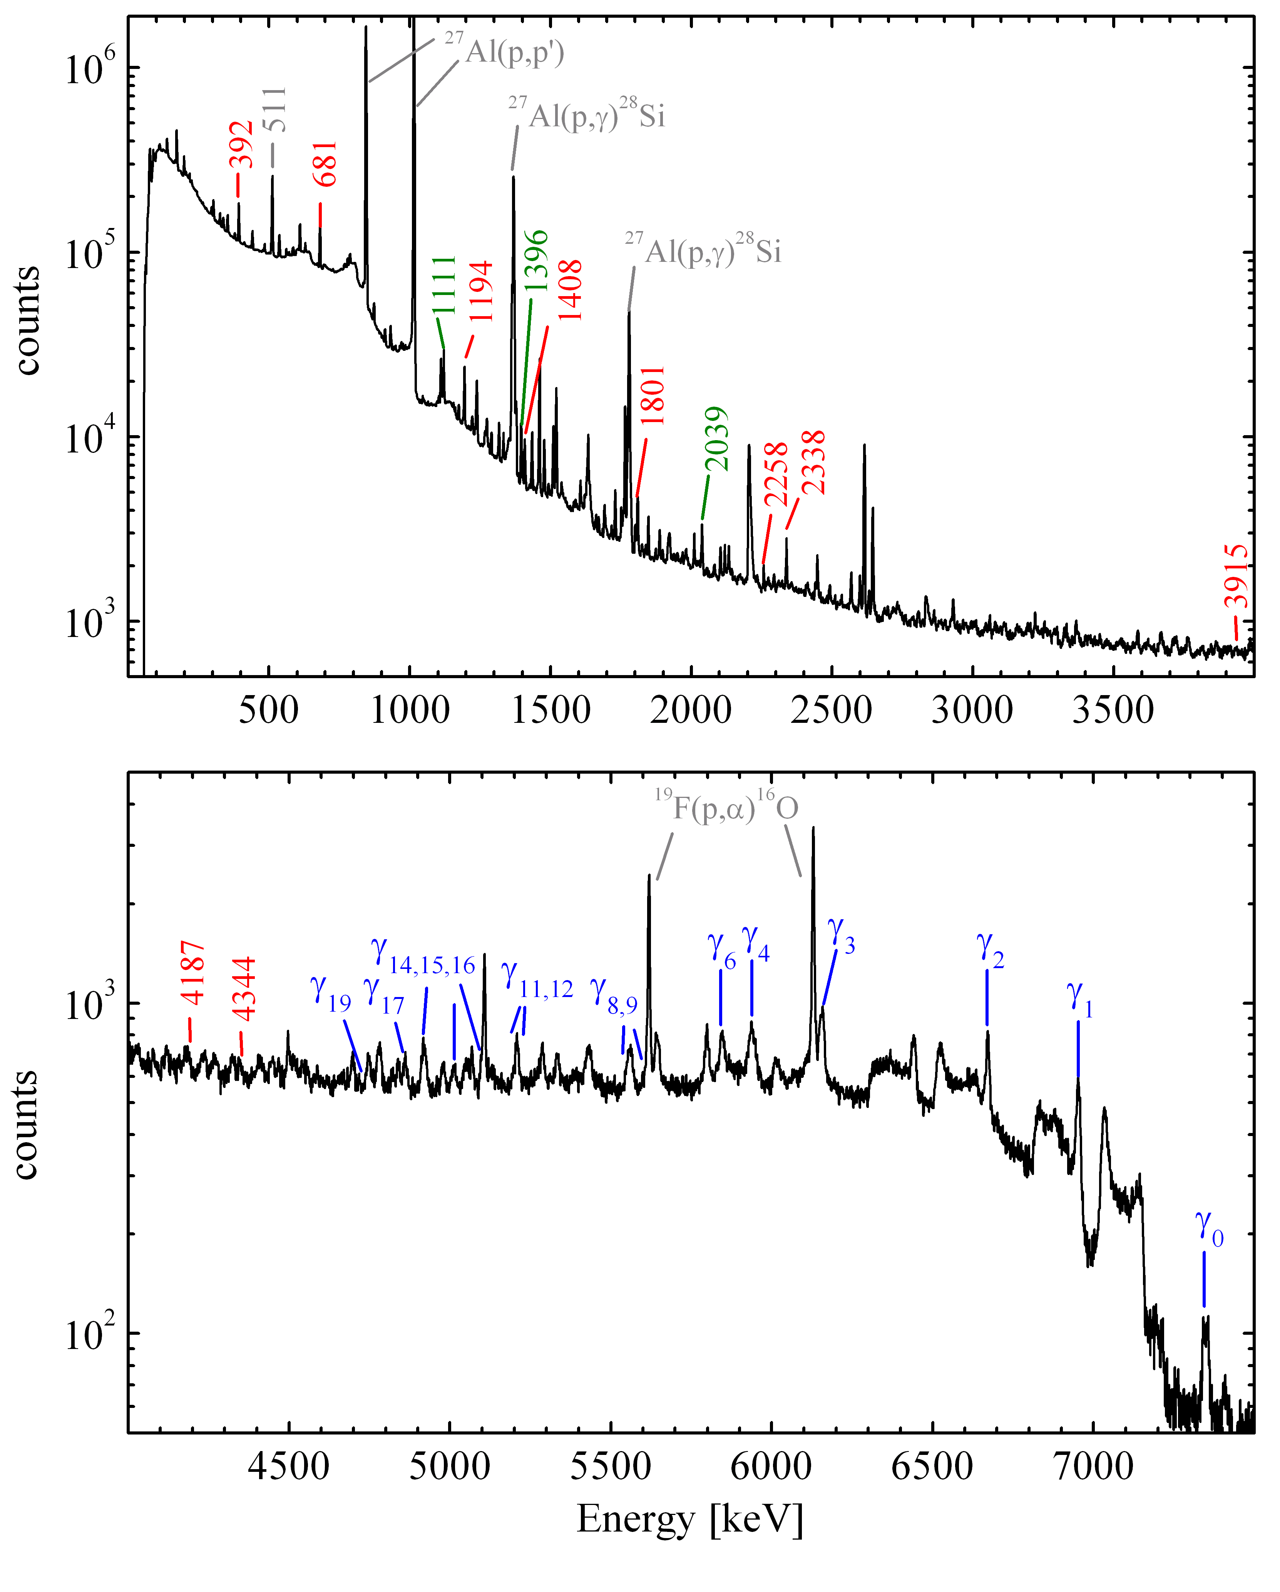
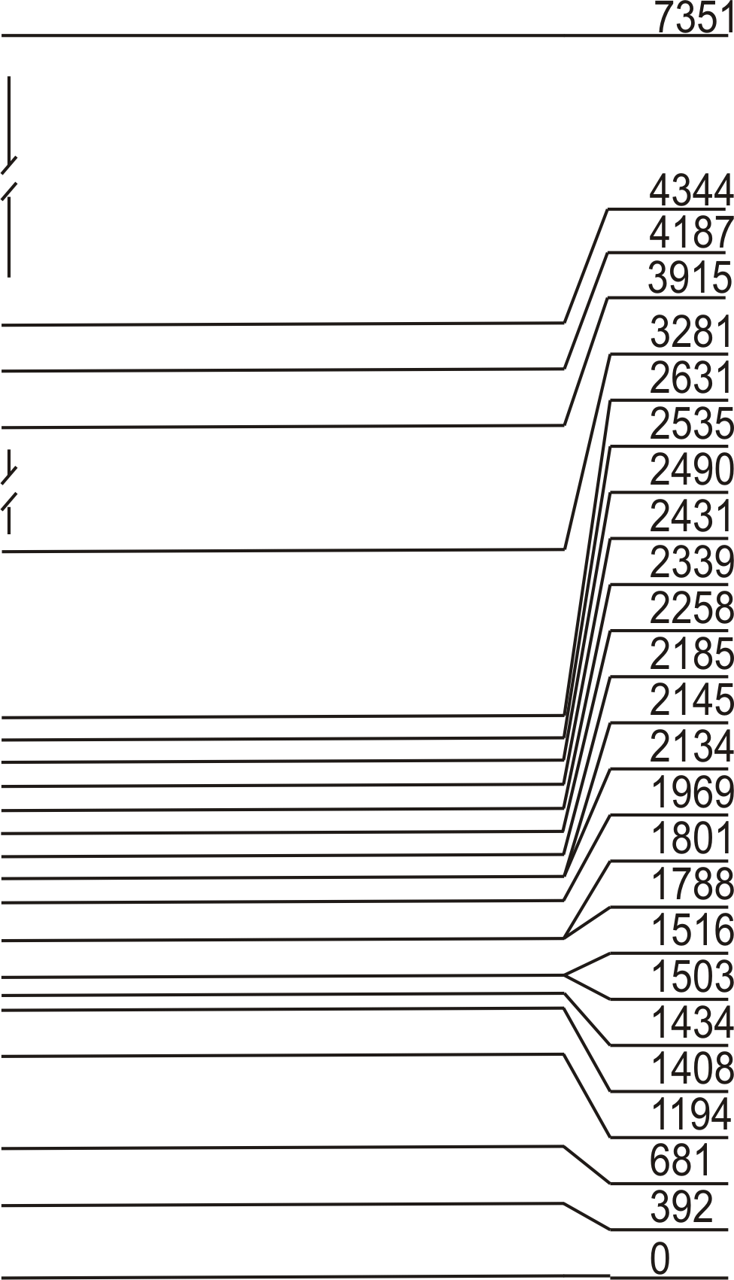
In-beam measurements @ HORUS
²⁷Al(p,p‘)
⁹³Tc
⁹²Mo(p,γ)⁹³Tc
²⁷Al(p,γ)²⁸Si
²⁷Al(p,γ)²⁸Si
E_{p}= 3300 keV
Q = 4087 keV
¹⁹F(p,α)¹⁶O
de-excitation of compound state
partial cross sections

Slide 51
In-beam measurements @ HORUS
²⁷Al(p,p‘)
⁹³Tc
⁹²Mo(p,γ)⁹³Tc
²⁷Al(p,γ)²⁸Si
²⁷Al(p,γ)²⁸Si
E_{p}= 3300 keV
Q = 4087 keV
¹⁹F(p,α)¹⁶O
de-excitation of compound state
transitions to ground state
Partial cross sections
total cross section

Slide 52
In-beam measurements @ HORUS
²⁷Al(p,p‘)
⁹³Tc
⁹²Mo(p,γ)⁹³Tc
²⁷Al(p,γ)²⁸Si
²⁷Al(p,γ)²⁸Si
E_{p}= 3300 keV
Q = 4087 keV
¹⁹F(p,α)¹⁶O
de-excitation of compound state
transitions to ground state
transitions to 1st excited state
Partial cross sections
Total cross section
production of 1st excited state

Slide 53
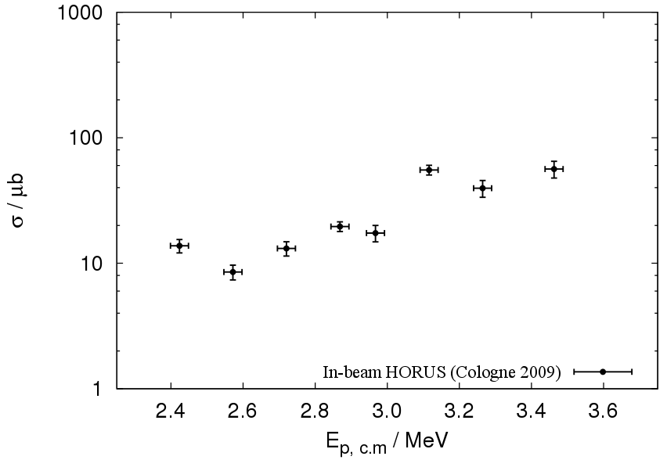
Results: ⁹²Mo(p,γ)
PRELIMINARY

Slide 54
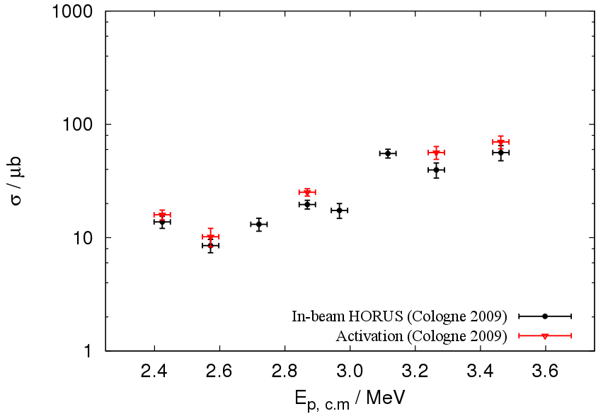
Results: ⁹²Mo(p,γ)
PRELIMINARY

Slide 55
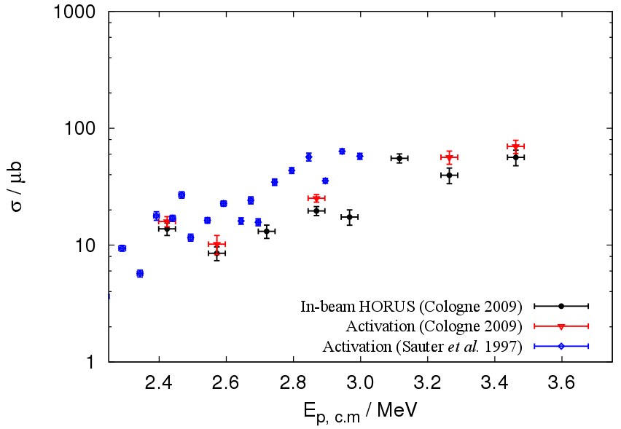
Results: ⁹²Mo(p,γ)
PRELIMINARY

Slide 56
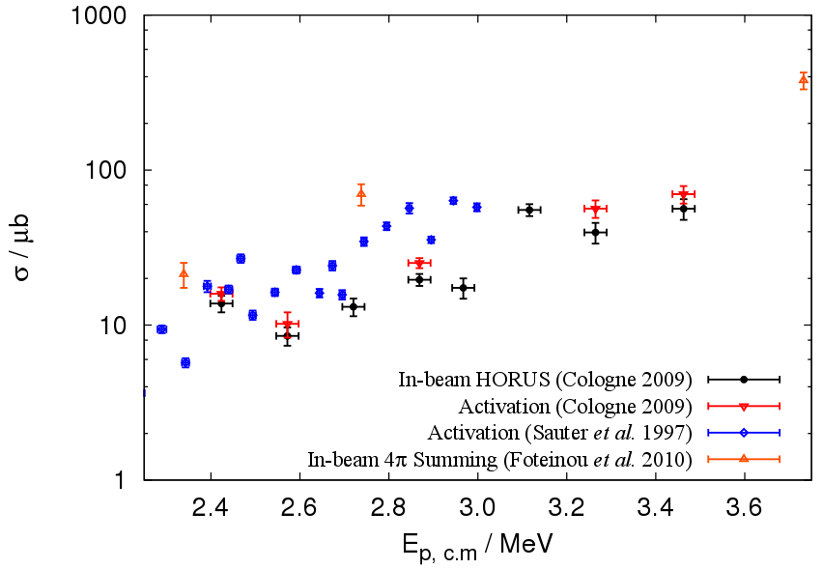
Results: ⁹²Mo(p,γ)
PRELIMINARY

Slide 57
In-beam measurements @ HORUS
Test experiment for ⁹²Mo(α,γ)
comparison with in-beam measurement using 4π NaI detector (to be published)
α energies ~ 9.3 - 10 MeV
Gamow window: 5.5 – 8.6 MeV
current ~ 30 pnA
⁹⁴Ru
⁹⁵Ru
⁹⁶Ru
⁹⁷Ru
(α,γ)
⁹³Tc
⁹⁴Tc
⁹⁵Tc
⁹⁶Tc
⁹²Mo
⁹³Mo
⁹⁴Mo
⁹⁵Mo

Slide 58
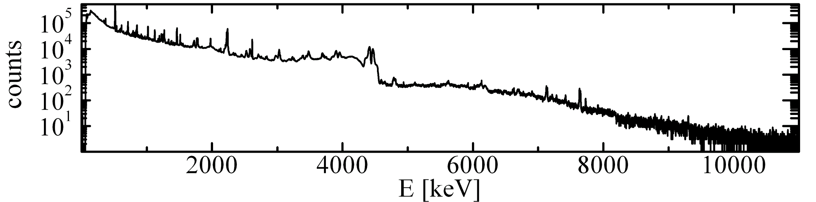
In-beam measurements @ HORUS
⁹²Mo(α,γ)⁹⁶Ru
E_{α}= 9300 keV
Q = 1692 keV
Many background reactions:
Target chamber
²⁷Al(α,n)³⁰P
²⁷Al(α,p)³⁰Si
²⁷Al(α,α‘)²⁷Al
Tantalum coating
of chamber

Slide 59
In-beam measurements @ HORUS
⁹²Mo(α,γ)⁹⁶Ru
E_{α}= 9300 keV
Q = 1692 keV
Many background reactions:
Target chamber
²⁷Al(α,n)³⁰P
²⁷Al(α,p)³⁰Si
²⁷Al(α,α‘)²⁷Al
Target contaminants
¹³C(α,n)¹⁶O
¹⁷O(α,n)²⁰Ne
¹⁸O(α,n)²¹Ne
Tantalum coating
of chamber
High vacuum or „Cooling Finger“

Slide 60
In-beam measurements @ HORUS
⁹²Mo(α,γ)⁹⁶Ru
E_{α}= 9300 keV
Q = 1692 keV
Many background reactions:
Target chamber
²⁷Al(α,n)³⁰P
²⁷Al(α,p)³⁰Si
²⁷Al(α,α‘)²⁷Al
Target contaminants
¹³C(α,n)¹⁶O
¹⁷O(α,n)²⁰Ne
¹⁸O(α,n)²¹Ne
Competitive reactions
⁹²Mo(α,p)⁹⁵Tc
Decay of radioactive reaction products
Tantalum coating
of chamber
High vacuum or „Cooling Finger“

Slide 61
In-beam measurements @ HORUS
⁹²Mo(α,γ)⁹⁶Ru
E_{α}= 9300 keV
Q = 1692 keV
Many background reactions:
Target chamber
²⁷Al(α,n)³⁰P
²⁷Al(α,p)³⁰Si
²⁷Al(α,α‘)²⁷Al
Target contaminants
¹³C(α,n)¹⁶O
¹⁷O(α,n)²⁰Ne
¹⁸O(α,n)²¹Ne
Competitive reactions
⁹²Mo(α,p)⁹⁵Tc
Decay of radioactive reaction products
Tantalum coating
of chamber
+
use γγ coincidence
techniques
High vacuum or „Cooling Finger“

Slide 62
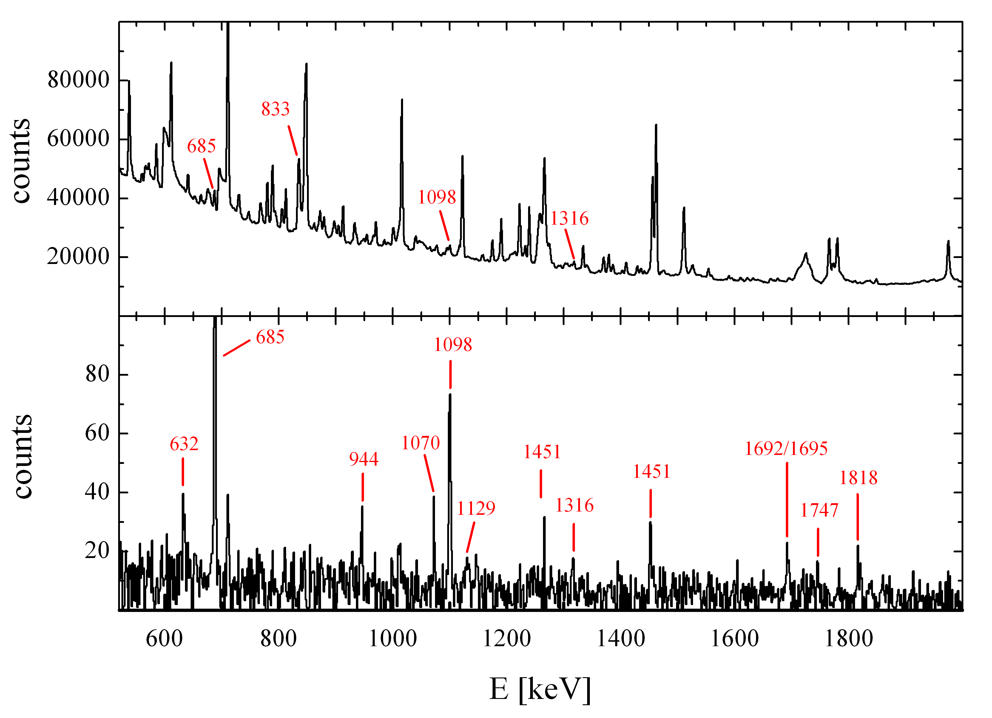
In-beam measurements @ HORUS
⁹²Mo(α,γ)⁹⁶Ru
No coincidence
600 800 1000 1200 1400 1600 1800
Coincidence with E_{γ}=833 keV
E_{γ} [keV]
E_{γ} [keV]

Slide 63
In-beam measurements @ HORUS
⁹²Mo(α,γ)⁹⁶Ru
No coincidence
600 800 1000 1200 1400 1600 1800
Coincidence with E_{γ}=833 keV
E_{γ} [keV]
E_{γ} [keV]

Slide 64
In-beam measurements @ HORUS
⁹²Mo(α,γ)⁹⁶Ru
No coincidence
Coincidence with E_{γ}=833 keV
E_{γ} [keV]

Slide 65

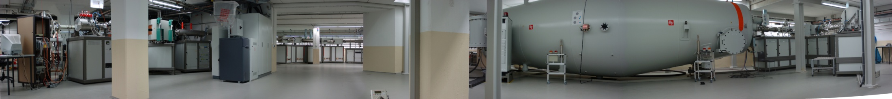



Cologne AMS
Tandetron accelerator with 6 MV terminal voltage
standard isotopes: ¹⁰Be, ¹⁴C, ²⁶Al, ³⁶Cl, ⁴¹Ca, ¹²⁹I
(geosciences, pre- and protohistory)
ample beam time reserved for nuclear physics applications
Universität
zu Köln

Slide 66
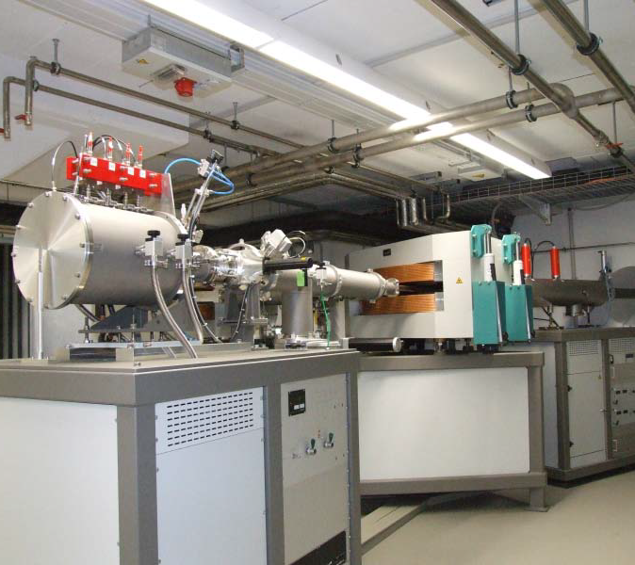
Cologne AMS
Status:
first ¹⁴C test measurement successful in February 2011
start of standard operation in fall 2011

Slide 67
Cologne AMS
results from first performance test for standard cosmogenic nuclides
Isotopes | Precision for acceptance | Measured precision
¹⁰Be / ⁹Be | 3 % at 10⁻¹² | 1.9 %
¹⁴C / ¹²C | 0.5 % at 10⁻¹² | 0.3 %
²⁶Al / ²⁷Al | 3 % at 10⁻¹¹ | 1.3 %
³⁶Cl / ³⁵Cl | 3 % at 10⁻¹² | 1.3 %
courtesy of S. Heinze

Slide 68
Cologne AMS
results from first performance test for standard cosmogenic nuclides
Isotopes | Precision for acceptance | Measured precision
¹⁰Be / ⁹Be | 3 % at 10⁻¹² | 1.9 %
¹⁴C / ¹²C | 0.5 % at 10⁻¹² | 0.3 %
²⁶Al / ²⁷Al | 3 % at 10⁻¹¹ | 1.3 %
³⁶Cl / ³⁵Cl | 3 % at 10⁻¹² | 1.3 %
courtesy of S. Heinze
prime example for Nuclear Astrophysics:
¹⁴⁴Sm(α,γ)¹⁴⁸Gd

Slide 69
Summary & Outlook
several techniques to study (p,γ) and (α,γ) reactions of astrophysical relevance on stable nuclei

Slide 70
Summary & Outlook
several techniques to study (p,γ) and (α,γ) reactions of astrophysical relevance on stable nuclei
activation technique
  counting setup with 2 HPGe clover detectors
  γγ coincidences and advantages of digital data acquisition
in-beam technique
  HORUS array provides large amount of information
accelerator mass spectrometry

Slide 71
Summary & Outlook
several techniques to study (p,γ) and (α,γ) reactions of astrophysical relevance on stable nuclei
activation technique
  counting setup with 2 HPGe clover detectors
  γγ coincidences and advantages of digital data acquisition
in-beam technique
  HORUS array provides large amount of information
accelerator mass spectrometry
provide experimental data base for (p,γ) and (α,γ) reactions
derive reliable global properties, e.g., optical model potentials

Slide 72



Experimental Facilities for Reaction Studies in Nuclear Astrophysics in Cologne
V. Derya, M. Elvers, J. Endres, A. Hennig,
J. Mayer, S. Pascu, S. Pickstone,
A. Sauerwein, F. Schlüter, M. Spieker,
K. O. Zell, and A. Zilges
H.W. Becker and D. Rogalla
U. Giesen

Slide 73
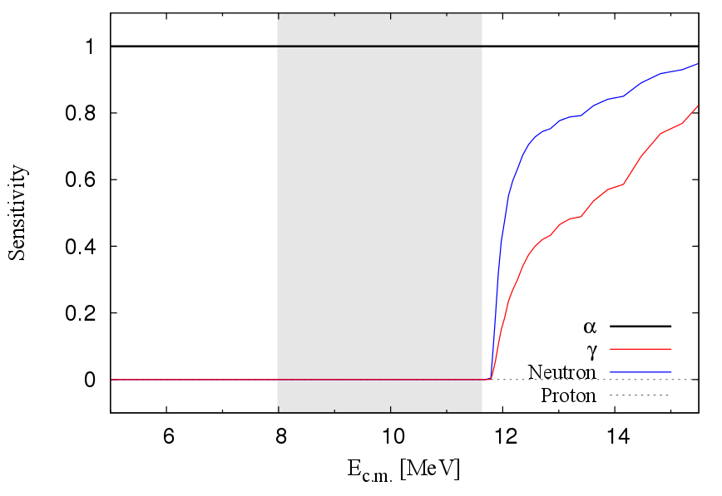
¹⁶⁸Yb(α,γ)¹⁷¹Hf - Sensitivity

