Slide 1
Accelerator Mass Spectrometry
(AMS)
496. Wilhelm und Else Heraeus-Seminar
February 6th to 10th, 2012 – Physikzentrum Bad Honnef – Germany
Astrophysics with modern small-scale accelerators

Slide 2
Outline
Method – Accelerator Mass Spectrometry (measure rare isotopes)
AMS at Munich (Garching)
New Facility DREAMS (DREsden AMS)
Notes:
Rare isotopes: radioactive ones – other elements, isotpes are everywhere

Slide 3
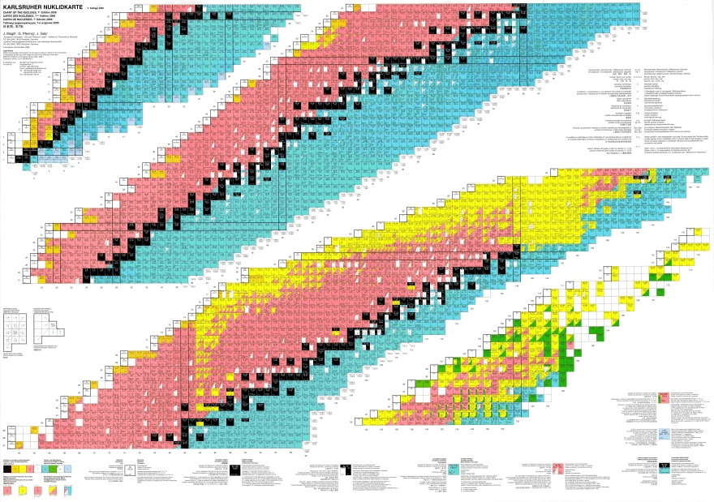
Historical
1939 Alvarez and Cornog discovered accidentally ³He (cyclotron).
From 1939 until 1977, for around 40 years, dark and silent!
1977 Muller proposed to measure ¹⁴C or ¹⁰Be by means of a cyclotron.
Independently, Gove, Litherland, and Purser suggested the use
of a Tandem accelerator for ¹⁴C measurements.
2012 More than 100 AMS laboratories worldwide.
From small table top accelerators until large facilities with
more than 10MV terminal voltage.
Isotopes of interest from ³H until the heaviest nuclides like ²⁴⁴Pu.
The majority of AMS
laboratories is dedicated to
¹⁴C and ¹⁰Be.

Slide 4
Accelerator Mass Spectrometry
Counting individual atoms (like conventional MS)
But
accelerator (mostly a Tandem)
molecules destroyed by stripping
mostly for radioisotopes
extremely sensitive (isotopic ratio ~ 10⁻¹⁶)
Notes:
This sensitivity is good but extremely sensitive means that all stable isotopes are in your sample. Therefore not all isotopes are suited for this method
We need isotopes which are produced and which decay – radionuclides (next slide).
4

Slide 5
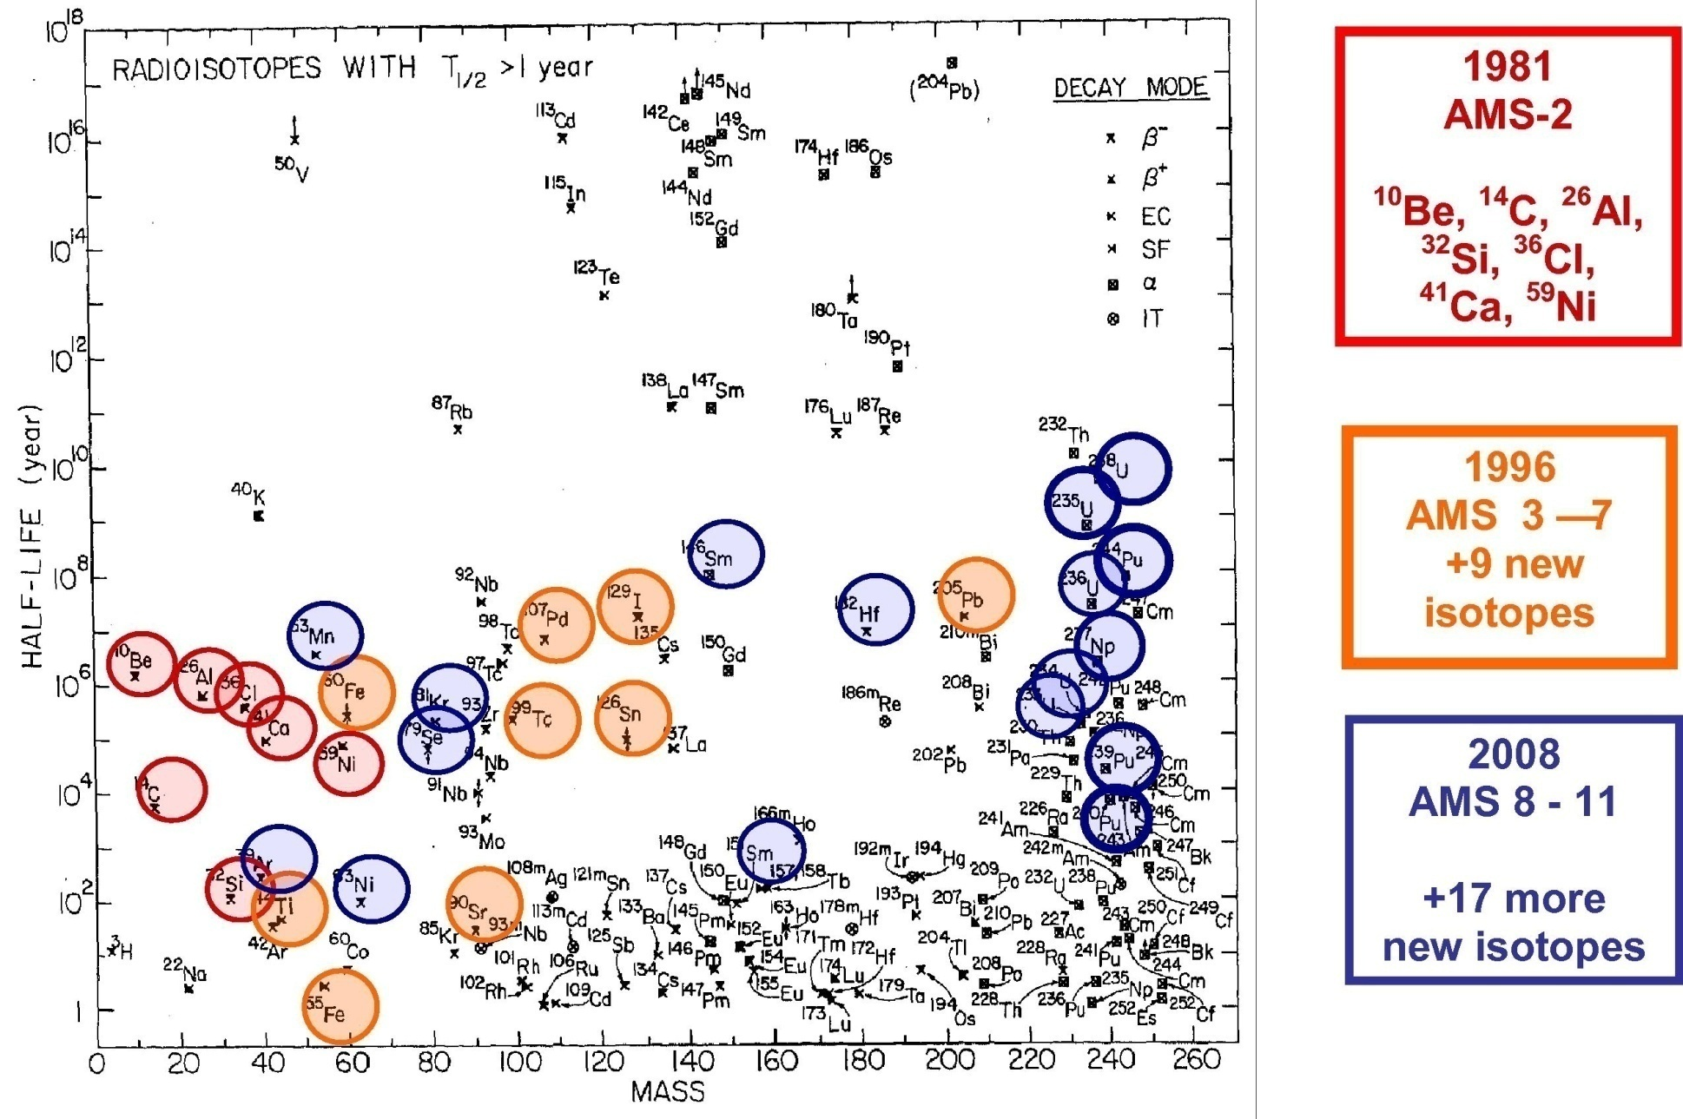
Radionuclides detected by AMS
Fig. 4 from D.Fink, NIM B 268, 2010
modified/updated from W. Kutschera 1981
Notes:
Here is an overview of radionuclides measured (successfully) by AMS – mass – half life – very long half life – primordial elements like stable elements still abundant shorter half life suited for AMS – growing number of isotopes measured with the years – short half lives – you can measure the activity. So what are the challenges at AMS?
Like 44Ti where decay counting is also possible (T1/2: ~60 a)
5

Slide 6
Accelerator Mass Spectrometry
challenge: isobar separation
luck (e.g. for ¹⁴C⁻ no stable ¹⁴N⁻ ion)
X-ray coincidence
chemistry
specific energy loss
deflection in a gas-filled magnet
At Munich/Garching
DREAMS later
Example (⁶³Ni in Cu):
m(⁶³Ni) = 62.929674 (T_{1/2} = 100 a)
m(⁶³Cu)= 62.929602 (stable)
Δm: < 1.2 10⁻⁶
Notes:
Again challenge of AMS – isobar separation!
Different methods – most famous –wide applications for AMS C-14 luck – understanding the whole process many disciplines involved to make the ultrasensitive measurements
As an example – worst case looking for an radionuclide in a matrix of the isobar!

Slide 7
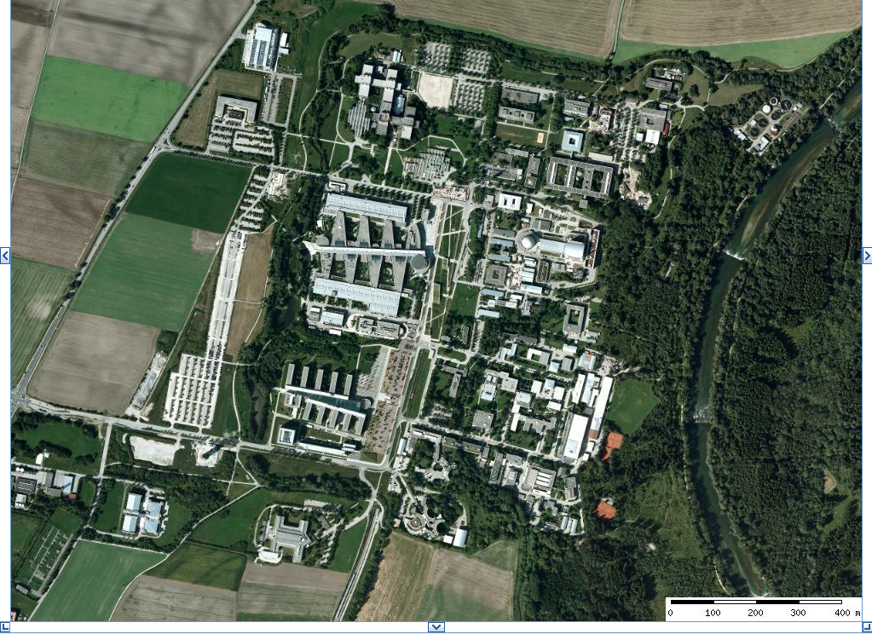
Garching Research Center about 14km North of Munich

Slide 8
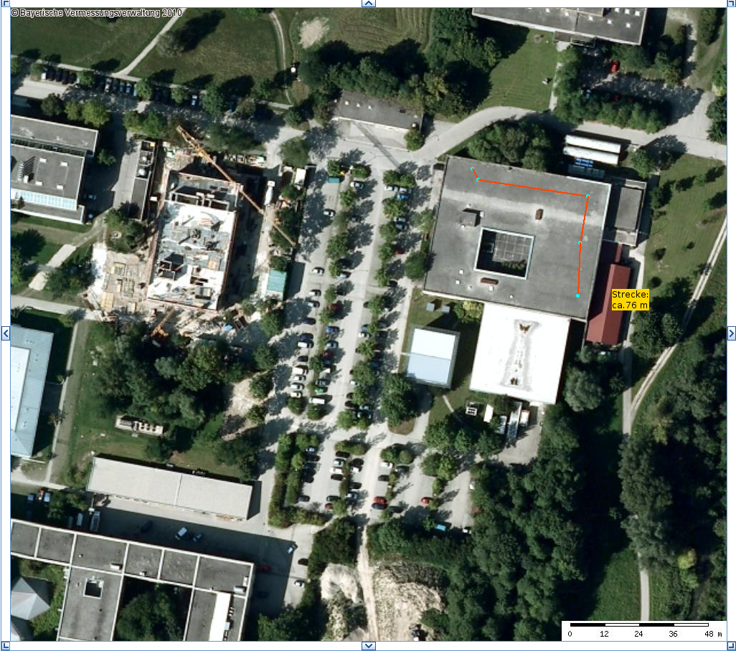
Tandem Accelerator Laboratory Garching
Part of the MLL (Maier Leibnitz Laboratory)
Ludwig Maximilians Universität and Technische Universität München
Length:
about 76 m

Slide 9
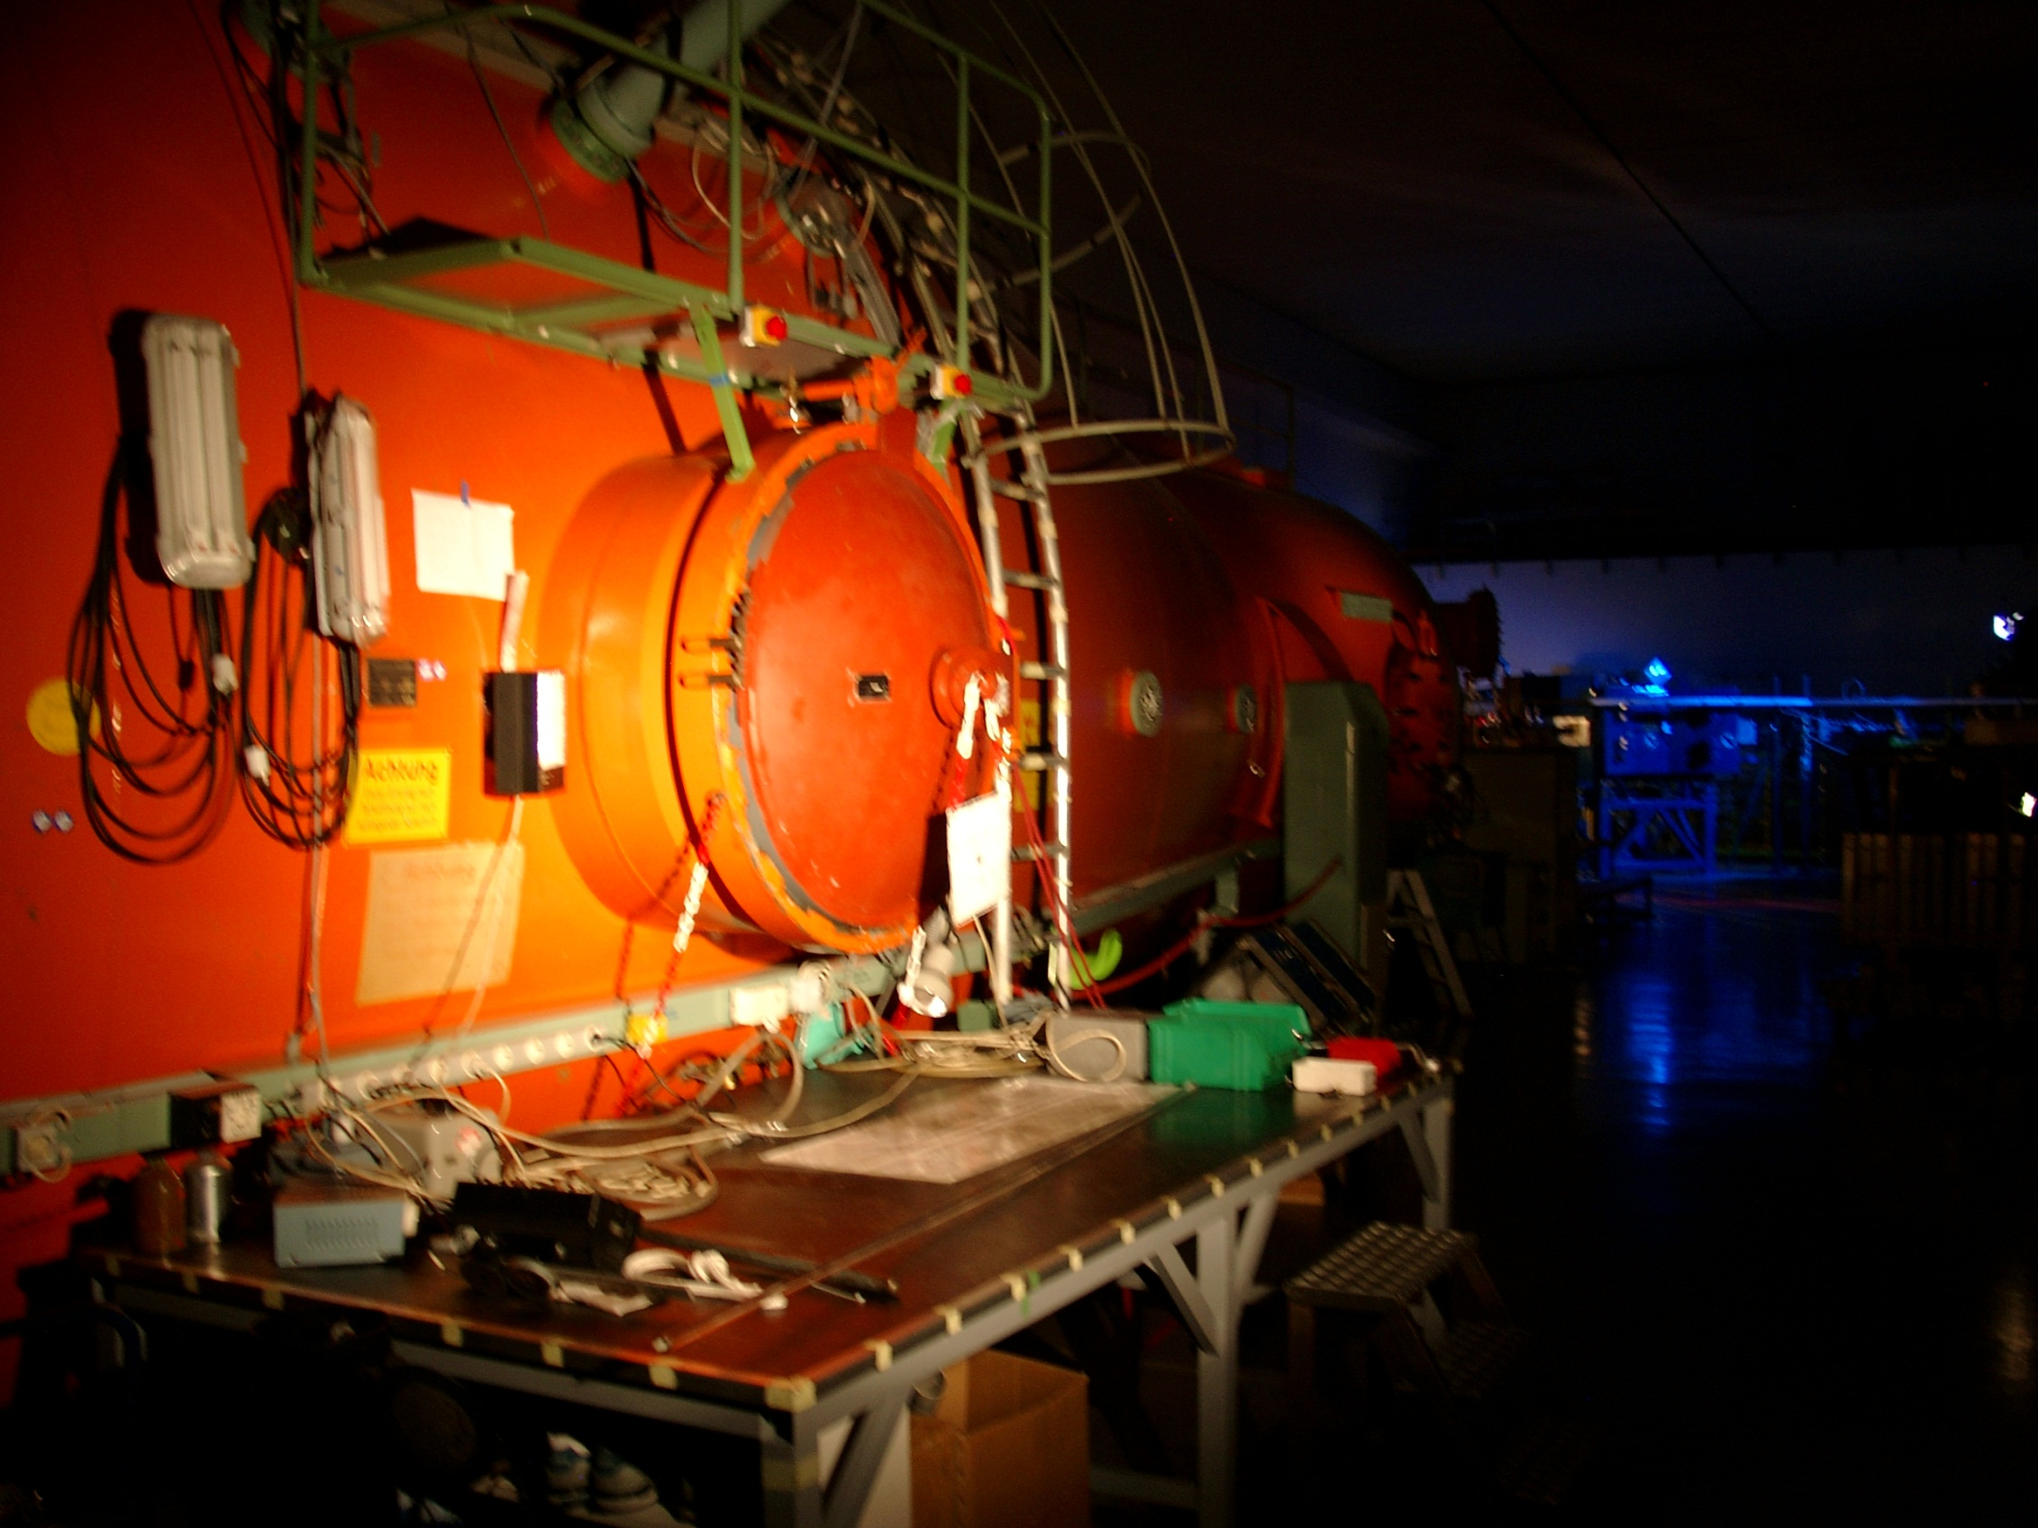

Slide 10

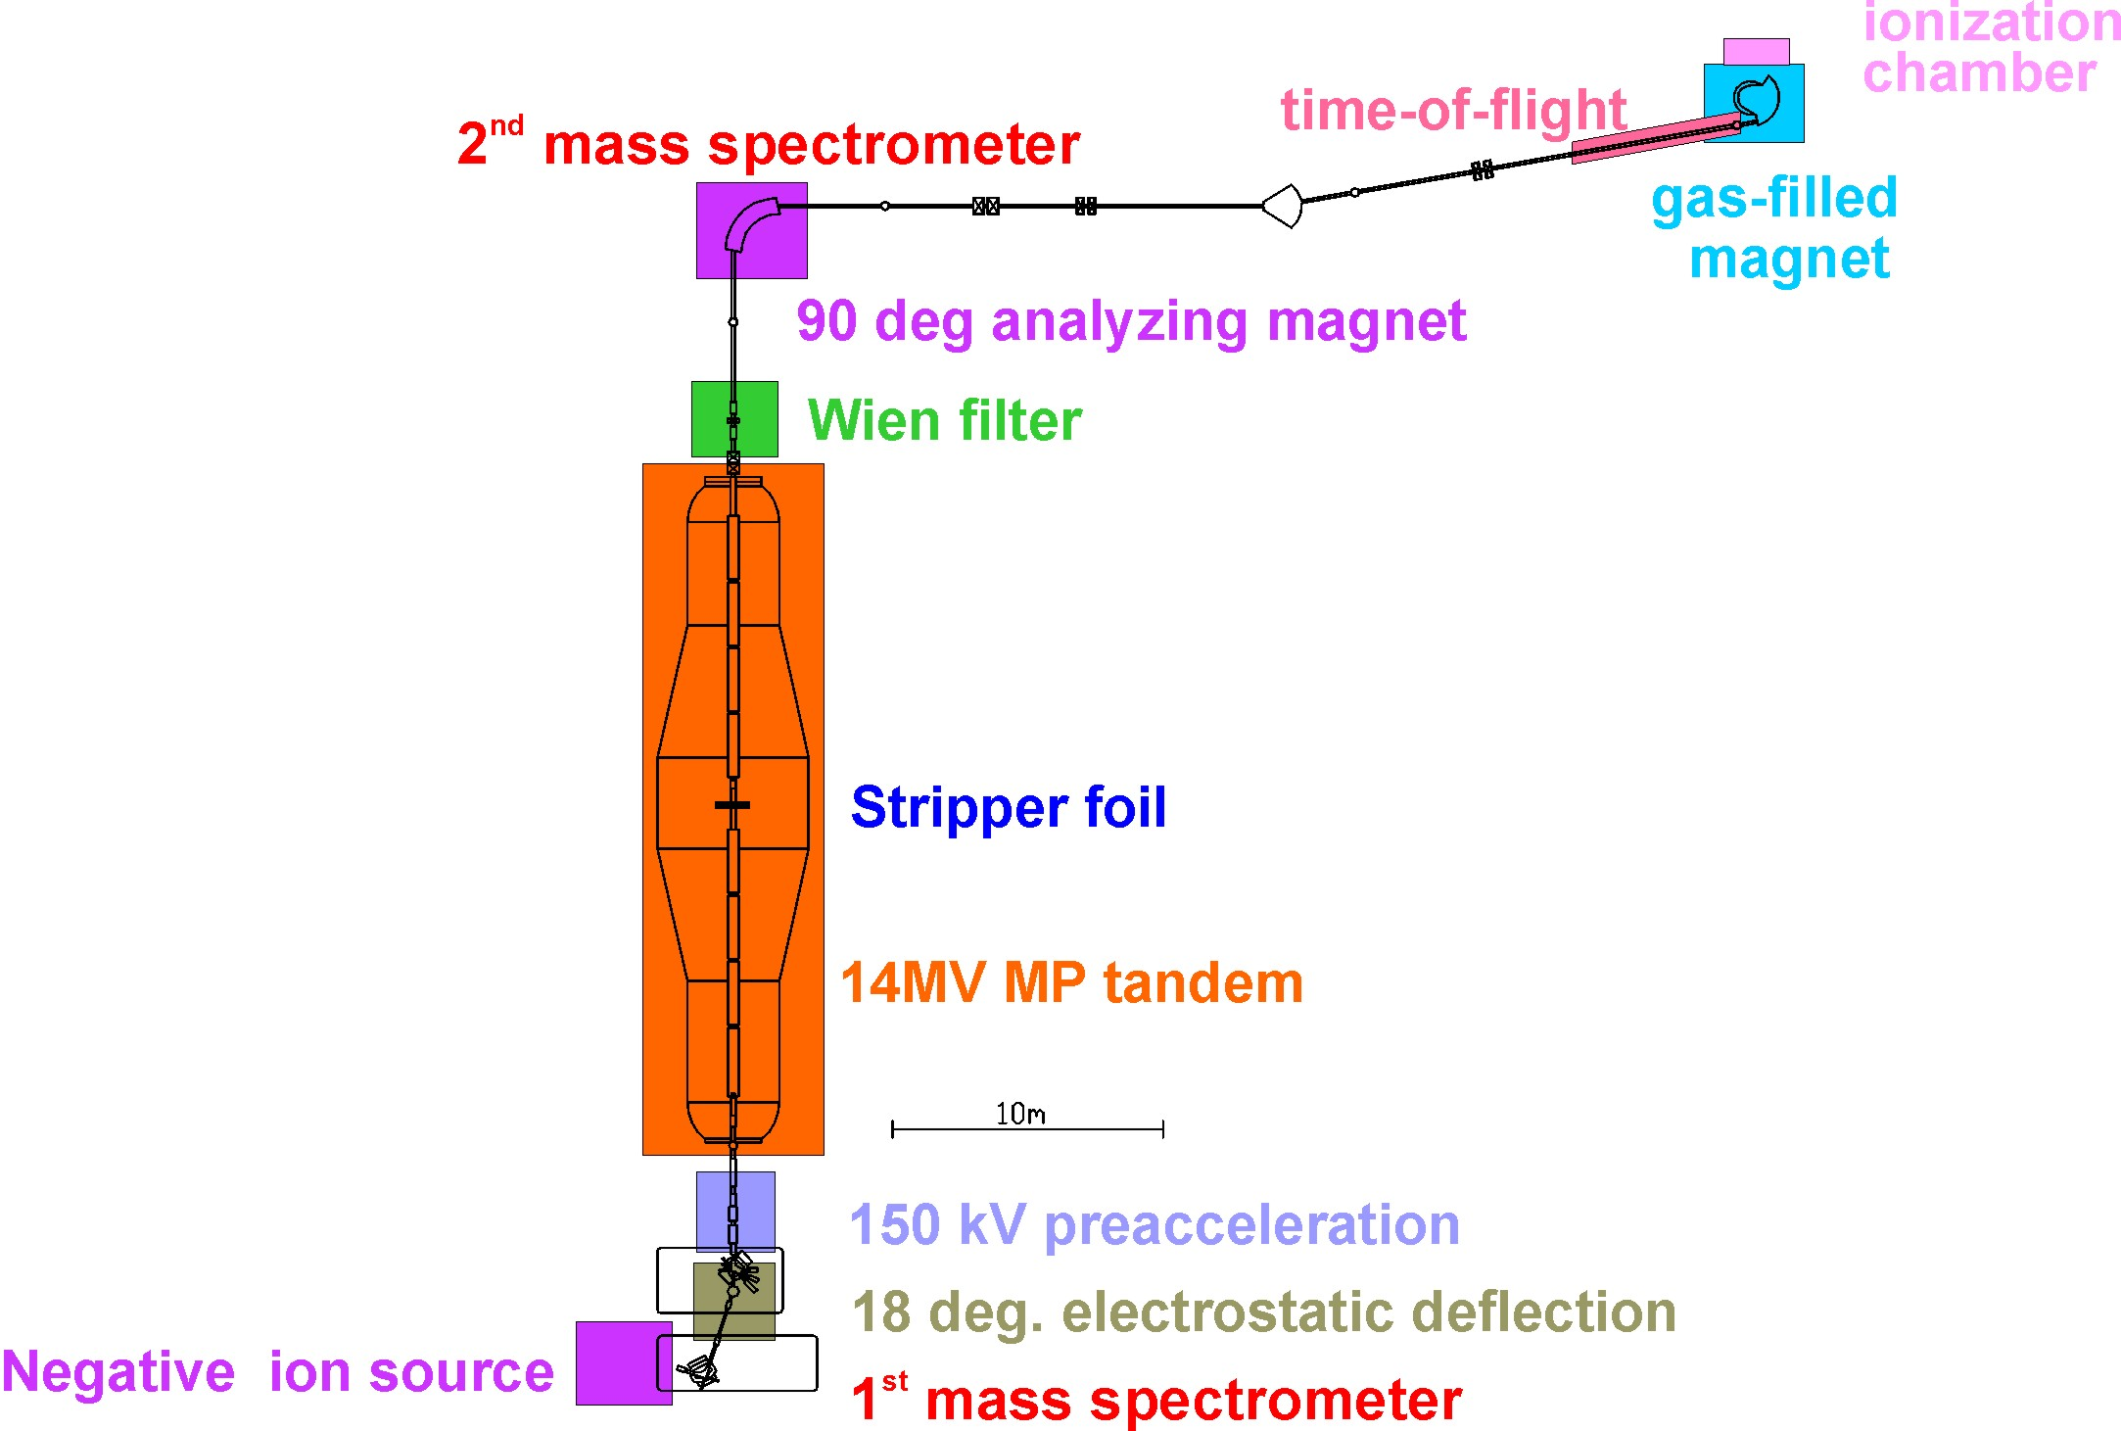
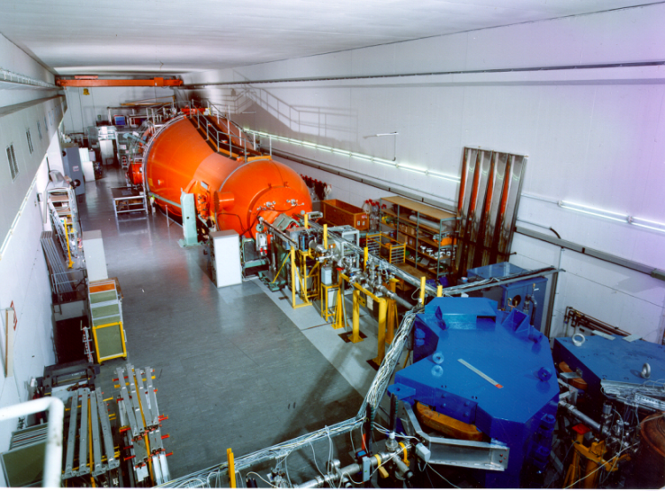
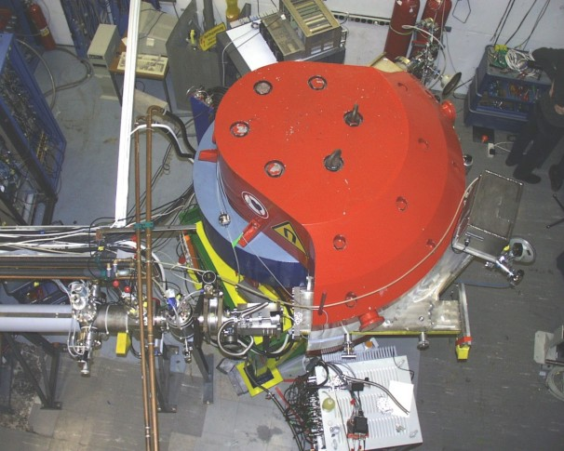
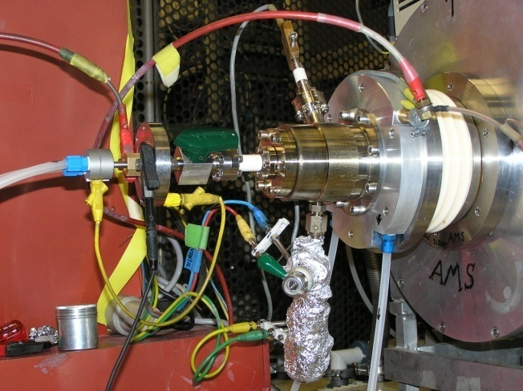
AMS Setup in Garching
Wien filter 2
1
Notes:
Start negative ion source, first mass spec, molecular background, high voltage tandem accelerator, stripping foil destruction of molecules, Wien filter (1 and 2) to separate the right velocity,2nd mass spec to separate a charge state, beam line to filter out background originating from scatter in the beam – guided to the detector system GAMS – I will explain the detector briefely.
10

Slide 11

Neg. Cs – Sputter Ion Source

Slide 12
AMS Setup in Garching
Wien filter 2
1
Notes:
Start negative ion source, first mass spec, molecular background, high voltage tandem accelerator, stripping foil destruction of molecules, Wien filter (1 and 2) to separate the right velocity,2nd mass spec to separate a charge state, beam line to filter out background originating from scatter in the beam – guided to the detector system GAMS – I will explain the detector briefely.
12

Slide 13
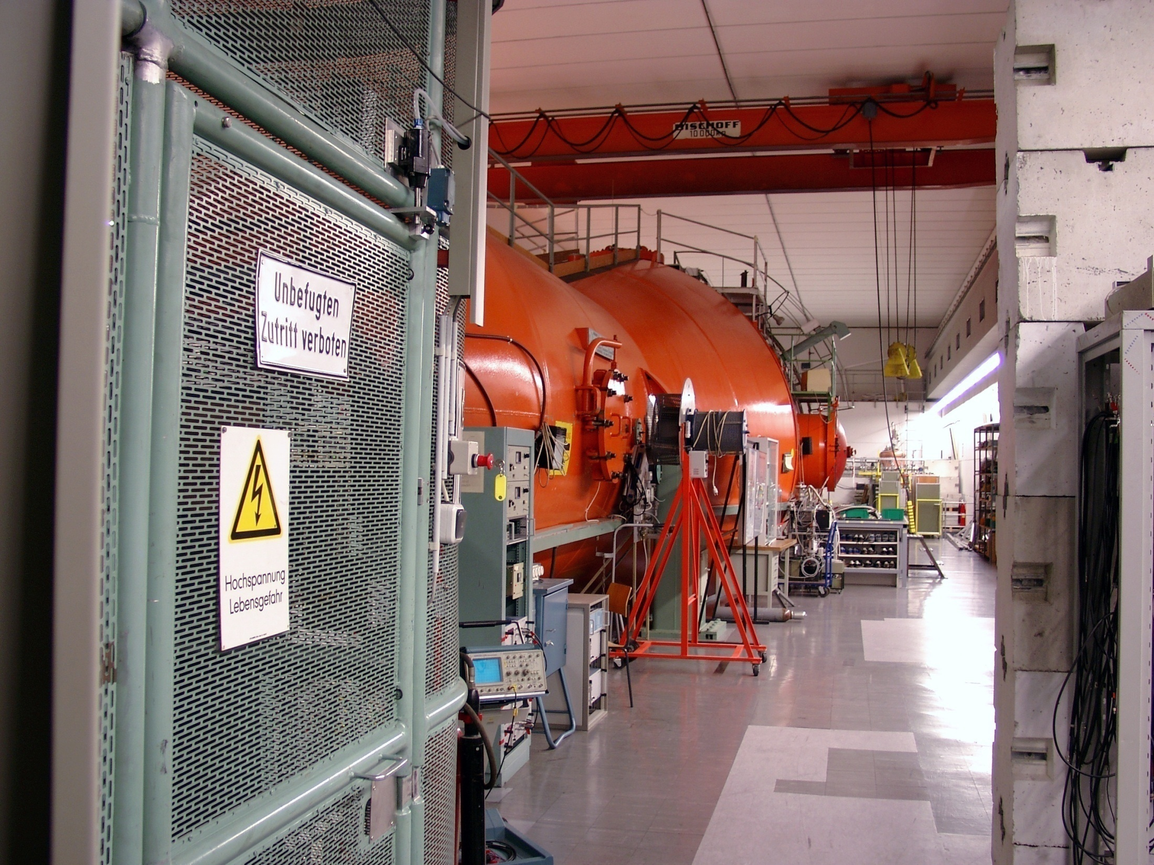
Low energy side of the Tandem

Slide 14
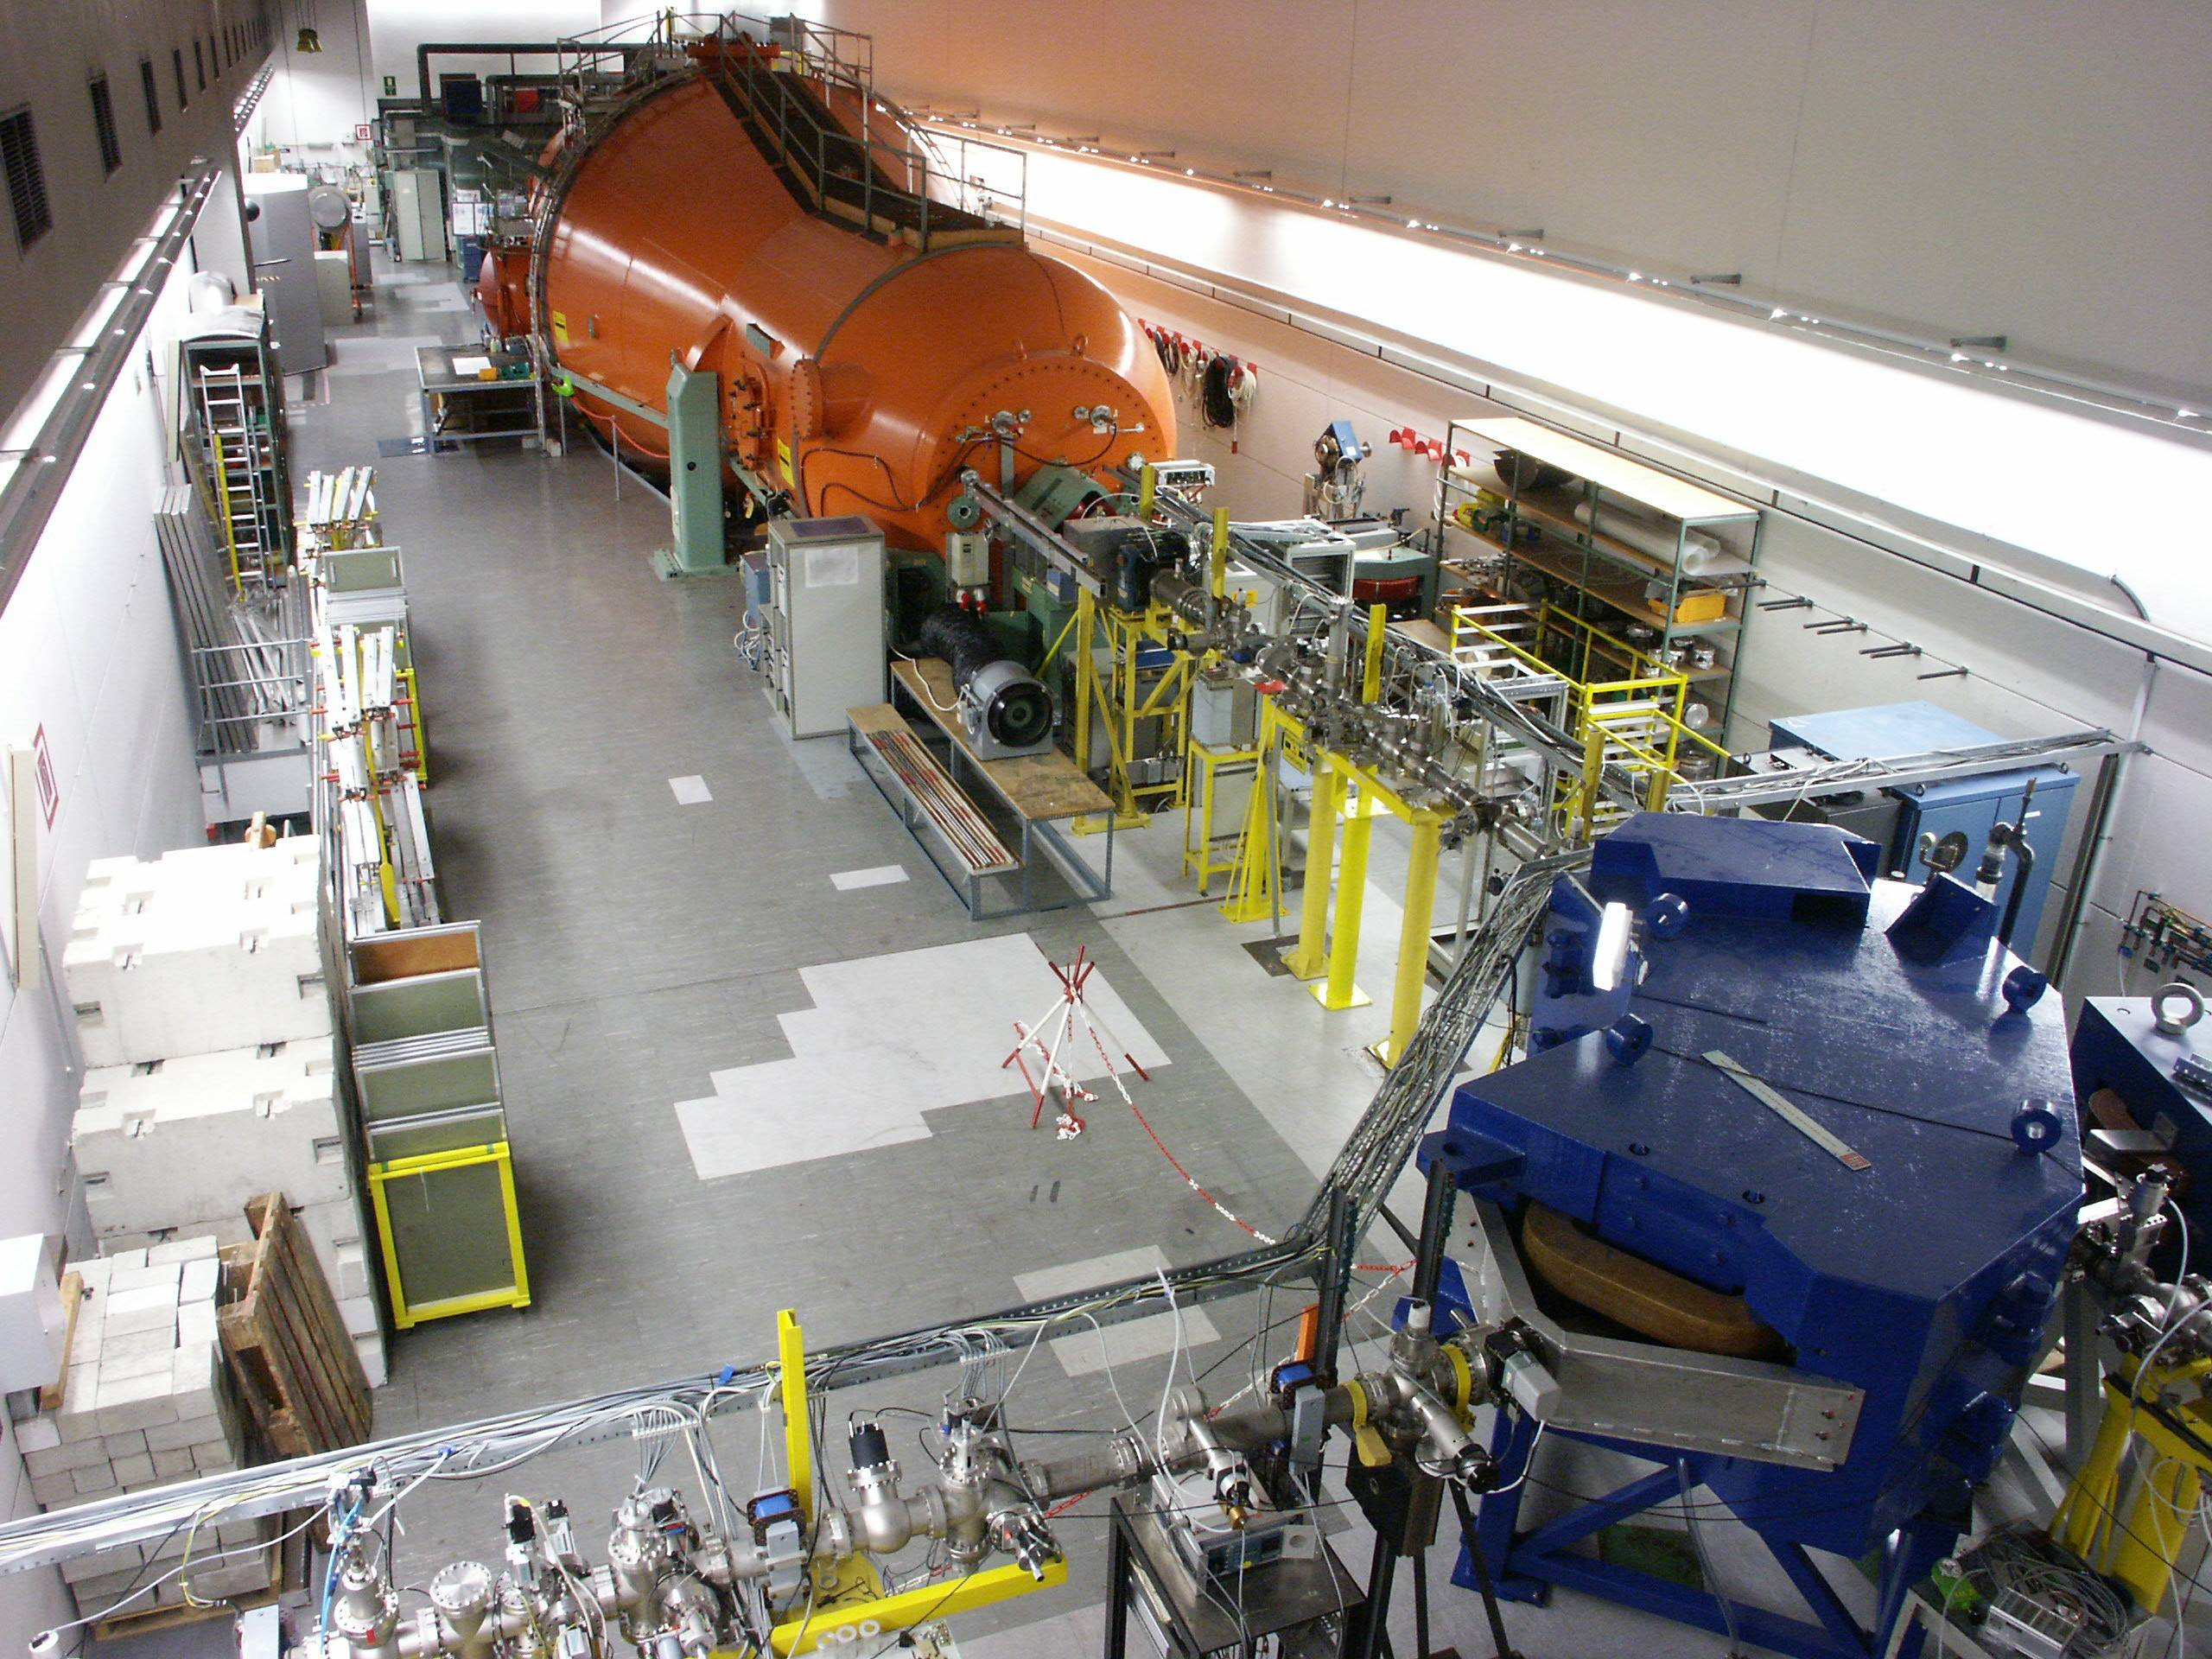
High energy side of the Tandem
e.g.: ⁶³Cu¹²⁺ + ⁶³Ni¹²⁺
isobars not yet suppressed

Slide 15
AMS Setup in Garching
Wien filter 2
1
Notes:
Start negative ion source, first mass spec, molecular background, high voltage tandem accelerator, stripping foil destruction of molecules, Wien filter (1 and 2) to separate the right velocity,2nd mass spec to separate a charge state, beam line to filter out background originating from scatter in the beam – guided to the detector system GAMS – I will explain the detector briefely.
15

Slide 16
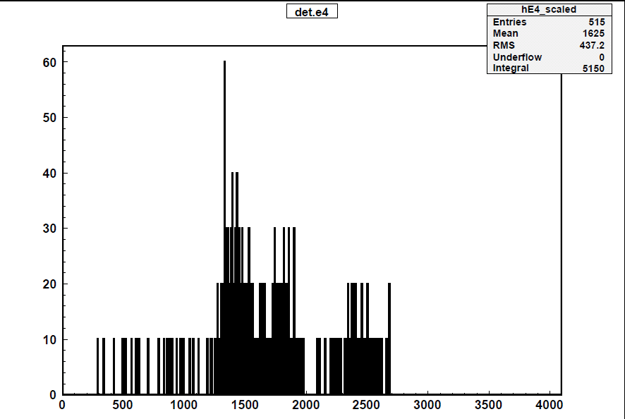
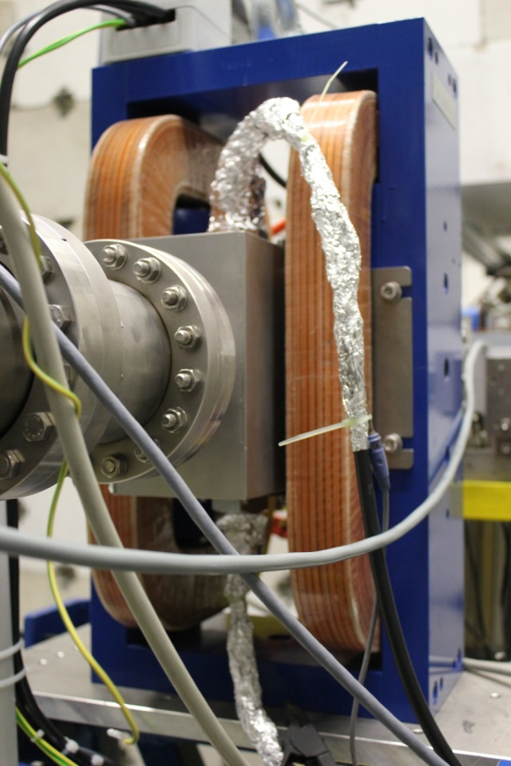
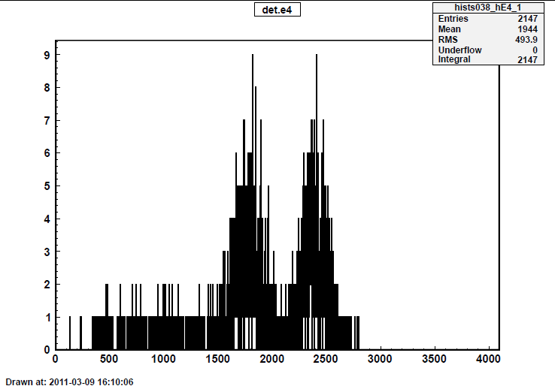
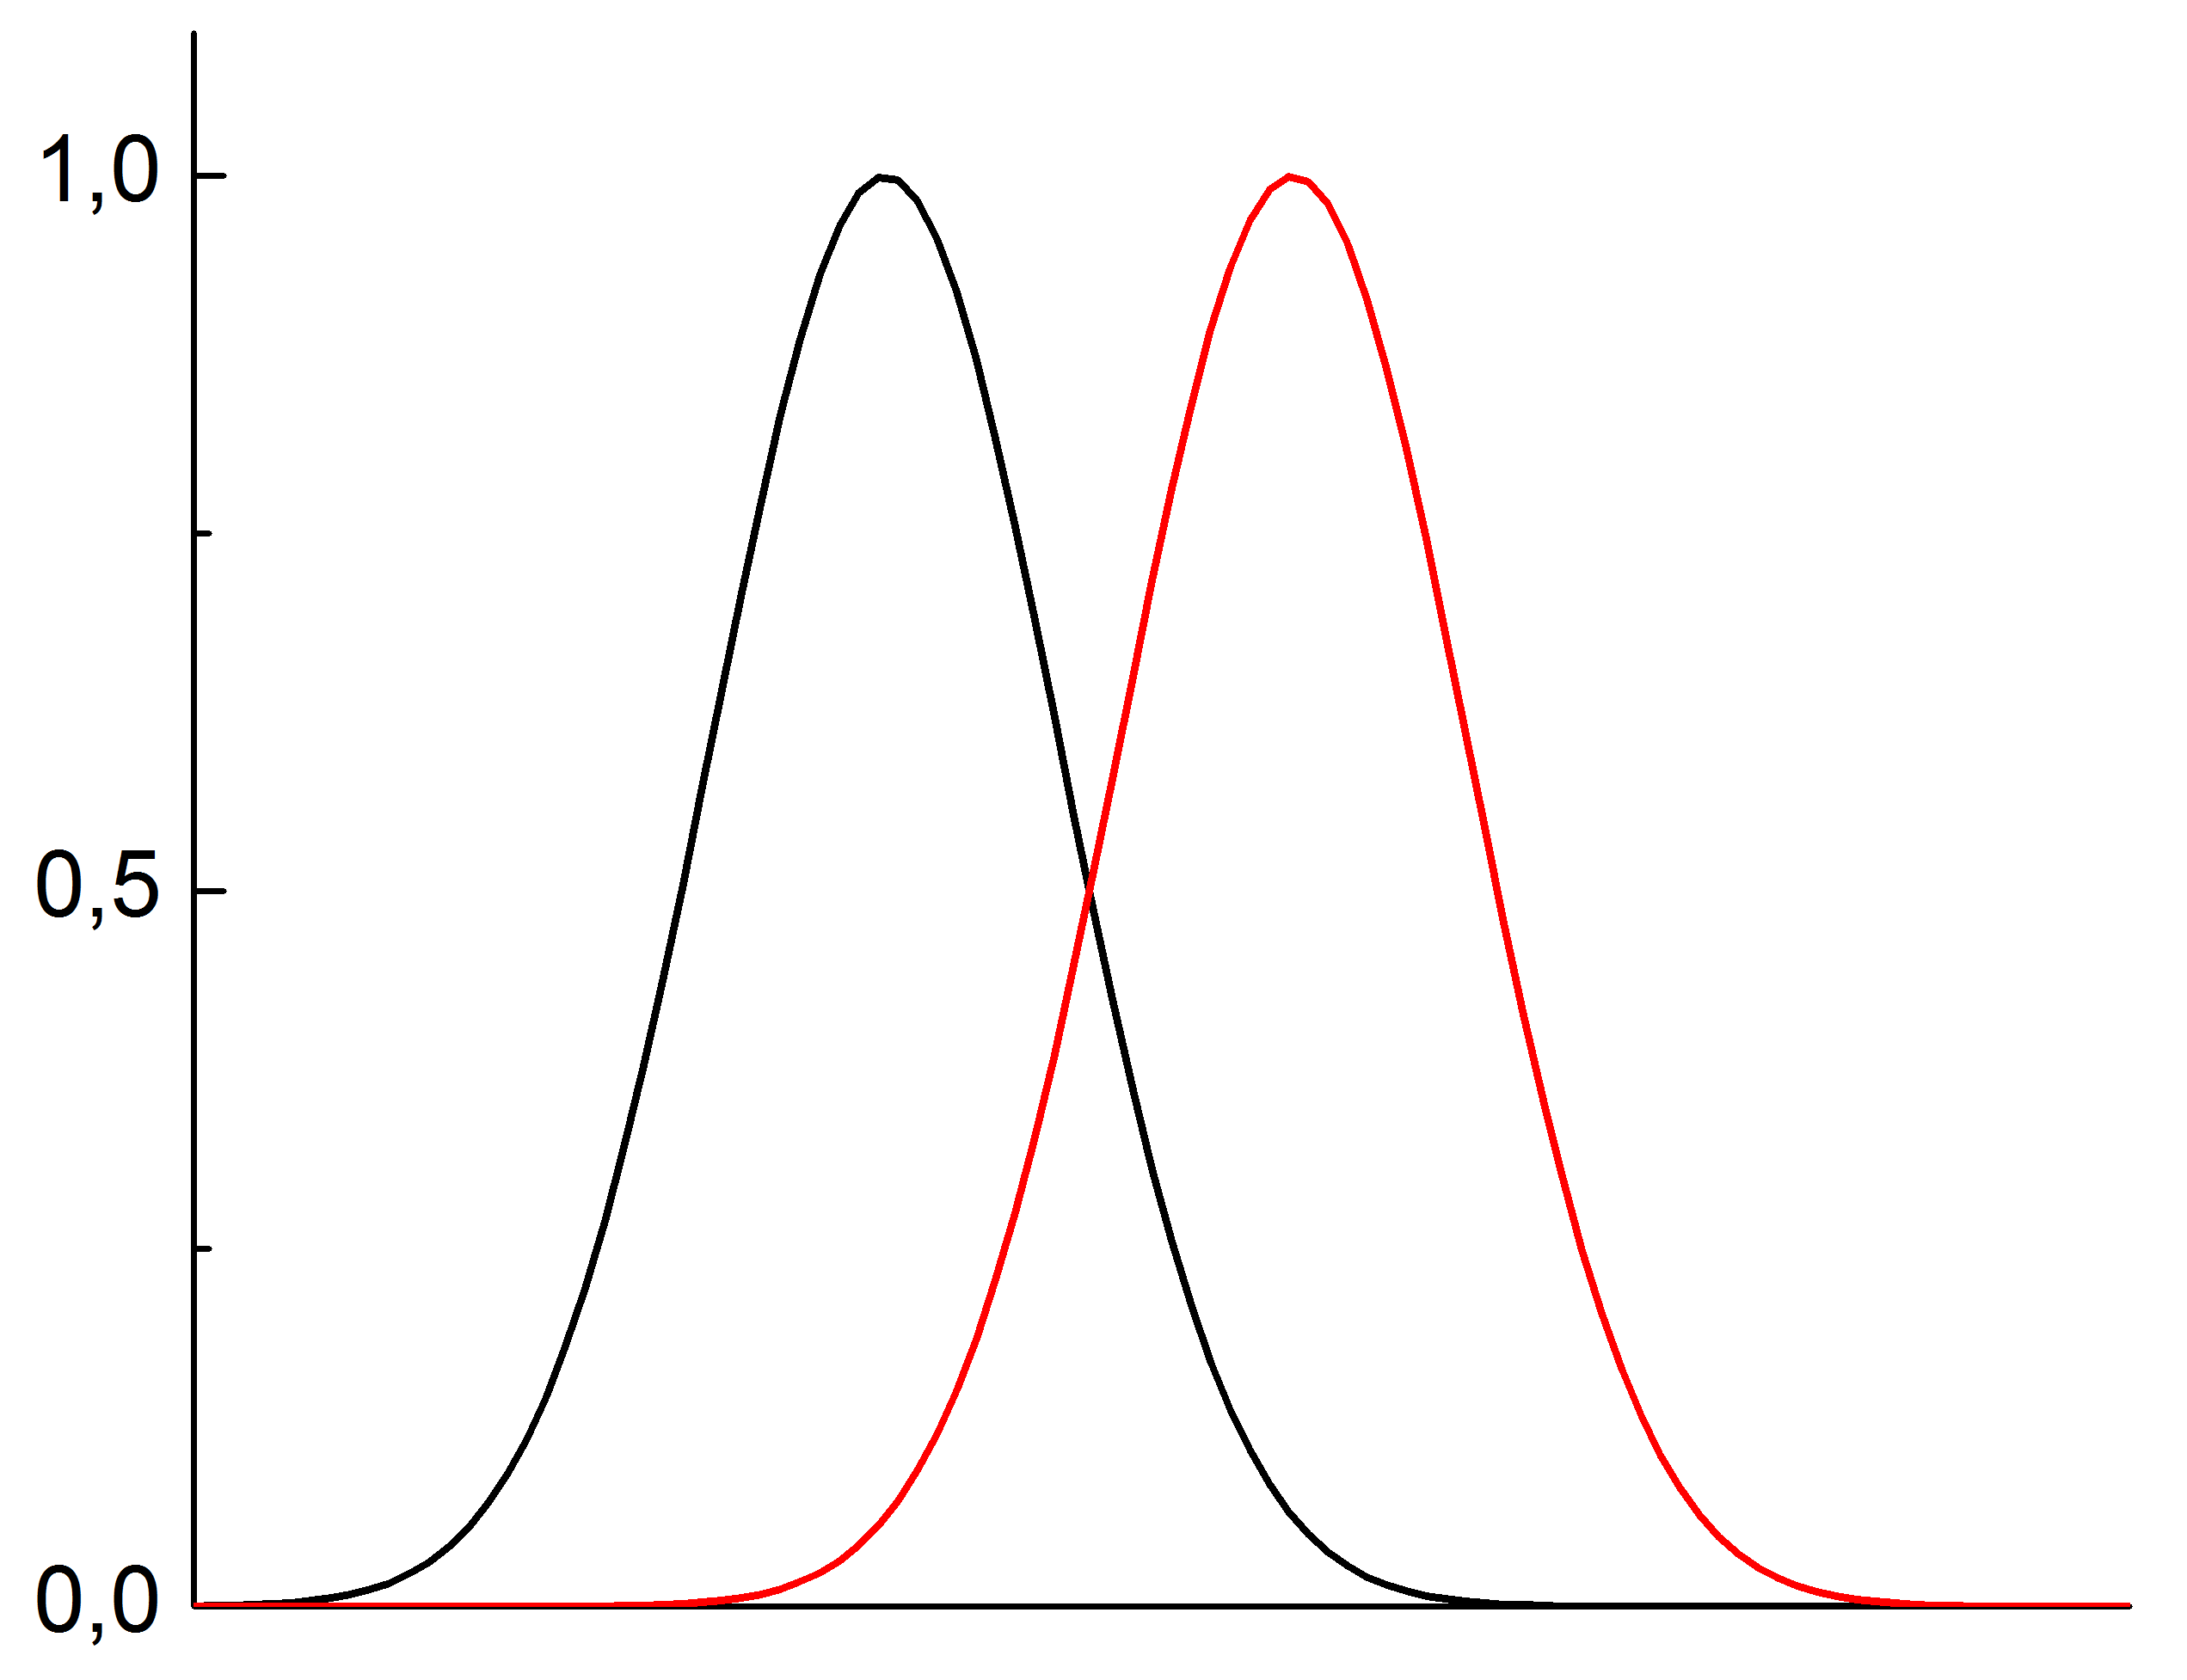
Wien Filters
WF off
⁶⁰Ni
d
WF on
⁵⁹Ni
FWHM
⁵⁹Co
Mass resolution:
distance between peaks d ≥ FWHM
Notes:
This slide shows the effect of the velocity filters when measuring highly sensitive 59Ni/60Ni ratio. The uninteresting isotope (60Ni) is efficiently supressed with the correct setting of the Wien filter. It is important to have alternating electric and magnetic separation. Therefore two new Wien filters were put into operation.

Slide 17
AMS Setup in Garching
Wien filter 2
1
Notes:
Start negative ion source, first mass spec, molecular background, high voltage tandem accelerator, stripping foil destruction of molecules, Wien filter (1 and 2) to separate the right velocity,2nd mass spec to separate a charge state, beam line to filter out background originating from scatter in the beam – guided to the detector system GAMS – I will explain the detector briefely.
17

Slide 18
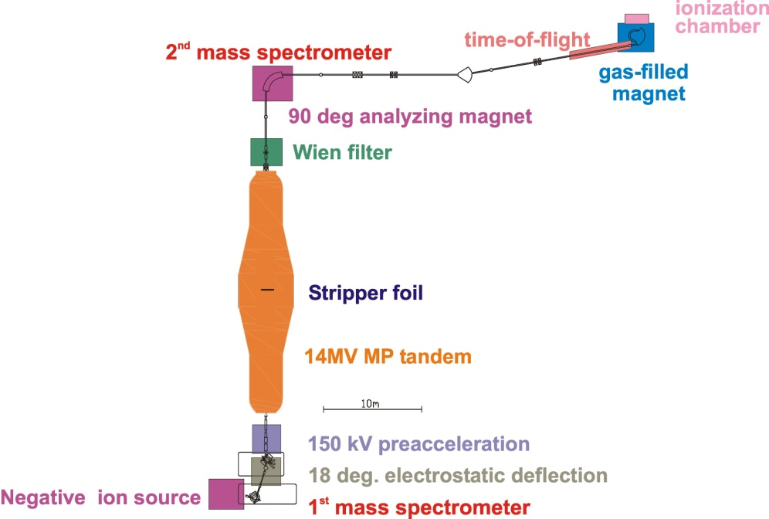
The Gas-filled Analyzing Magnet System
Notes:
18

Slide 19
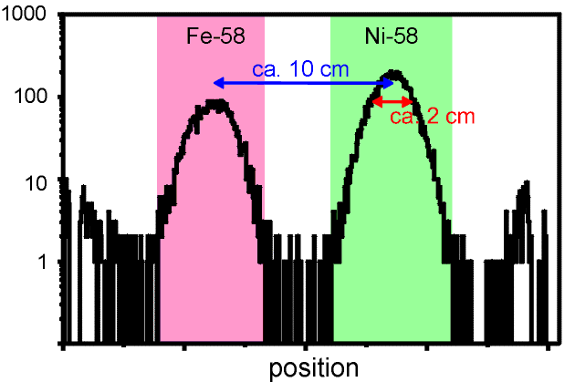
Isobar Separation in a Gas-filled Magnet
magnetic rigidity
in a gas-filled magnet
Notes:
Separation in a GFM – magnetic rigidity can be seen in this formula – if we have a gas the incoming beam interacts with the gas atoms and the charge changing reactions lead to mean charge state – then deflection with a magnet -> separation in position -> place the detector at the right position – block the isobar!
19

Slide 20
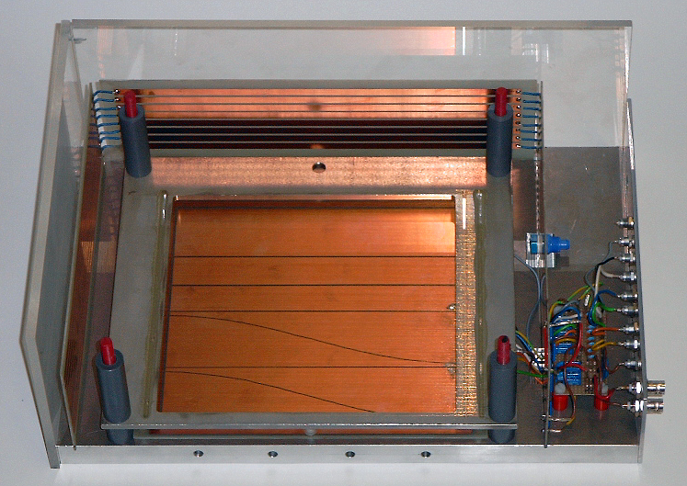
Ionization chamber
Frisch grid: E_{tot}
y-angle: dt
e5
e4
e3
e2r
e2l
position: p
x-angle: dp
e1r
e1l
δE
9 „independent“ signals
Notes:
20

Slide 21
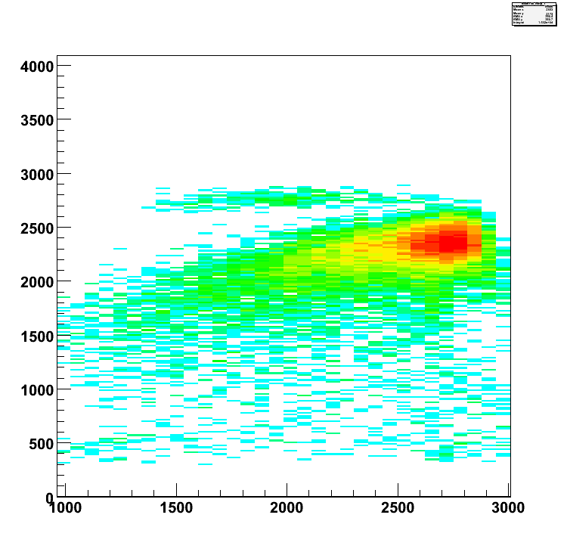
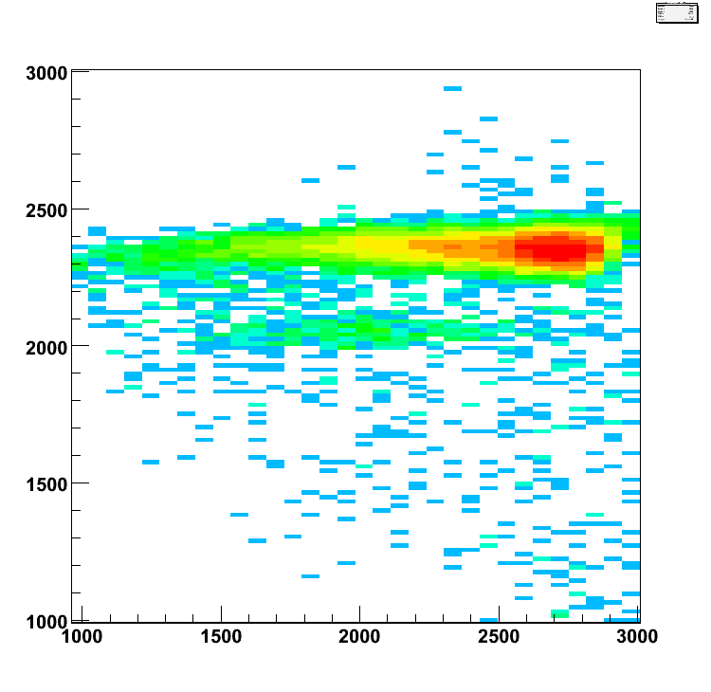
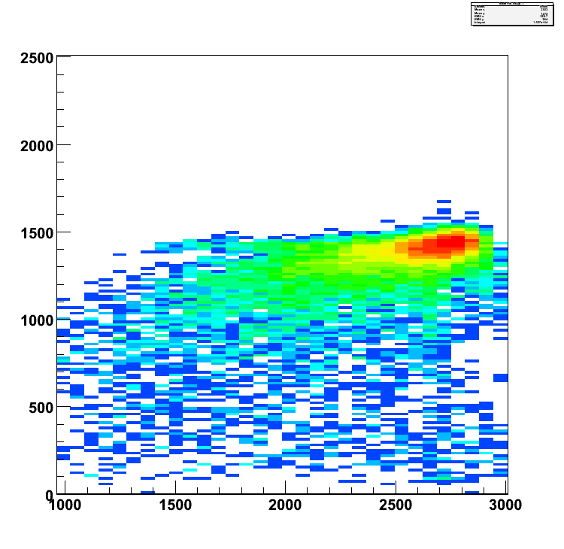
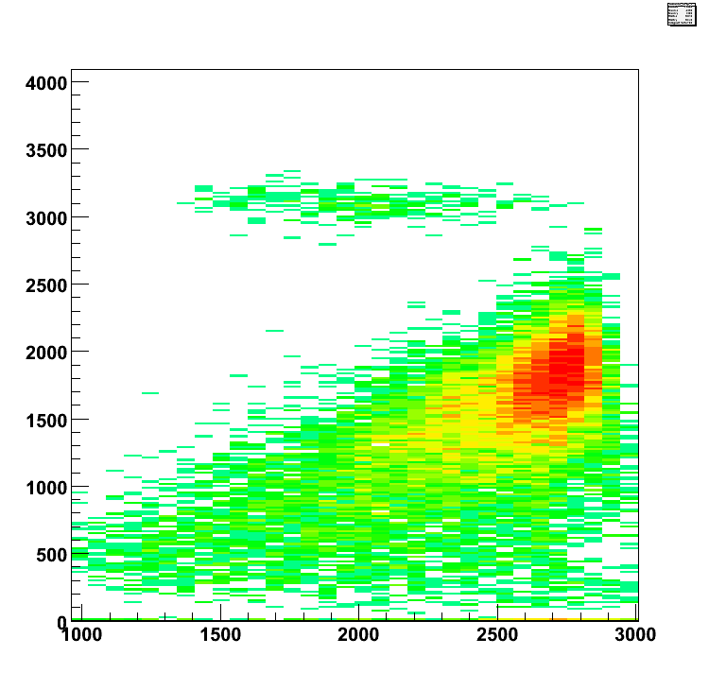
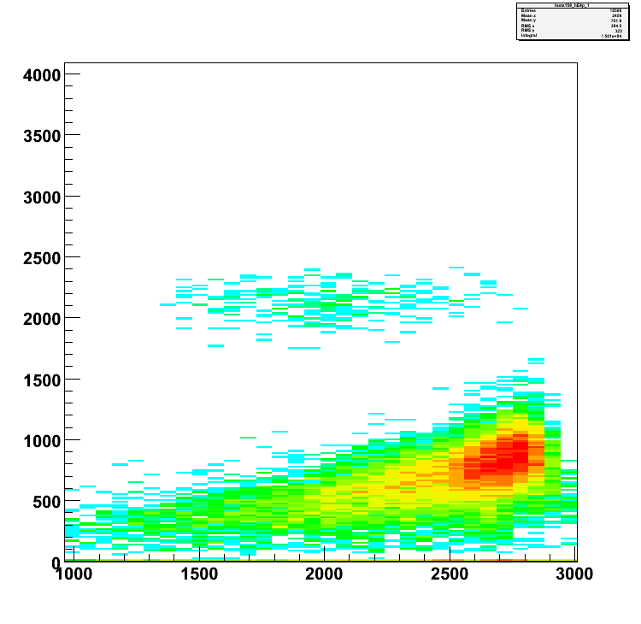
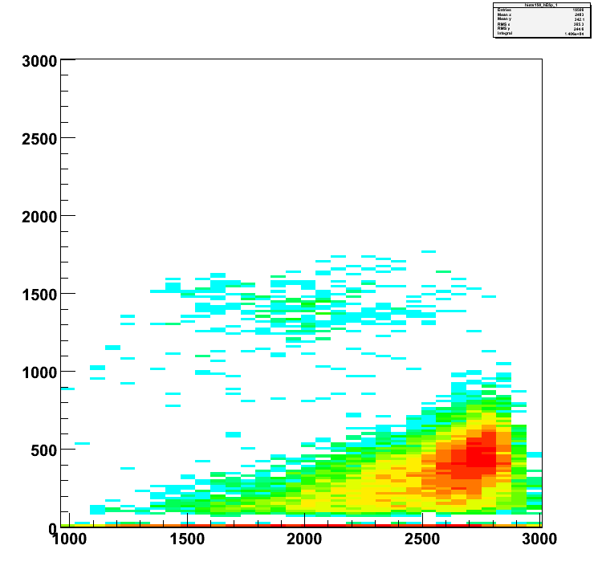
spectra for calibration sample: ⁶⁰Fe/Fe = 5 ·10⁻¹²
Ni/Fe ≈ 10⁻⁵ => ⁶⁰Ni/⁶⁰Fe ≈ 10⁶
E_{tot}
dE1
dE2
⁶⁰Fe
⁶⁰Fe
⁶⁰Ni
⁶⁰Fe
position
position
position
dE3
⁶⁰Fe
dE4
dE5
⁶⁰Fe
⁶⁰Fe
position
position
position

Slide 22
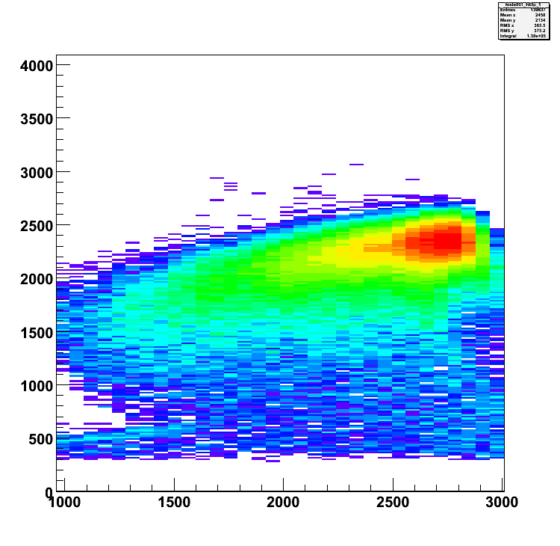
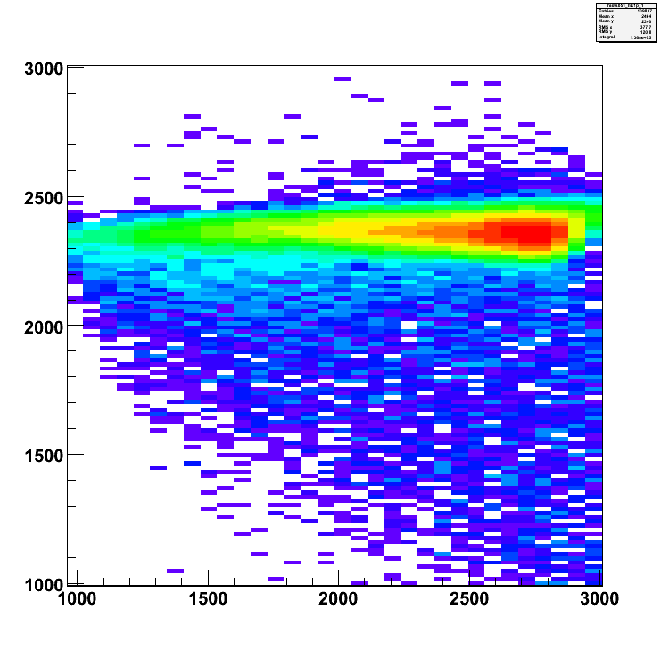
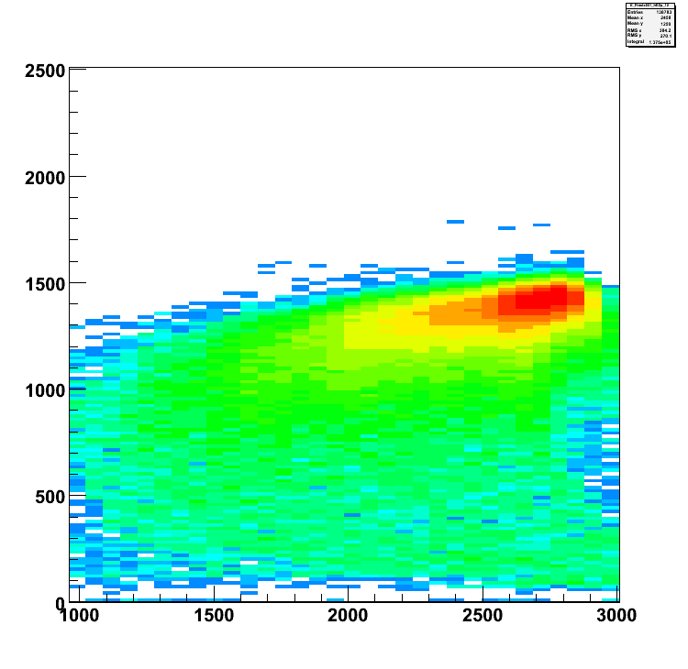
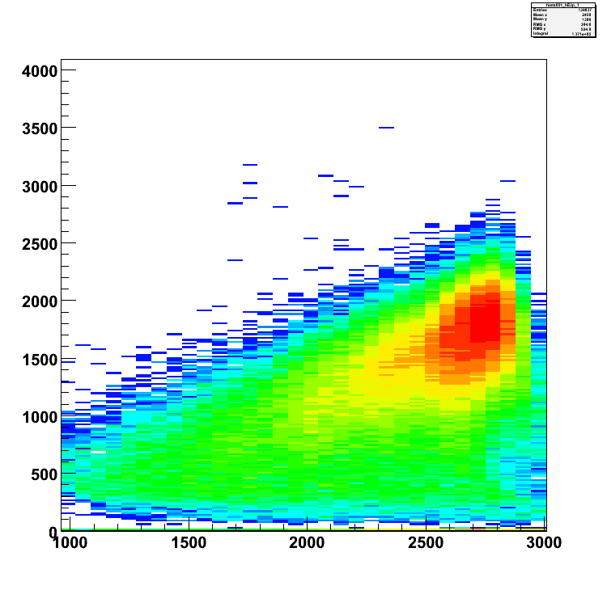
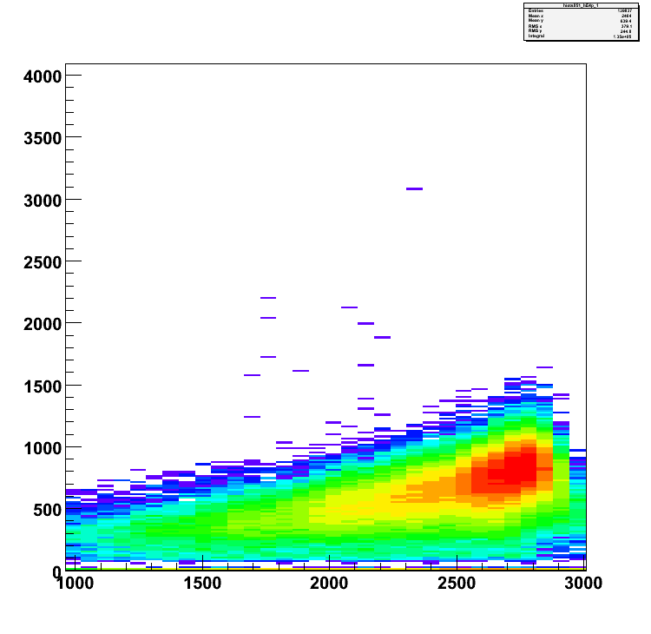
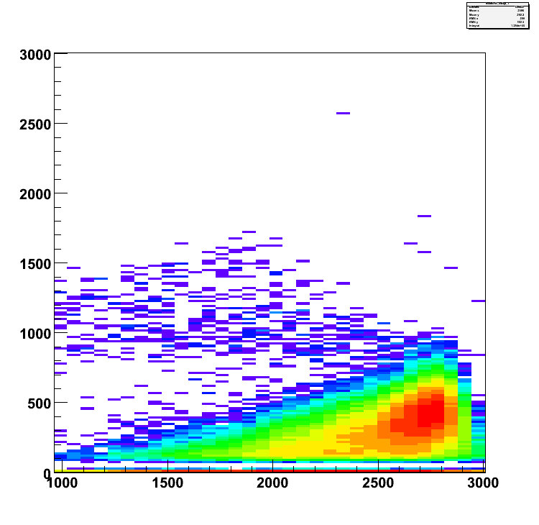
spectra for crust sample: ⁶⁰Fe/Fe ~ 2·10⁻¹⁵
with windows
E_{tot}
dE1
dE2
⁶⁰Fe
⁶⁰Fe
⁶⁰Ni
⁶⁰Fe
position
position
position
dE3
⁶⁰Fe
dE4
dE5
⁶⁰Fe
⁶⁰Fe
position
position
position

Slide 23
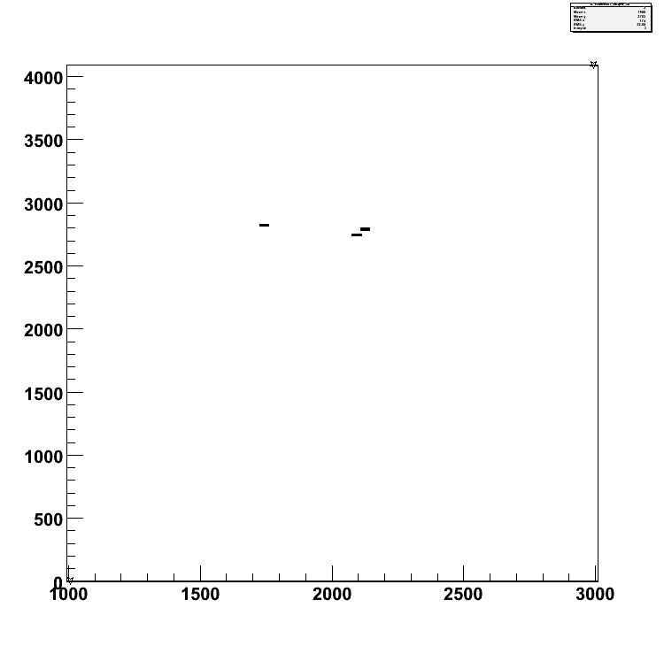
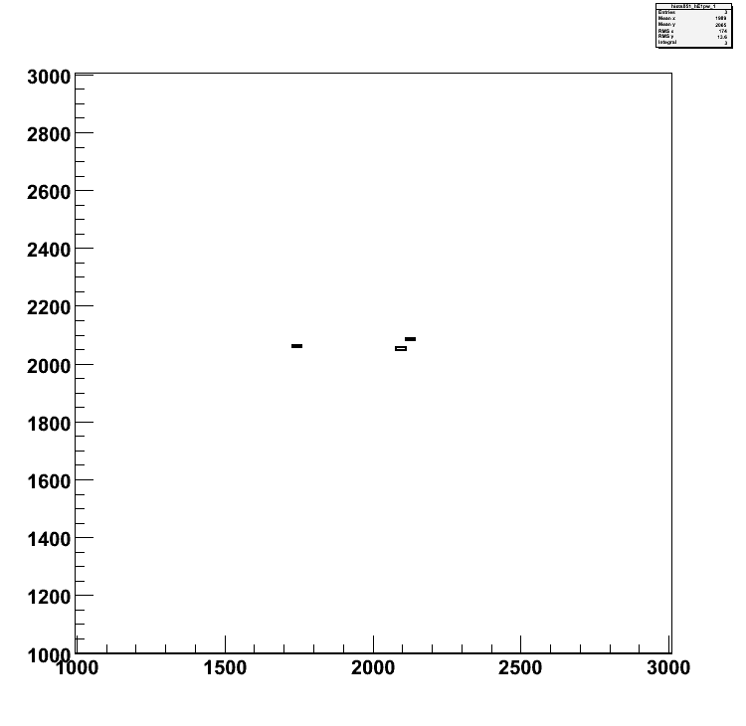
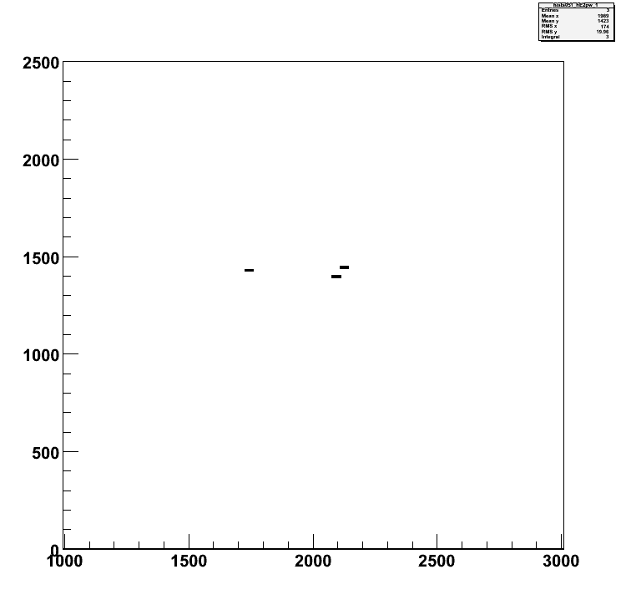
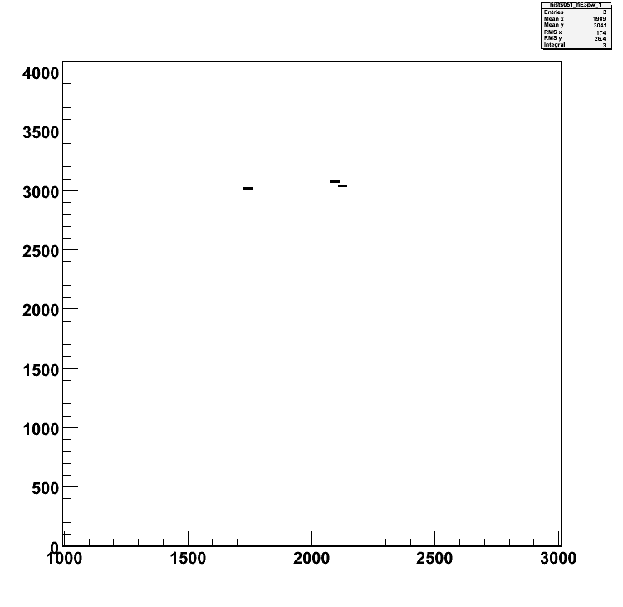
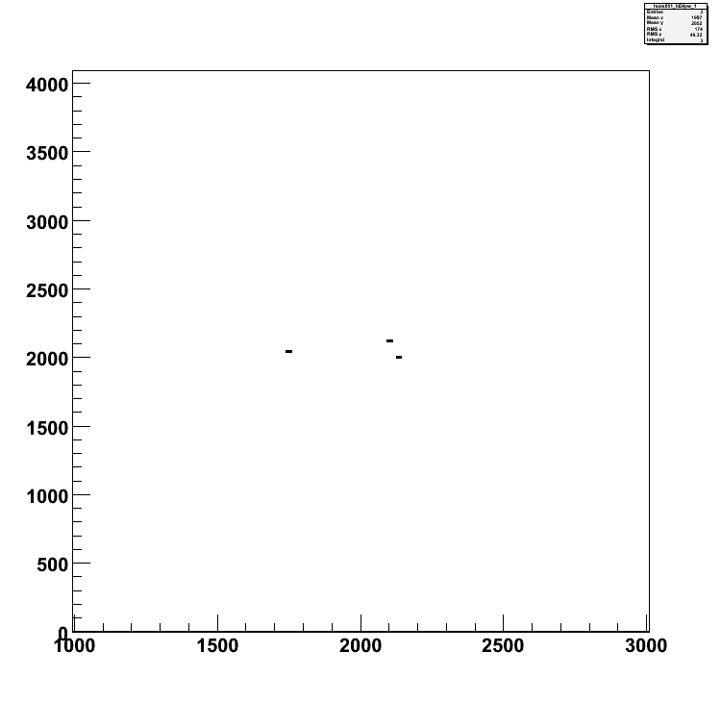
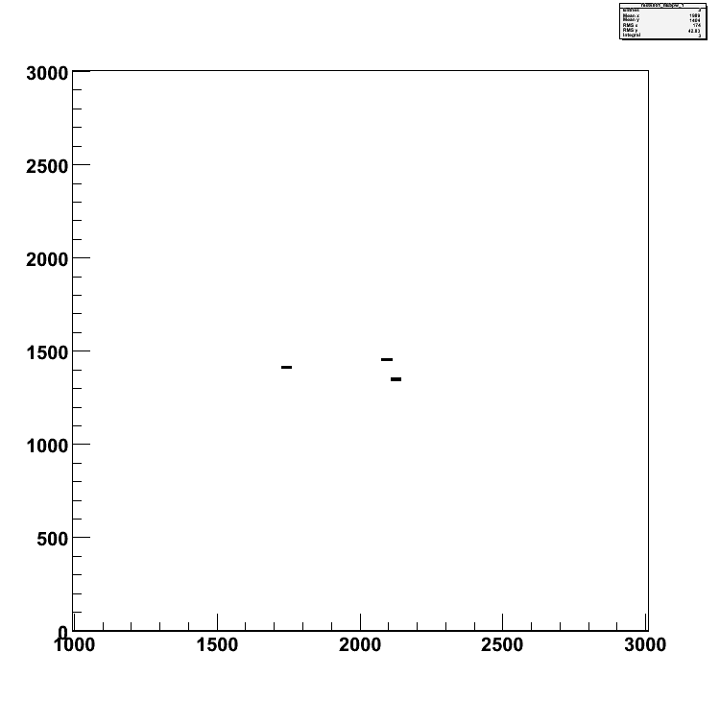
spectra for crust sample: ⁶⁰Fe/Fe = 1.4 ·10⁻¹⁵
with windows
E_{tot}
dE1
dE2
⁶⁰Fe
⁶⁰Fe
⁶⁰Fe
position
position
position
dE3
⁶⁰Fe
dE4
dE5
⁶⁰Fe
⁶⁰Fe
position
position
position

Slide 24
some numbers
1 μA ⁵⁶FeO⁻ => 6·10¹²/sec
transmission 5% => 3·10¹¹/sec
for ⁶⁰Fe/⁵⁶Fe = 10⁻¹⁵ => 3·10⁻⁴/sec = 1event/hour
10 mg ⁵⁶Fe => 10²⁰ atoms
1 μA ⁵⁶FeO⁻ => 6·10¹² atoms/sec
neg. ion yield 10⁻³ => 6·10¹⁵ atoms/sec used
sample lasts for => 1.5·10⁴ sec = 4 hours

Slide 25
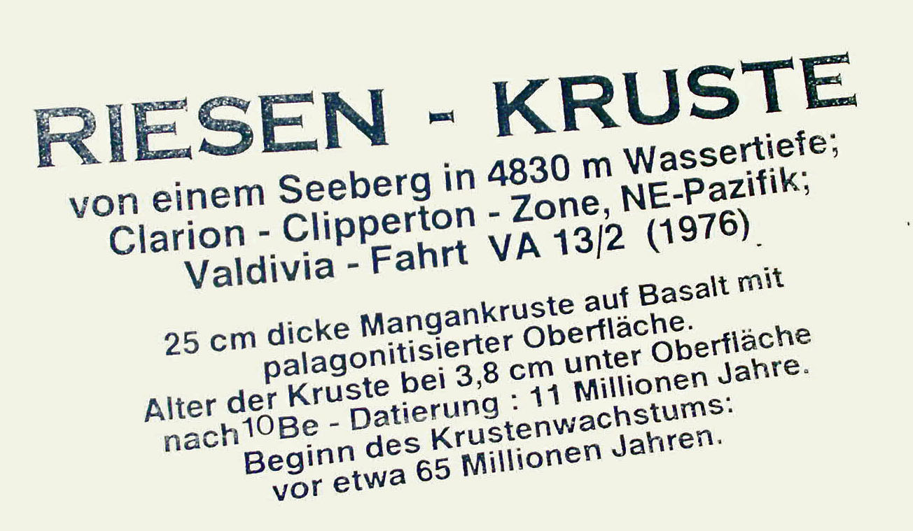
Application:
Manganese Crusts
Notes:
Was suchen wir in Mangankrusten? Welches Signal? Nicht historische Vergangenheit – ist eher ungewöhnlich für Messungen mit Radioisotopen mit langer Halbwertszeit. – ich versuche das zu illustrieren:

Slide 26
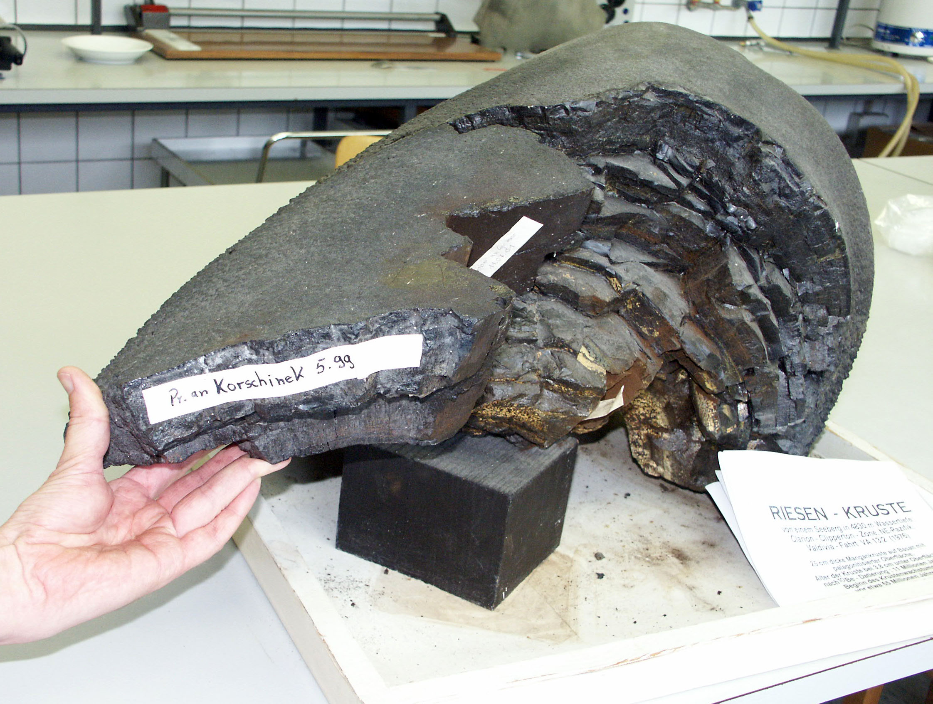
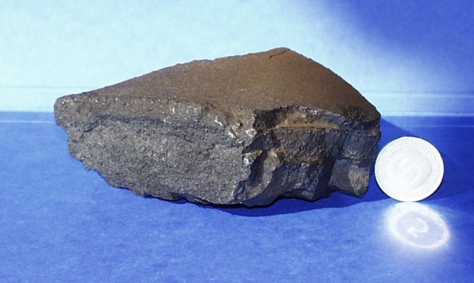
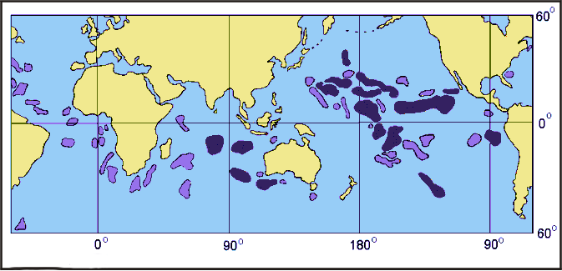
Reservoir: Manganese Crust

Slide 27

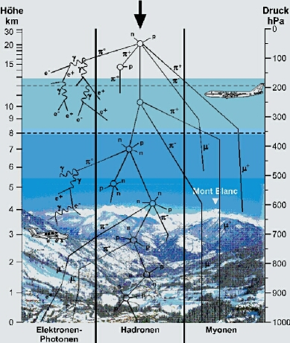
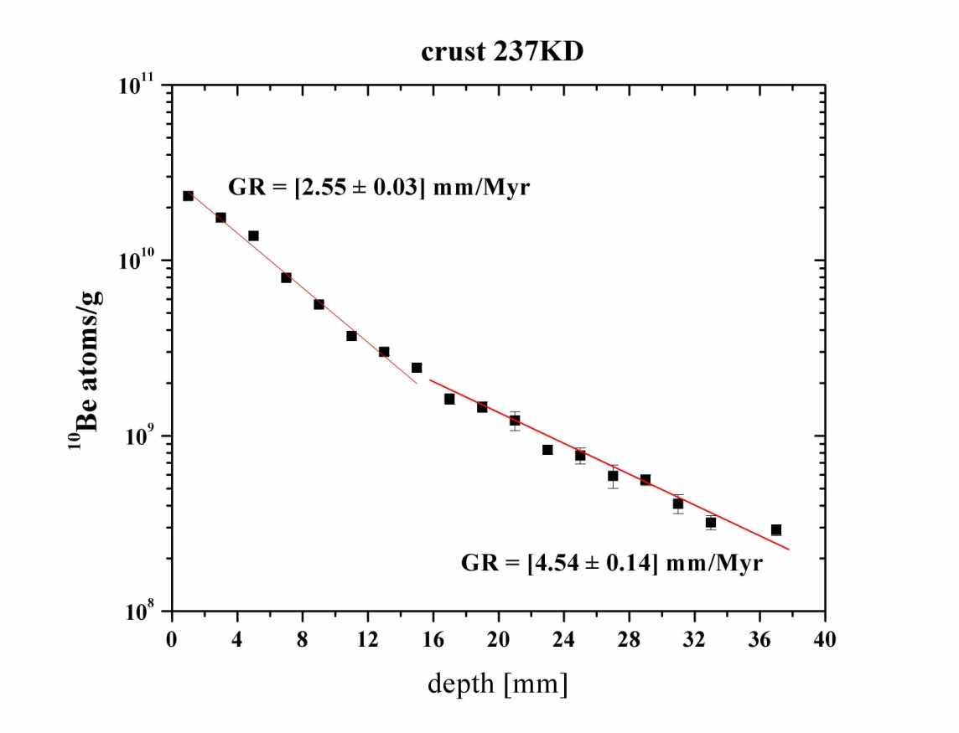
¹⁰Be
¹⁰Be, T_{1/2}= 1.387 Myr
Korschinek et al. NIMB 2010
Chmeleff et al. NIMB 2010

Slide 28
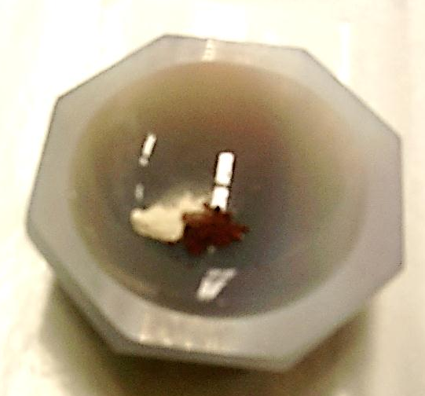
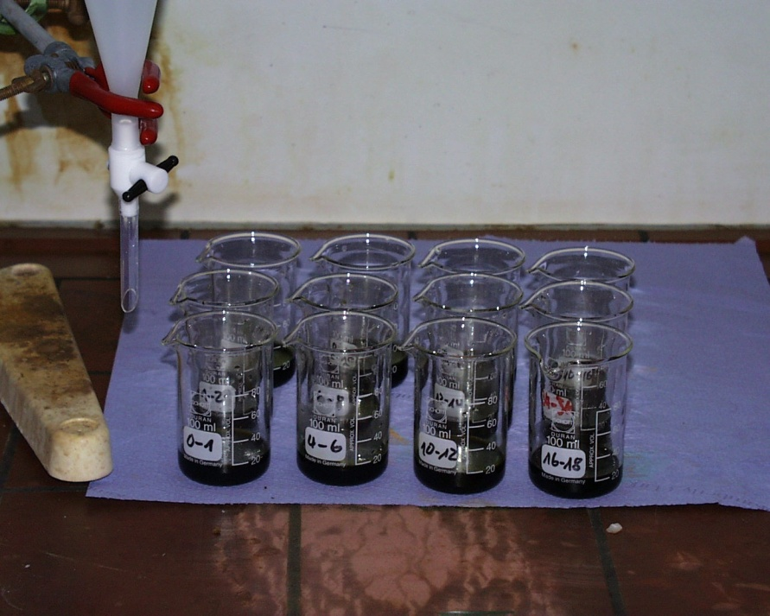
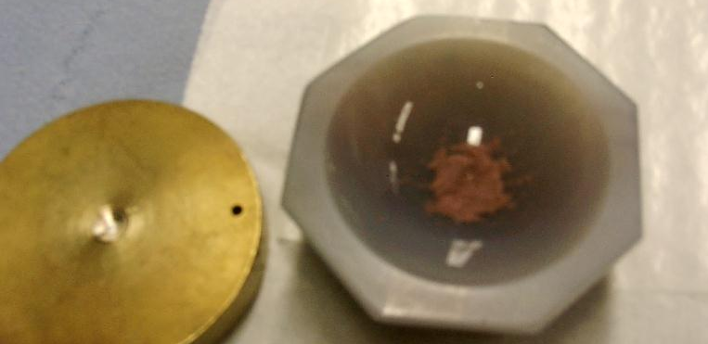
Sample Preparation
Chemical Preparation
1: Whole material
2: Leaching of Fe
Mixing with Ag powder
Layers of 1-2 mm
In Sample holder:

Slide 29







Ionization Chambers
Gas-filled
Analyzing
Magnet
System
Thanks to Iris Dillmann
Time-of-flight setup
(3.19m flight path)
90° Analyzing Magnet
(2nd Mass Separation)
Wien
Filter
3.19m
Wien
Filter
TOF
Stop
135° Magnet
B= 0.6-1.2 T
p= 3.5-7 mbar N₂
m>m_{i}
v<v_{i}
+
TOF
Start
+
−
Faraday
Cup
N
S
m<m_{i}
−
v<v_{i}
v>v_{i}
v>v_{i}
Wien
Filter
N
+
Switching Magnet
−
S
Accelerator Mass Spectrometry
at the
14 MV Munich MP Tandem
Positive
Ions
☹
Carbon
Stripper
Foil
😐
Negative
Ions
(Cs Sputter)
Negative
Ion Source
18° Electrostatic
Deflection
😐
m<m_{i}
☹
m>m_{i}
Sample
90° Injector Magnet
(1st Mass Separation)

Slide 30

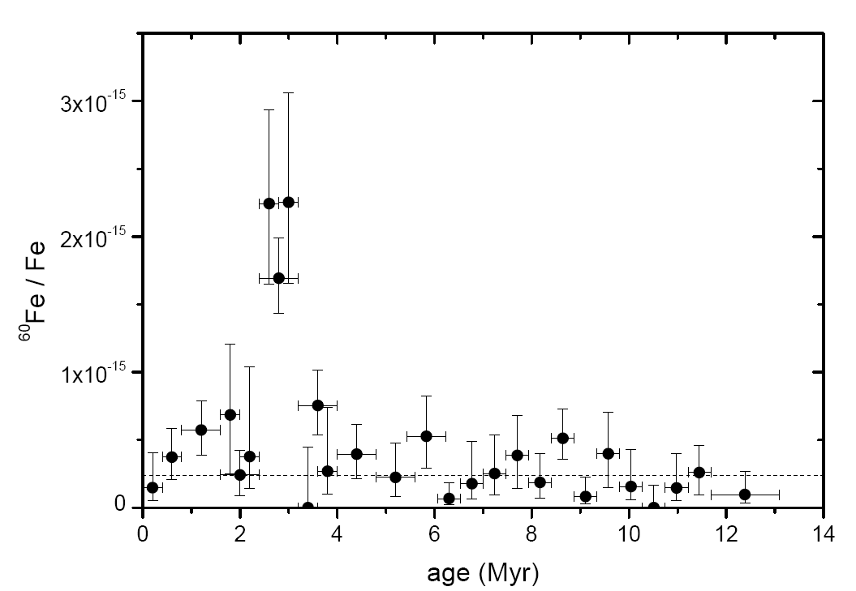
Measurements with GAMS:
Deep See
Ferro-Manganese Crust
Knie et al. PRL 93 (2004)

Slide 31
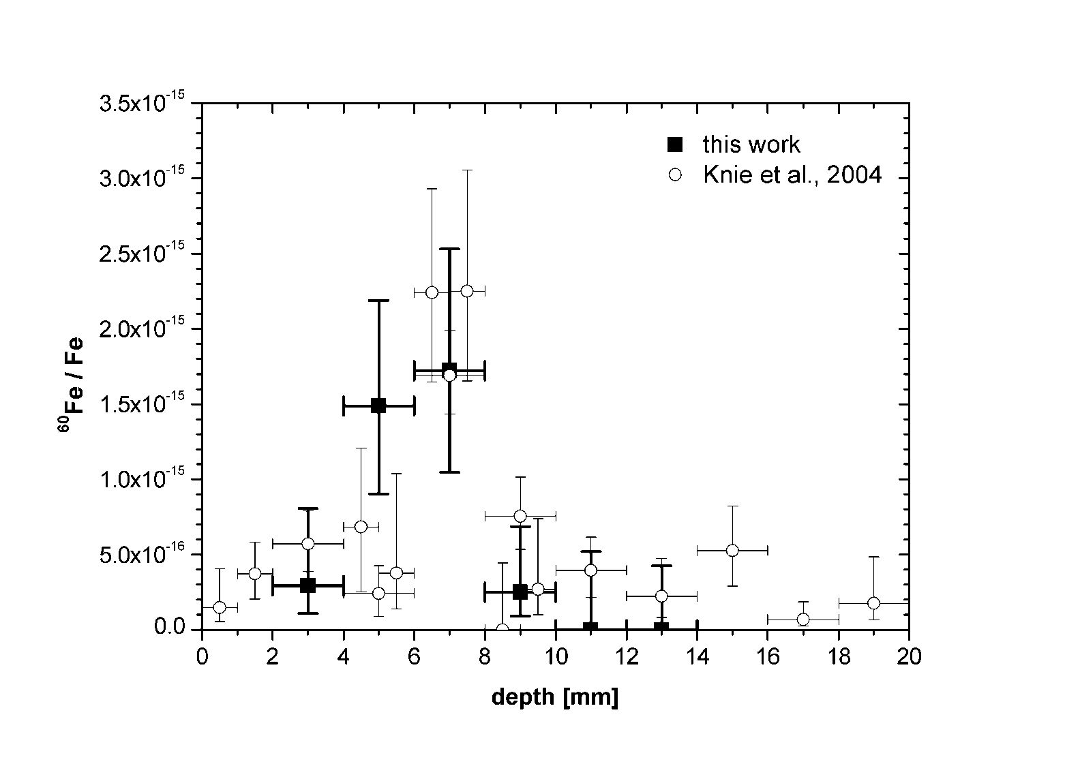
Leaching of the
Ferro-Manganese Crust
The pacific was enriched in ⁶⁰Fe 2.2 Myr ago!
Fitoussi et al. PRL 93 (2008)

Slide 32
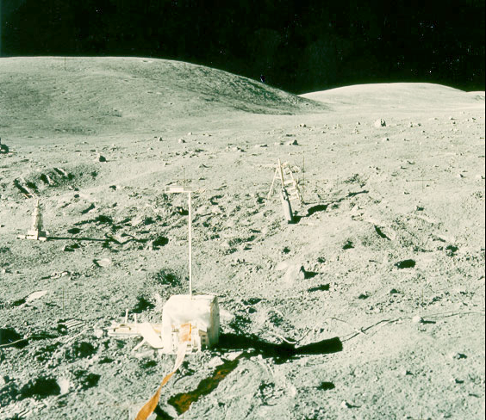

Signal in more reservoirs: Moon
collaboration with
G. Herzog et al. (Rutgers University)
and NASA
First measurement!
D.L. Cook et al., 40th Lunar and Planetary Science Conference (2009), 1129.
Notes:
From lunar compendium meyer et al. 2007 A16drill.pdf
Figure 1: Photo of ALSEP site at Apollo 16 after deep drill core was taken. The drill moter
is in view. Approximate location of drill hole in red. Stone Mountain about 5 km distant.
AS16-113-18367.

Slide 33
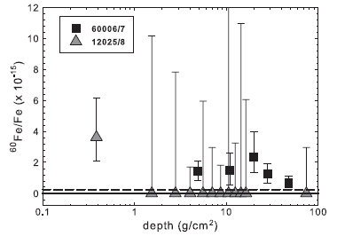
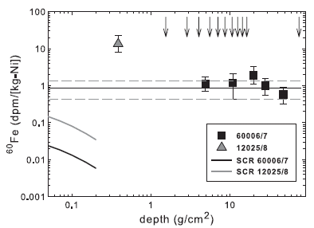
First measurements: ⁶⁰Fe from Lunar Samples
Potential origins:
  Galactic Cosmic Rays
  Solar Cosmic Rays
  Deposition of SN debris
Cook et al, LPSC XXXIX (2009)
Cook et al, LPSC XXXIX (2009)
P_{60Fe-GCR} = (0.88±0.44) dpm/kg Ni
Knie et al, Planetary Science Letters 34, 729 (1999)
P_{60Fe-SCR} = 0.07– 0.45 dpm/kg Ni on the surface
Cook et al, LPSC XXXIX (2009)
Notes:
This graph show the results of 60Fe measurements performed in the year 2005 in the Maier Leibnitz Laboratorium also by our group. The graph on the left show the 60Fe to stable iron. Signal of 60Fe above blank level were observed in all five samples from the core of Apollo 16 and in the uppermost sample from core 12025/8, but not in any of the deeper samples from this core, where no single 60Fe event was detected and only upper limits could be determined.
There are 3 potential origins for 60Fe on the Moon: Production by galactic cosmic rays, production by solar cosmic rays or deposition of SN debris. We can estimate the contribution of GCR by comparing our results with the activity measured in iron meteorites. GCR produce a mean rate of 0.88 dpm/kg Ni (solid line on the right graph, dashed line indicate 1 SD deviation). All five sample from Apollo 16 have activities that are comparable to the range of GCR values in meteorites. Almost all of the other samples had no detectable 60Fe, but the large uncertainties place these results within the range of GCR values.
Calculation have been performed in order to estimate the production rate by SCR. This is greatest at the surface and quickly decreases with depth. No contribution is expected at the depth of the samples from the Apollo 16 core.

Slide 34
AMS at GAMS
Isotope | application | ion in ion out | isobar | isobar Supp. | sensitivity
²⁶Al | astroph. x-section manganese crusts | AlO⁻ Al⁷⁺ | ²⁶Mg | 10⁹ | few 10⁻¹⁵
³⁶Cl | groundwater, meteorites | Cl⁻ Cl¹⁰⁺ | ³⁶S | 10^{9 –} 10¹⁰ | < 10⁻¹⁵
⁴¹Ca | Hiroshima teeth, meteorites | CaH₃⁻,CaF₃⁻ Ca⁹⁺ | ⁴¹K | 10^{9 –} 10¹⁰ | < 10⁻¹⁵ 10⁻¹⁴ CaF
⁴⁴Ti | astroph. x-section | TiO⁻ Ti⁹⁺ | ⁴⁴Ca | 10^{9 –} 10¹⁰ | few 10⁻¹⁵
⁵³Mn | crusts, in-situ, meteorites, sediments, moon rocks | ⁵³MnO⁻ ⁵³Mn¹¹⁺ | ⁵³Cr | 10⁹ | 10⁻¹⁴ – 10⁻¹²
⁵⁹Ni | nuclear waste, meteorites, astroph. x-section (NIMB2007) | ⁵⁹Ni⁻ ⁵⁹Ni¹²⁺ | ⁵⁹Co | 10⁹ | few 10⁻¹⁴
⁶⁰Fe | crusts, meteorites, moon rock, nuclear waste | ⁶⁰FeO⁻ ⁶⁰Fe¹¹⁺ | ⁶⁰Ni | >10¹¹ | few 10⁻¹⁶
⁶³Ni | Hiroshima copper, neutron dosimetry, astroph. x-section | ⁶³Ni⁻ ⁶³Ni¹²⁺ | ⁶³Cu | 10⁸ – 10⁹ | few 10⁻¹⁴
⁷⁹Se, ⁹³Mo,⁹³Zr, ¹⁰⁷Pd | astroph. x-section (Proc. NiC IX 2006), half-life, nuclear waste | various | ⁷⁹Br, ⁹³Nb, ¹⁰⁷Ag | 10⁶ | few 10⁻¹² ? few 10⁻¹⁰ ? ?

Slide 35


AMS Setup in Garching
Andres Arazi
Pankaj Baghel
Shawn Bishop
Iris Dillmann
Thomas Faestermann
Leticia Fimiani
Jose M. Gomez Guzman
Karin Hain
Klaus Knie
Gunther Korschinek
Johannes Lachner
Peter Ludwig
Moumita Maiti
Astrid Meier
Hisham Nassar
Mikhail Poutivtsev
Werner Rühm
Georg Rugel
Anton Wallner
Wien filter 2
1

Slide 36
Accelerator Mass Spectrometry
challenge: isobar separation
luck (e.g. for ¹⁴C⁻ no stable ¹⁴N⁻ ion); X-ray coincidence;
deflection in a gas-filled magnet
chemistry
specific energy loss
absorber foil and ESA
(electrostatic analyzer)
DREAMS
Example (¹⁰Be and ¹⁰B):
m(¹⁰Be)= 10.0135 AMU (T_{1/2} = 1.387 Myr)
m(¹⁰B) = 10.0129 AMU (stable)
Δm: 6 × 10⁻⁵
Notes:
Again challenge of AMS – isobar separation!
Different methods – most famous –wide applications for AMS C-14 luck – understanding the whole process many disciplines involved to make the ultrasensitive measurements
As an example – worst case looking for an radionuclide in a matrix of the isobar!

Slide 37



Dresden AMS facility - DREAMS
AMS detection system
AMS ion sources

Slide 38


Ion Beam Center at Helmholtz-Zentrum Dresden-Rossendorf
New 6 MV accelerator
10 m
Chambers
Magnets
Accelerators
Ion sources
Beam lines

Slide 39

6 MV Tandetron for AMS, IBA and HEII
AMS section
6 MV Tandetron
AMS injector
Ion implantation
section
IBA & II injector
90°- AMS analyzing magnet
IBA analyzing magnet
Faraday cups for ⁹Be, ¹²C, ¹³C, ²⁷Al, ⁴⁰Ca, ³⁵Cl, ³⁷Cl, ¹²⁷I, …
10 m
AMS sputter sources
Absorber foil for isobar suppression
35° ESA
Installed in 2009-2010
30° vertical magnet
Terminal voltage: 0.3 - 6.0 MV
Maximum TV: 6.6 MV
Terminal voltage stability: ~ 10⁻⁵
Gas ionization detector
Automatic
wafer handling system
for HE ion implantation

Slide 40


AMS ion source:
Cs sputter ion source SO-110 (HVEE)
1 cm
Cooled base
AMS target holder
Insulator
Ionizer
Cathode
Negative Ions
Extractor
Magnetic
manipulator
(HV insulated)
Insulator
Ionizer shroud
Cs - Vapor
20 cm
20 - 30 kV
Extraction voltage
3 - 10 kV
Sputter voltage
Wheel for 200 samples (4 x 50)

Slide 41

AMS ion injector
Better precision by an
sequentially isotope injection by a
bouncer magnet
Bouncer magnet
Magnet chamber
on high potential: up to ±3 kV
Switching frequency: ~100 Hz
stable nuclide: 100 µs
Radionuclide: 10 ms
Waiting: 400 µs
X-Slit
54° ESA
AMS-Source

Slide 42
6 MV Tandetron for AMS, IBA and HEII
AMS section
6 MV Tandetron
AMS injector
Ion implantation
section
IBA & II injector
90°- AMS analyzing magnet
IBA analyzing magnet
Faraday cups for ⁹Be, ¹²C, ¹³C, ²⁷Al, ⁴⁰Ca, ³⁵Cl, ³⁷Cl, ¹²⁷I, …
10 m
AMS sputter sources
Absorber foil for isobar suppression
35° ESA
30° vertical magnet
Terminal voltage: 0.3 - 6.0 MV
Maximum TV: 6.6 MV
Terminal voltage stability: ~ 10⁻⁵
Gas ionization detector
Automatic
wafer handling system
for HE ion implantation

Slide 43

AMS facility: high energy side
90°-AMS magnet
Aperture 4
Quadrupole
triplet lens
Faraday cup chamber
Fixed FC (for ¹²C)
Moveable FC
Absorber foils
Quadrupole lens
35°-elektrostatic analyzer (ESA)
Quadrupole lens
30° vertical magnet
Faraday cup
Detector (Gas ionization chamber)

Slide 44

AMS facility: measurement of stable isotopes
High precision moveable FC for stable isotopes and energy stabilization
Slit system for HV stabilization in the moveable FCs
90°-AMS magnet
Fixed FC
Moveable FC
fixed Faraday cup
Faraday cup chamber
2 moveable Faraday cups
Radioisotope path
to absorber foil and 35°-ESA

Slide 45


Isobar suppression
Main interest at DREAMS: ¹⁰Be, ²⁶Al, ³⁶Cl, ⁴¹Ca and ¹²⁹I
¹⁰Be - ¹⁰B
absorber foil and 35° ESA for isobar suppression
³⁶Cl - ³⁶S
Foil thickness:
1 µm, 500 nm, 200 nm
Faraday cups
Si₃N₄- absorber foil holder
Beam
Q-lens
35°- ESA
Si₃N₄- absorber foil set

Slide 46


AMS detector
Vertical 30°-magnet and gas ionization detector
Gas: Isobutene (8 - 40 mbar)
4 anodes: ΔE₁, ΔE₂, ΔE₃, E_{rest}
Window: 75 nm thick silicon nitride (8x8 mm²)

Slide 47
AMS detector
Gas ionization detector with 4 anodes
A B C D Anodes
Ions
Gas ionization
Isobutane C₄H₁₀
Ions
³⁶Cl
³⁶S
10 cm
HVEE
Isobutene, 17.5 mbar
Detector without housing

Slide 48
Test with ¹⁰Be samples
current dependence: NIST 4325 standards

Slide 49

Replica measurements of ¹⁰Be isolated from material originating from the LL chondrite Dhurmsala
Notes:
Fig. 3: Replica measurements of 10Be isolated from material originating from the LL
chondrite Dhurmsala (Fragment 2/3A, ~70 g without ~1 g of metal, homogenised to size fraction of <125 μm [NEU93]. AMS targets have been prepared at four chemistry labs (U of Cologne, U Hanover, Rutgers U, PRIMELab) by eight scientists (M. Altmaier, W. Klas, M. Knauer, B. Meltzow, S. Merchel, J. Mokos, U. Neupert, C. Schnabel) [MER98 and references therein]. AMS measurements have been performed from 1994-1998 at ETH Zurich (values adapted to new half-life and standard values [KUB10]) and PRIMElab. The new DREAMS 10Be value is from BeO prepared in 2011 from ~150 mg of the same Dhurmsala fraction.

Slide 50
Current performance data DREAMS (2010/2011)
¹⁰Be
²⁶Al
³⁶Cl
⁴¹Ca
¹²⁹I
currents (µA)
terminal voltage (MV)
stripped to
extraction as
BeO⁻ Al⁻ Cl⁻ CaF₃⁻ I⁻
2 - 7 0.2 - 0.5 20 - 30 0.15 - 0.2 3 - 5
4.5 2.7 6.0 5.8 5.0
Be²⁺ Al³⁺ Cl⁵⁺ Ca⁴⁺ I⁵⁺
total transmission (%)
(with absorber foil)
Be⁴⁺ Cl¹¹⁺
58 35 26 16 9
only absorber foil
36
12
total with absorber foil
21
3
suppression factor
2·10⁶
7·10³
background
precision (%)
4.5·10⁻¹⁶ 8·10⁻¹⁶ 3 ·10⁻¹⁵ 8 ·10⁻¹⁵ 2 ·10⁻¹³
0.7 2.3 2.7 2.5 1.2
(at 10⁻¹²) (at 10⁻¹²) (at 10⁻¹²) (at 10⁻¹¹) (at 10⁻¹¹)
*no AgBr backing! Ni cathodes with Ni pins

Slide 51

Thanks to the AMS group at HZDR (DREAMS)
Sh. Akhmadaliev,
S. Pavetich, S. Merchel

Slide 52

New Isotopes ?
First: Look into the
Ion Cook Book
Scanned version available under:
http://tvdg10.phy.bnl.gov/
COOKBOOK/
Find someone for your DREAMS to become true !

Slide 53
Thank you for your attention !

