Slide 1
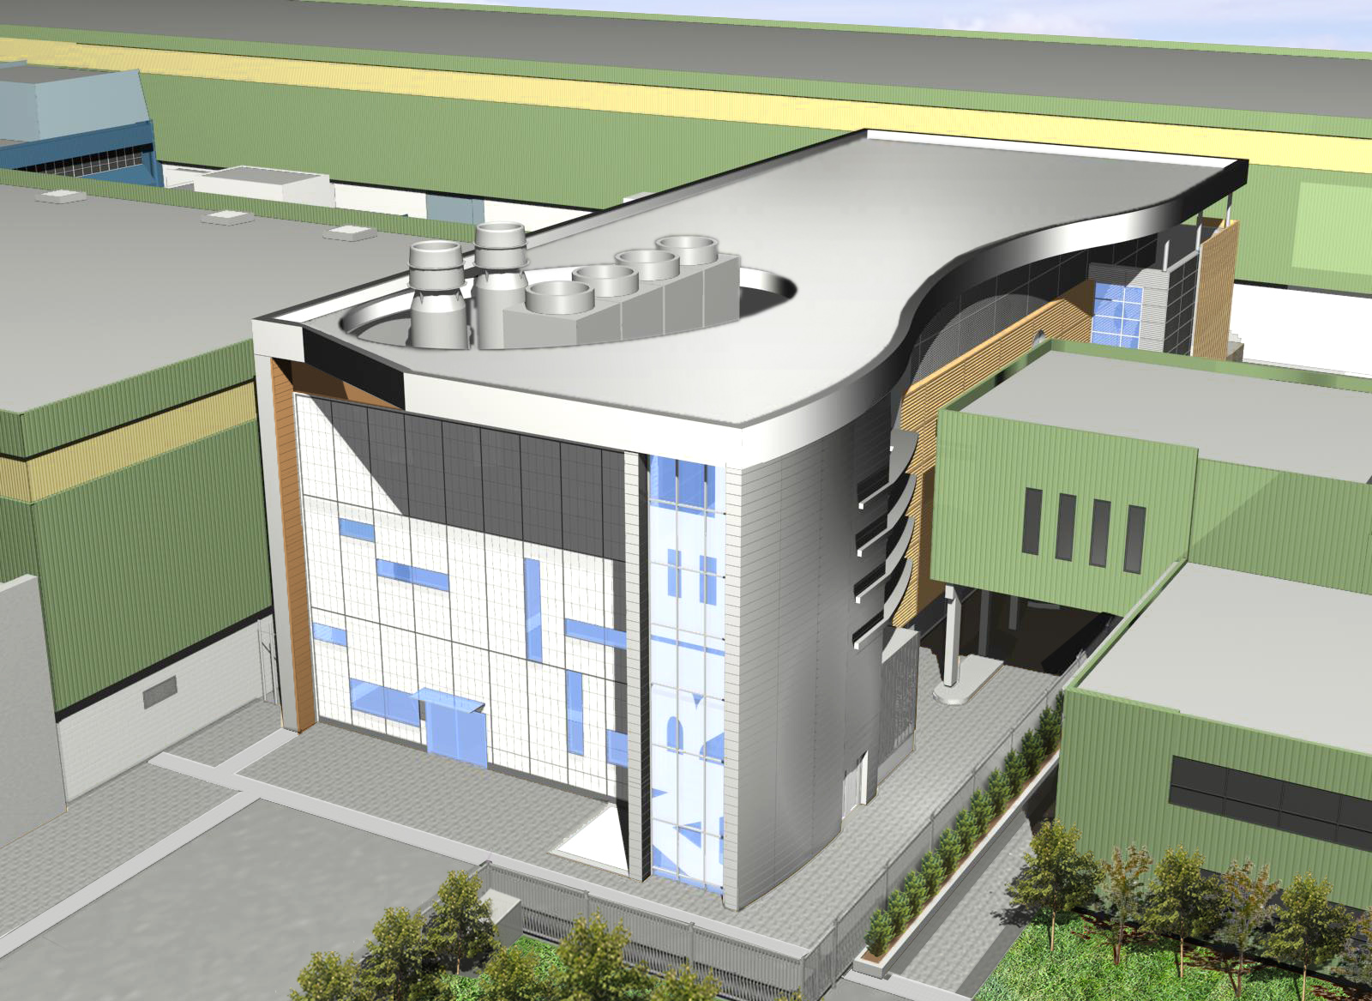
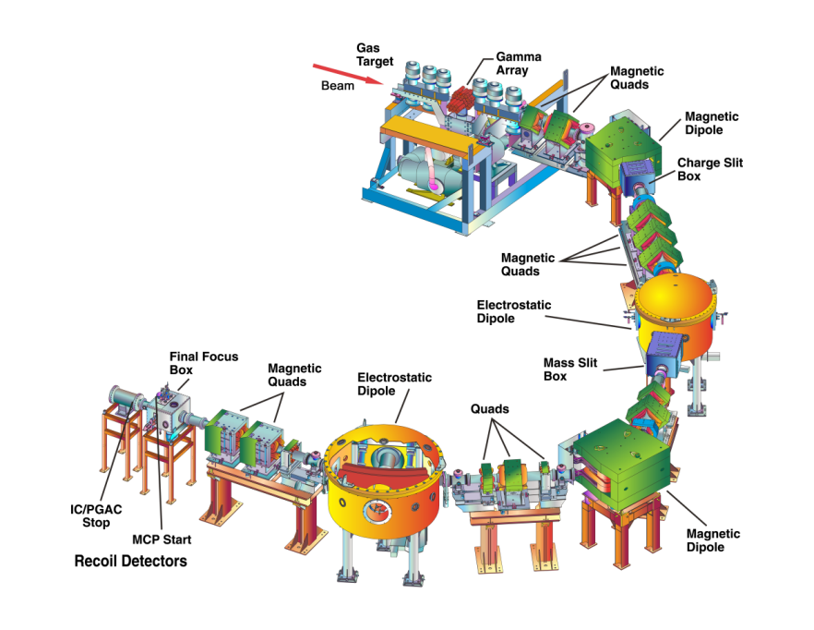
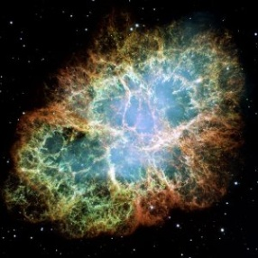


Nuclear Astrophysics with
Rare Isotope Beams at TRIUMF
Feb. 9, 2012
Reiner Krücken
Science Division | TRIUMF
Department of Physics and Astronomy | University of British Columbia

Slide 2
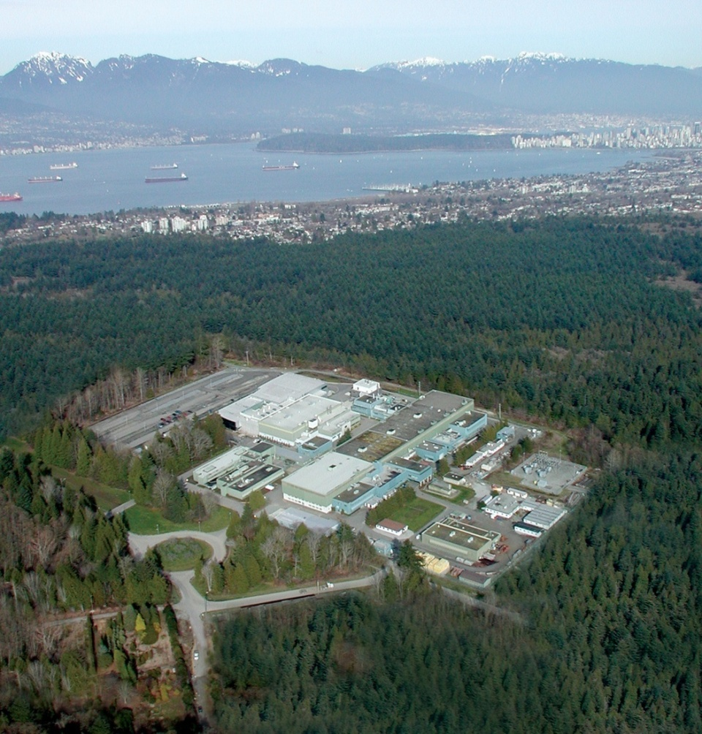
TRIUMF: A National Science Laboratory
Members
University of Alberta
University of BC
Carleton University
University of Guelph
University of Manitoba
Université de Montréal
Queen’s University
Simon Fraser University
University of Toronto
University of Victoria
York University
Associate Members
University of Calgary
McMaster University
University of Northern BC
University of Regina
Saint Mary’s University
University of Winnipeg
Research focus:
Advancing isotopes for science & medicine
Probing the structure & origins of matter
TRIUMF is owned & operated by a consortium of 17 universities
Founded 42 years ago in Vancouver

Slide 3
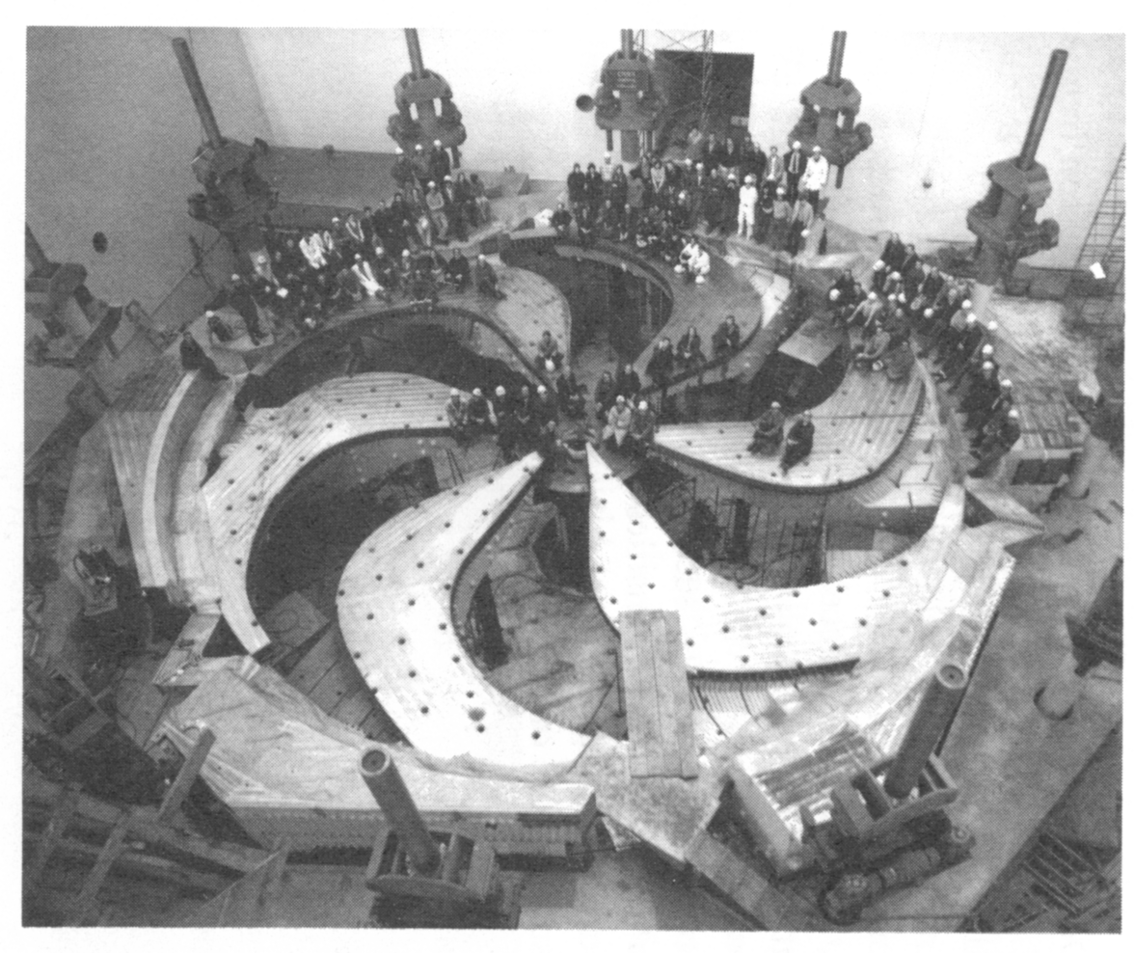
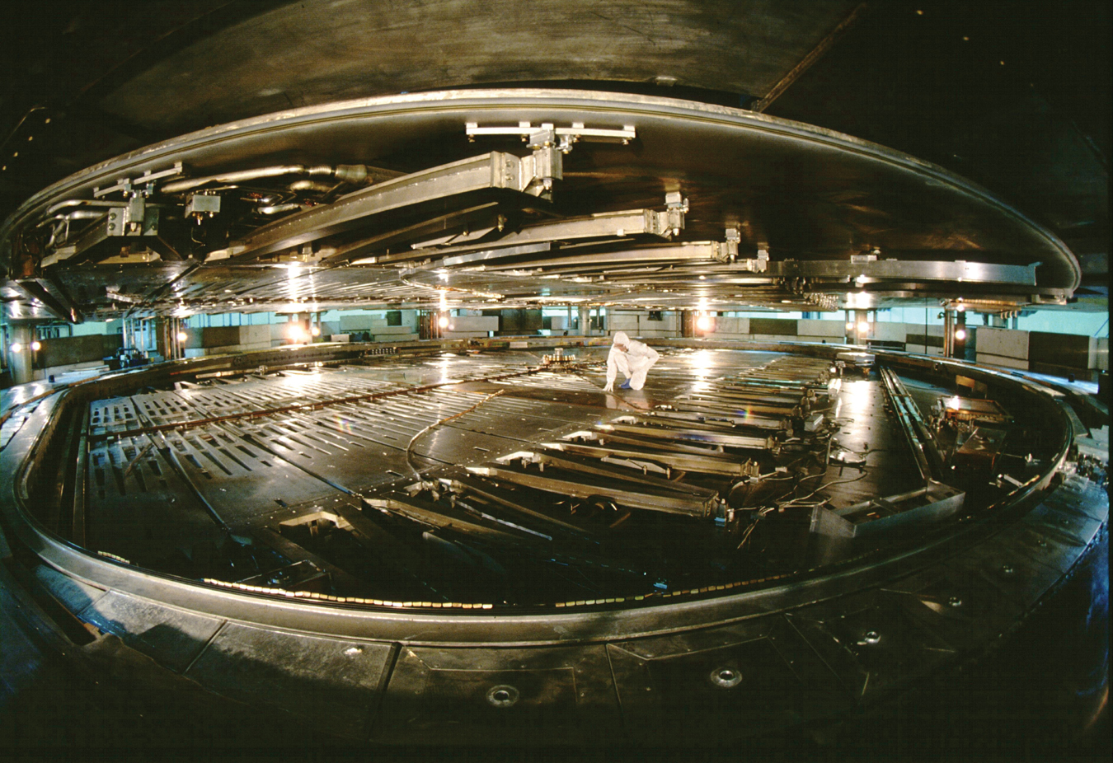
TRIUMF’s 500 MeV cyclotron

Slide 4
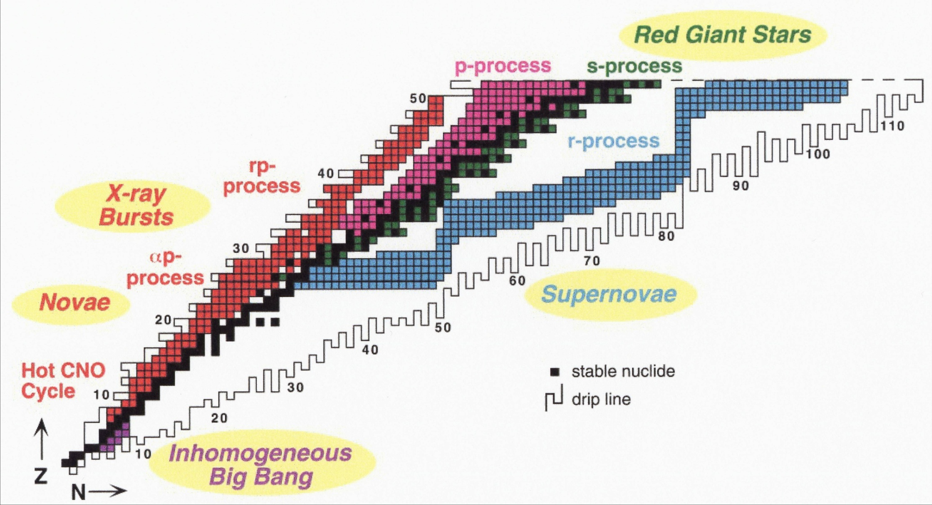
Nucleosynthesis processes
M.S. Smith and K.E. Rehm,
Ann. Rev. Nucl. Part. Sci, 51 (2001) 91-130

Slide 5
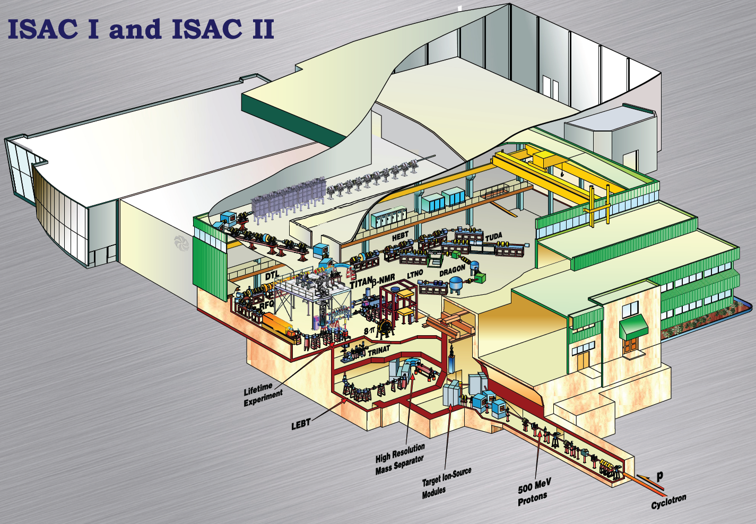
ISAC rare isotope facility
ISOL facility with highest primary beam intensity (100 μA, 500 MeV, p)
ISAC I: 60 keV & 1.7 AMeV ISAC II: > 6 AMeV for A<150
Programs in
Nuclear Structure & Dynamics
Nuclear Astrophysics
Electroweak Interaction Studies

Slide 6
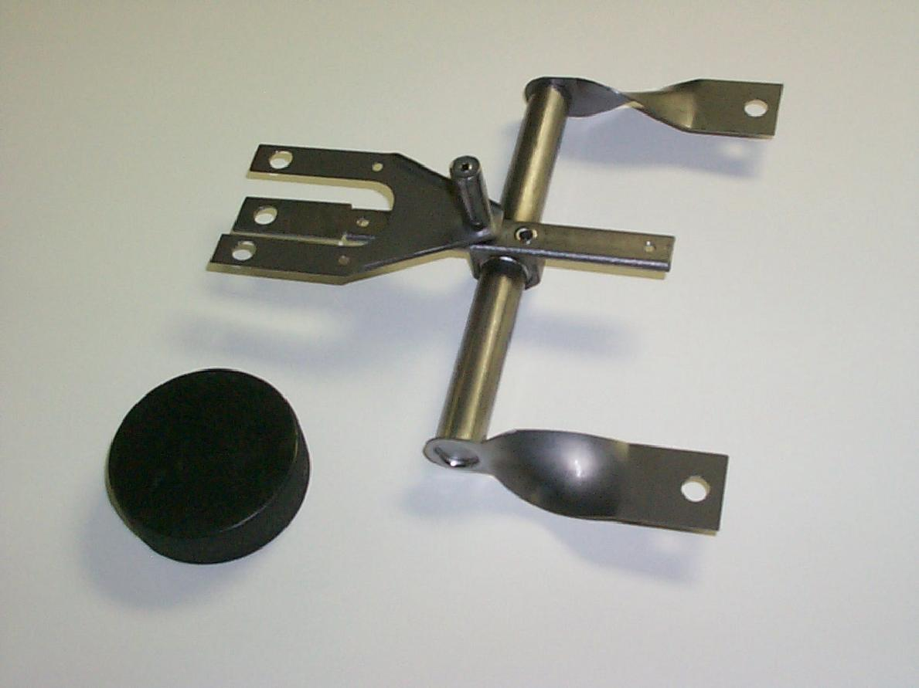
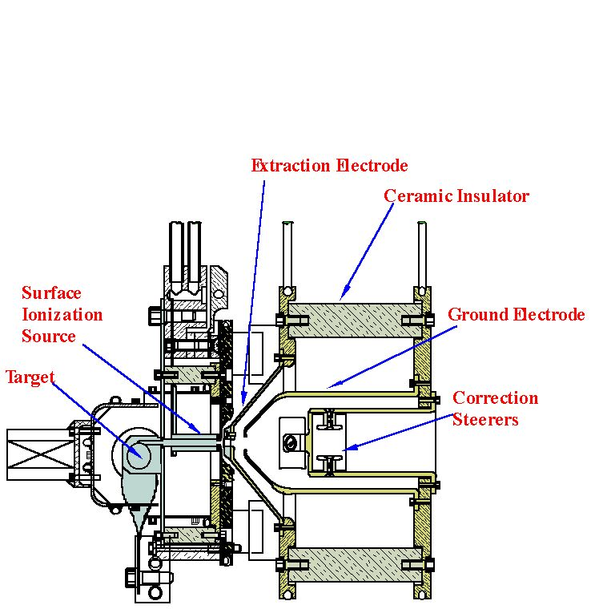

ISAC Production Target
Ta
SiC
ZrC
Nb
UC
UO
Ion Sources:
Surface
FEBIAD
RILIS
Extracted ion beam <60 keV
500 MeV
Proton Beam
×
To Mass
Separator

Slide 7
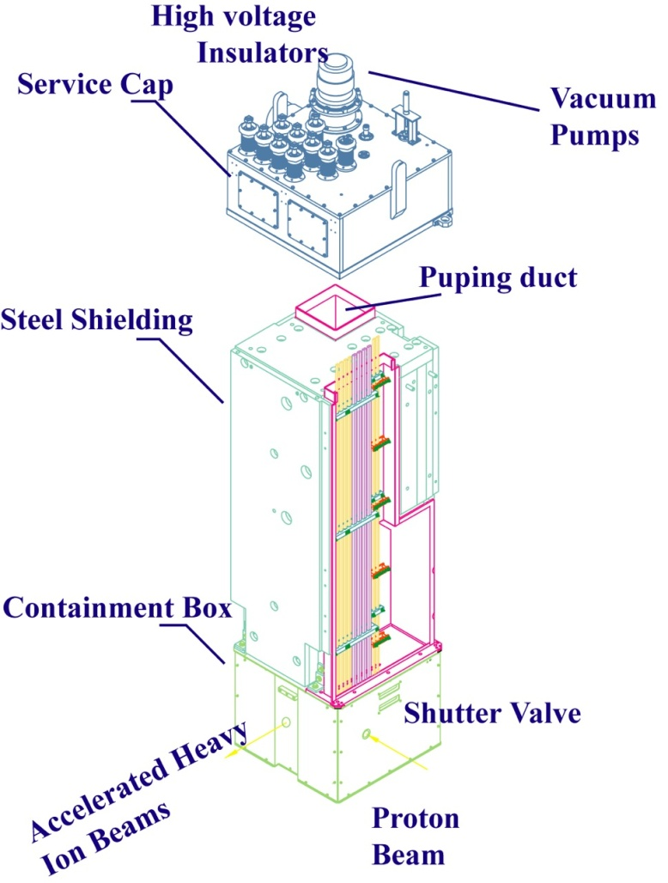
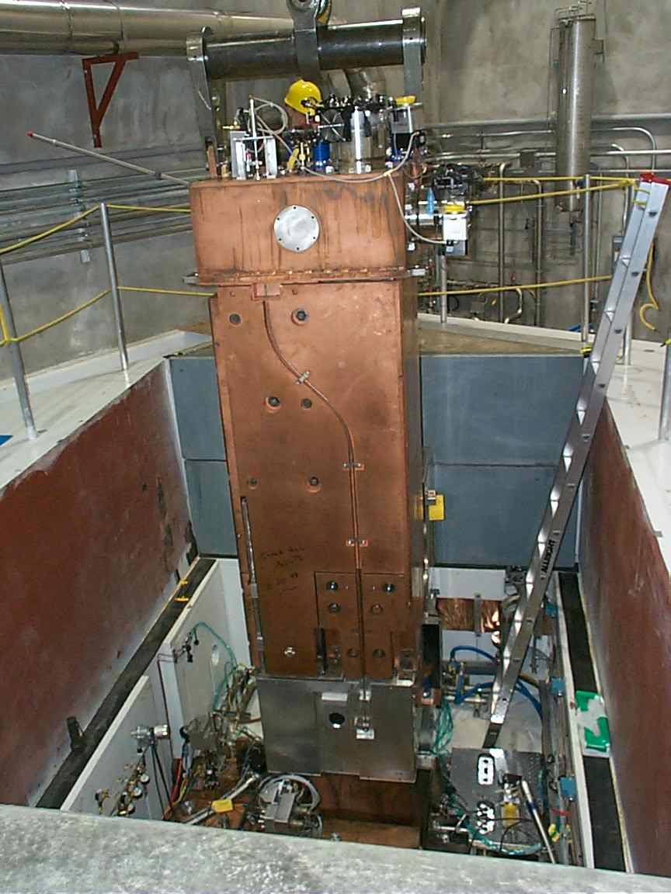
Target Module

Slide 8
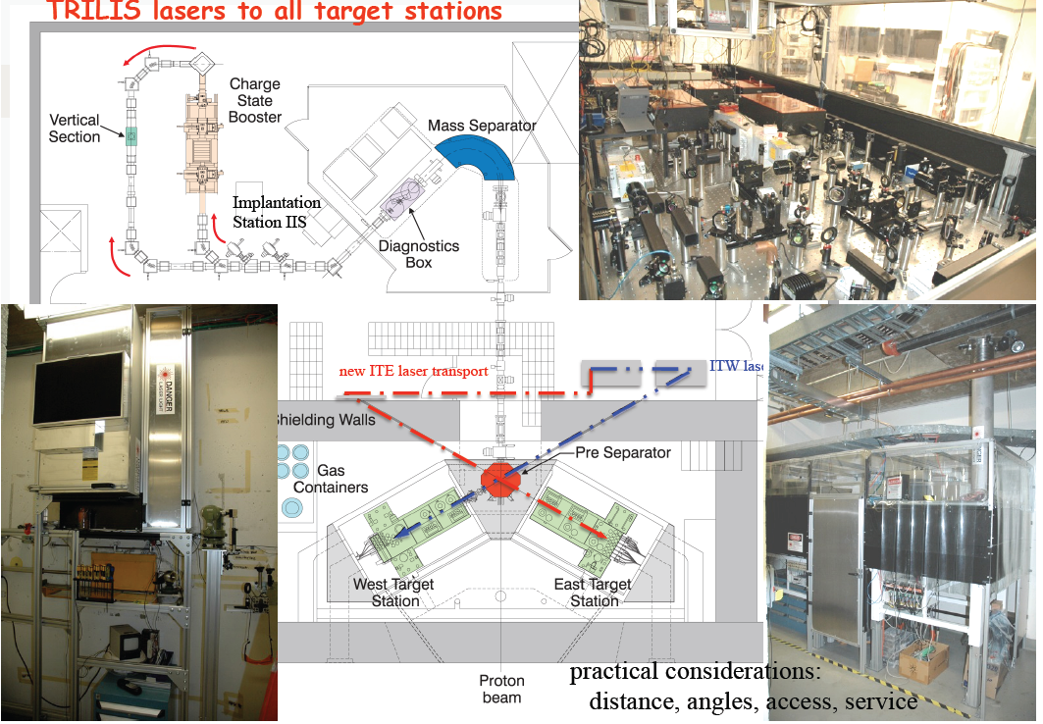
2011 TRILIS in East and West

Slide 9
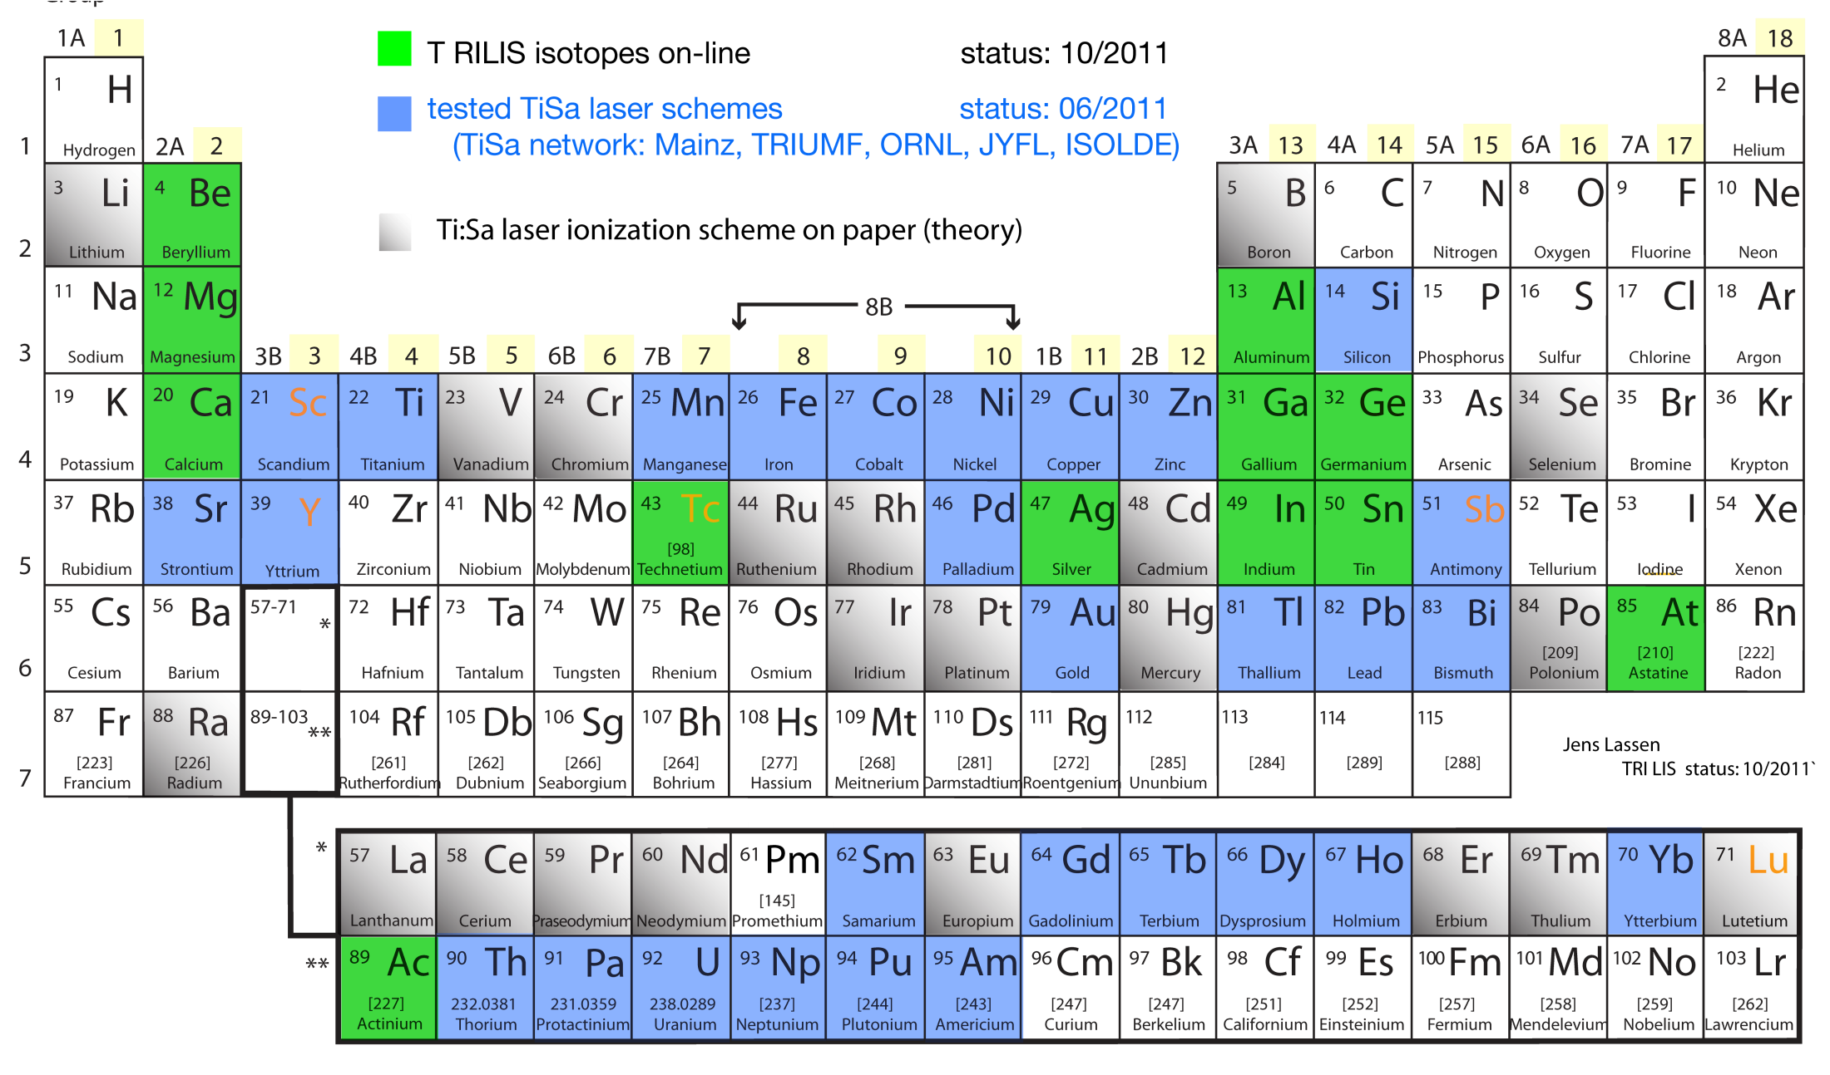
TRILIS RIB Development
2011 T RILIS RIB’s: Be, Ca, Mg, Al, In, Ge, Ac, Tc, At
2011 off-line developments: Sc, Y, Sb
Jens Lassen | TRIUMF Resonant Ionization Laser Ion Source

Slide 10
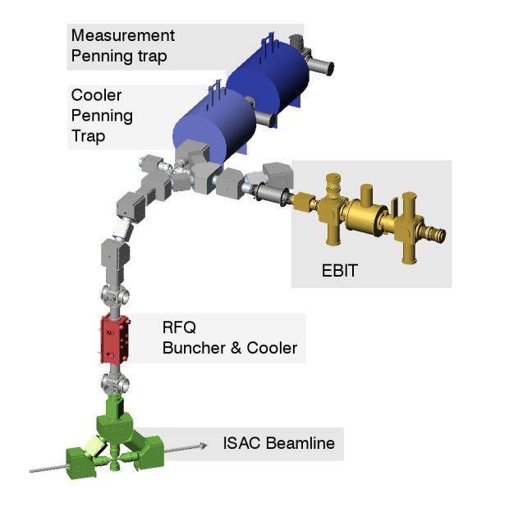
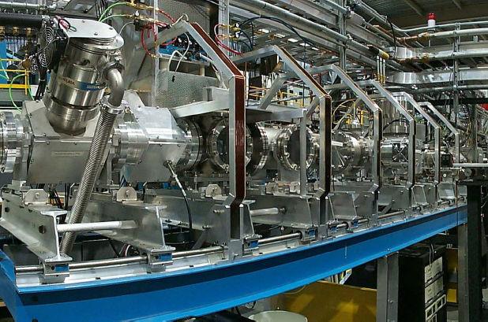
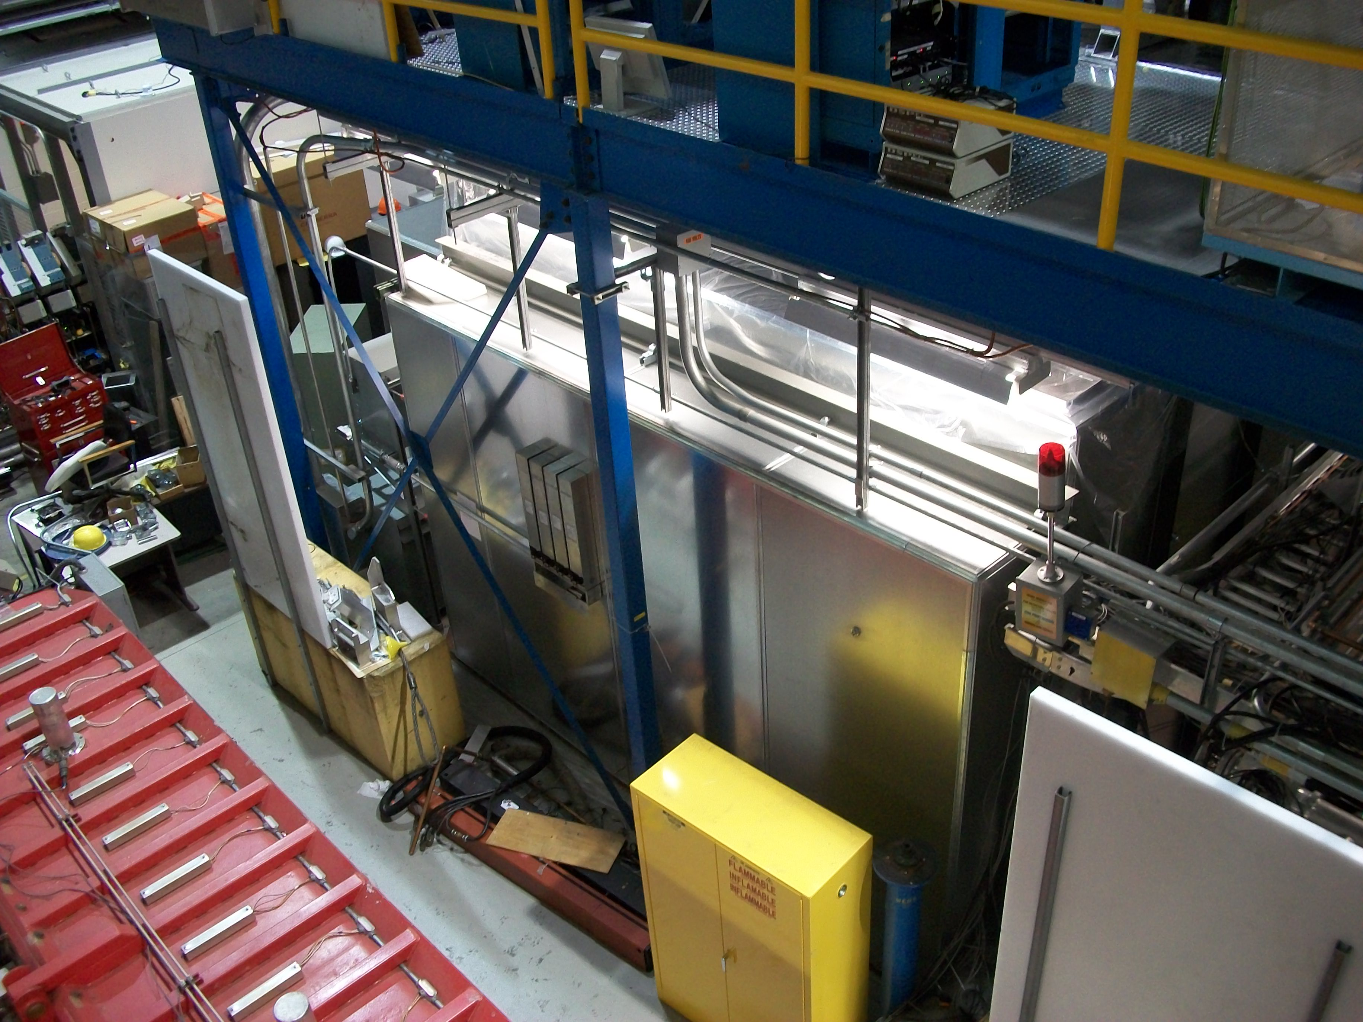
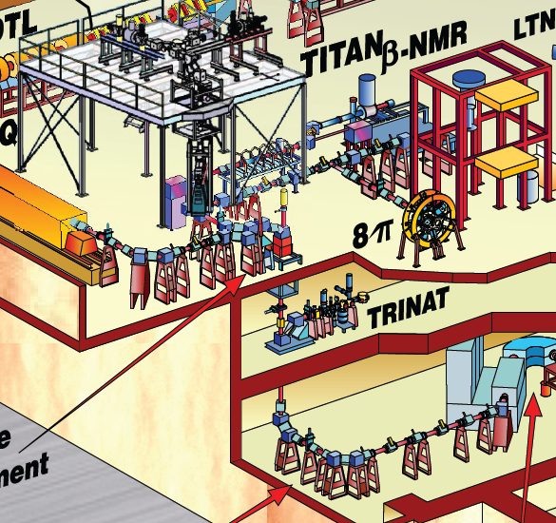
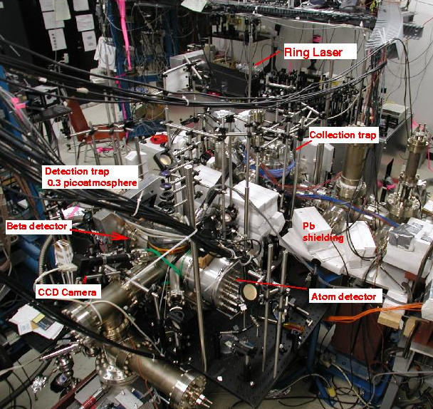
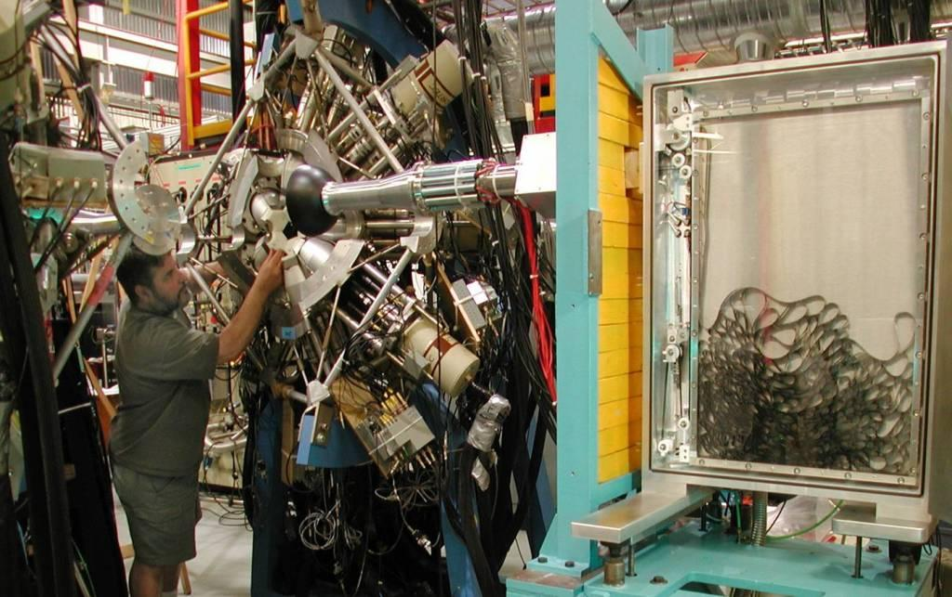
ISAC experimental areas
Low energy
< 60 keV
TITAN
Penning Traps
➔ Masses
Collinear beam line
Polarized beams:
Laser spectroscopy, MTV,
betaNMR (material science)
FRANCIUM MOT
TRINAT
Neutral Atom Trap
anapole moment
8π
Nuclear Decay

Slide 11
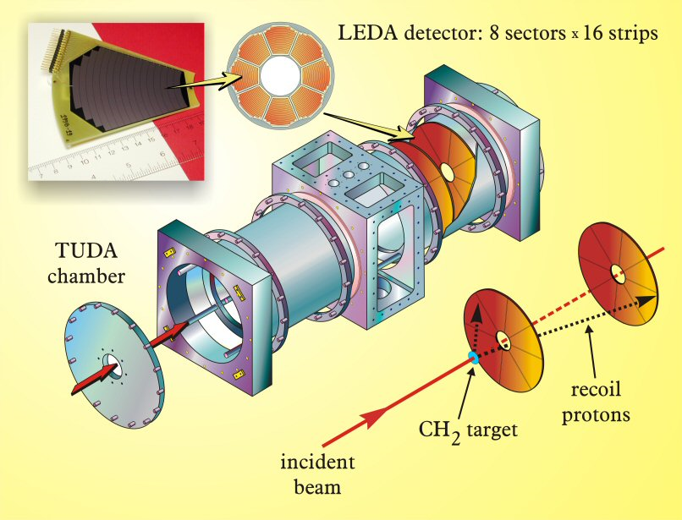
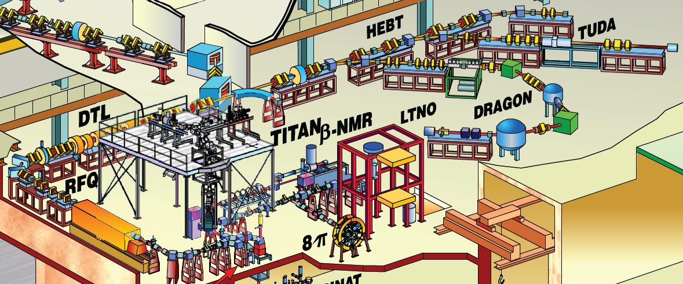
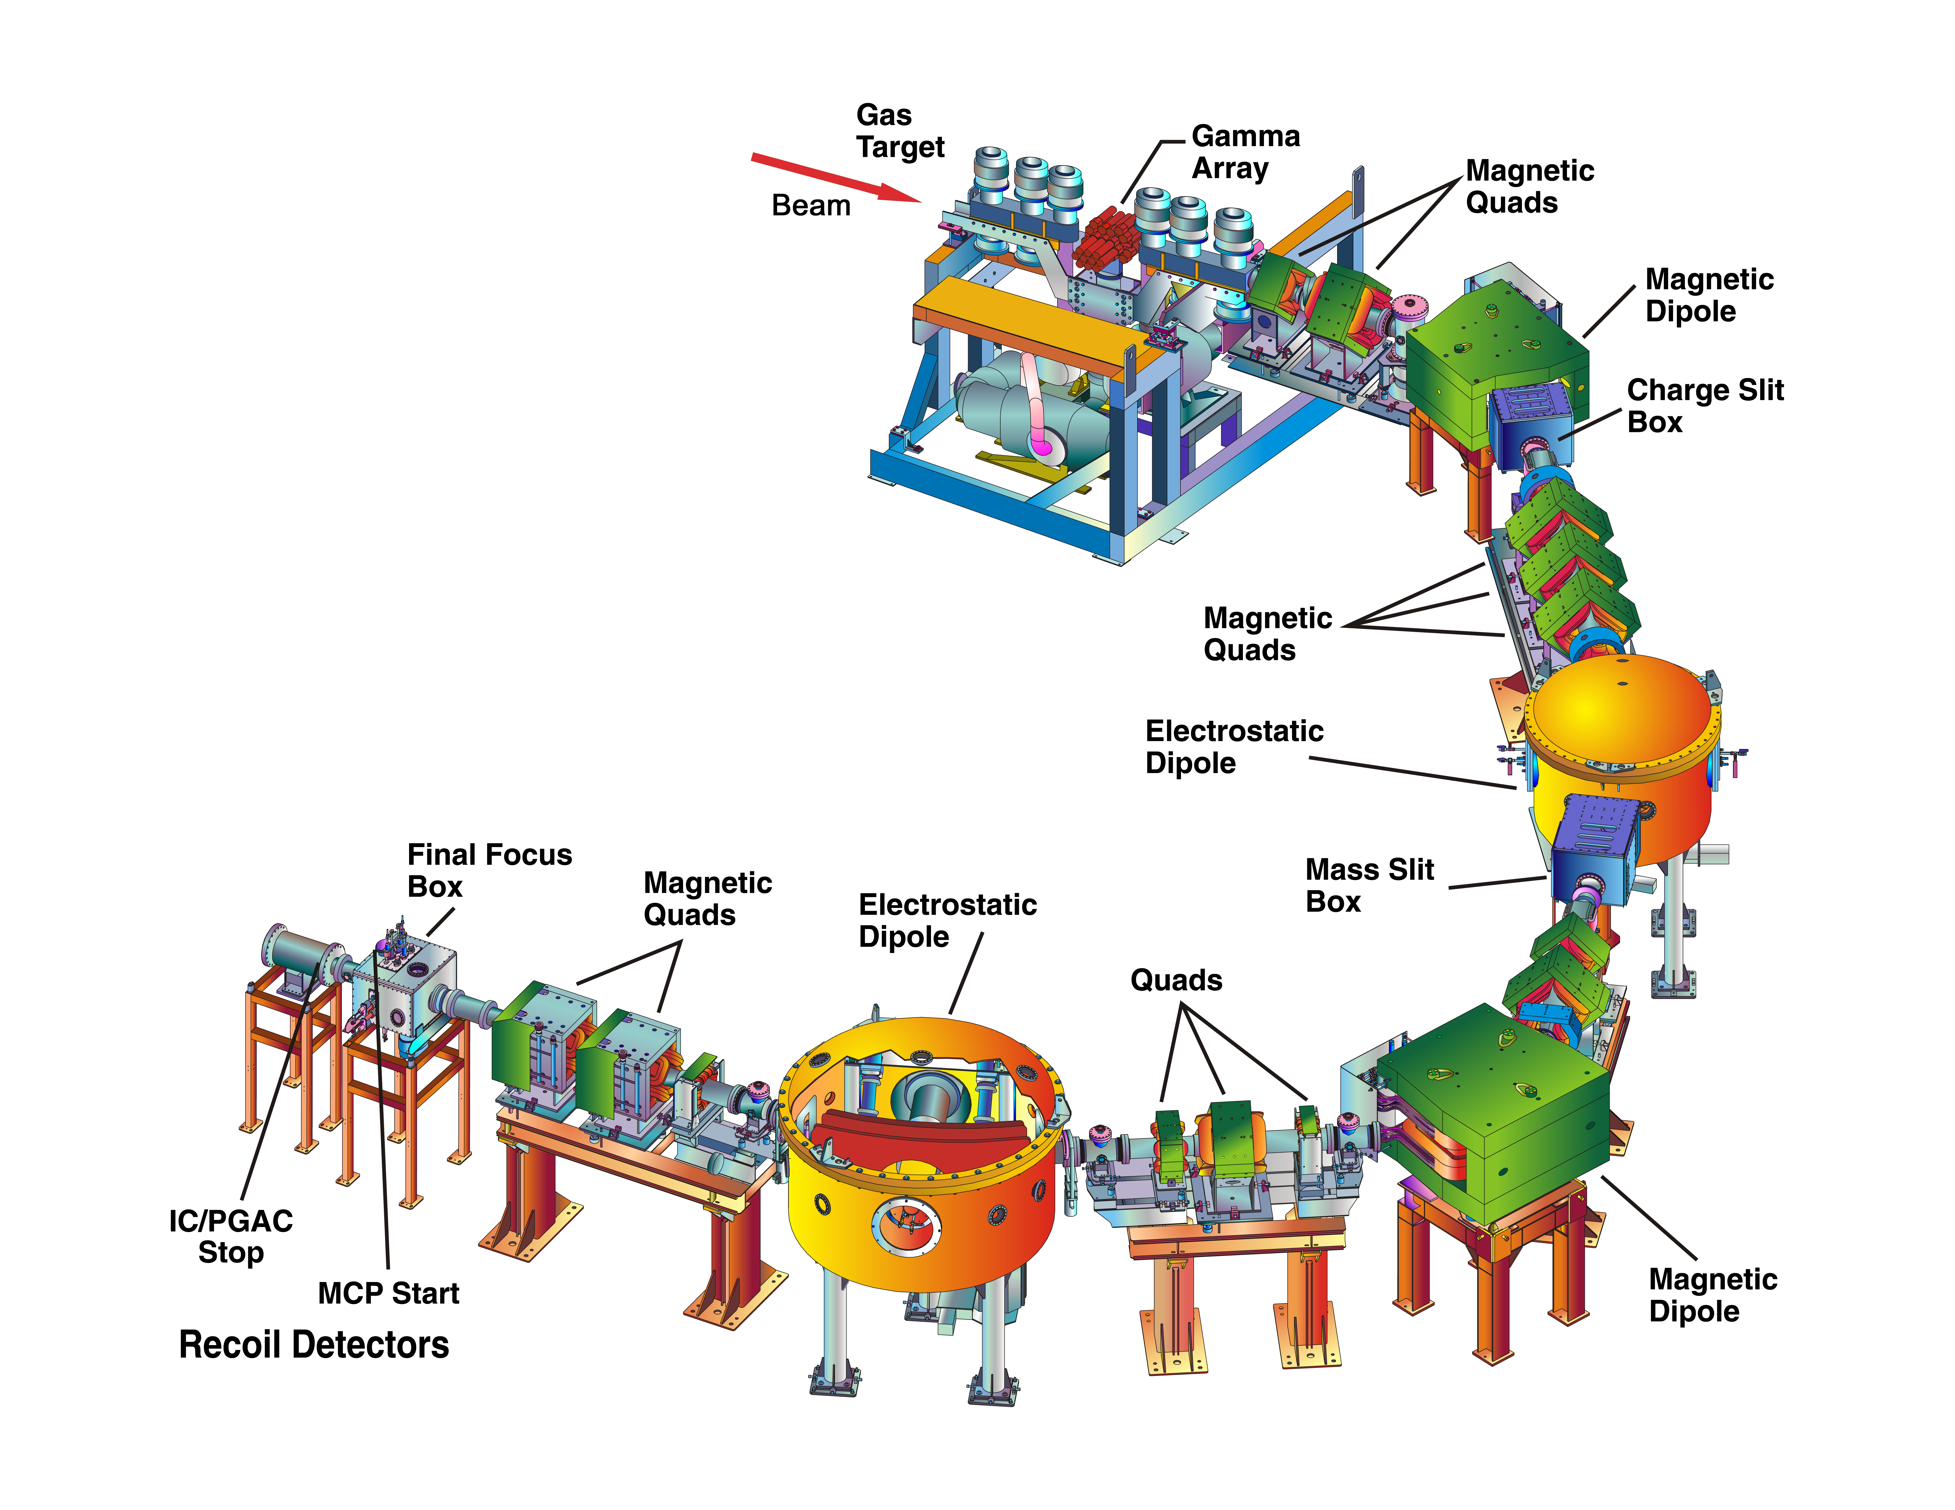
ISAC experimental areas
medium energy
~ 0.15 -1.7 AMeV
TUDA
Astrophysical charged particle reactions
DRAGON
Astrophysical capture reactions

Slide 12
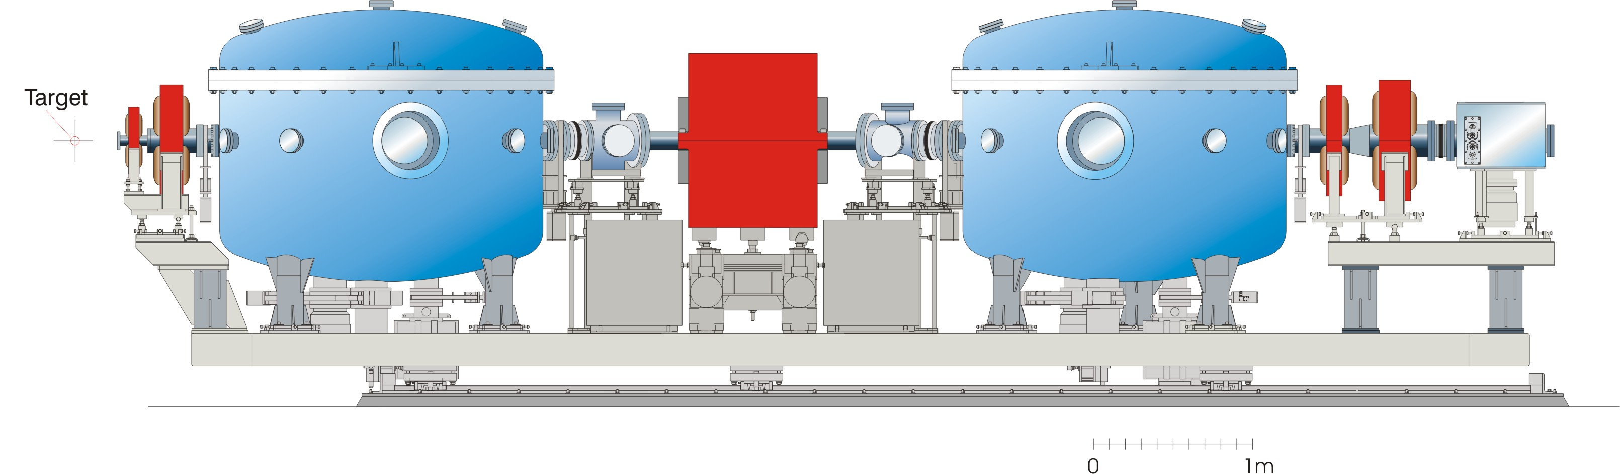
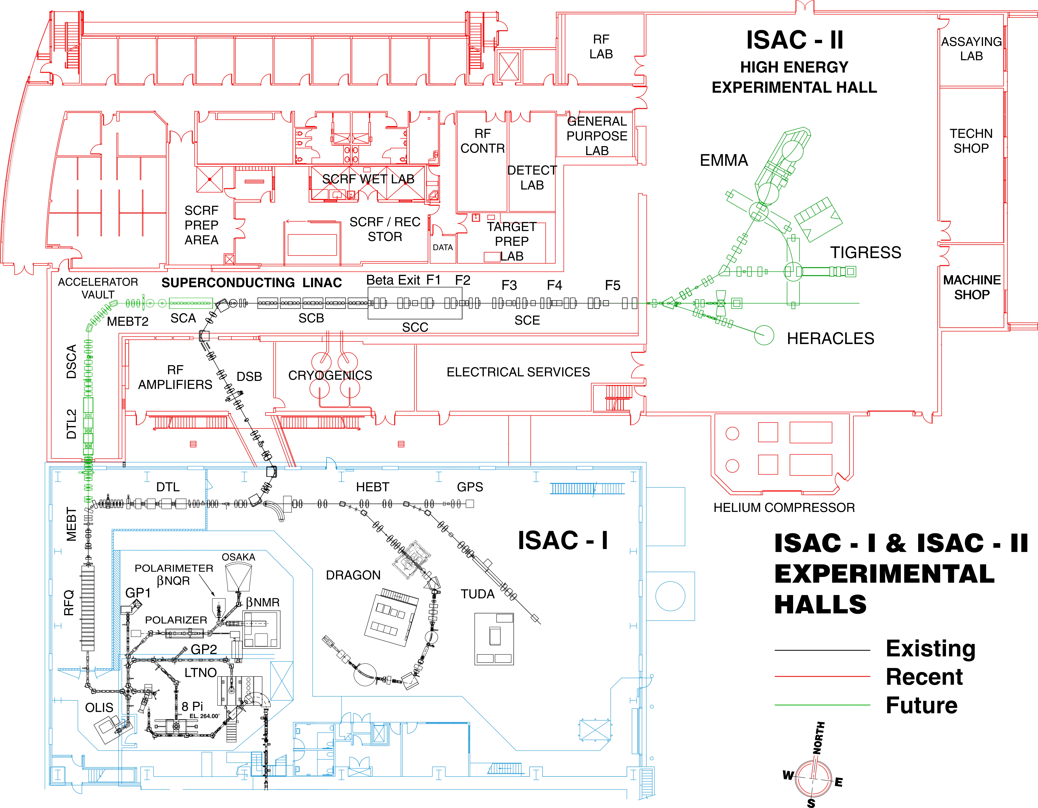

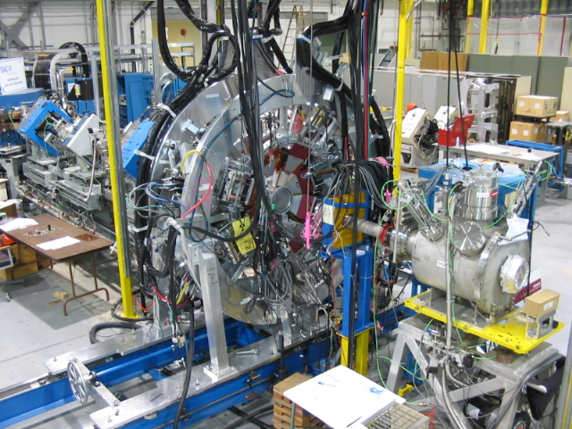
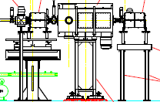
ISAC experimental areas
high energy
> 6 AMeV for A < 150
EMMA
Mass analyzer for nuclear reactions
Gamma spectrometer
Nuclear Reactions
IRIS
Solid hydrogen target for nuclear reactions

Slide 13
ISAC – Facility for Nuclear Astrophysics
Fabrication of implanted radioactive targets
ISAC I - ‘LE’
ISAC I - ‘HE’
ISAC II
Collection
TUDA
TIGRESS+ SHARC/DESCANT
RIB
EMMA
+ SHARC
8π/GRIFFIN
DRAGON
~30 keV
0.15-1.8 MeV/u
3-16 MeV/u
TITAN
DSL Facility
TUDAII / IRIS
Beta decay studies and lifetimes
Charged-particle reactions, direct (α,p), (p,α), & indirect, transfer, (p,p’) + TACTIC (α,n),(p,p) etc
Identifying resonances, reaction Q-values: Coulex, (p,p’), (d,p), (⁶Li,d), transfer, fusion-evaporation
Direct radiative capture (p,γ), (α,γ)
Precision mass measurements (Q-values, Separation energies)
Excited state lifetimes
e.g. in ¹⁵O via ¹⁶O(³He,α)¹⁵O
Notes:
ISAC is the ideal place to do this research, because of the wide variety of nuclear quantities we can measure, and in particular, the first order quantities: nuclear masses, decay lifetimes, and the difficult to measure direct reaction rates at ISAC I. There is also a lot of indirect work can be done at ISAC II.
Crucial to all this, are the radioactive beams. Without them we would have a Ferrari in the garage but no gas to put in it!

Slide 14
Explosive H and He burning

Slide 15
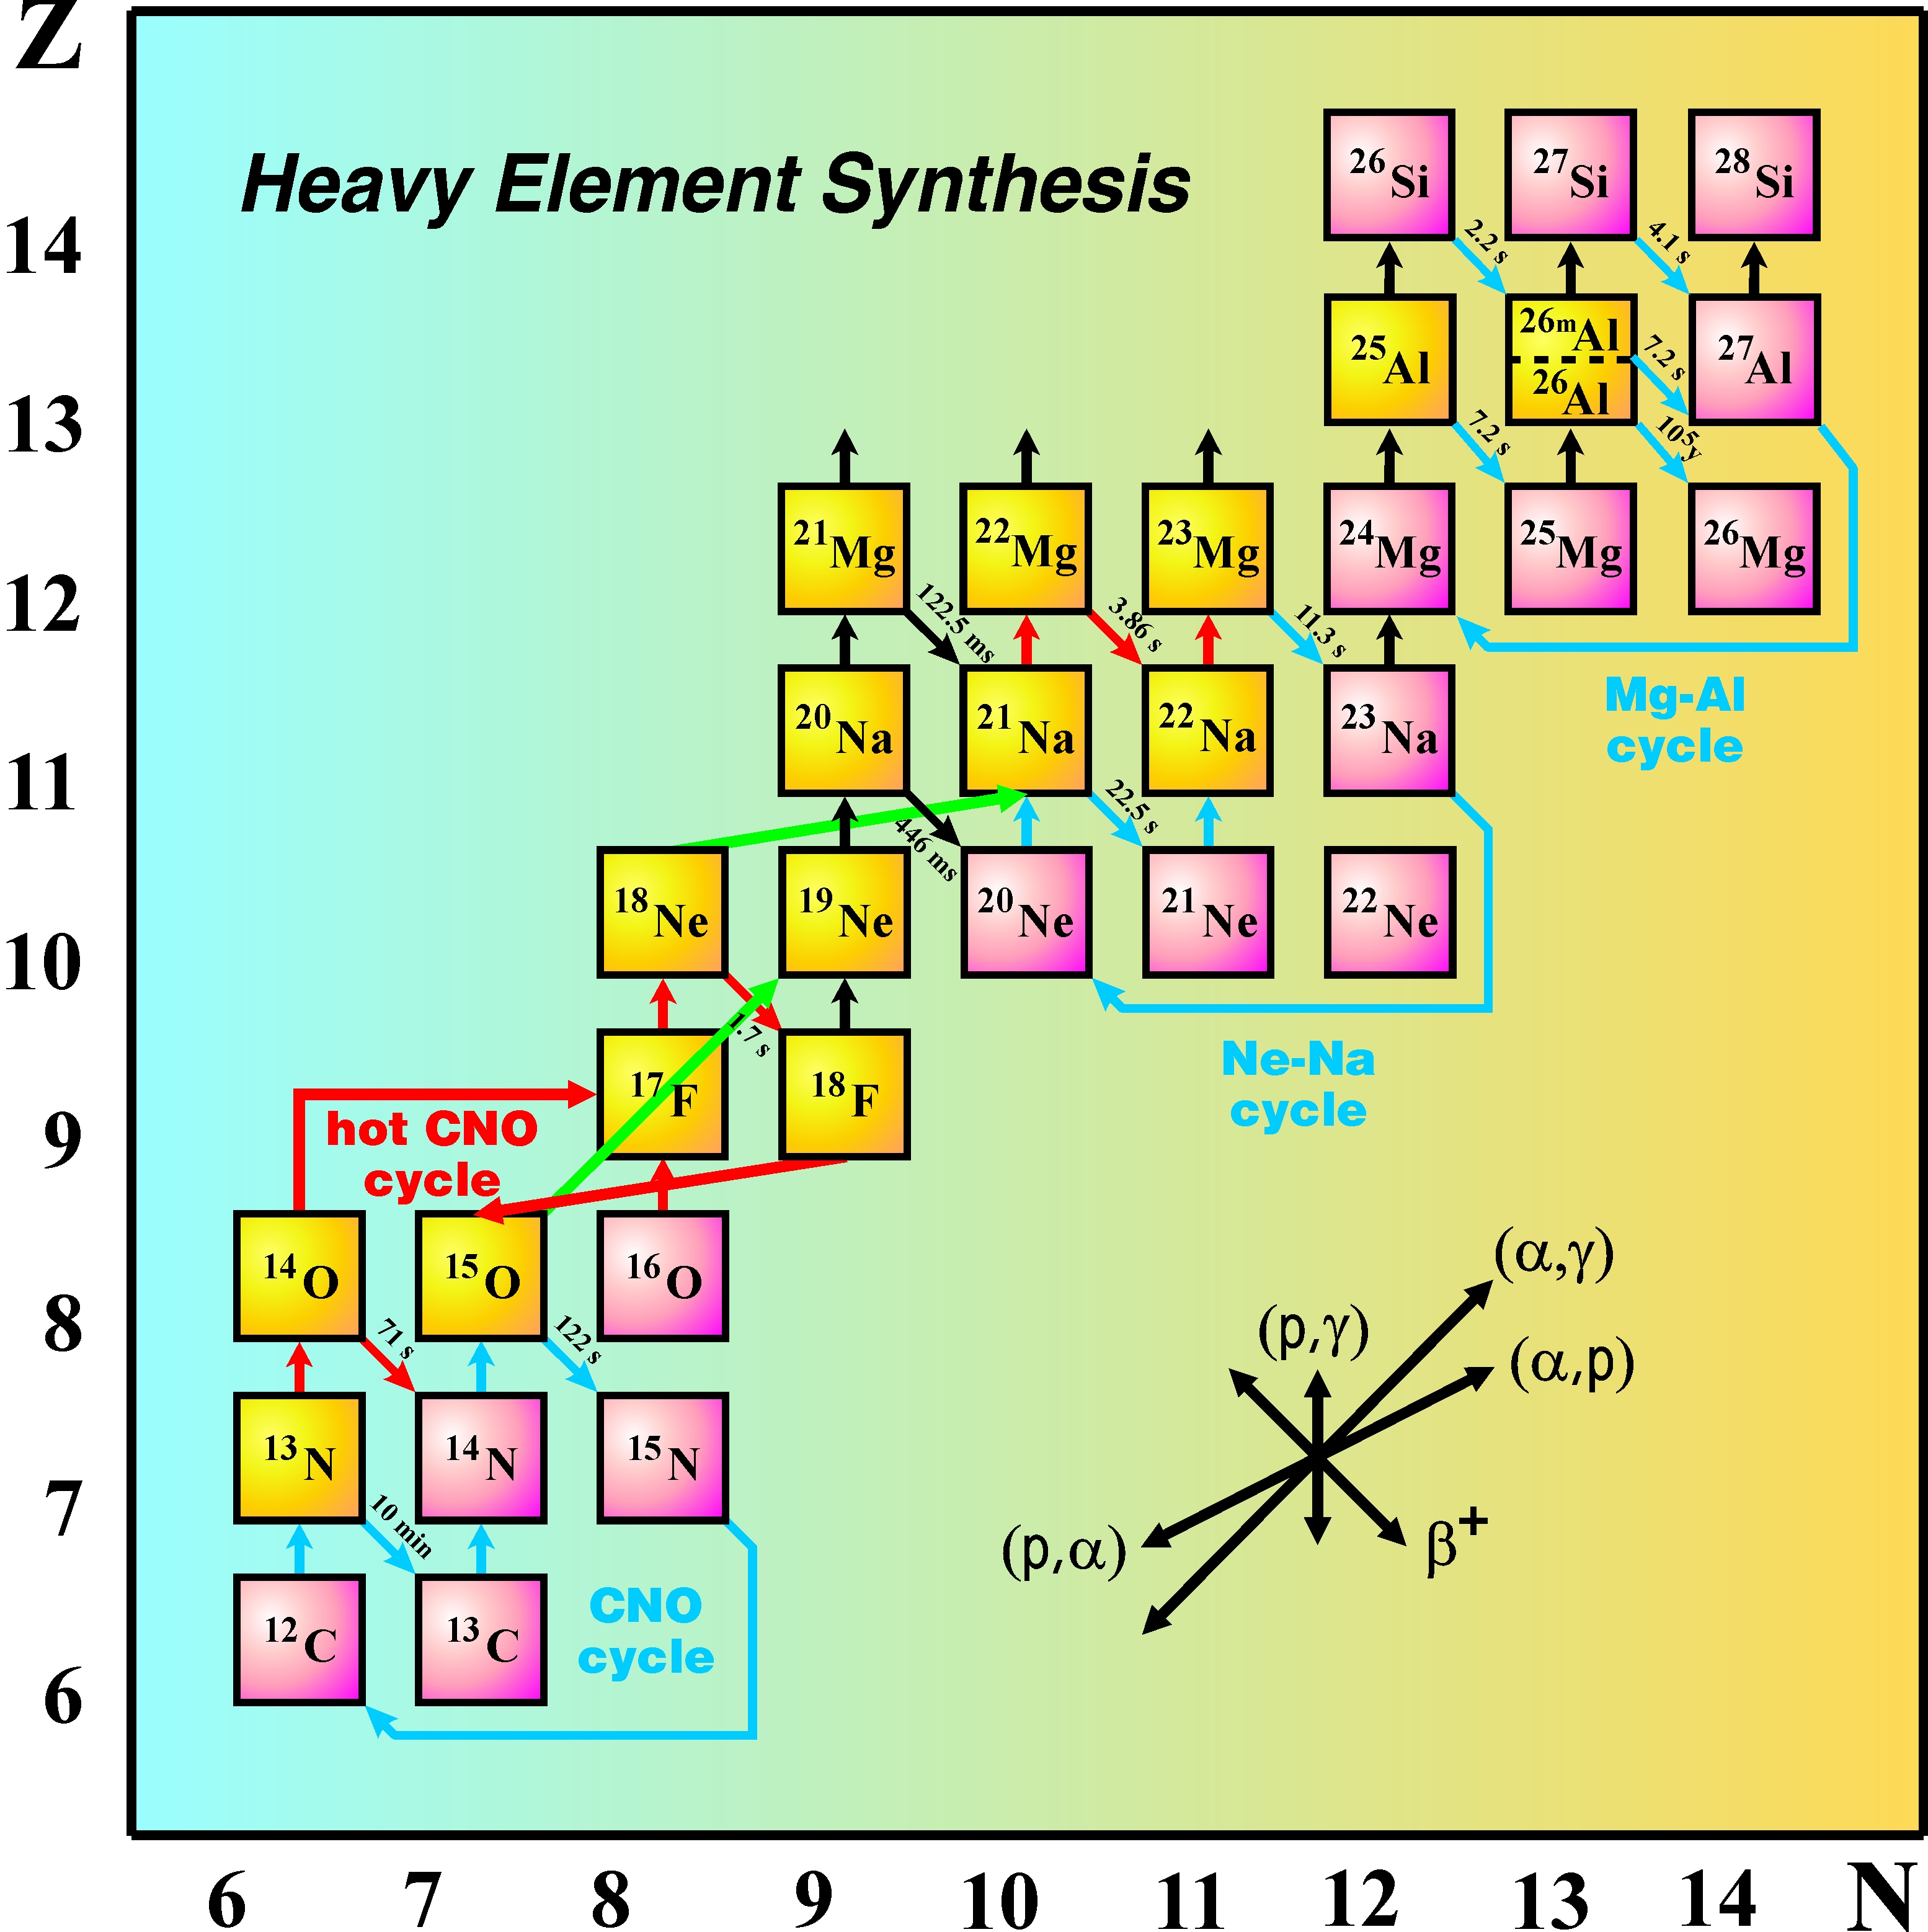
Explosive H & He burning
proton-rich outflows in Novae, X-ray bursters, Core collapse SN :
p- and α-capture reactions play important role in flow of material to higher masses.
Cosmic gamma ray emitters as forensic tools of astrophysical processes:
novae: ¹⁸F, ²²Na, ^{26g}Al,…;
CC SN: ⁴⁴Ti, ^{26g}Al,..,
isotopic ratios in presolar grains (sulfur, silicon ratios in ‘nova grains’)
NOVA, X-RAY Bursts,Type I SN
rp process
IGNITION
REACTIONS
Notes:
Concentration of research on explosive hydrogen and helium burning in novae, x-ray bursts and core collapse supernovae.
Also responsible for the synthesis of cosmic gamma ray emitters. ISAC I accelerator well matched for energies.

Slide 16

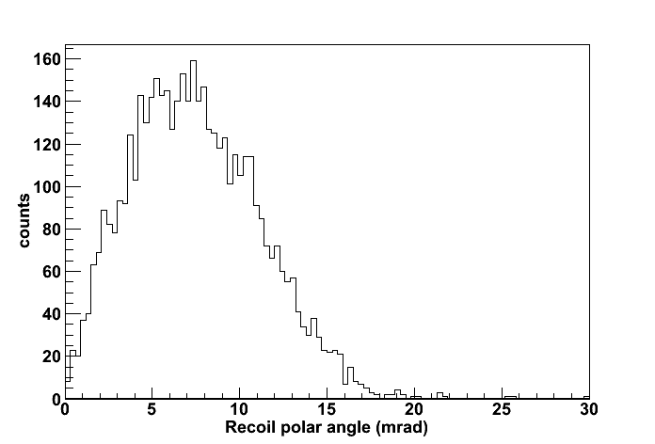
Radiative capture in inverse kinematics
Radionuclei that can’t be made into a target
  accelerate them, make H or He target.
Gaseous H₂ or He target
Detect recoils in coincidence with γ rays
Measure stopping powers directly (required for ωγ)
Change target thickness easily
Can make target ‘extended’
  (sensitivity to resonance position ⇒ resonance energy)
Target does not degrade over time
Target elastic scattering for normalization
Thick target yield function in inverse kinematics
Max recoil angle ⇐ kinematics & decay scheme
Need recoil separator with full acceptance and high beam suppression

Slide 17
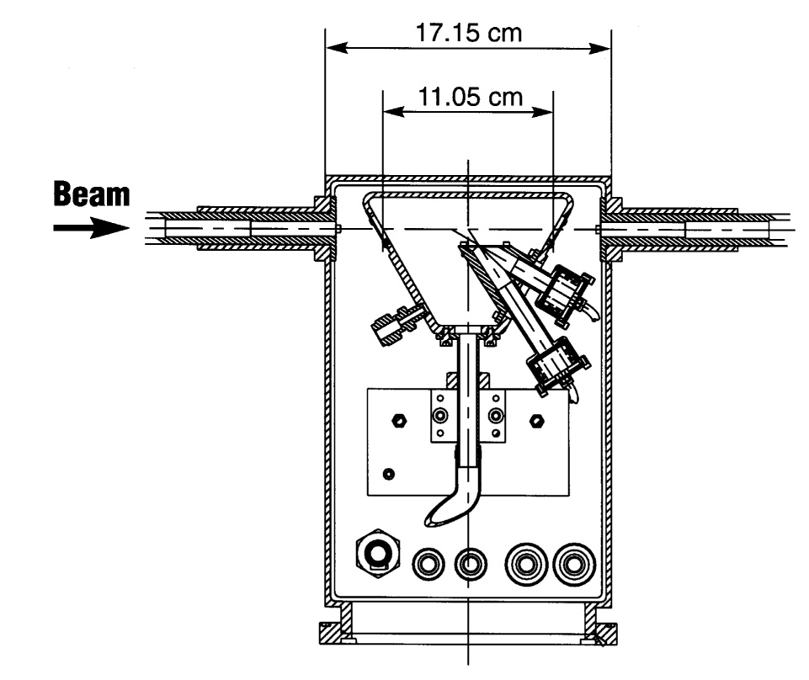
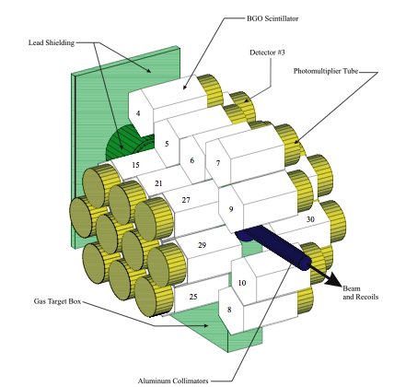
Detector of Recoils And Gammas Of Nuclear reactions DRAGON
MEME design
Windowless recirculating target: H₂ or He
LN₂ cooled zeolite cleaning trap
1-10 mbar
30-element BGO γ array 40-70% eff.

Slide 18
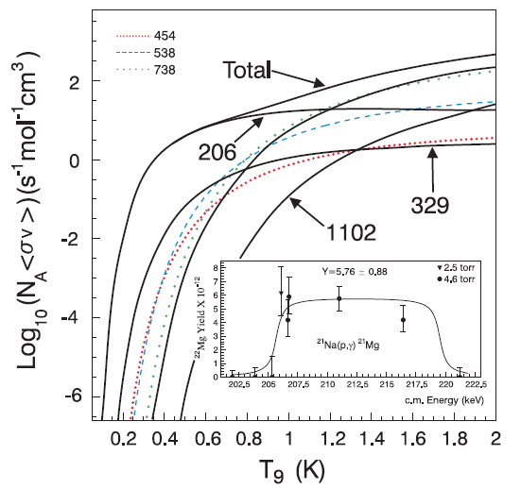
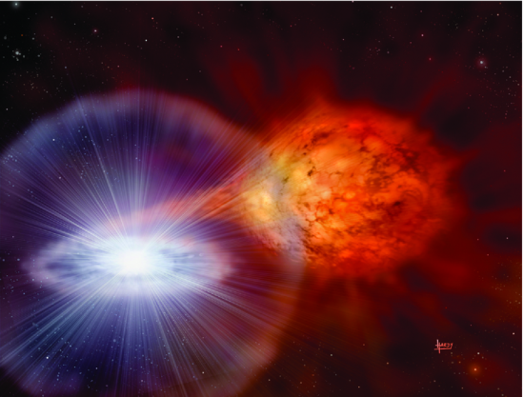
Textbook example: ²¹Na(p,γ)²²Mg
10⁸ pps ²¹Na
Talk: S. Bishop
S. Bishop et al., Phys. Rev. Lett. 90 (2003)162501
J.M. D’Auria et al., Phys. Rev. C 69 (2004) 065803

Slide 19
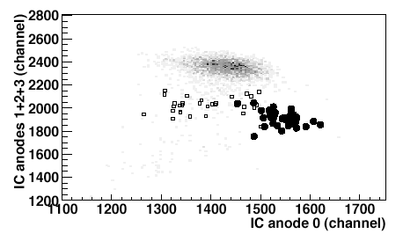
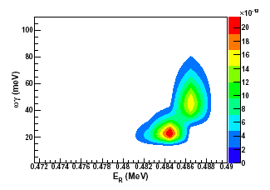
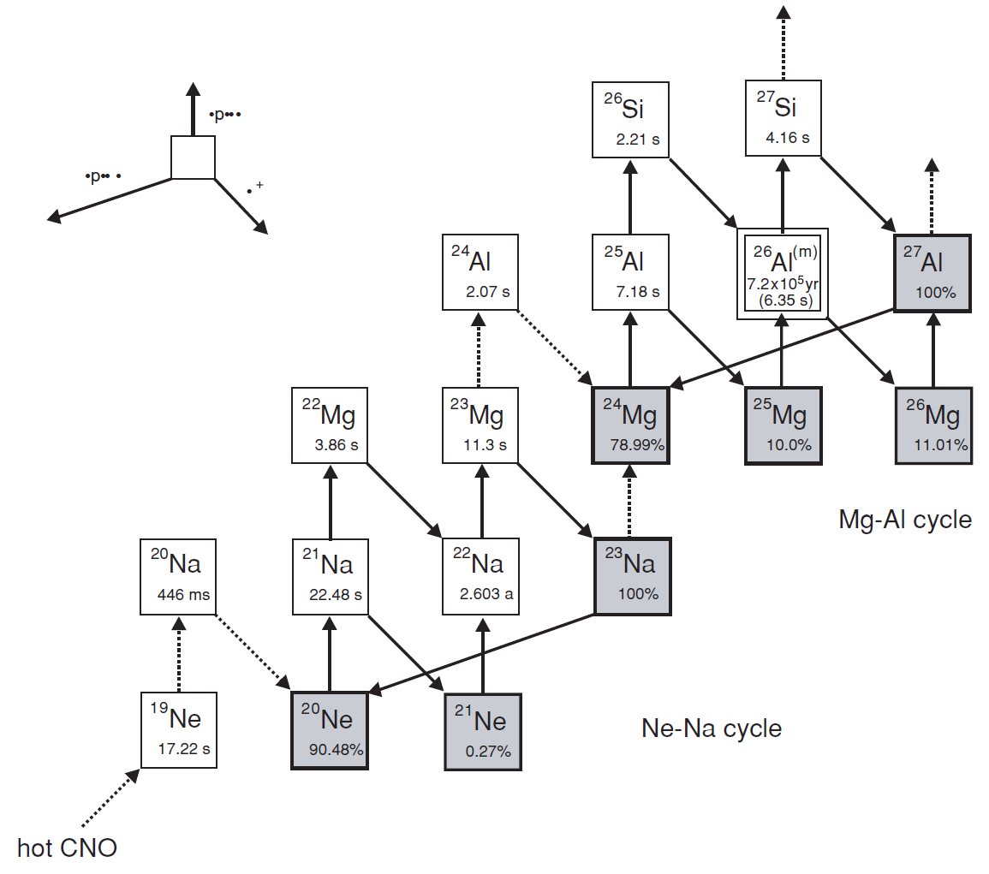

²³Mg(p,γ)²⁴Al direct measurement at DRAGON
important link between Ne-Na and Mg-Al cycles in O-Ne classical novae.
Affects both ²²Na and ^{26g}Al radioisotope ejecta from classical novae (important γ-ray astronomy targets)
No experimental determination of reaction rate
²³Mg beam of 5 x 10⁷ s⁻¹ via HP-SiC and laser ionization
DRAGON result reduces uncertainty by orders of magnitude
E vs. ΔE
²⁴Al
²⁴Mg
Dominant resonance in ²³Mg(p,γ)²⁴Al strength/energy determination
L. Erikson et al., PRC 81 (2010) 045808
19
Notes:
23Mg(p,gamma) is one of these reaction that affects both the 22Na and 26Al ejected abundances from novae. DRAGON recently performed the first ever direct measurement of this reaction, possible because of the development of an intense 23Mg accelerated beam. The results reduce the uncertainty of the reaction rate, which previously depended on theory, by a couple of orders of magnitude, and thus eliminates this reaction now as a source of uncertainty in the gamma rays signal from 22Na.

Slide 20
TUDA - The TRIUMF UK Detector Array
Posters: Jessica Tomlinson, Carine Tsimba Nsangu

Slide 21
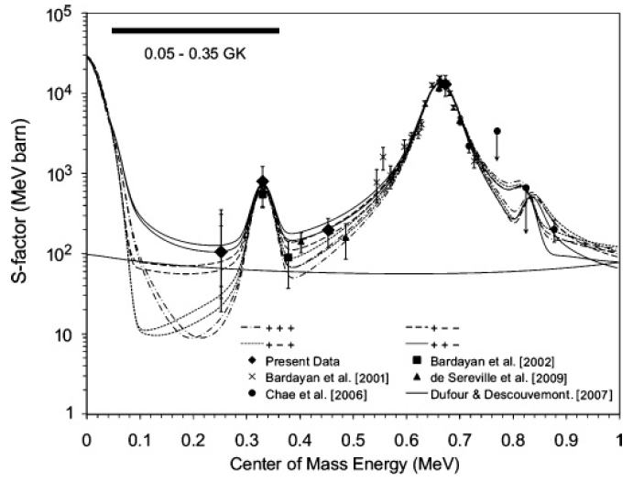
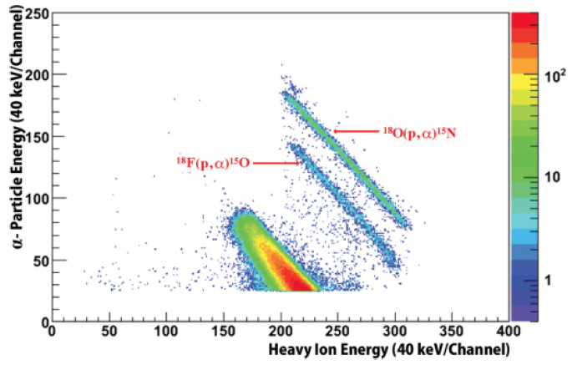
¹⁸F(p,α)¹⁵O direct measurement at TUDA
¹⁸F responsible for 511 keV emission in classical novae
¹⁸F(p,α)¹⁵O reaction destroys ¹⁸F
first measurement at relevant energies
using most intense (5 x 10⁶ pps) accelerated ¹⁸F beam worldwide
reduced uncertainty for
511 keV spectrum in
classical novae
C.E. Beer et al, (York, Edinburgh, TRIUMF) PRC 83, 042801 (R) (2011)
Notes:
- The 18F(p,a) reaction measured at TUDA. This is the lowest energy measurement anywhere of this reaction, right in the region of astrophysical importance. This greatly reduces the uncertainty in the 511 keV spectrum expected from classical novae. This was only possible because we have the highest intensity accelerated 18F beam in the world.

Slide 22
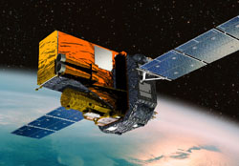
Novae observables: ¹⁸F(p,γ)¹⁹Ne reaction
Observation of γ-ray emission from novae gives information on explosion conditions
γ-ray flux fo 511keV dominated by decay of ¹⁸F
Final abundance of ¹⁸F depends on rates of production/destruction processes
Production:
decay of ¹⁸Ne and ¹⁷O(p,γ)¹⁸F (DRAGON U. Hager)
Destruction:
¹⁸F(p,α)¹⁵O (TUDA A. Laird and A. Murphy)
¹⁸F(p,γ)¹⁹Ne (DRAGON A. Laird and C. Ruiz)
²⁰Na
²¹Na
¹⁸Ne
¹⁹Ne
²⁰Ne
¹⁷F
¹⁸F
¹⁹F
¹⁴O
¹⁵O
¹⁶O
¹⁷O
¹⁸O
Abundances of ¹⁶O (maybe), ¹⁸O and ¹⁹F also influenced
¹³N
¹⁴N
¹⁵N
¹²C
¹³C
First direct measurement of the ¹⁸F(p,γ)¹⁹Ne reaction –
DRAGON Nov 2011

Slide 23
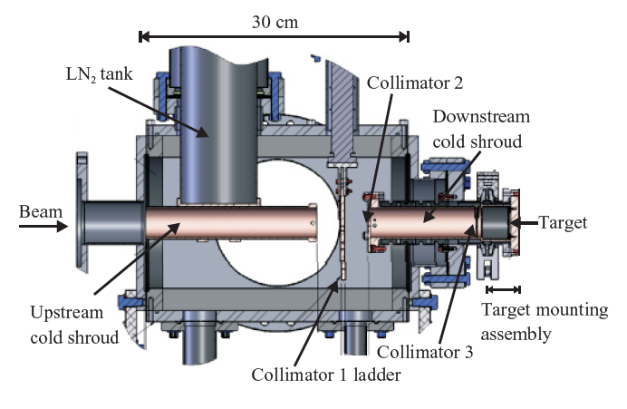
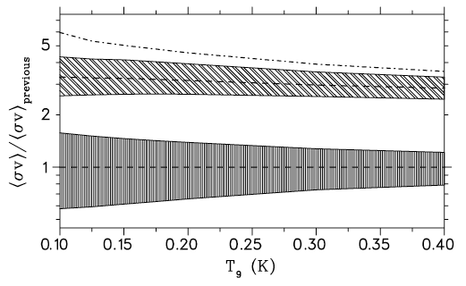
Direct measurement of ²²Na(p,γ)²³Mg
²²Na elusive candidate for cosmic γ-ray observation
²²Na(p,γ)²³Mg reaction destroys ²²Na
(p,γ) run at CENPA, Seattle, with ²²Na target from ISAC
Stronger resonance strengths measured: reaction rate much higher
➔ reduction in net ²²Na abundance
distance for detectable
novae down by factor 2!
A.L. Sallaska et al, (Seattle, TRIUMF, Barcelona)
PRL 105, 152501 (2010), PRC 83, 034611 (2011)
Notes:
- Probably the most impacting, is our measurement of 22Na(p,g). ISAC has a very intense 22Na beam, so we produced very high quality rastered targets from it. We then built an experimental setup and measured this at the University of Washington in Seattle, where we could run a proton beam at the right energy uninterrupted for a long time. Our results show a much stronger reaction rate than previously thought, with better precision. This has the implication that less 22Na is made in the nova models, and decreases the ‘detectability distance’ of the 22Na line from novae by a factor 2, changing the average time we’d have to wait to see this line from an individual novae by approximately a factor 4!

Slide 24
stellar burning

Slide 25
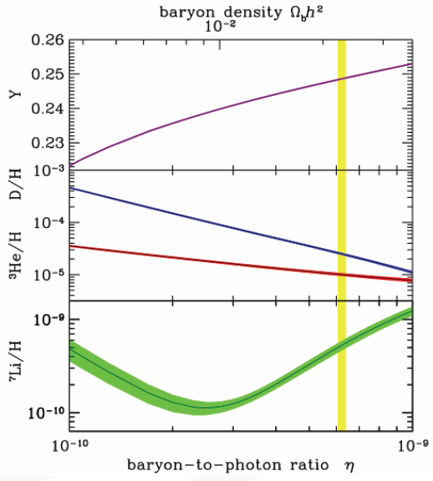
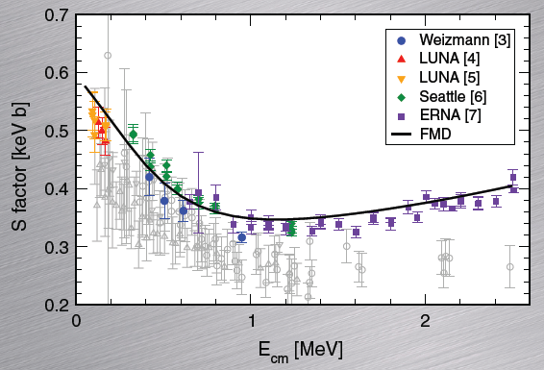
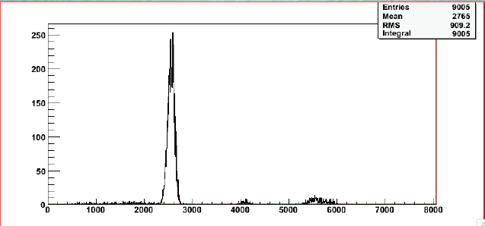
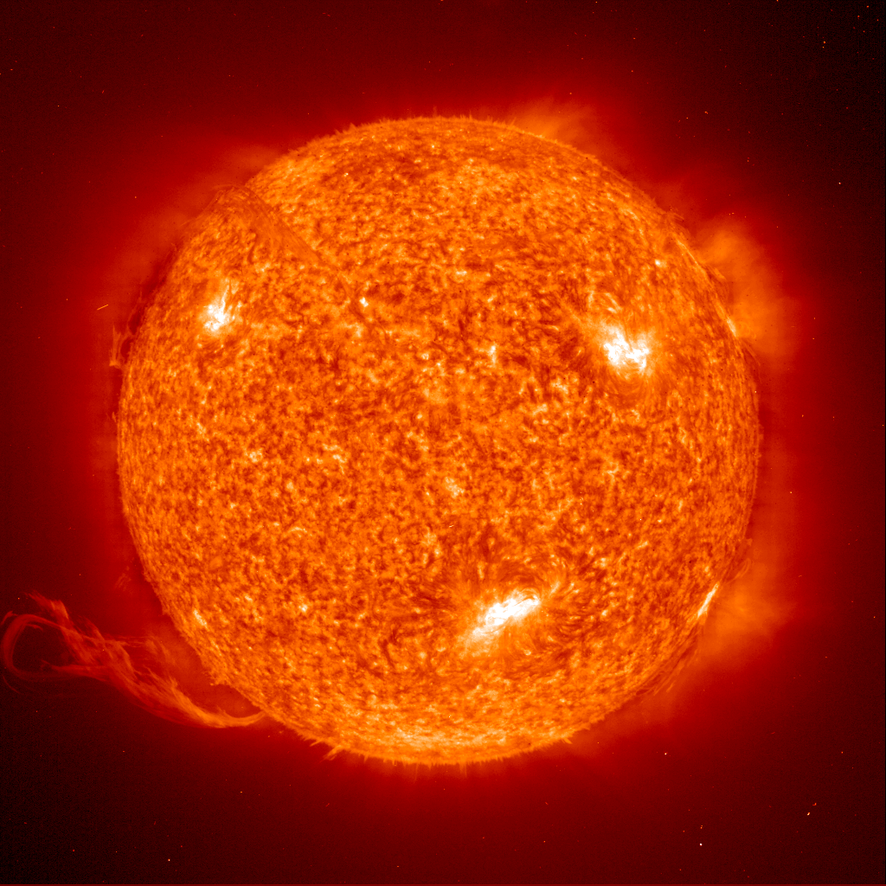
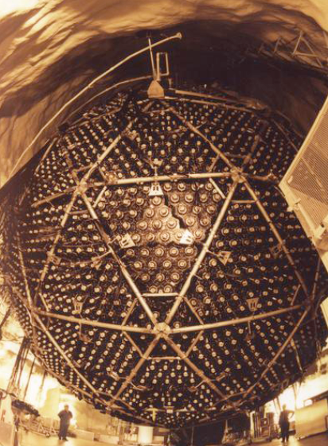
³He(α,γ)⁷Be with DRAGON
Astrophysical S factor for ³He(α,γ)⁷Be: S₃₄(0) relevant for
  primordial ⁷Li production
  ⁷Be, ⁸B solar neutrino flux (SNO, BOREXINO)
DRAGON experiment under analysis (Nara Singh, Davids et al.)
  Aim: resolve discrepancy between existing data
Recoil energy spectrum at DRAGON focal plane for E= 2.2 MeV
  10¹⁷ beam suppression
FMD calculation [T. Neff, PRL106,042502 (2011)] in good agreement with ERNA data [Di Leva et al. PRL 102, 232502 (2009)], disagrees with Parker & Kavanagh, Weizmann data

Slide 26
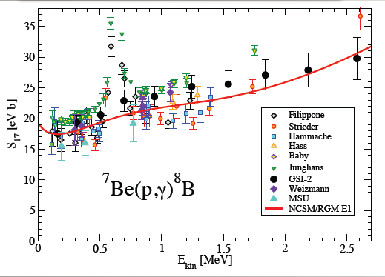
Ab initio reactions calculations
NCSM/RGM calculation of p-⁷Be scattering & radiative capture
⁷Be states 3/2-,1/2-, 7/2-, 5/2-
Soft NN potential
(SRG-N3LO with Λ = 1.86 fm-1)
The first ever ab inito calculations of ⁷Be(p,γ)⁸B
P. Navratil et al., PRC 82, 034609 (2010)

Slide 27
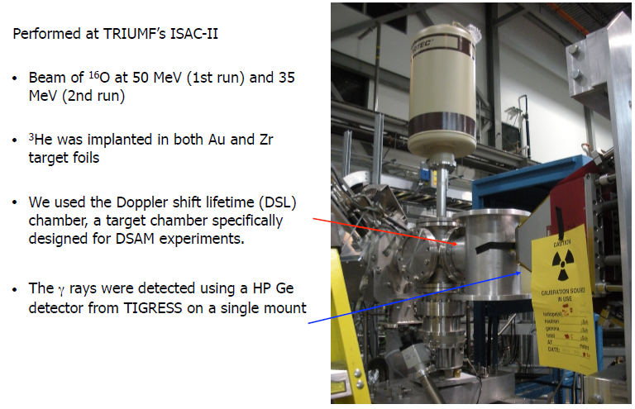
Doppler-shift Lifetime (DSL) station
¹⁶O(³He,α)¹⁵O
Under analysis
B. Davids et al.

Slide 28
p-process

Slide 29
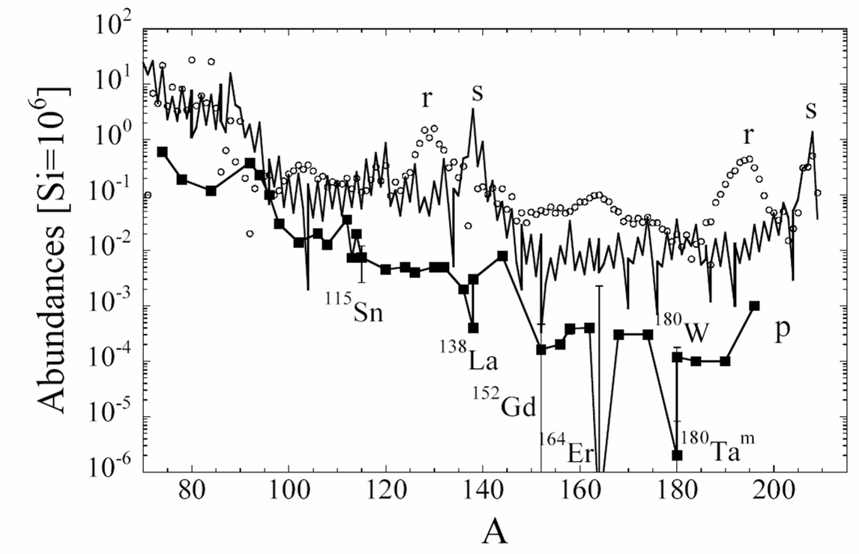
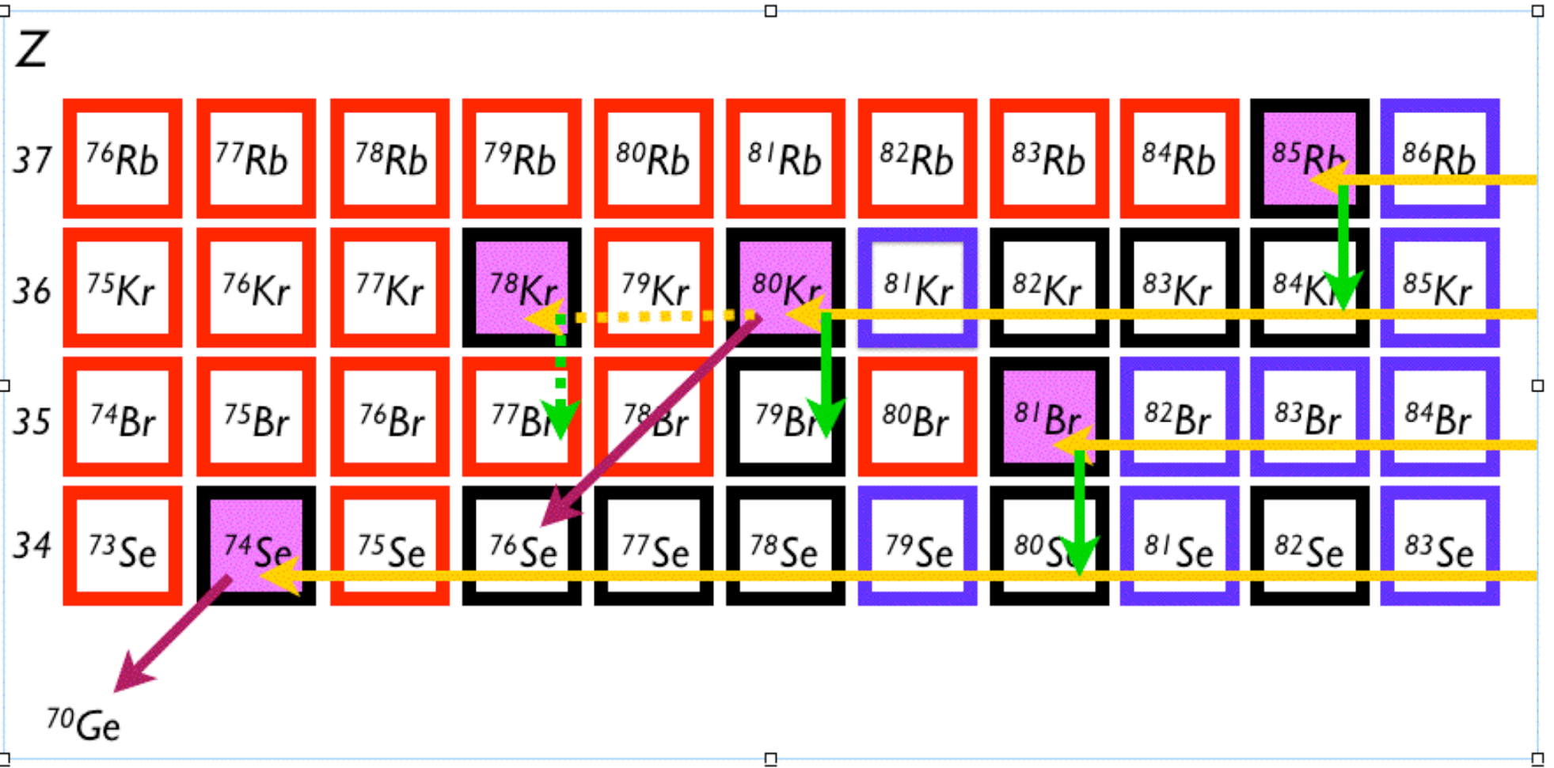
Capture reactions for p-nuclei
  first high-mass capture ⁸⁴Kr(α,γ) with DRAGON
  opens opportunity to measure p-process rates
  Key reaction: ⁷⁶Se(α,γ)⁸⁰Kr
  for p-process branching point ⁸⁰Kr
A.Laird et al.

Slide 30
s-process

Slide 31



NEURAL: a detector for neutron-induced astrophysical reactions
L. Buchmann et al.
Production sites for ²⁶Al under debate
Need accurate rates for ²⁶Al destruction via (n,p), (n,α) reactions
Experiment with neutrons (150-200 keV) at LANSCE (LANL) approved
Implanted ²⁶Al target from TRIUMF (10¹⁶ atoms)
NEURAL detector (TPC + Si) under development at TRIUMF

Slide 32
r-process

Slide 33



Shell structure and the r-process
Nuclear shell structure
defines r-process path
imprinted in abundance pattern
maybe modified for exotic nuclei
robust r-process pattern
➔ Combine accurate nuclear physics and precision astronomy to constrain astrophysical scenarios
J.J. Cowan, C. Sneden, Nature 440 ( 2006)

Slide 34




TACTIC – An Active Target TPC
Primary aim:
Influences:
possibly ¹²C production in inhomogeneous Big Bang nucleosynthesis
abundance of r-process seed nuclei
Talk: E. Martin
L. Buchmann et al.

Slide 35
What information needs to be measured?
DOE milestones:
Measure masses, lifetimes, spectroscopic strengths,
and decay properties of selected neutron-rich nuclei
in the supernova r-process, and reactions to predict
radionuclide production in supernovae.
Measure transfer reactions on r-process nuclei near the
N=50 and N=82 closed shells.

Slide 36


S. Nishimura et al.
RIBF experiment

Slide 37





¹³²Sn(d,p)¹³³Sn measurement at ORNL
four single particle states seen w/ large spectroscopic factors ~ 1.0
p1/2 state observed for the first time
E_{x}, J^{π}, spectroscopic factors determined
confirmation of doubly magic nature of ¹³²Sn
Kate Jones et al. 2010

Slide 38

Relevance of odd-N nuclei
r-process nucleosynthesis
sensitivity study
Union College / ORNL /
NCSU collaboration
rate factor
variation
odd-N and
significant
impact
odd-N nuclei near closed neutron shell identified as having significant impact on the abundances of hundreds of predicted r-process abundances
R. Surman et al.
Phys. Rev. C 79 (2009) 045809
examples
  ^{131,133}Cd, ^{131,133,135,137}Sn, ^{132,134}Sb, and ¹³⁷Te …

Slide 39

Decay and in-beam spectroscopy at ISAC
Access to:
decay half-lives
P_{n} values (DESCANT)
resonance properties
  e.g. ²¹Na(p,p’) @ TIGRESS
general structure information

Slide 40




Towards the r-process path:
10 μA 500MeV protons on 16 mg/cm² UCx
V.V. Simon et al. in prep for PRC
First decay spectroscopy with 8π at A=102
¹⁰²Rb ➔¹⁰²Sr
?
Structure along r-process path
Energy (keV)

Slide 41


Advanced Rare Isotope Laboratory

Slide 42

Advanced Rare Isotope Laboratory
ISAC II
expand RIB program with:
three simultaneous beams
increased number of
hours delivered per year
new beam species
enable long beam times (nucl. astro, fund. symm.)
increased beam
development capabilities
New electron linac driver
for photo-fission
New proton beamline
New target stations and
front end
staged installation
High
Energy
New
Accelerators
New
Front End
Low
Energy
Medium
Energy
ISAC I
New Mass
Separators
New
Targets
e-linac
Cyclotron
Notes:
42
42

Slide 43



ARIEL construction and development
Demolition began late Oct. 2011 to make way for new ARIEL building
Presently developing the technology for the new electron linac (e-Linac)
100 kW, 25 MeV
electrons by 2014
500 kW, 50 MeV electrons by 2017
e-LINAC

Slide 44


ARIEL science reach
New proton spallation beam line on UC
Experiments at the r-process path:
masses, T_{1/2}, P_{n}
(d,p), (t,p) reactions
  → single particle structure
  → pairing correlations
  → (n,γ)
decay spectroscopy
Photo-fission on U-target
  100 kW, 25 MeV e-beam:
  ➔ ~ 10¹³ fissions/sec
  2⋅10¹⁰ ¹³²Sn/sec (in target)

Slide 45
Summary and Outlook
TRIUMF/ISAC provides high intensity RIBs for direct and indirect studies of nuclear reactions and nuclear properties for astrophysics
Current studies concentrate on explosive H & He burning
  recent result on Novae constrain gamma-ray emissions from ¹⁸F, ²²Na
  next: ¹⁸Ne(α,p)²¹Na, ¹⁸F(p,γ)¹⁹Ne, ^{26m}Al(p,γ)²⁷Si, ^{26m}Al(d,p)²⁷Al
  implanted ²⁶Al targets for ²⁶Al(n,p/α), ²⁶Al(d,p), ²⁶Al(³He,d)
10μA, 500 MeV protons on actinide targets from Dec. 2011
  high intensity neutron rich beams towards r-process nuclei
The new ARIEL facility will enable
  high intensity production of n-rich r-process nuclei from photo-fission
  multi-user capability with 3 parallel ISOL targets for
    long experiments for direct reactions (e.g. DRAGON, TUDA)
    more time for beam development of high intensity beams (e.g. ¹⁵O)

Slide 46




















Thank you
TRIUMF:
Alberta | British Columbia | Calgary | Carleton | Guelph | Manitoba | McMaster | Montréal | Northern British Columbia | Queen’s | Regina | Saint Mary’s Simon Fraser | Toronto | Victoria | Winnipeg | York
Canada:
TRIUMF, UBC, SFU, U. Toronto, UNBC, U. Victoria, U. Alberta, McMaster, U. Guelph, U. PEI
International:
Argonne, Yale U., Colorado School of Mines, Clemson, Ohio U., UW Seatlle, U. Edinburgh, U. Liverpool, York U., N.U. Ireland, KU Leuven, ULP. Strasbourg, U. Bochum, U. Münster, TU München, U. Konstanz, VERA Vienna, U. Napoli,
UPdC & IdEEdC Barcelona, Hebrew U. Jerusalem, Saha Institute Calcutta, CIAE Beijing, CNS Tokyo

Slide 47

Canadian Nuclear Astrophysics Institute
How do stars explode?
How are the heavy elements formed in stars and star explosions?
What are the properties of neutron stars?
Astrophysics
Observations
Modeling
Astronomy
Laboratory
Experiments
Nuclear Physics

Slide 48
Indirect methods
Reactions a+b c+d
Resonant reactions :
Spectroscopic information needed: spins, partial widths, branching ratios…
➔ Study properties of relevant resonances
Study of Time Inverse Reactions a+b c+d
Coulomb Dissociation and radiative capture reactions (GSI)
Trojan Horse Method and 2-body reactions induced by light particles (Catania)

Slide 49
ISAC Beam Development Plan
Conditioning Station:
Phase I
Conditioning Station:
Phase II
TM3 Refurbishing
TM2 Refurbishing
ARIEL TM1
March 2012
May 2011
July 2012
March 2013
April 2014
2010 2015
August 2011
June 2012
April 2013
December 2011
TM1
Repair
North
Hot Cell
Quick Disconnect
10µA UC_{x}
Complete
In progress
Future

Slide 50

¹⁴N(p,γ)¹⁵O
Reaction rate determines energy
release and thereby age of oldest stars
in our galaxy
Temperature of solar core implies
99% of energy released through pp
chains, ~ 1% via CN cycle
Predicted solar neutrino fluxes due to
¹³N, ¹⁵O exceed 10⁸ cm⁻² s⁻¹ on Earth
Measurements reveal primordial
composition of solar core
Flux predictions depend on ¹⁴N(p,γ)¹⁵O rate at very low energy, require ±3.5% error
B. Davids et al.

Slide 51

¹⁴N(p,γ)¹⁵O
Largest remaining uncertainty in reaction rate is due to width, Γ, of 6.791 MeV state
Knowledge of Γ would strongly constrain the R-matrix fit
➔ Measure lifetime to obtain width
B. Davids et al.

Slide 52

¹⁸F(p,γ)¹⁹Ne direct measurement at DRAGON
A. Coc et al. Astron. Astrophys. 357, 561-571 (2000)
At nova temperatures, the 38 keV, 330 keV and 665 keV resonances dominate
330 keV and 665 keV dominate for the higher peak temps seen in Iliadis’ O-Ne models
330 keV strength constrained somewhat by Γ_{γ} analogue assignment
665 keV strength has no similar assignment: resonance strength unconstrained
38
330
665
Courtesy U. Hager, A. Laird

Slide 53

¹⁸F(p,γ)¹⁹Ne direct measurement at DRAGON
Measurement of 665 keV resonance (one on-resonance point as total width known)
Beam intensity around 3 x 10⁶ pps (need 10⁸ for 330 keV resonance)
¹⁸O:¹⁸F ratios of 2:98
DRAGON total on-target intensity measured via cups, elastic scattering, and mini ion chamber in charge slit box
Ratio measured using attenuated RIB in ionisation chamber
ΔE-E in DRAGON focal plane
2 possible events identified in ~ 40 hours
➔ ~ 30 times lower resonance strength then expected (assuming above is valid)
Courtesy U. Hager, A. Laird

