Slide 2
OUTLINE
MOTIVATION
MEASUREMENT OF S(E )
PREVIOUS DATA
EXPERIMENT
OBSERVABLES
RESULT
ONGOING WORK AT TRIUMF

Slide 3
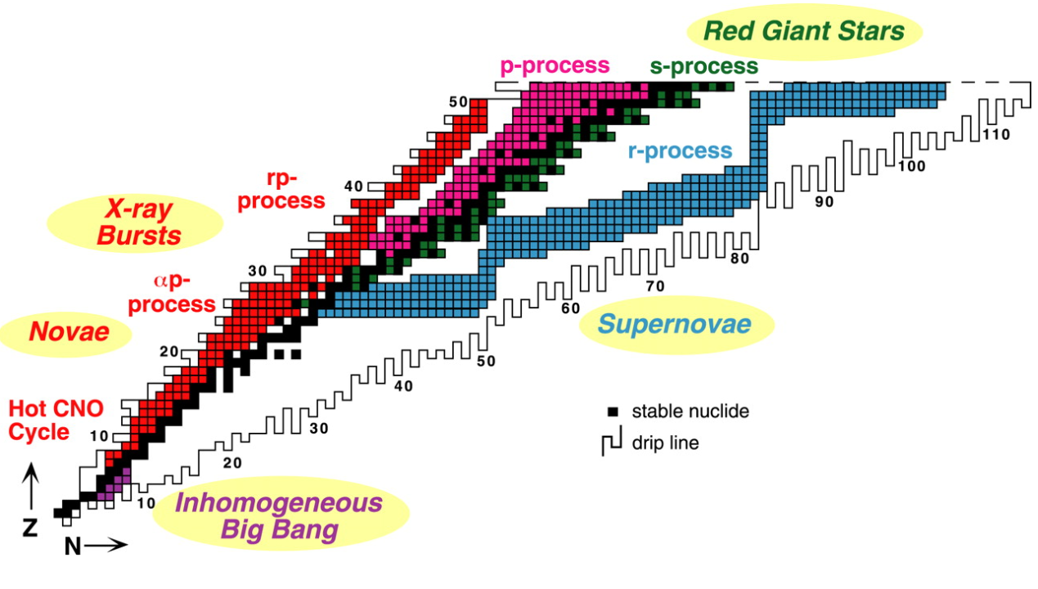
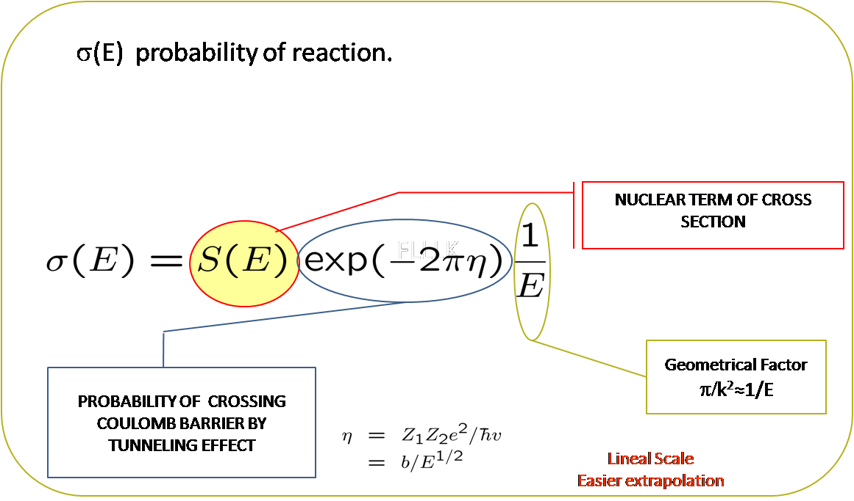
MOTIVATION : ASTROPHYSICAL SITES
M.S. Smith and K.E. Rehm Ann. Rev. Nucl. Part. Sci, 51 (2001) 91-130
(p, g), (p, a),
(a, g), (a, p),
(n, g)
A≈7
³He(⁴He,γ)⁷Be
1st time measured by Holmgren and Johnston PR 113, (1959) 1556
CROSS SECTIONS 1000 TIMES HIGHER THAN THOUGT PREVIOUSLY

Slide 4
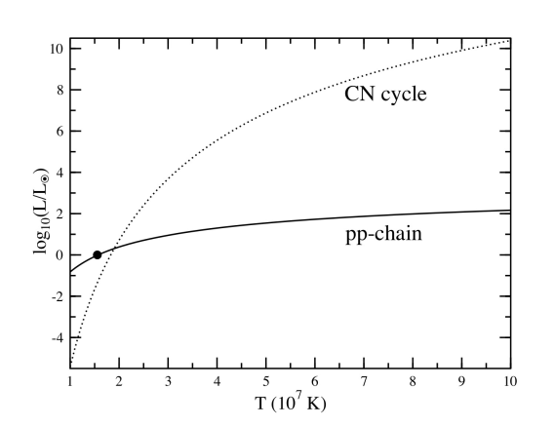
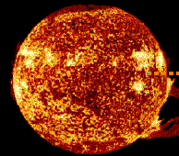
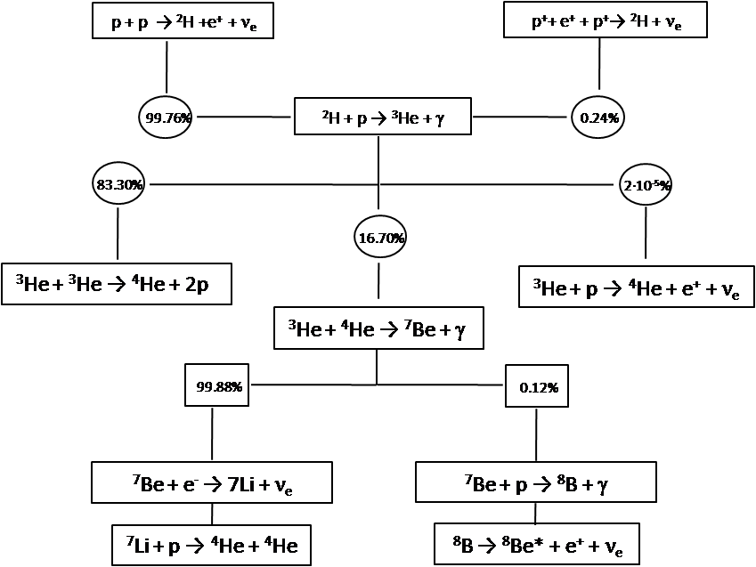
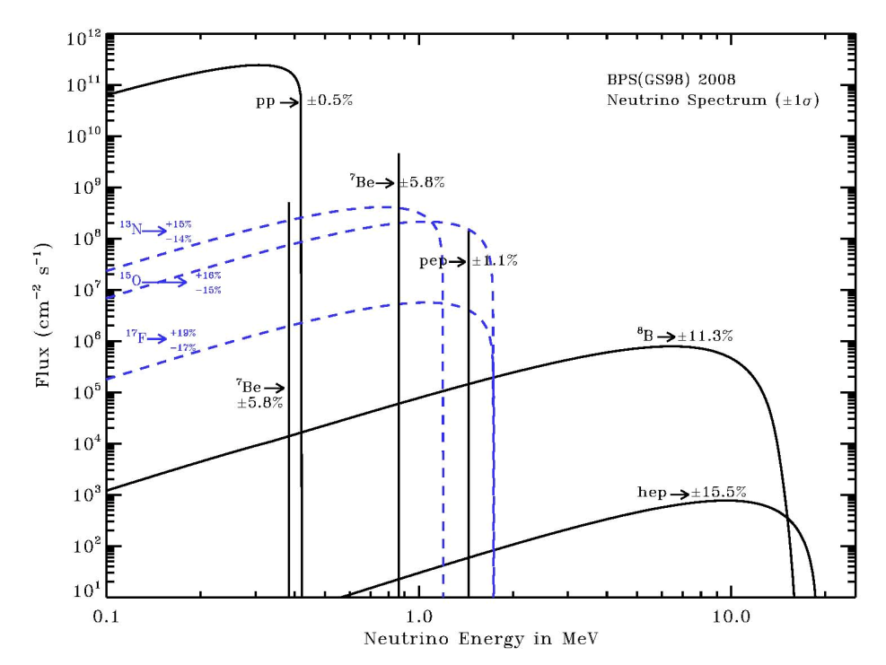
MOTIVATION : STANDAR SOLAR MODEL
Φ(⁸B) α S₃₄(0)^{0.86}
Φ(⁷Be) α S₃₄(0)^{0.81}
σ(E) of ⁴He(³He,γ)⁷Be reaction is an important parameter in SSM for determining the high
energy neutrino flux originating from the β decay of ⁸B following the reaction ⁷Be(p, ⁸B).

Slide 5
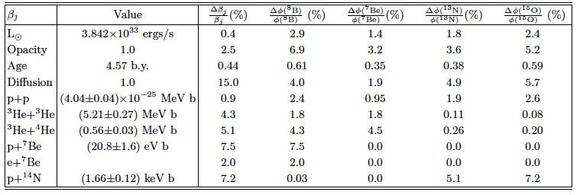
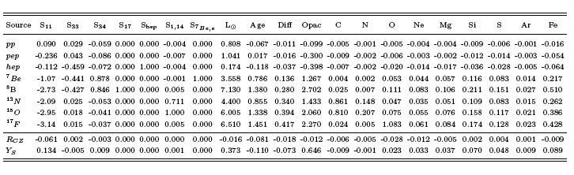
MOTIVATION : STANDAR SOLAR MODEL
It is the second largest error contribution among nuclear inputs parameter!
Logarithmic partial derivatives of neutrino fluxes with respect to solar inputs times uncertainties show leading sources of uncertainty
arXiv:0811.2424v1 [astro-ph]

Slide 6
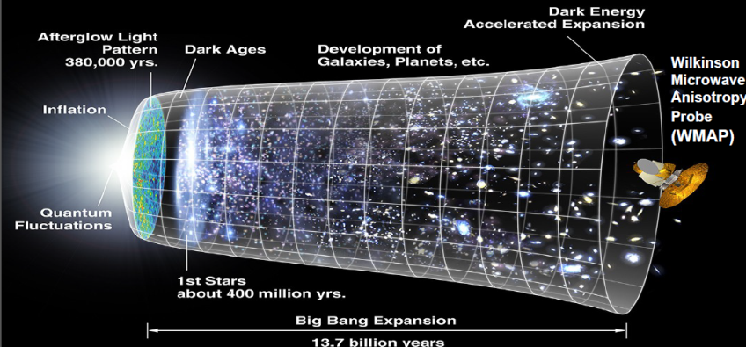
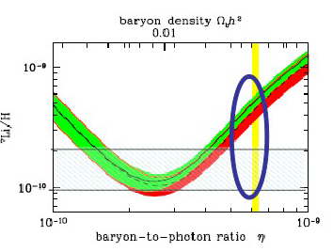
MOTIVATION :PRIMORDIAL ⁷Li
J. Cosm. Astr. Phys 11 (2008) 12
*WMPA estimates the baryon to photon ratio
*A factor 3 in relative abundance of ⁷Li
*Estimations predicted the relative abundances of ⁴He and D respect to H
*Some new approaches have been address without success:
O. S. Kirsebom and B. Davids. PRC84 (2011):
“In summary, we have shown that the 16.8-MeV state in ⁹B is unable to enhance the ⁷Be(d , p) reaction rate by the amount needed to resolve the cosmological lithium problem”
⁷Li/H α S₃₄(0)^{0.96}

Slide 7
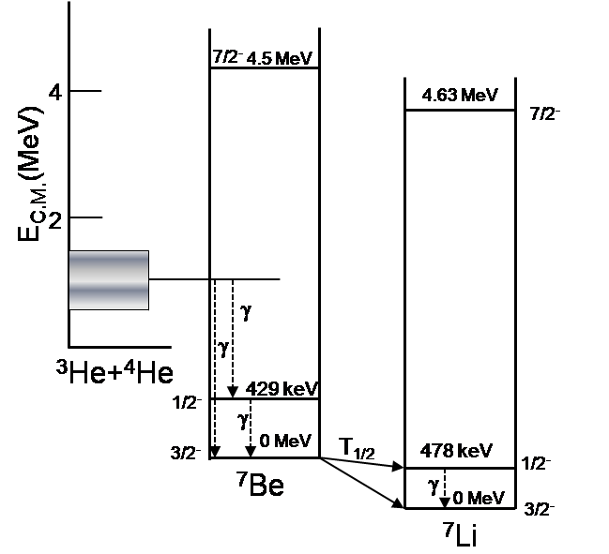
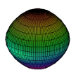
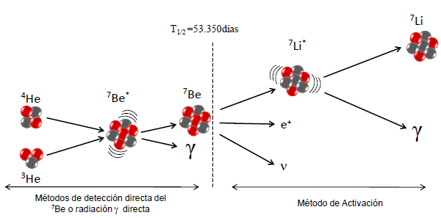
EXPERIMENTAL MEASUREMENT OF σ(E) FOR ⁴He(³He,γ)⁷Be
Direct detection of ⁷Be recoils produced during the reaction. (European Recoil Separator for Nuclear Astrophysics-ERNA)
Direct Detection of the gamma radiation from the de-excitation from the 429 keV state in ⁷Be
Delayed Detection of gamma radiation of the 478 keV state in 7Li after EC decay of 7Be:
T1/2=53.350 (50) days.
B.R 10.44%
Indirect Method: PRC 70, 011602(R) (2004)
Proton
⁴He
Neutron
⁴He
³He
⁷Be
…..coulomb breakup is the main reaction mechanism. The extraction of S34(0), using the Coulomb dissociation method, may be promising, but as yet, the uncertainties due to the nuclear and E2 contributions, along with the experimental uncertiainties in the measurement, makes it nuclear whether this method will be able to improve on the radiative capture measurements.
ν
⁷Be
⁷Li
Direct detection of 7Be or prompt
γ radiation detection
Activation Method
³He

Slide 8
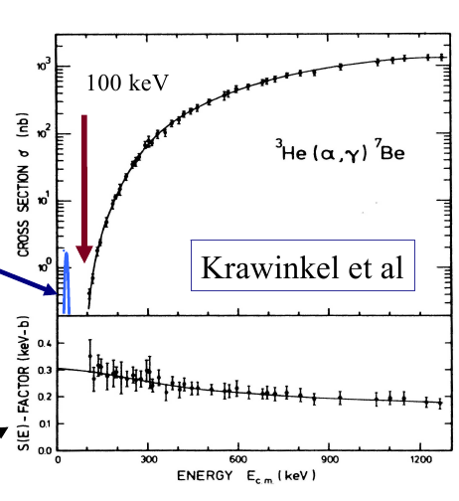
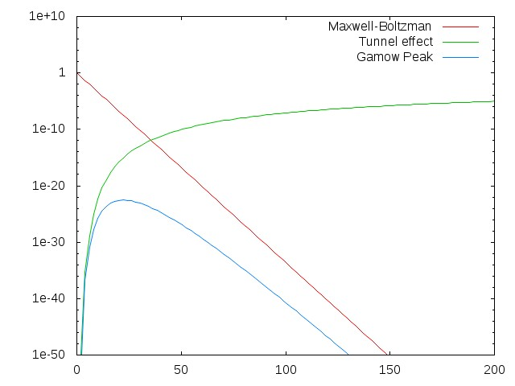
EXPERIMENTAL MEASUREMENT OF σ(E) FOR ⁴He(³He,γ)⁷Be
EXPERIMENTAL RESTRICTIONS → THEORETICAL MODELS→ EXTRAPOLATIONS TO THE ASTROPHYSICAL FACTOR

Slide 9
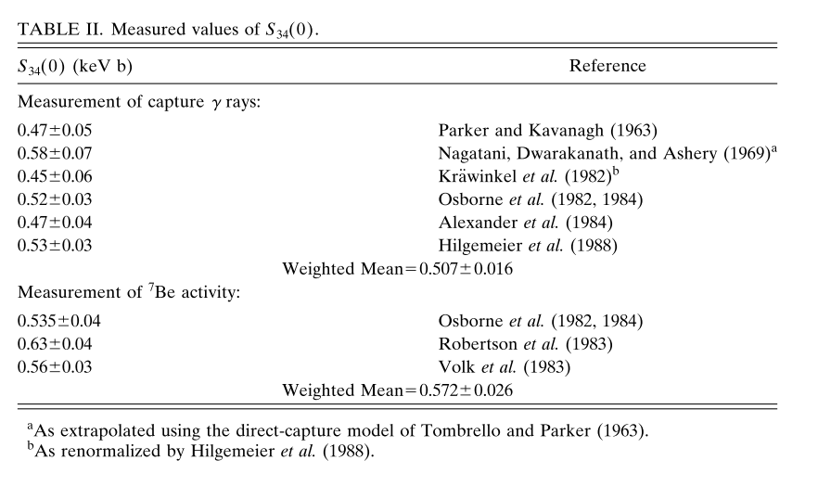
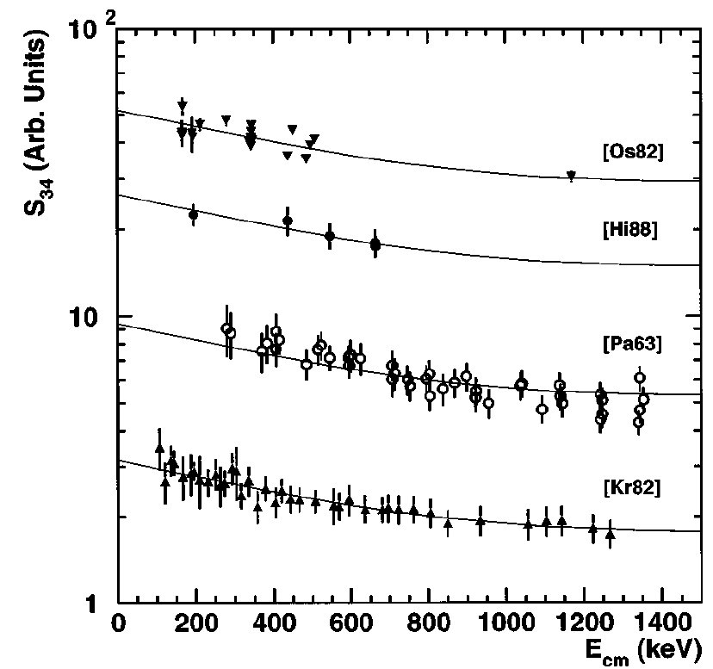
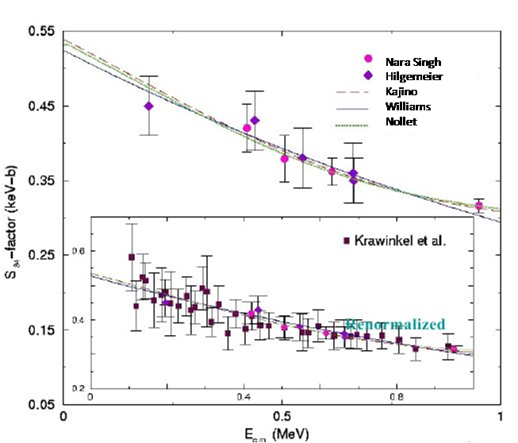
PREVIOUS DATA AND MODELS
Solar Fusion cross sections. I. Rev. Mod. Phys. Vol 70 No 4 (1998)
S₃₄(0)= (0.53±0.05)
B.S. Nara Singh et al.,
PRL 93, 262503 (2004)
S₃₄(0) =0.53(3)(1)

Slide 10
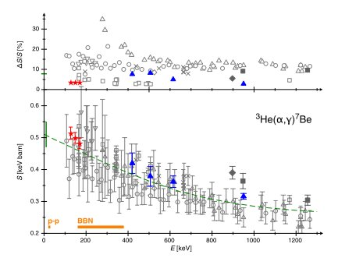
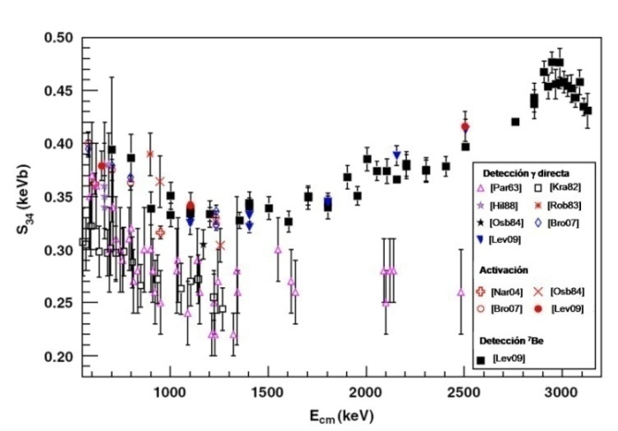
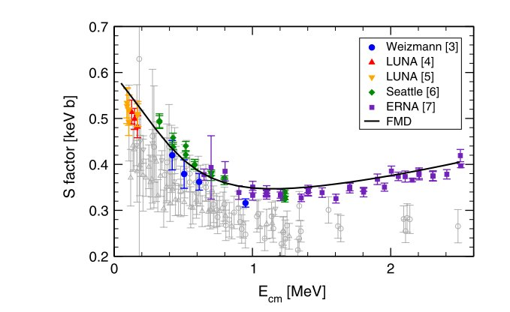
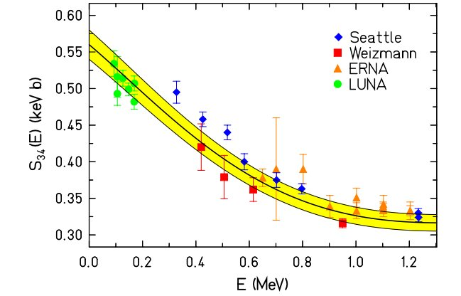
PREVIOUS DATA AND MODELS
LUNA: D. Bemmerer PRL 97, 122502 (2006)
ERNA: A. Di Leva PRL 97, 232502 (2009)
T Neff PRL 106, 042505 (2011)
Solar Fusion cross sections. II. Rev. Mod. Phys. Vol 83 No 1 (2011)
S₃₄(0)= 0.56 ± 0.03 (exp) ± 0.02 (theor) keV·b compared with the previous value (0.53 ± 0.05) keV·b
(The analysis is based on all activation data plus ERNA recoil data)

Slide 11

THE EXPERIMENT
GAS TARGET OF ⁴He AND BEAM OF ³He⁺ PARTICLE
BEAM ENERGIES: 2.3, 3.2, 4, 4.4, 4.8 5.3 MeV
The gas in the chamber must be separated
from the line by a Foil
foil must keep the pressure differences between
line and chamber
As thin scattering-foil as possible while still
resistant to heat from the beam → Ni foil 1 μm thick
GAS SYSTEM TO GUARANTEE CONSTANT PRESSURE IN THE REACTION CHAMBER
EXPRESION :
OBSERVABLES: Nº ion ⁷Be, nº of incident ³He⁺ ion, nº ions ⁴He in the target
EXPERIMENT IN 2009/2011

Slide 12
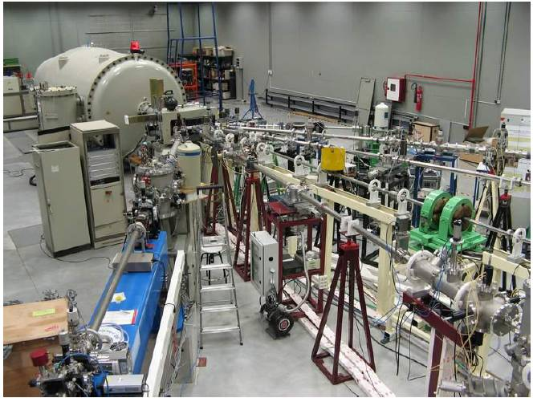
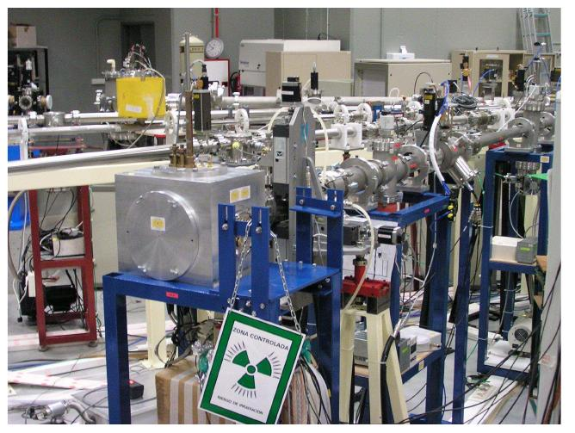
THE EXPERIMENT: CMAM
Centro de Microanálisis de Materiales de Madrid (CMAM), at Universidad Autónoma de Madrid
Seven experimental lines. One line for Experimental Nuclear Physics operated by Grupo de Fisica Nuclear Experimental del IEM-CSIC
High voltage system Cockcroft-Walton
Tandem electrostatic accelerator of 5MV
Two ion sources:
Sputtering source
  Duoplasmatron source
  (used during the experiment)
NUCLEAR PHYSICS LINE

Slide 13
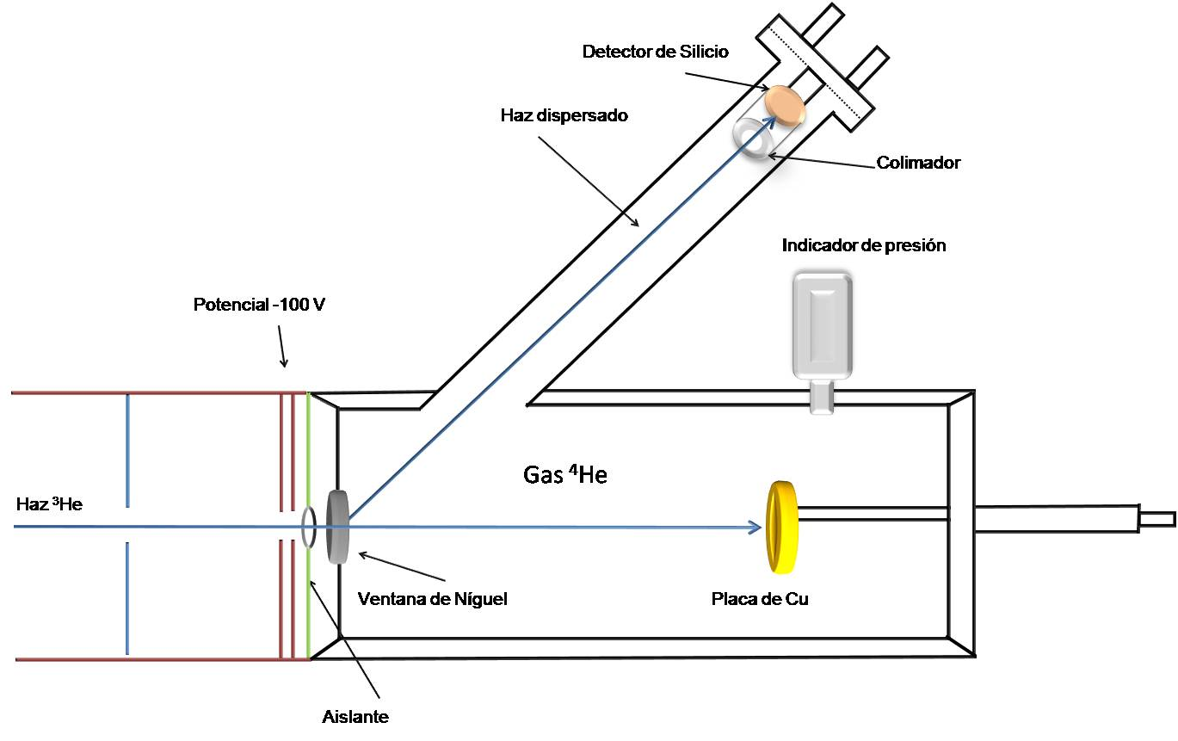
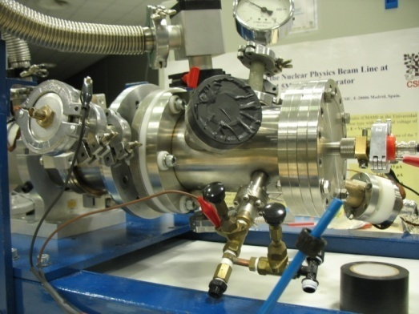
THE EXPERIMENT: SET-UP
N_{p} (monitoring)
Silicon detector
Scattered beam
Collimator
N_{p} (charge integration)
-180 V suppressor
Pressure gauge
⁴He Gas
³He beam
Ni foil
Cu catcher
N_{t}=9.966 ·10¹⁸· l·P/(T+T₀)
Insulator
⁷Be recoils

Slide 14
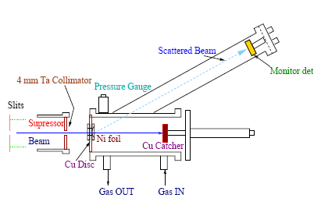
EXPERIMENTAL MEASUREMENTS
Catcher electrically connected to the chamber
Suppressor at -100V to avoid escape of e⁻ and loss of current integrations
≈1µA (6.2 · 10¹² ³He/s)
≈3µbar (≈50torr & 300K )
³He(⁴He,γ)⁷Be E_{γ} =429 KeV
· θ ≈ 45º
·E_{beam} ≈ 4 MeV / I ≈ 1µA
·t_{Ni} ≈ 1 µm / d = 8.9 g/cm³
·Energy-loss in the Ni foil
taken into account.
Assuming the R.S
at the middle of the foil
E_{beam}= 4 MeV
26.04 cm Ni foil - Si
Energy Loss in Ni foil
Some Parameters Leak Rate 0.10 torr/h (Very good)
      Line pressure ≈ 1.1 · 10⁻⁶ torr
      Typical currents 170 nA
C.R.≈ 295 7Be/s
7Be in catcher
≈4155 3He at 45º
-100V
E(3He at Si) ≈ 2.694 MeV

Slide 15
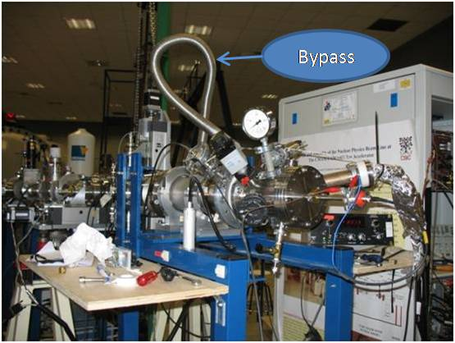
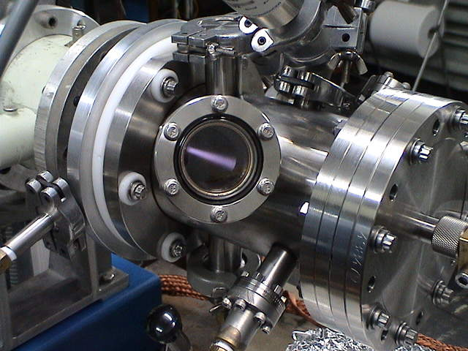
EXPERIMENTAL SET-UP II

Slide 16
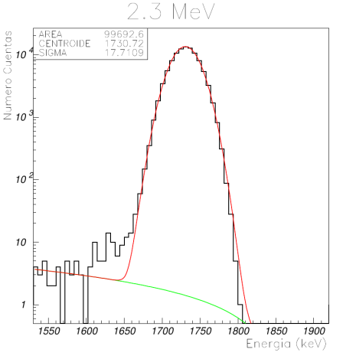
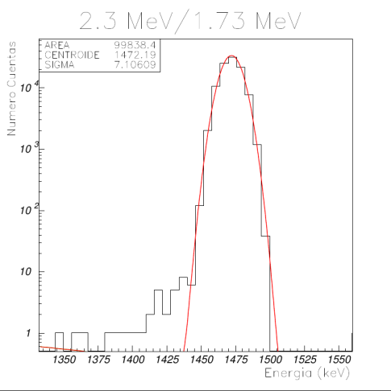
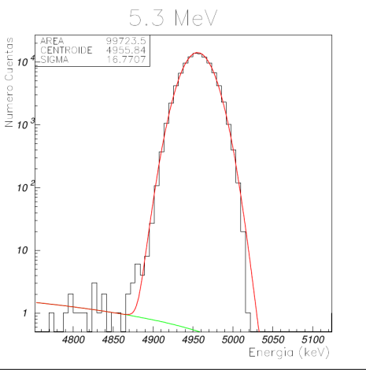
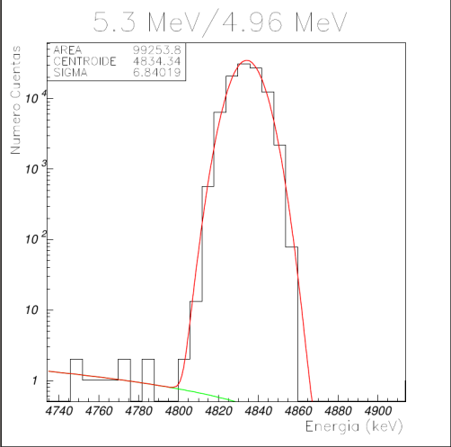
OBSERVABLES MEASUREMENTS
A) E_{CM}
We assume the reactions take placed at the center of gas target [1][2]
Beam energies with ±10 keV error
Energy loss in the Ni foil and gas target simulated with TRIM
Straggling in Ni foil and Gas target simulated with TRIM negligible
[1] B. S. Nara Singh et al. PRL 93, 262503 (2004)
[2]A.R. Junghans et al. PRL 88, 0411101 (2002)

Slide 17
OBSERVABLES MEASUREMENTS
B) ⁴He: (N_{t} : number of gas target ions per cm² ) Assuming ideal gas due to the low pressures we can consider:
P: gas pressure (Torr)
T₀ : room temperature (k)
l: target length (cm)
T_{c} temperature correction due to the beam heating measured experimentally using the 1.518 MeV resonance in the ¹⁰B(α,p)¹³C. 17K for 500nA @ 2 MeV. [1]
E_{beam} (MeV) | P^{on} (Torr) | T (K) | Distance (catcher-foil) | N_{t} (at/cm²)
2,1 | 60,14 | 301,62 | 12,472 | 2,40E+19 ± 1,26E+17
2,3 | 54,68 | 300,26 | 13,49 | 2,37E+19 ± 1,24E+17
2,5 | 60,16 | 303,20 | 11,635 | 2,23E+19 ± 1,16E+17
2,8 | 60,08 | 305,42 | 12,003 | 2,28E+19 ± 1,18E+17
3,2 | 63,77 | 309,23 | 13,49 | 2,69E+19 ± 1,36E+17
4 | 60,18 | 307,78 | 13,113 | 2,48E+19 ± 1,26E+17
4,4 | 50,66 | 316,51 | 11,02 | 1,70E+19 ± 8,65E+16
4,8 | 50,83 | 318,44 | 11,12 | 1,71E+19 ± 8,65E+16
5,3 | 56,68 | 319,04 | 13,29 | 2,28E+19 ± 1,20E+17

Slide 18
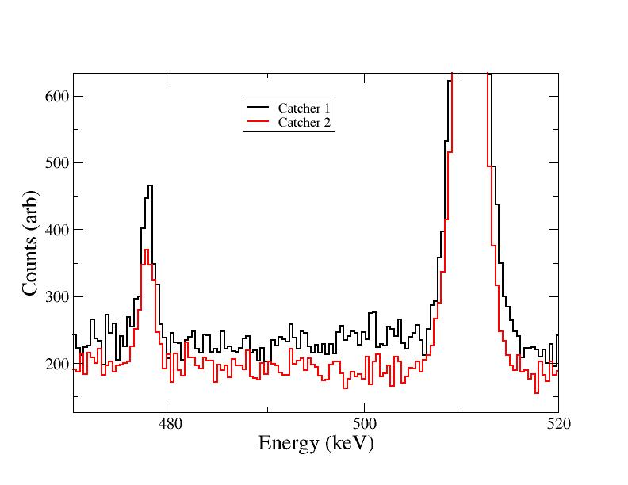
OBSERVABLES MEASUREMENTS
C) ³He: Charge Integration & Elastic Scattering in the Ni foil
E_{beam} (MeV) | INTENSITY (pulses) | N_{P} (CI) | R.Integ | N_{P} (RS) | Differnce
2,1 | 66728190 | 4,17E+16 | 1,04E+08 | 3,95E+16 | 5,17%
2,3 | 45392867 | 2,83E+16 | 5,90E+07 | 2,79E+16 | 1,38%
2,5 | 79411131 | 4,96E+16 | 7,96E+07 | 4,75E+16 | 4,24%
2,8 | 84483595 | 5,27E+16 | 6,67E+07 | 5,00E+16 | 5,26%
3,2 | 79985633 | 4,99E+16 | 4,93E+07 | 5,00E+16 | -0,14%
4 | 1,08E+08 | 6,77E+16 | 4,04E+07 | 6,93E+16 | -2,31%
4,4 | 83724293 | 5,23E+16 | 2,54E+07 | 5,16E+16 | 1,20%
4,8 | 51641298 | 3,22E+16 | 1,29E+07 | 3,17E+16 | 1,66%
5,3 | 62372718 | 3,89E+16 | 1,27E+07 | 3,98E+16 | -2,14%
D) ⁷Be:
~900 cts. in 478 peak.
6 days of counting
E) Complementary measurements
Angle of Silicon Detector → 44.9 (2)˚
Ni foil thickness → 1.03 (2) μm
Collimator radius → 0.270 (3) mm

Slide 19
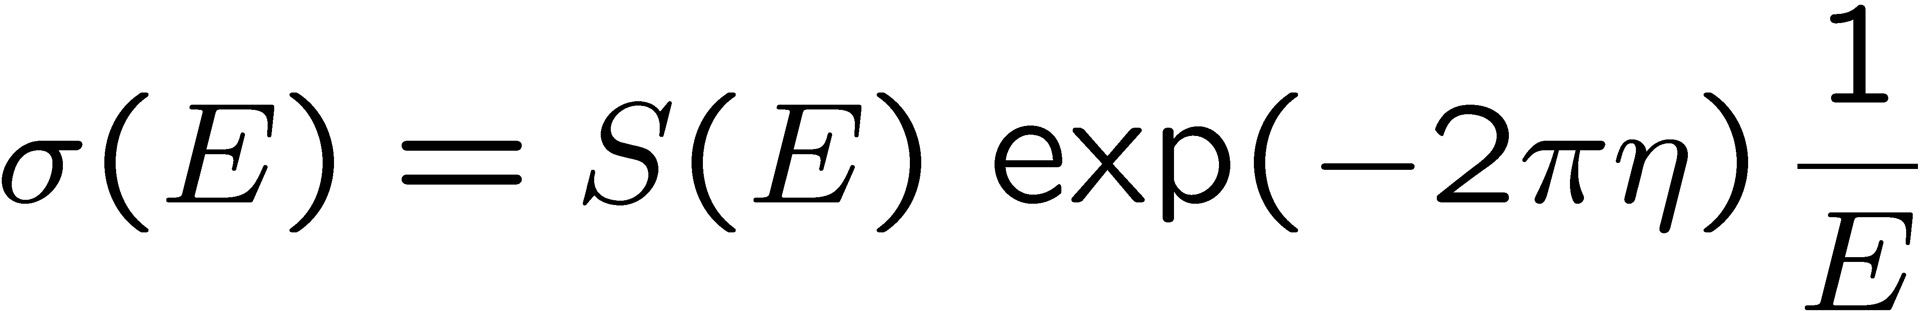
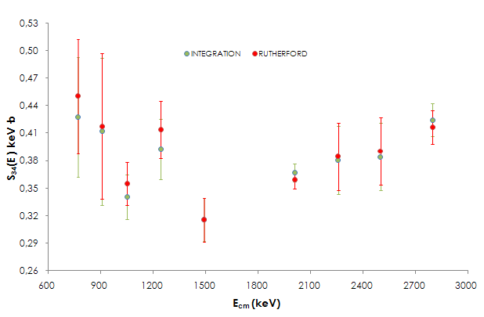
RESULTS Ι
E_{CM} (KeV) | σ (Ε) (μb) | S₃₄(E)^{IC} (keV·b) | S₃₄(E)^{RS} (keV·b)
768,2 | 1,49 | 0,43(15)(6) | 0,45(7)(5)
906,5 | 1,95 | 0,41(19)(4) | 0,42(8)(4)
1050,2 | 2,05 | 0,34(7)(4) | 0,36(2)(3)
1242,4 | 3,00 | 0,39(8)(4) | 0,41(3)(3)
1489,8 | 3,02 | 0,32(8)(3) | 0,32(2)(2)
2009,0 | 4,6 | 0,37(3)(3) | 0,36(1)(2)
2257,3 | 5,33 | 0,38(10)(3) | 0,38(4)(2)
2500,2 | 5,77 | 0,38(9)(3) | 0,39(4)(2)
2797,7 | 6,82 | 0,42(4)(3) | 0,42(2)(2)
GOOD AGREEMENT BETWEEN BOTH TECHNIQUES
PRELIMINARY

Slide 20
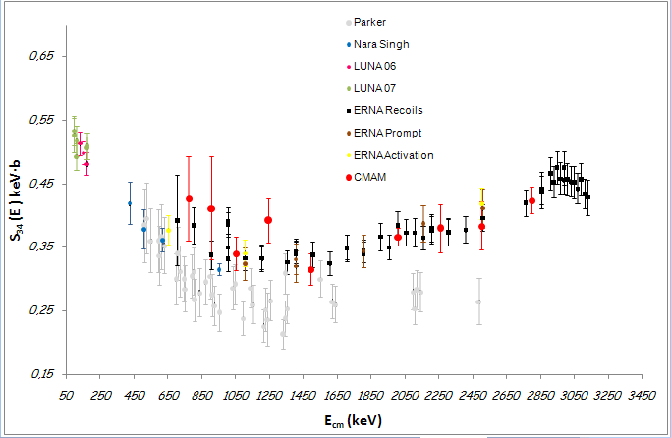
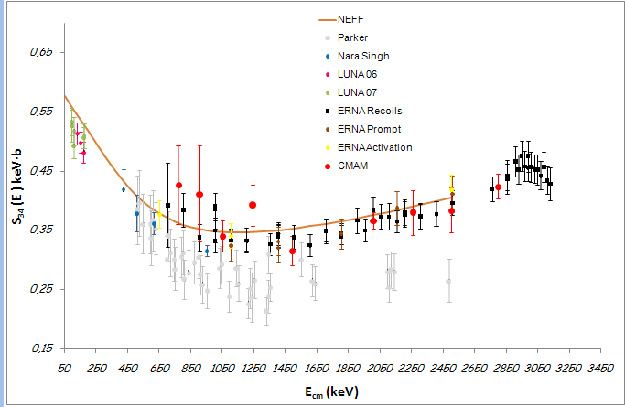
RESULTS ΙΙ: COMPARISON
PRELIMINARY
NEAR FUTURE WORK: NEW MEASUREMENTS IN THE SAME RANGE IN THE NEW SINGLE ENDED 3MEV ACCELERATOR AT UNIVERSITY OF AARHUS…EXPECTED CURRENTS 3 TIMES HIGHER, AND DOBLE TIME MEASUREMETS→ STATISTICAL ERRORS MUCH LOWER THAN 3%

Slide 21
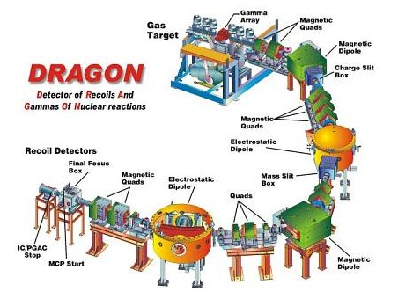
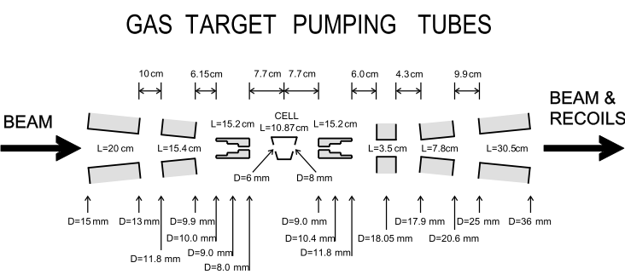
ONGOING WORK
THREE NEW MEASUREMTS ALREADY DONE WITH DRAGON – TRIUMF:
DIRECT DETECTION OF THE ⁷Be RECOILS AT DSSSD detector.
³HE WINDOWLESS TARGET @ 6 TORR

Slide 22
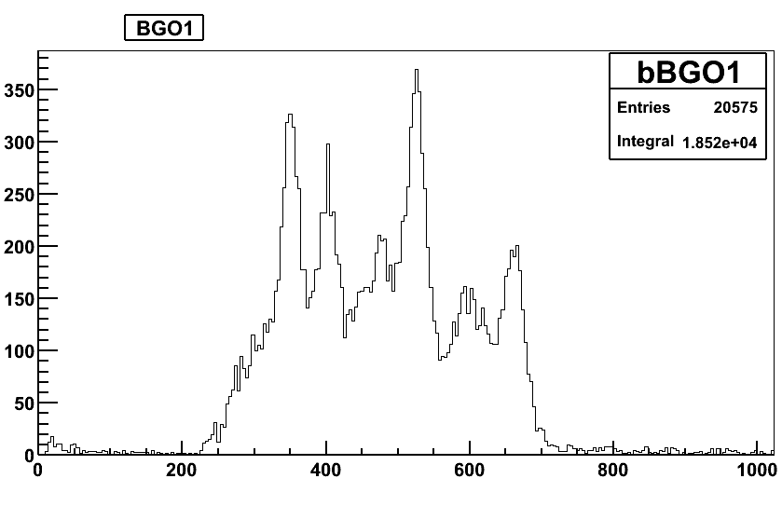
ONGOING WORK
BEAM SUPPRSION OF ≈10¹⁵ !!!!
TARGET DENSITY PROFILE MEASUREMENTS ALREADY DONE WITH THE REACTION ¹²C(³He, γ)

Slide 23
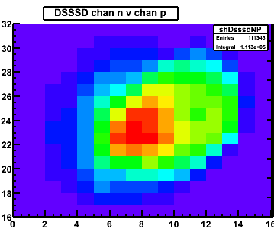
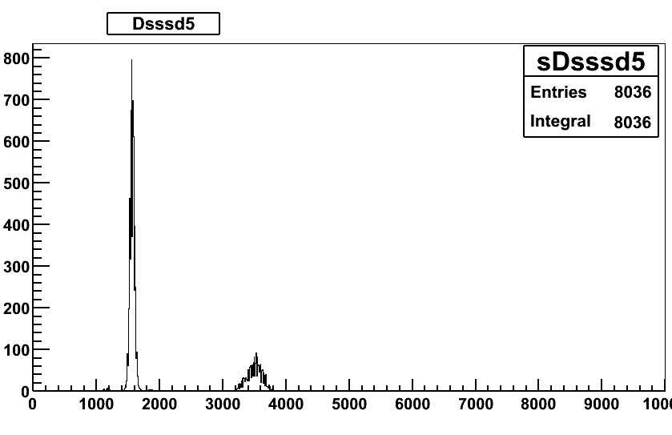
THREE ENERGIES MEASURED @ 6.6 , 5.2 and 3.5 MeV →
CM energies: 2.8, 2.2 and 1.5 MeV
KEY QUESTIONS REMAINING: NEXT SPRING MEASURMENTS OF THE CHARGE STATE DISTRIBUTION WITH A STABLE Be BEAM.

Slide 24
º
THANK YOU
FOR YOUR ATTENTION
S34-CMAM
Instituto de Estructura de la Materia-CSIC: M. Carmona-Gallardo, O.Tengblad ,A. Perea, M.J.G. Borge, J.A. Briz,
M. Cubero, V. Pesudo, G. Ribeiro, J. Sánchez del Rio
University of York: B.S. Nara Singh, B.R. Fulton, J. McGrath
Centro de Microanalisis de Materiales (CMAM): A.M. Martin
The Weizmann Institute: M. Hass, V. Kumar, K. Singh
Soreq Nuclear Research Centre: Y. Nir-El, G. Haquin, Z.Yungreiss.
University of Aarhus: H. Fynbo
S34-TRIUMF
Instituto de Estructura de la Materia-CSIC: M. Carmona-Gallardo, O. Tengblad,
University of York: B.S. Nara Singh, B.R. Fulton, A.M. Laird, S.P. Fox
TRIUMF: B. Davids, A. Rojas, A. Shotter, C. Ruiz, D. Ottewell, D.A. Hutcheon, G. Ruprecht, J.Fallis, L. Buchmann,
S.K.L. Sjue, U. Hager, S. Triambak
The Weizmann Institute: M. Hass
Simon Fraser University: S. Reeve, D. Howell, N. Galinski
NSCL, Michigan State University: R.H. Cyburt

