Slide 1



Slide 2
Outline
The motivation to study this reaction
Experimental setup
Choice of the measurement parameters
Possible data analysis approach
GEANT4-simulations
Ongoing work and summary

Slide 3
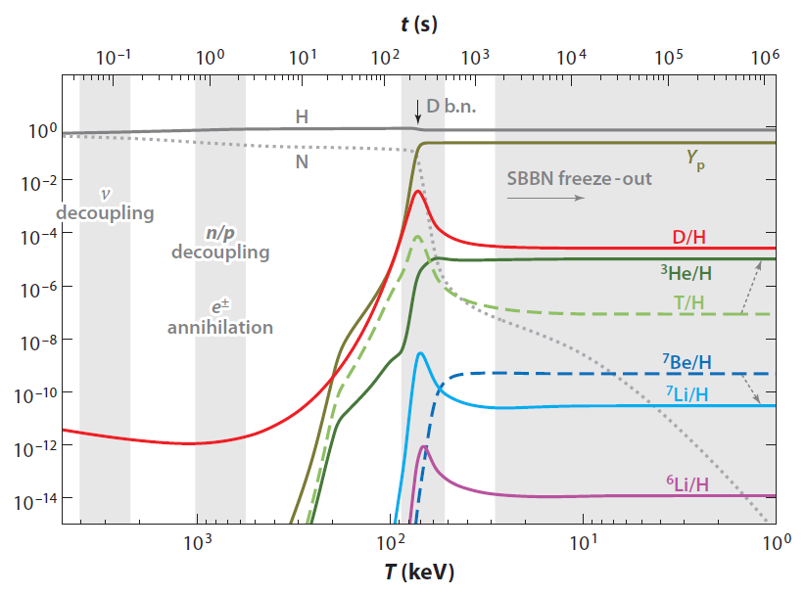
The motivation to study this reaction
comparably small
amount of ⁶Li has been
synthesized during Big
Bang nucleosynthesis
production mainly by
d(α,γ)⁶Li
in later periods further
depletion and
production of Li may
have occurred
expected: no or variable
Li abundance in stars
[taken from M. Pospelov and J. Pradler,
Annu.Rev.Nucl.Sci. 2010, 60:539-568]

Slide 4
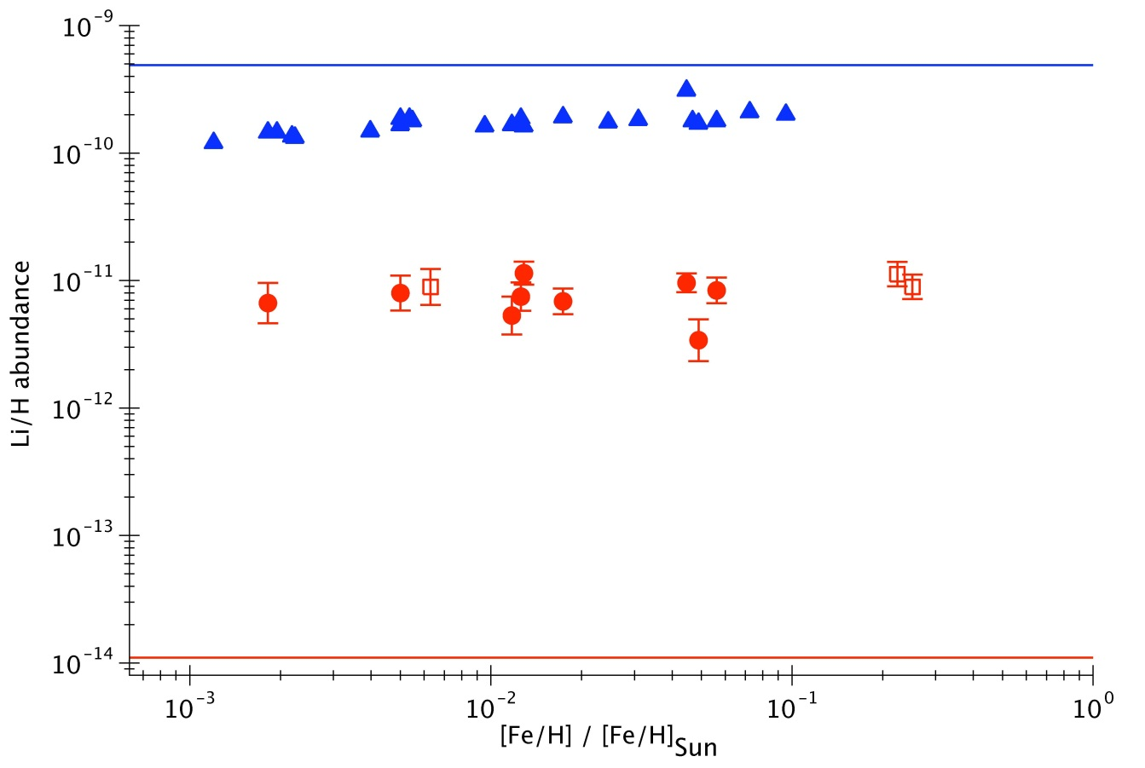
The motivation to study this reaction
BBN prediction
constant amount of
Li is found in stars
of different metallicity
(which is the content of
heavy elements)
prediction, using known
nuclear reaction rates:
three orders of
magnitude less ⁶Li
is this Li primordial?
do we have wrong
nuclear reaction rates?
⁷Li
⁶Li
BBN prediction
[data from M. Asplund et al.,
Astrophys. J. 644, 229 (2006)]

Slide 5
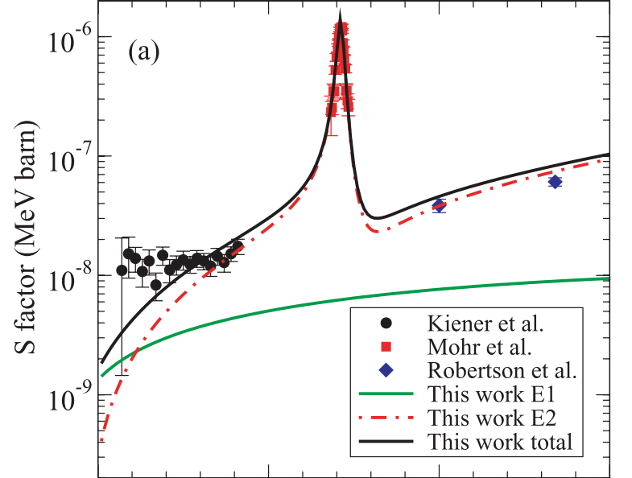
The motivation to study this reaction
Direct measurements so far:
Robertson et al. 1991, E > 1 MeV
Mohr et al. 1996, around the
resonance at 0.7 MeV
Recent indirect measurements
(high energy coulomb breakup)
by Hammache et al. at GSI
GSI work provided upper limits,
due to nuclear breakup contribution
direct measurement at LUNA
is possible
LUNA
BBN
energy region
0
0.5
1.0 MeV
[taken from F. Hammache et al.,
Phys. Rev. C 82, 065803 (2010)]

Slide 6
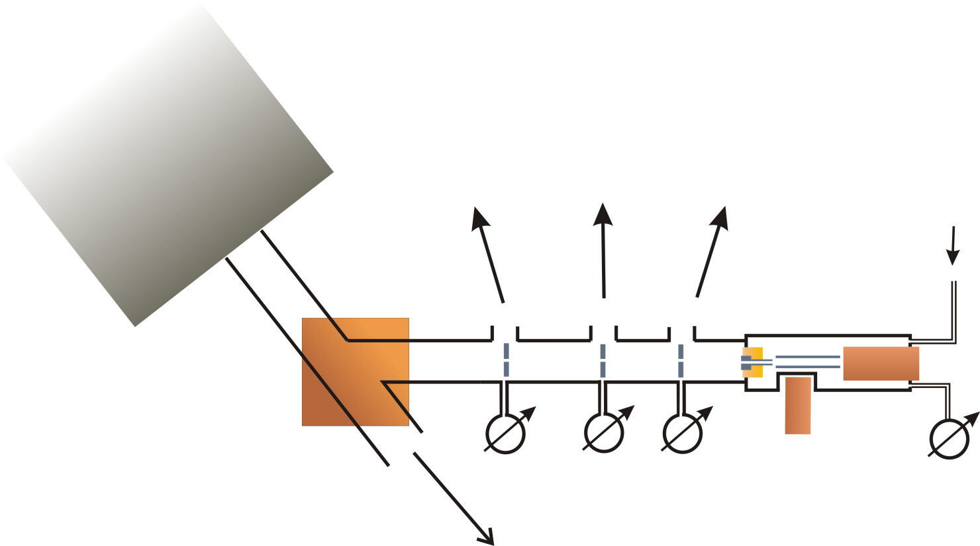
Experimental setup
⁴He beam on a windowless D₂ gas target
beam current measurement by calorimeter
HPGe detector for γ detection, Si detector for protons
pumping stages
Accelerator
3rd
4∙10⁻⁷ mbar
2nd
6∙10⁻⁷ mbar
1st
8∙10⁻⁴ mbar
D₂ gas inlet
Si detector
calorimeter
Magnet
target
0.3 mbar
HPGe detector (137%, ULB)
to solid target

Slide 7
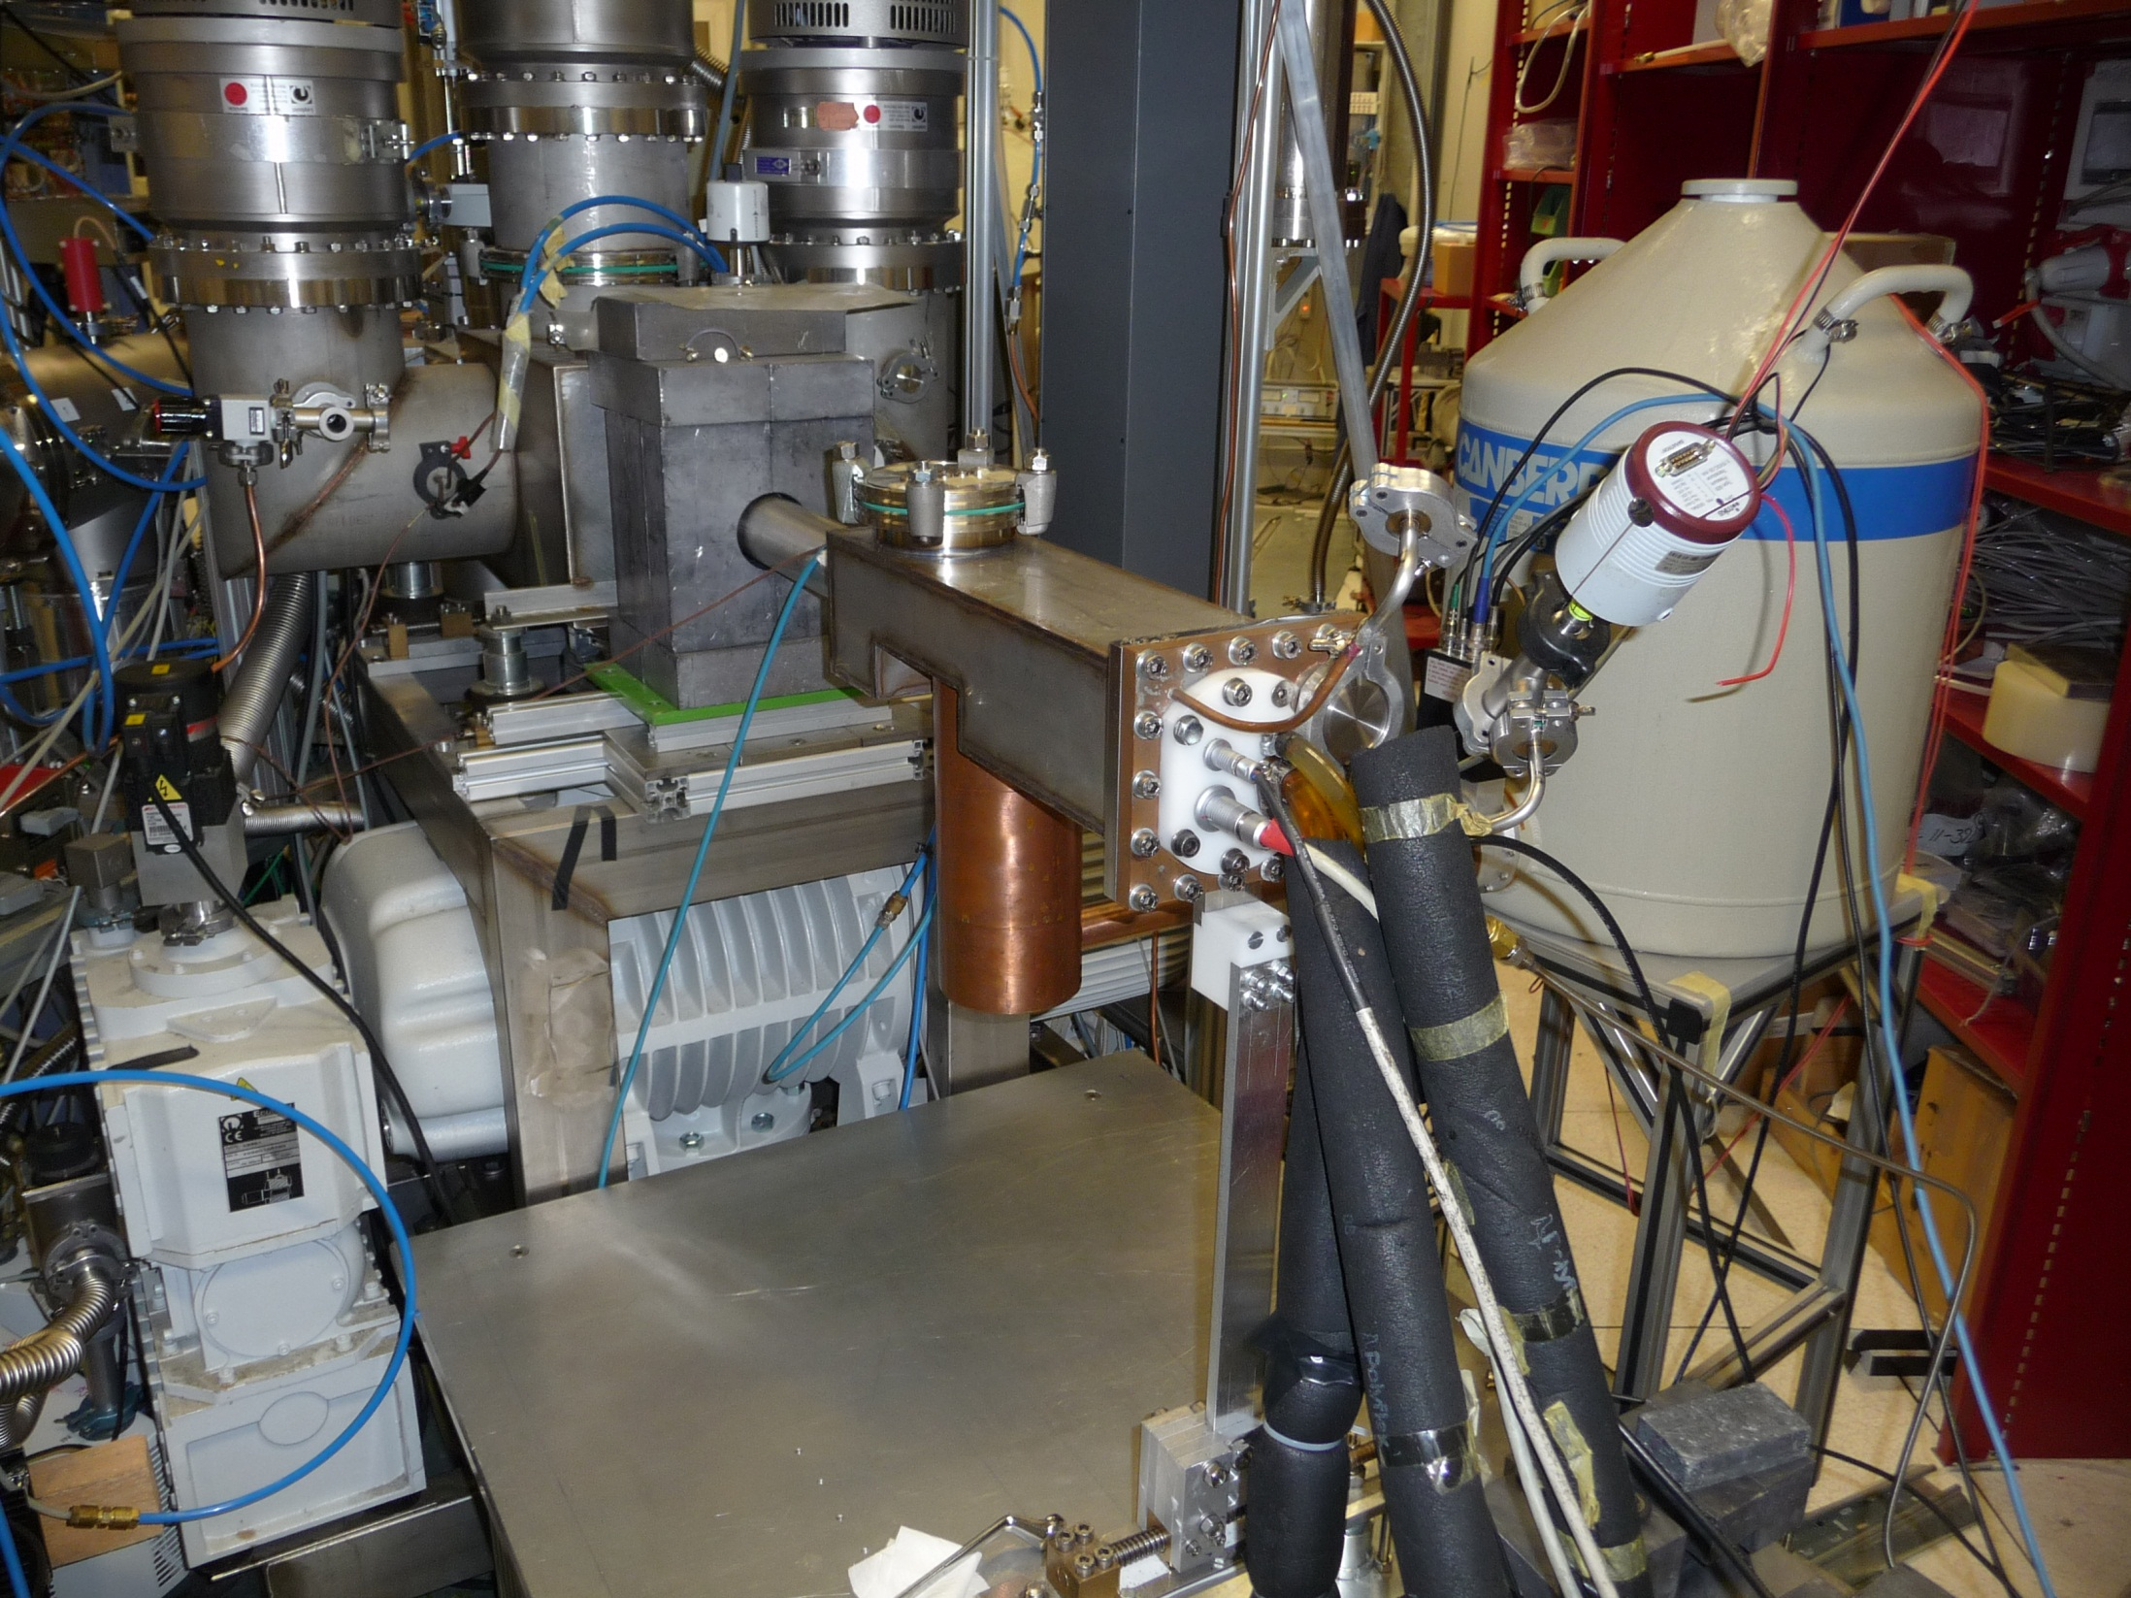
About the experimental setup

Slide 8
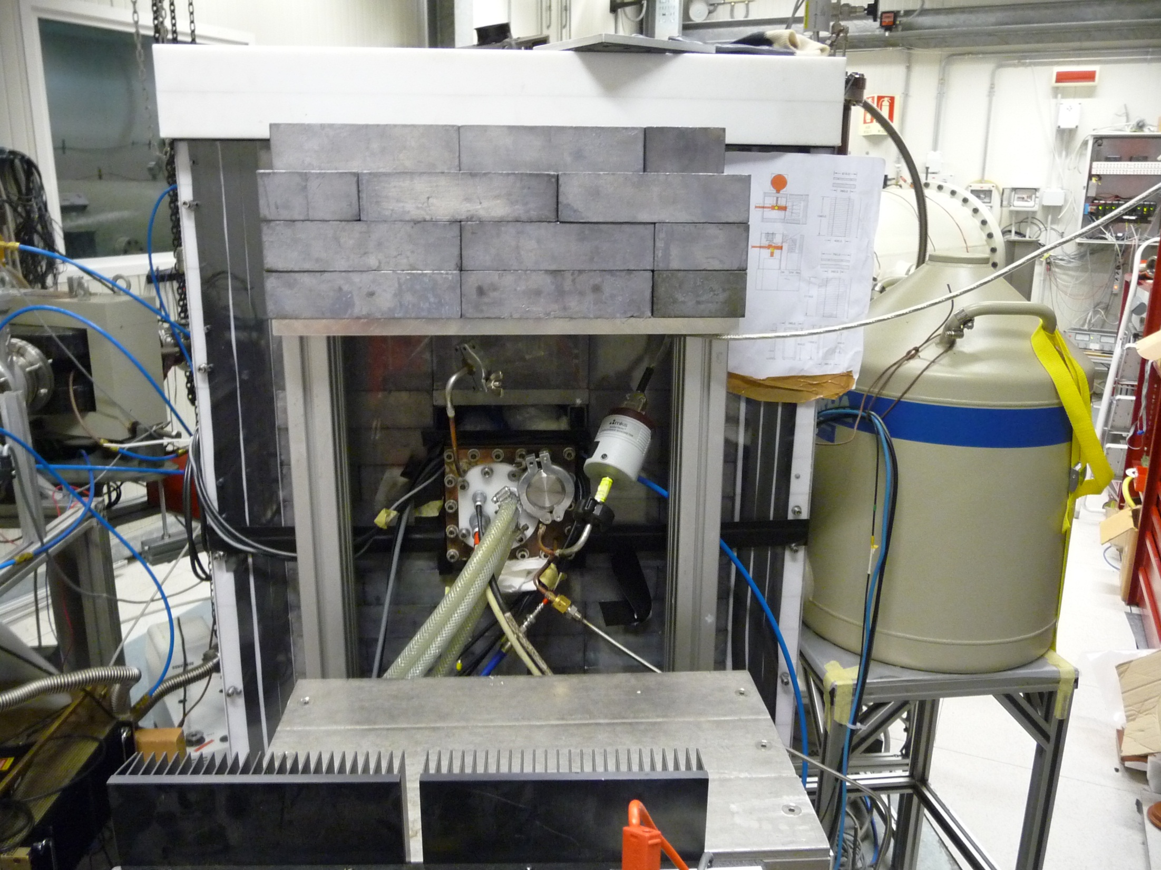

Slide 9
Experimental setup
The data aquisition system:
Ortec Maestro for the HPGe and the silicon detector
Caen N1728B digitizer („TNT2“) for the HPGe detector (working in parallel)
calorimeter and gas target data are stored permanently
Data obtained since September 2010:
0.2 mbar, 400 keV: 200 h, 185 C
0.3 mbar, 280 keV: 490 h, 540 C
0.3 mbar, 400 keV: 440 h, 520 C
about 20 days of natural background data

Slide 10
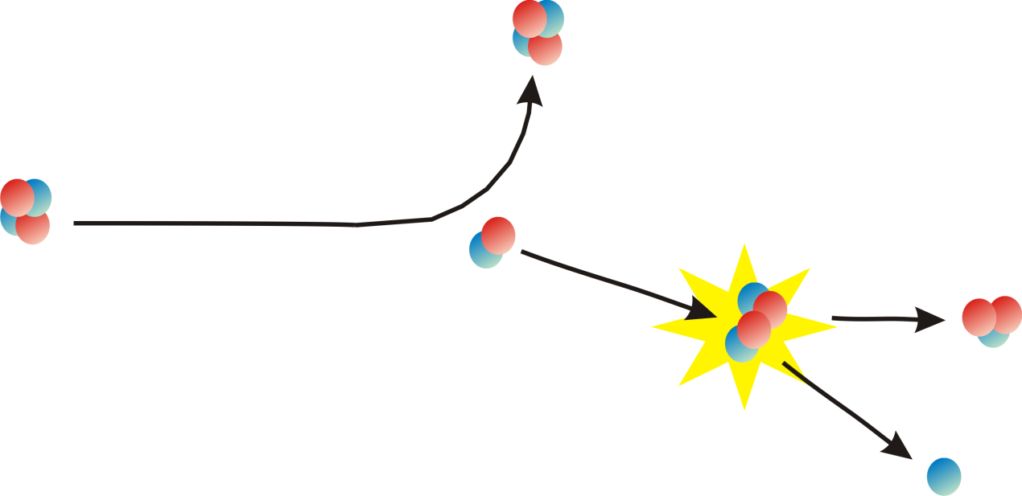
Choice of the measurement parameters
Main background sources:
²³⁸U and daughter nuclides from the surrounding rock
²³²Th and daughter nuclides from dirt and from lead bricks
but much more important is the beam induced background:
²H(α,α)²H
Rutherford scattering
also ²H(²H,p)³H
occurs with similar cross section
monitoring of neutron production
²H(²H,n)³He
d+d - reaction

Slide 11
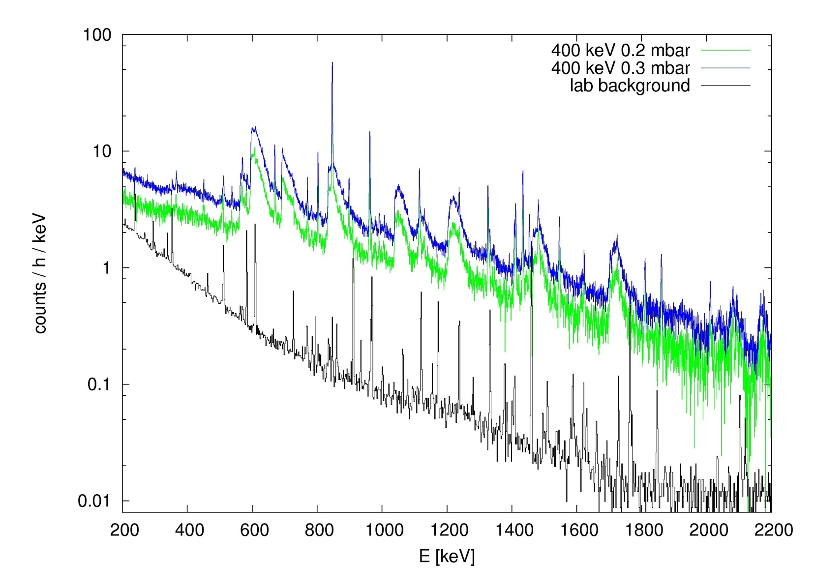
Choice of the measurement parameters
TNT2 data, lab background subtracted, normalized

Slide 12
Choice of the measurement parameters
Parameter | Yield depends… | Constraints | Choice
beam energy | exponential | LUNA2 accelerator provides up to 400 keV beams | 400 keV (and 280 keV)
beam intensity | nearly linear | accelerator capability and LNGS neutron rate limitation | up to 350 µA
gas target pressure | nearly linear | quadratic increase of neutron production | 0.3 mbar
measurement time | linear | increasing neutron production due to implantation

Slide 13
Possible data analysis approach
Where is the d(α,γ)⁶Li gamma signal expected to be found?
very broad signal, position depends on beam energy
low expected signal counting rate in Ge detector (max. 2 counts / hour)
similar natural background rate inside the fully shielded setup
$E_{γ}=Q+\frac{m_{α}}{m_{α}+m_{d}}E_{α}−\frac{E_{γ}^{2}}{2{(m}_{{}_{}^{6}{Li}})c^{2}}−\frac{v}{c}E_{γ}cosθ=1590…1622 keV$ (400 keV beam)
energy of recoiled ⁶Li
(0.14 keV)
Doppler shift
(± 16 keV)

Slide 14
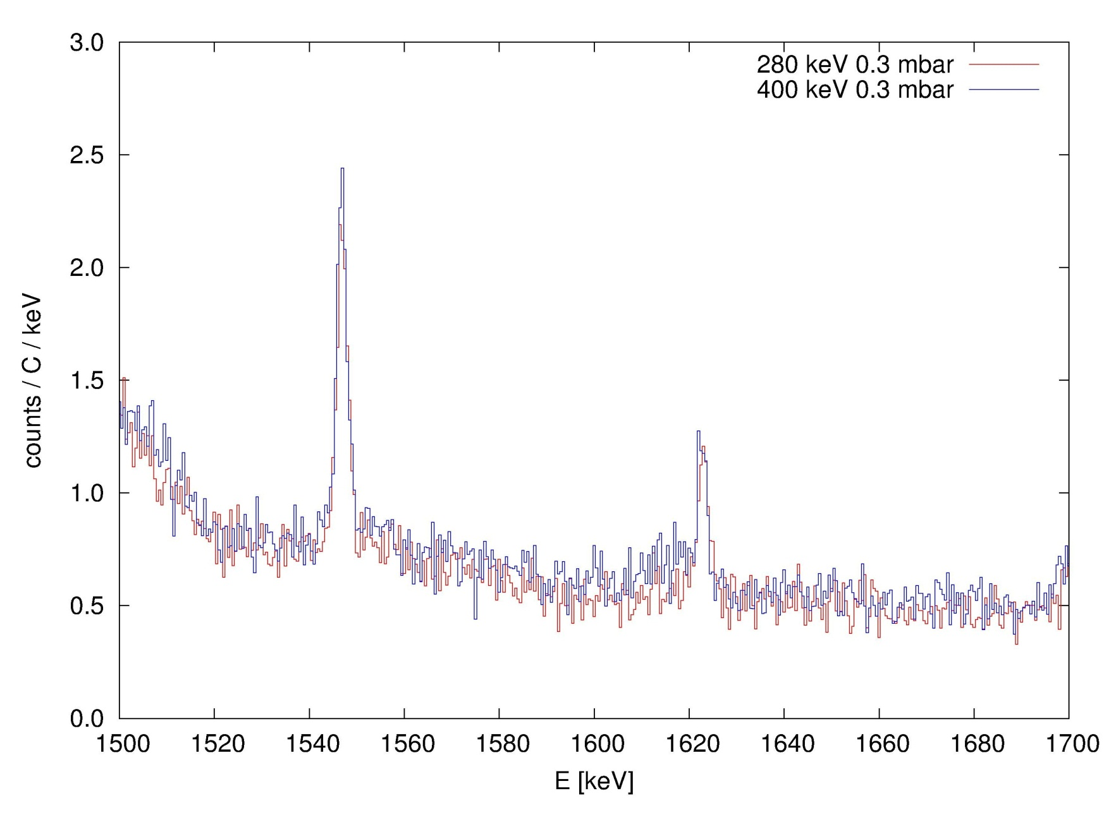
Possible data analysis approach
1549 keV
⁶³Cu(n,n‘γ)
280 keV ROI
400 keV ROI
How can a yield
be extracted?
1623 keV
⁶⁵Cu(n,n‘γ)
TNT2 data, May/June 2011, lab background subtracted, normalized

Slide 15
Possible data analysis approach
Beam induced background
subtraction approach
But:
both spectra to be subtracted have to be normalized (to include the same beam
induced background)
due to different neutron energy spectra, the normalization factor
depends on the gamma energy
1623 keV
⁶⁵Cu

Slide 16
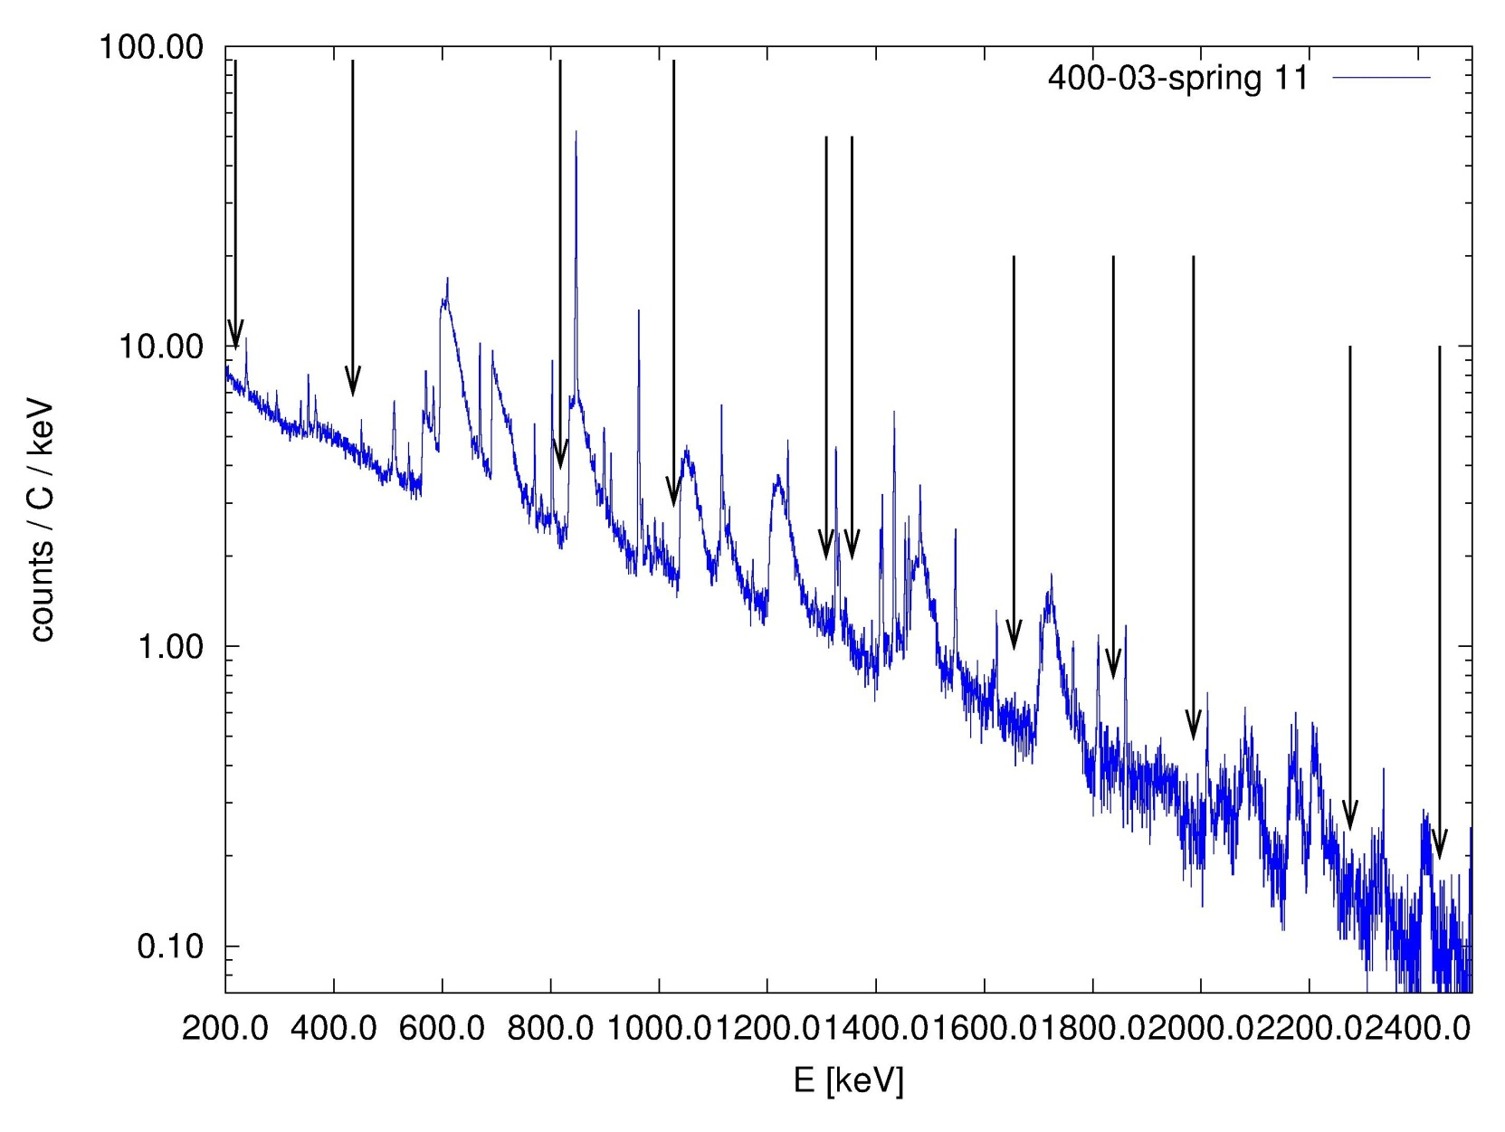
Possible data analysis approach
choice of several „flat“ regions to calculate beam induced background ratios along the spectrum
200 600 1000 1400 1800 2200

Slide 17
Possible data analysis approach
„Flat“ regions:
(with May/June 2011 data; natural background is subtracted)

Slide 18
Possible data analysis approach
Plot of flat region contents, normalized by charge and region width

Slide 19
Possible data analysis approach
the beam induced background ratio depends on the
region energy!

Slide 20
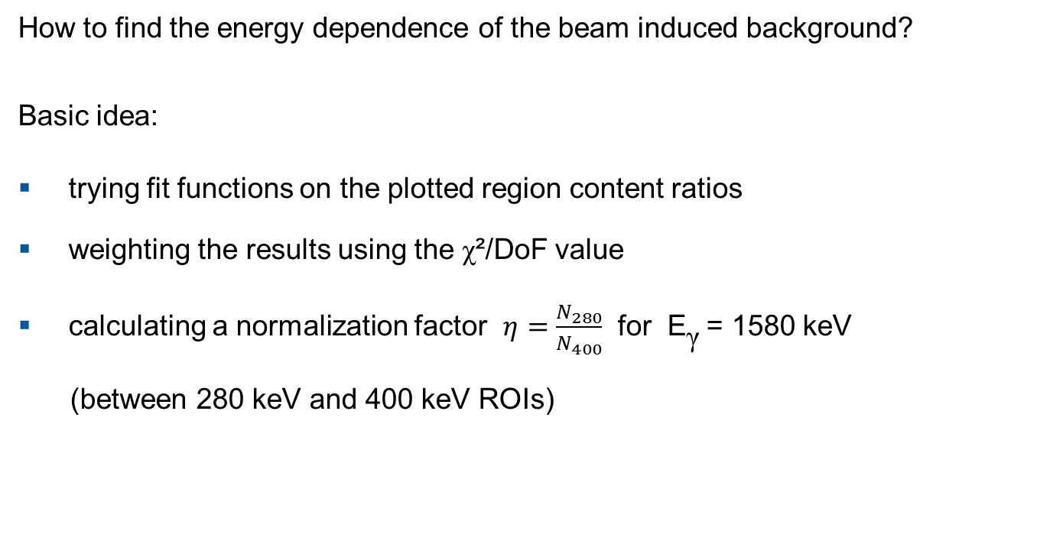
Possible data analysis approach
How to find the energy dependence of the beam induced background?
Basic idea:
trying fit functions on the plotted region content ratios
weighting the results using the χ²/DoF value
calculating a normalization factor $η=\frac{N_{280}}{N_{400}}$ for E_{γ} = 1580 keV
(between 280 keV and 400 keV ROIs)

Slide 21
Possible data analysis approach

Slide 22
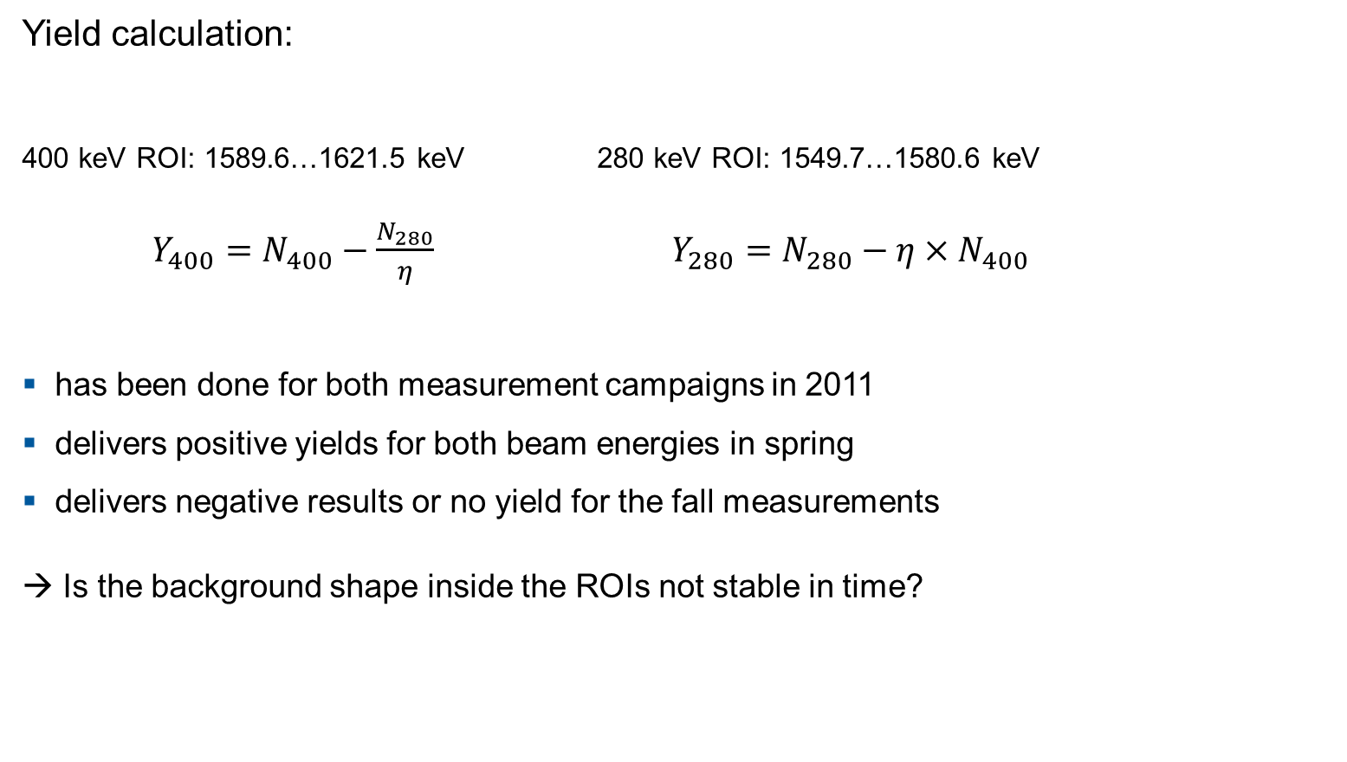
Possible data analysis approach
Yield calculation:
400 keV ROI: 1589.6…1621.5 keV 280 keV ROI: 1549.7…1580.6 keV
$Y_{400}=N_{400}−\frac{N_{280}}{η}$ $Y_{280}={N_{280}−η×N}_{400}$
has been done for both measurement campaigns in 2011
delivers positive yields for both beam energies in spring
delivers negative results or no yield for the fall measurements
→ Is the background shape inside the ROIs not stable in time?

Slide 23
Possible data analysis approach
0.3 mbar TNT2 data
400 keV and 280 keV
raw spectra
sum of counts in
200…4000 keV
normalized by time
Counts/s
spring 2011
fall 2011
Charge (C)

Slide 24
Possible data analysis approach
Analysis constraints
Observation | Reason | Problem
no distinct d+α signal is visible | small effect compared to others | subtraction of a spectrum without the signal is necessary
increasing beam induced background with time | implantation of deuterium in metal surfaces | pure charge ratios not useable for spectra normalization
spectrum shape depends on beam energy | different neutron energy spectrum | energy dependent normalization factor is necessary
spectrum shape depends on measurement time | implantation changes neutron source distribution | frequent exchange of affected setup parts is necessary

Slide 25
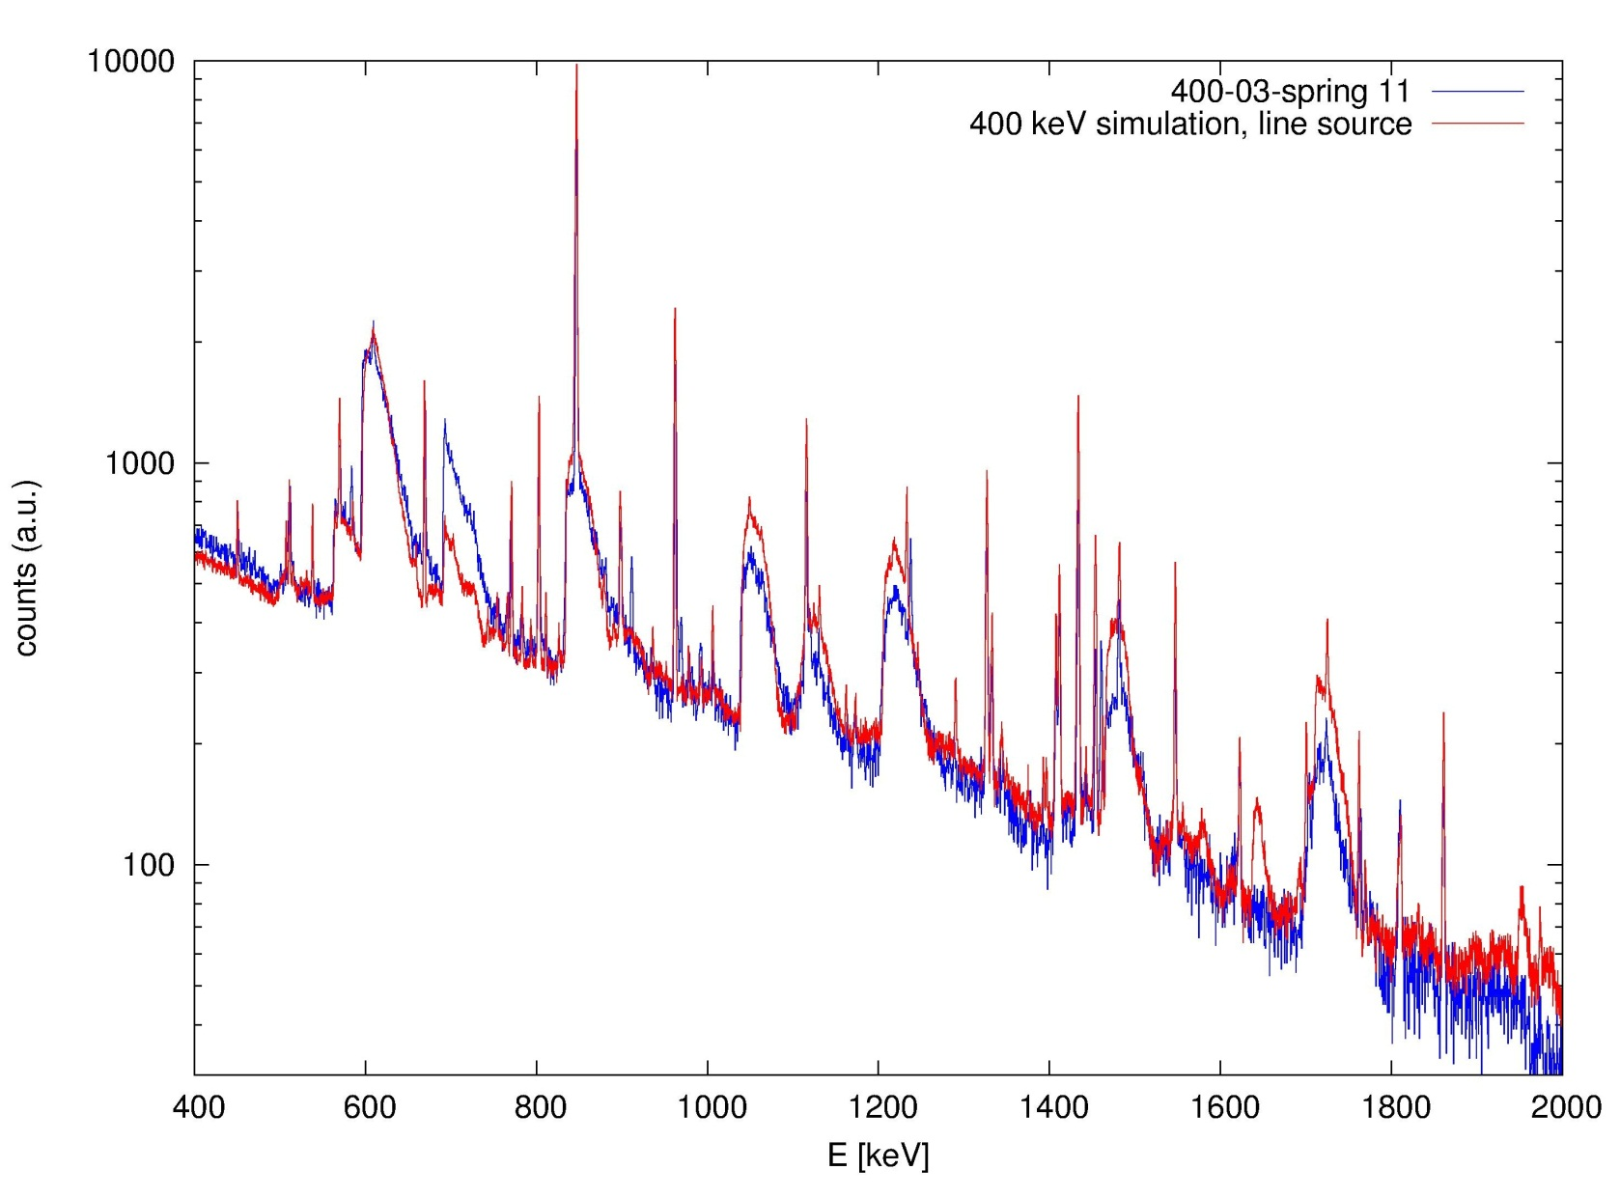
GEANT4-simulations
measurement
and simulation
are in good
agreement!
simulations done
by Z. Elekes

Slide 26
GEANT4-simulations
The beam induced background level has doubled within 1000 C of beam charge.
Hypothesis: As the gas target pressure has not been changed, this effect is due to deuterium implantation in metal surfaces:
target collimator
steel tube along the beam (was always intended to stop deuterons)
beam calorimeter
How affects a changing neutron source geometry the measured γ-spectra?

Slide 27
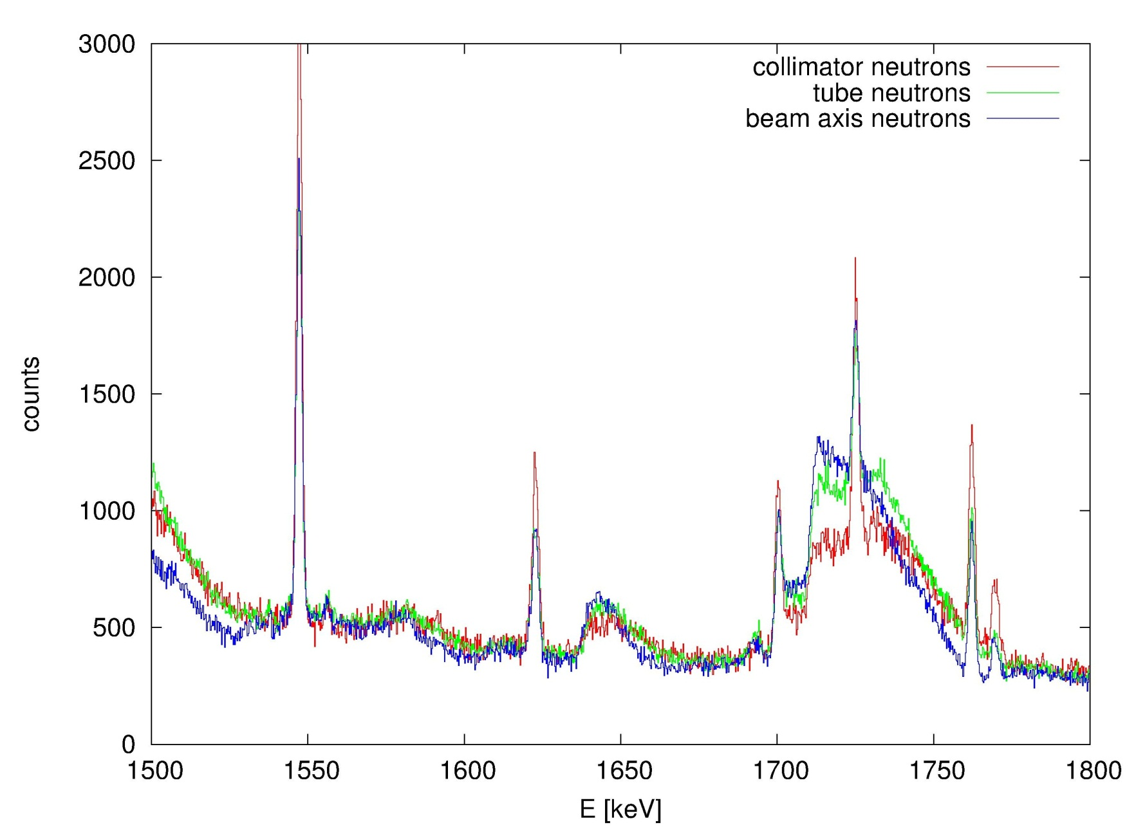
GEANT4-simulations
beam induced background shape
depends on the
neutron source geometry!

Slide 28
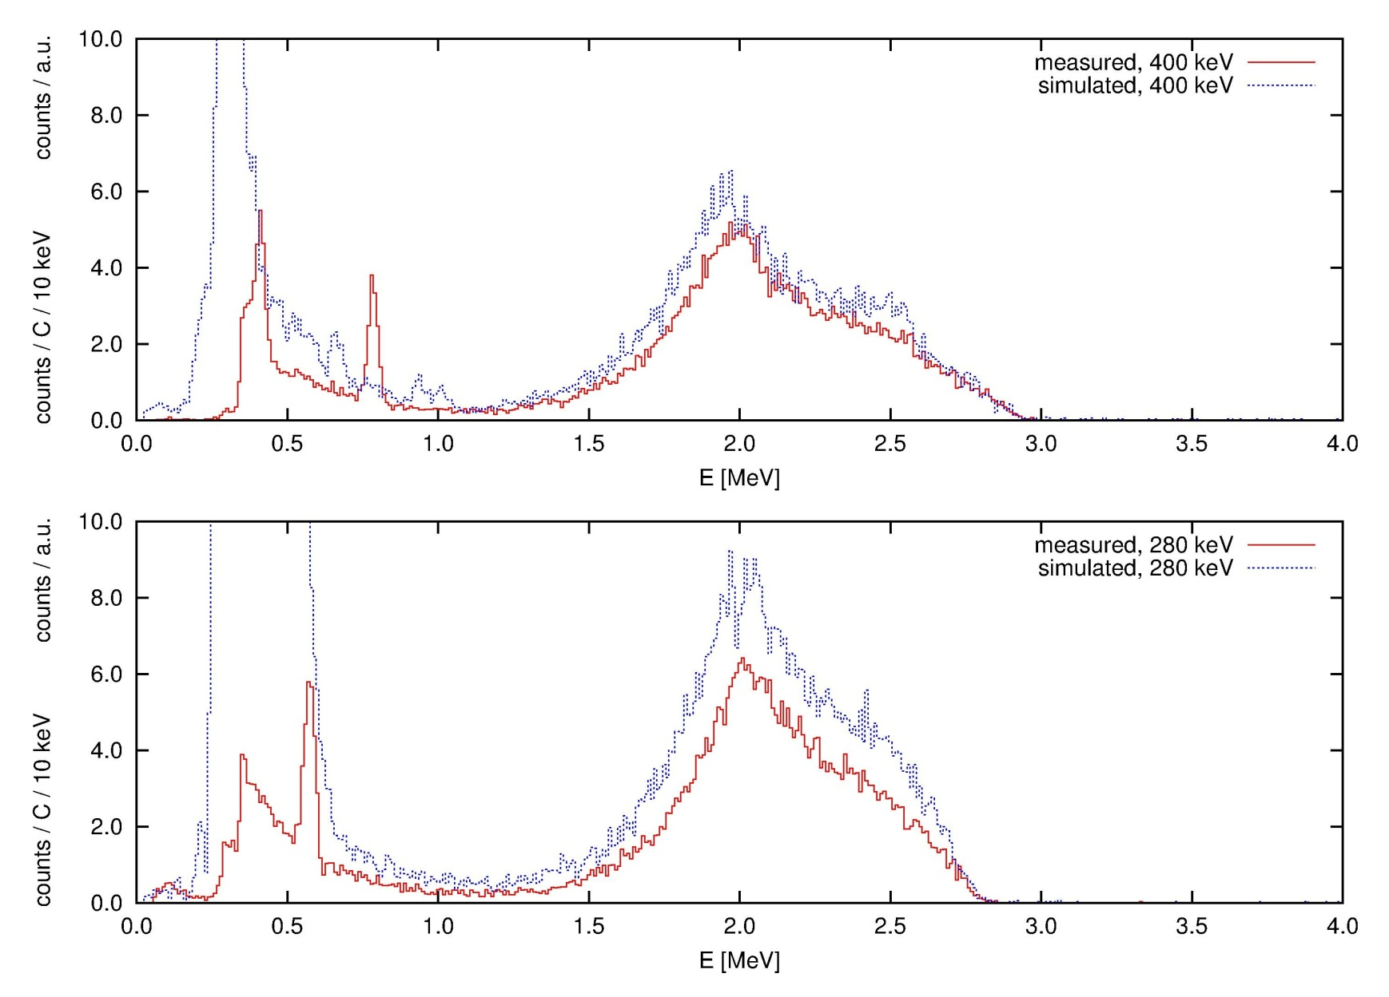
GEANT4-simulations
0.3 mbar Maestro data of silicon detector, compared
with simulation results
(by P. Corvisiero)

Slide 29
Ongoing work
The next beam time is scheduled for March and April 2012.
Intentions and goals:
exchanging deuterated setup components
measurement with an AmBe neutron source to compare with simulation results
increasing amount of d(α,γ)⁶Li data
Si detector resolution and recalibration works
further work to understand the background in the γ-detector
data analysis

Slide 30
Summary
no direct measurement of the astrophysical S-factor at low energies yet
new data could answer still open questions about the ⁶Li origin in our universe
the LUNA experiment at LNGS is able to measure very low cross sections
a possible data analysis approach for a small, broad signal has been developed
the beam induced background needs to be studied further
GEANT4 simulations are helpful

Slide 31
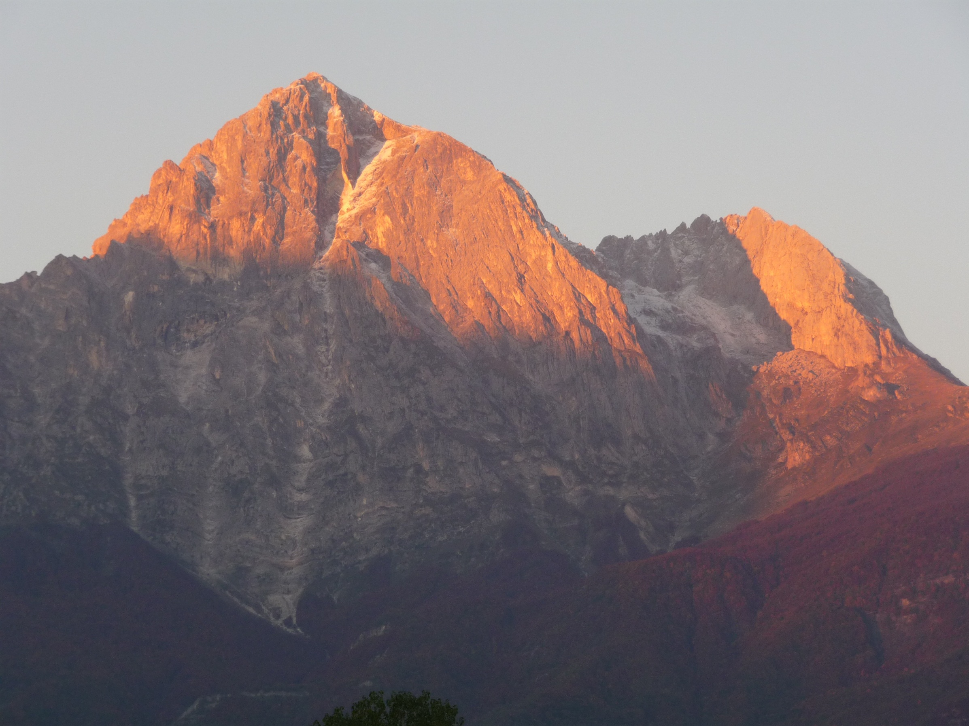
Thank you for your attention!
The LUNA collaboration:
A. Bellini, D. Bemmerer, C. Broggini, A. Caciolli, P. Corvisiero, H. Costantini,
Z. Elekes, M. Erhard, A. Formicola, Zs. Fülöp, G. Gervino, A. Guglielmetti,
C. Gustavino, Gy. Gyürky, G. Imbriani, M. Junker, A. Lemut, M. Marta,
C. Mazzocchi, R. Menegazzo, P. Prati, V. Roca, C. Rolfs, C. Rossi Alvarez,
E. Somorjai, O. Straniero, F. Strieder, T. Szücs, F. Terrasi, H.P. Trautvetter,
D. Trezzi
This work is supported by DFG (BE 4100/2-1).

Slide 32
