Slide 1
¹²C and 3α studied with small accelerators
496th WE-Heraeus-Seminar
Bad Honnef
February 6-10 2012
Introduction to the 3α reaction
3α breakup of the Hoyle state
Search for “missing” states in ¹²C
Hans Fynbo
Aarhus University
Denmark
Notes:
Reviews
Bertram+Maria,
Pfuztner, Karny, Grigorenko, Riisager
review, Olof+Diget

Slide 2
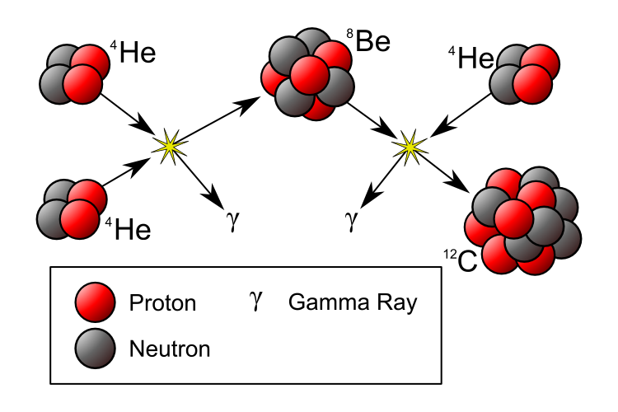
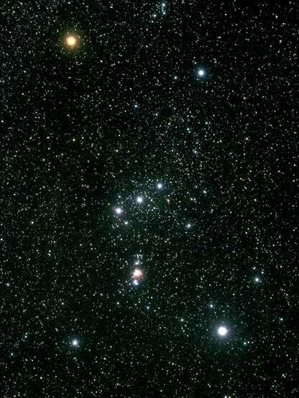
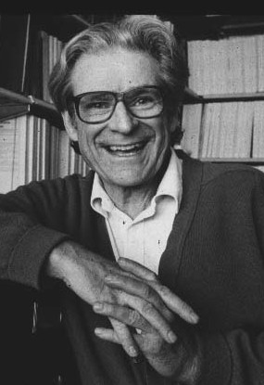
-0.092
g.s. 0⁺
⁴He⁺⁴He
⁸Be
g.s. 0⁺
¹²C

Slide 3
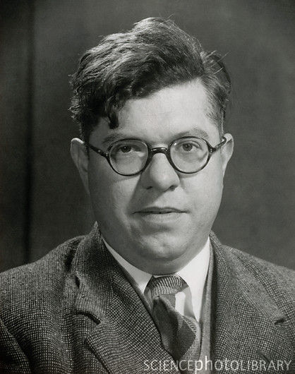
-0.092
g.s. 0⁺
7.65 0⁺
⁴He⁺⁴He
⁸Be
7.27
γ
4.44 2⁺
γ
g.s. 0⁺
¹²C
3

Slide 4
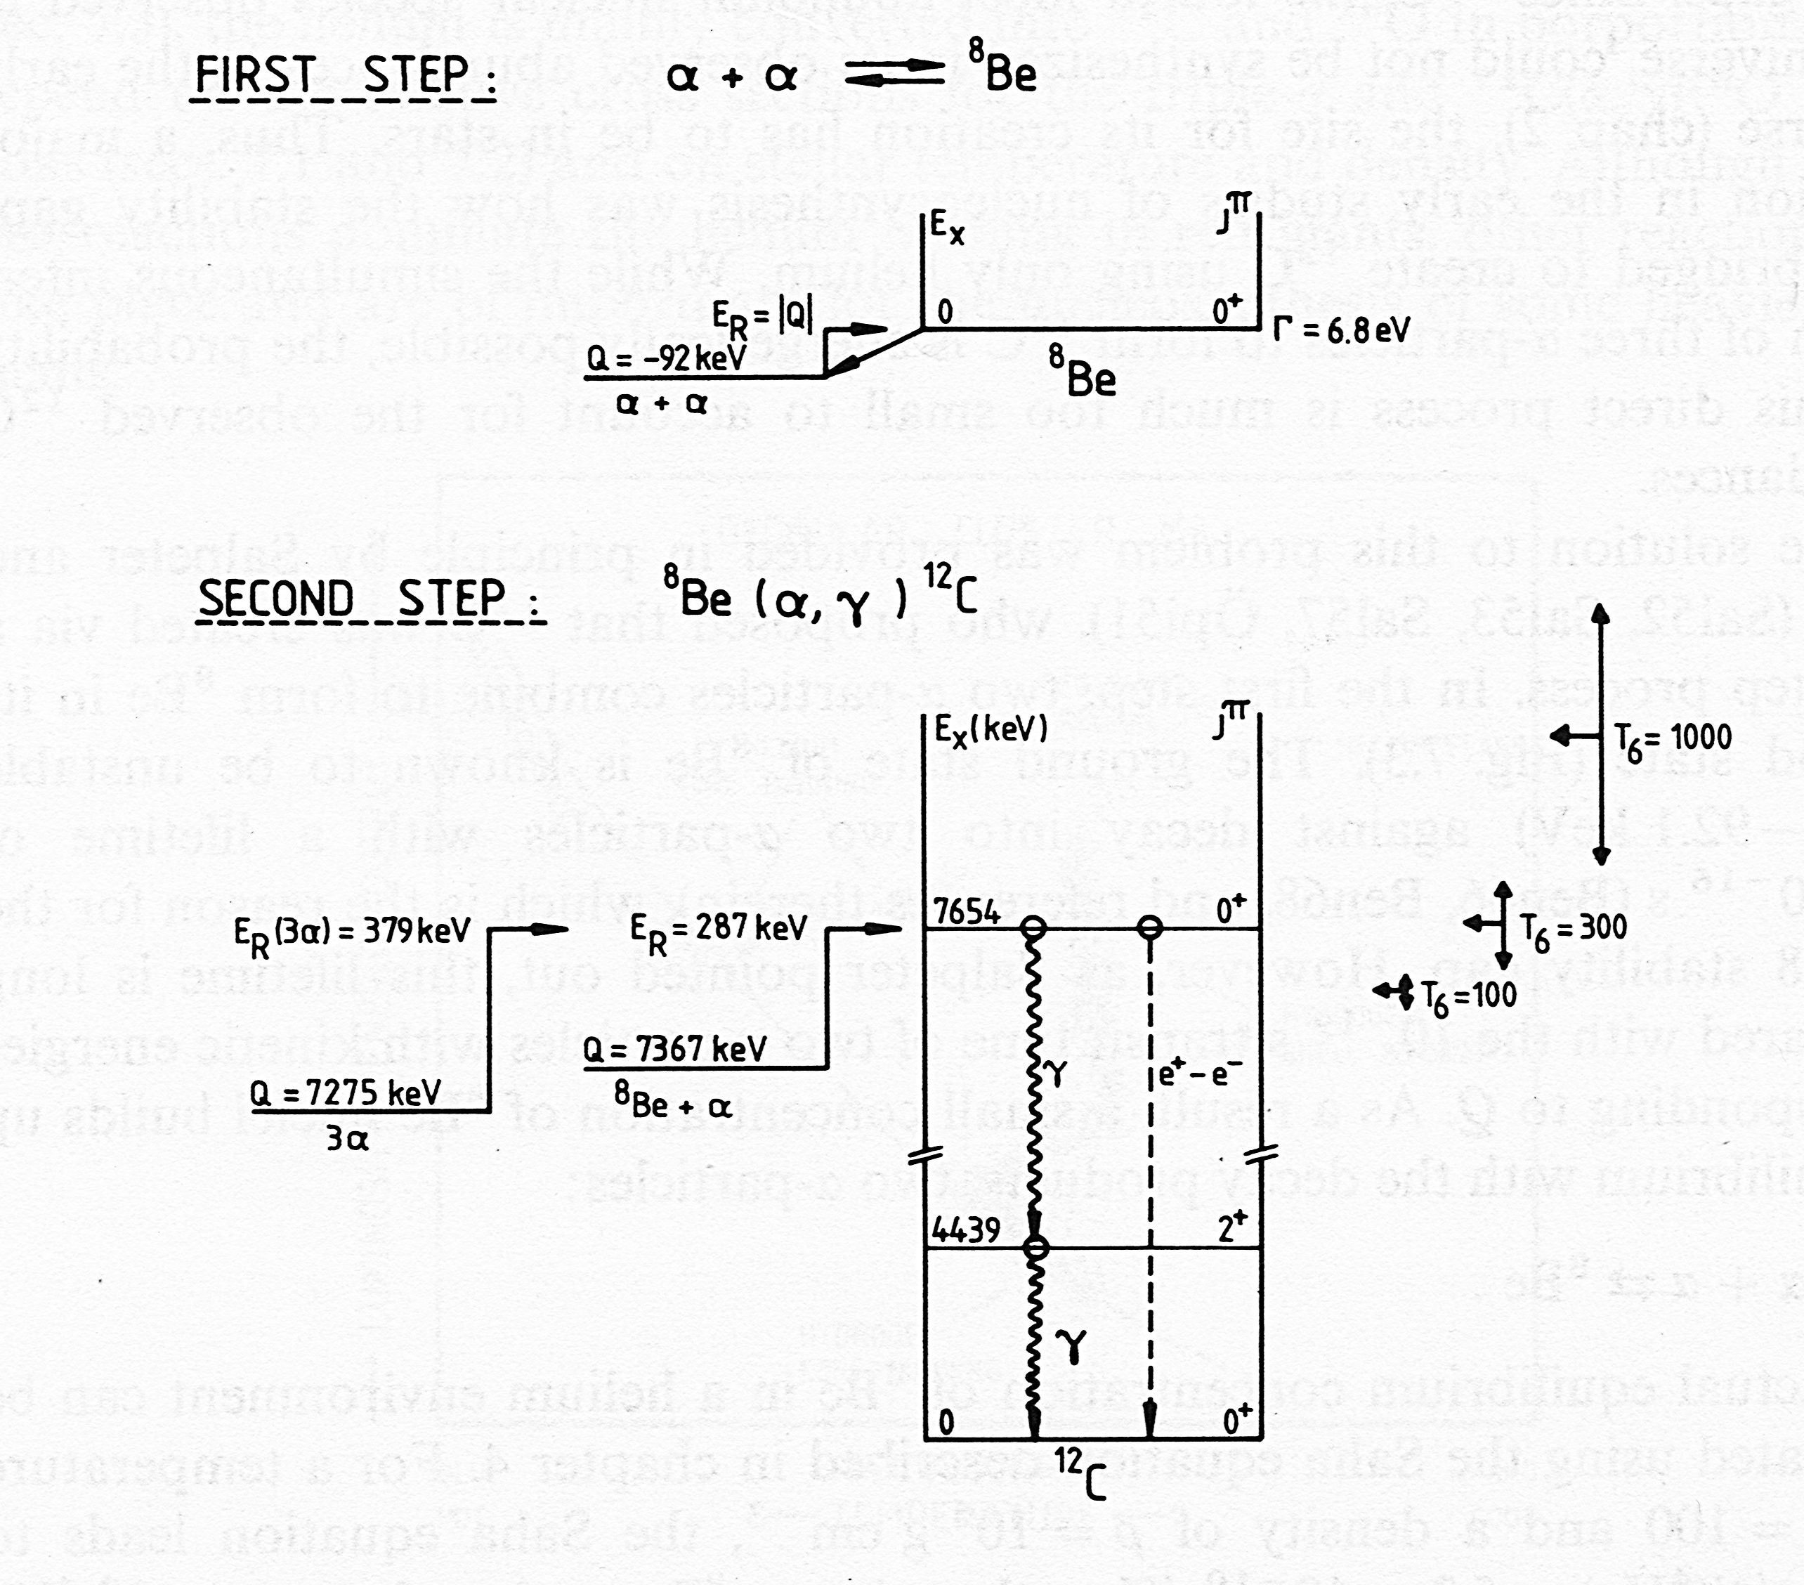
Quantity | Value | Error(%)
Q_{3α} | 379.4(2)keV | 1.2
Γ_{rad}/Γ | 4.12(11) ×10⁻⁴ | 2.7
Γ_{e+e-}/Γ | 6.7(6) × 10⁻⁴ | 9.2
Γ_{e+e-} | 52.0(1.4) μeV | 2.7 Crannell 2005
Γ_{e+e-} | 59.6(1.5) μeV | 2.5 Chernykh 2010
Γ(⁸Be)/Γ_{tot} | >0.96 | 4 Freer 1994
Γ(⁸Be)/Γ_{tot} | 0.83(5) | 6 Raduta 2011
Hoyle state
Q₂= -287 keV
α +⁸Be
Γ_{π}
Q₁ = -92 keV
α + α
Γ_{γ}

Slide 5
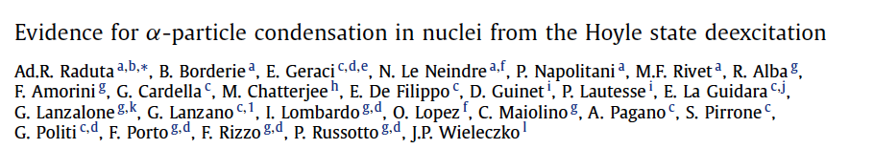
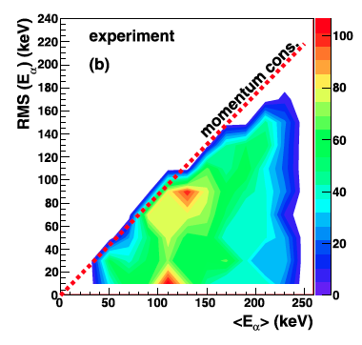
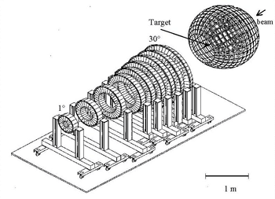
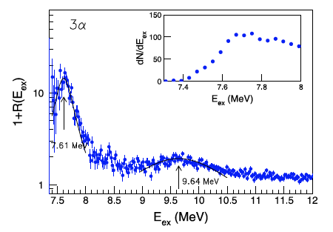
¹²C+⁴⁰Ca 25MeV/u

Slide 6
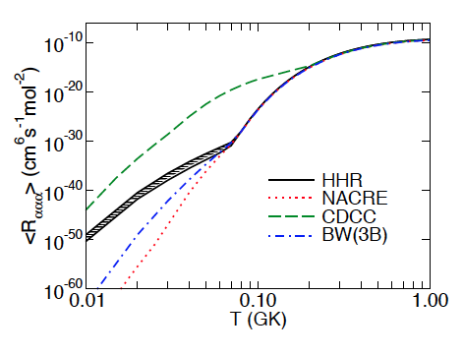
3α-rate at low temperatures
⁸Be
resonance
arXiv:1112.2136v1 [nucl-th]

Slide 7
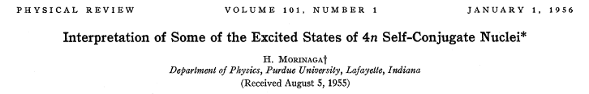

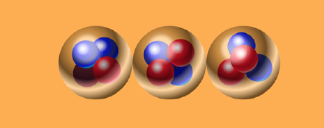
3α-rate at high temperatures
10.84 1⁻
2⁺ ?
≈10.3 (0⁺)
9.64 3⁻
Haruhiko Morinaga (TUM)
7.65 0⁺
α+α+α
7.27
4.44 2⁺
g.s. 0⁺
¹²C
J^{π}=2⁺ E≈9.7 MeV

Slide 8
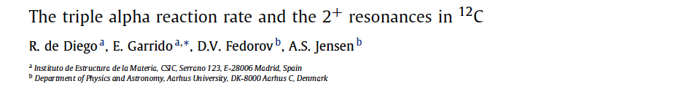
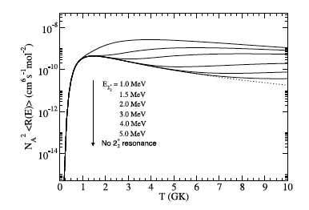
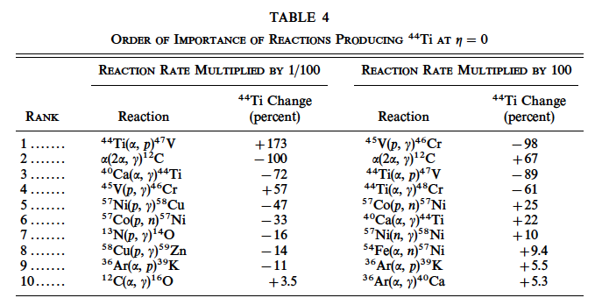
Tur et al. APJ 2010
Magkotsios et al. APJs 2010
Magkotsios et al. APJ 2011
The et al. APJ 1998
Phys. Lett. B 2011.
Phys. Rev. C36 (1987) 54..

Slide 9
3α breakup of the Hoyle state
Search for “missing” states in ¹²C

Slide 10

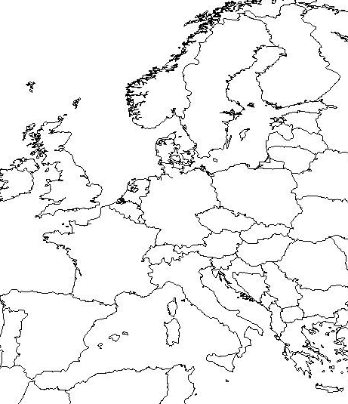

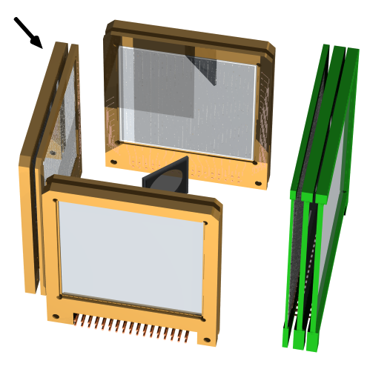

³He+¹¹B d+¹²C* d+3α @ 8.5 MeV
³He
CMAM, Madrid
Oliver Kirsebom
(now at Triumf)

Slide 11

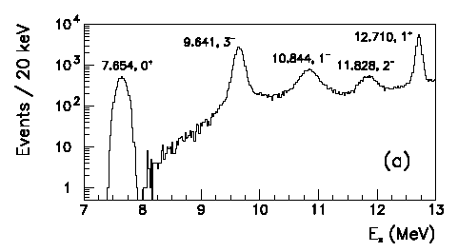
12.71 1⁺
11.83 2⁻
10.84 1⁻
≈10 0,2⁺
9.64 3⁻
7.65 0⁺
7.27
4.44 2⁺
g.s. 0⁺
¹²C
5000 events

Slide 12
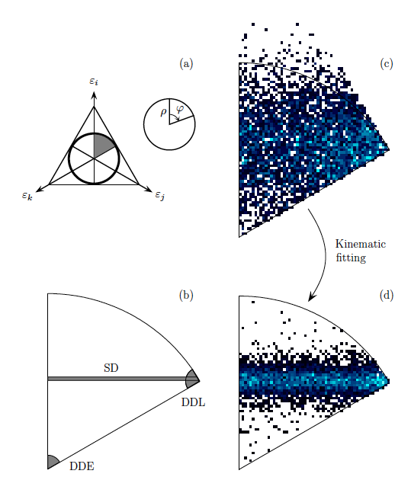
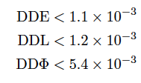
Limits:
Raduta et al.
DDE = 7.5±4 %
DDE = 9.5±4 %
SD = 83±5 %
(O. Kirsebom et al. to be submitted)

Slide 13
3α breakup of the Hoyle state
Search for “missing” states in ¹²C

Slide 14
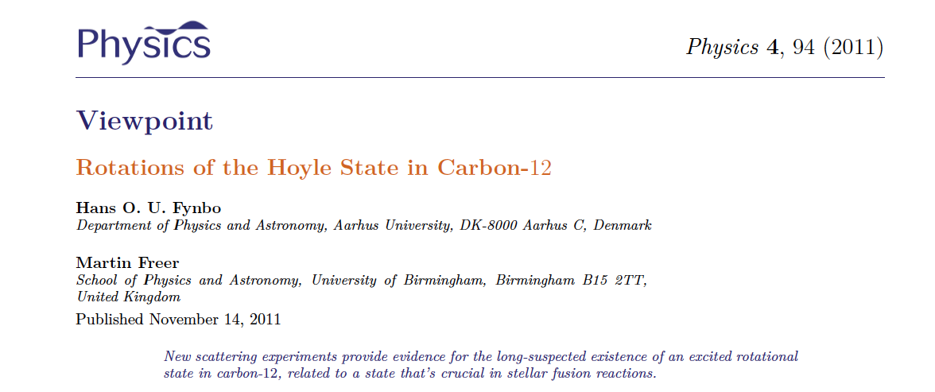
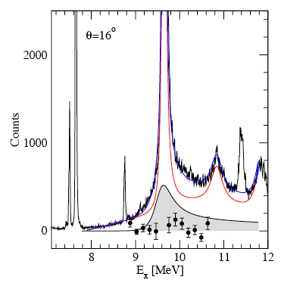
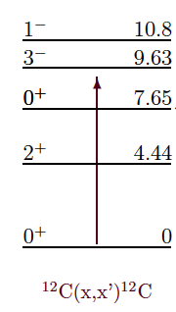
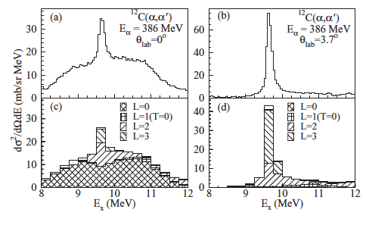
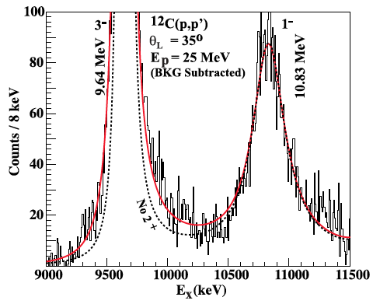
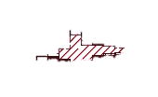
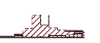
Stellenbosch: Freer et al. (2009): ¹²C(p,p´)¹²C
2⁺?
3⁻
1⁻
Osaka: Itoh et al. (2011): ¹²C(α, α´)¹²C
Yale : Zimmerman et al. (2011): ¹²C(p,p´)¹²C
3⁻
3⁻
3⁻
1⁻

Slide 15
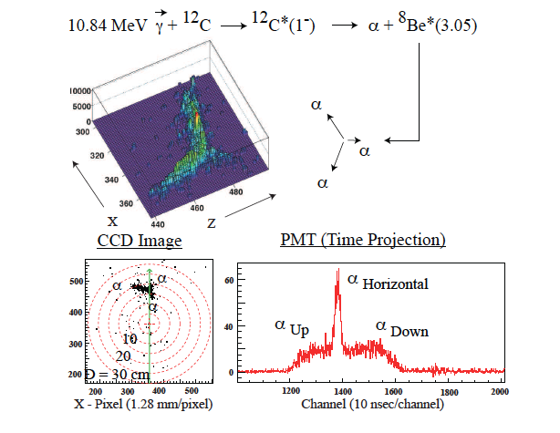
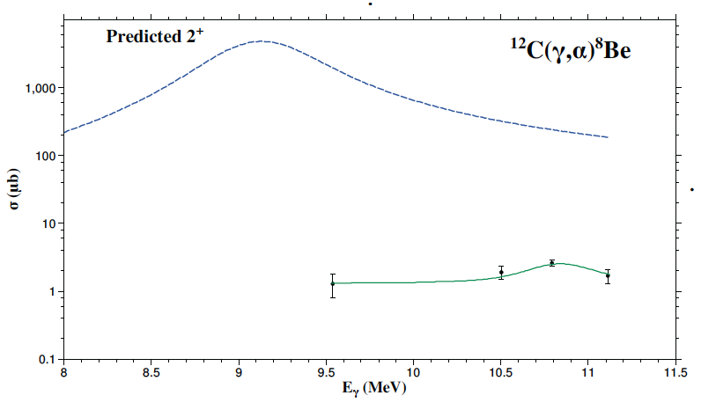
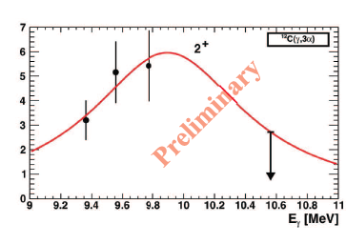
Journal of Physics: Conference Series 202 (2010) 012016
Journal of Physics: Conference Series 267 (2011) 012046

Slide 16
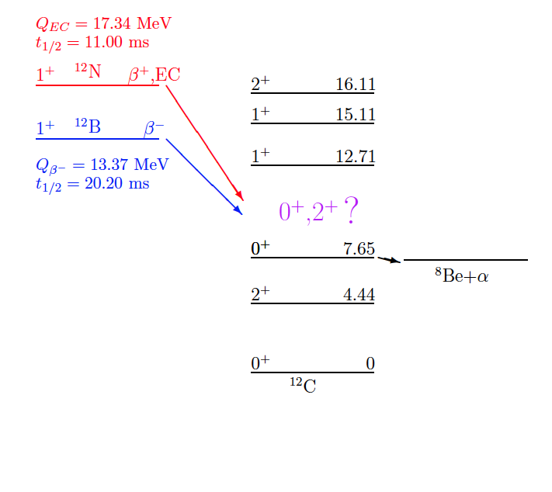
Idea 1 :
Remove 3⁻ state using β-decay
Only 0⁺, 1⁺, and 2⁺ states

Slide 17


Direct Kinematics+ISOL
¹²C/¹¹B
¹²N/¹²B+X
¹²N/¹²B
p/d
Magnet
3α (β)
Inverse Kinematics+Separator
¹²N/¹²B
¹²N/¹²B+X
Magnets
p/d
3α (β)
¹²C/¹¹B
Notes:
In the top half of the slide I show the ISOL approach, where the produced short-lived isotopes are extracted from the target and ionised, mass separated and stopped in a thin collection foil. This foil can then be surrounded by effective detector arrays. The advantage is that this allows to measure all the three alpha-particles in coincidence with reasonable detection efficiency. The disadvantage is that there still energy loss effects in the collection foil, although much less than in the old “in beam” method. Also, the detection efficiency is dependent on the kinematics and needs to be calculated from Monte-Carlo simulations.
We have used the ISOL method at experiments at ISOLDE facility at CERN and the IGISOL beam-line in Jyvaskyla in Finland. Today I will only talk about our results from Jyvaskyla, whereas our earlier results are published in these references.
The alternative method is to use inverse kinematics shooting the heavy beam on a thin gas target and extract the produced short lived isotopes as beams of 10-20MeV/u and separate and direct them onto an implantation detector. Then the subsequent decays happen in the detector and the summed energy of the three particles is measured directly. If the detector is thin enough the energy deposition of the beta-particles is not a problem.
The advantage is that there are no energy-loss effects and that the sum energy is measured without kinematics dependent detection efficiencies, and that one can count the number of implanted ions and compare to the number of subsequent decays to extract branching ratios. The disadvantage is that the individual alpha-particle energies are not measured and that there is a small energy deposition of the beta-particles.
We have recently used the fragment method at the TRIuP facility at KVI in the Netherlands.

Slide 18
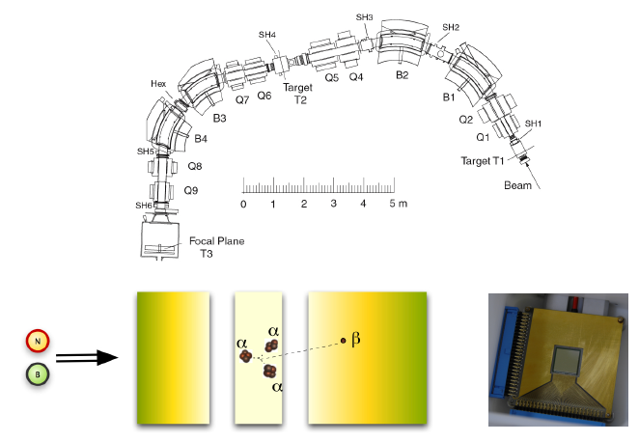

K. Jungmann
H. Wilschut
TRIμP separator
Solveig
Hyldegaard
¹²N/¹²B
R.Raabe

Slide 19
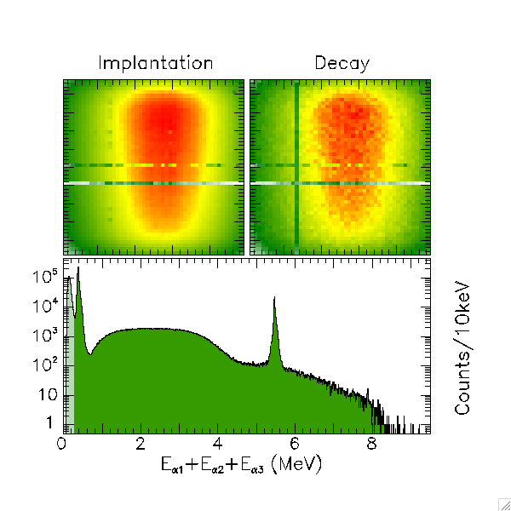
¹²N Q_{beta}=16.32
15.11 1⁺
12.71 1⁺
≈10 0⁺
7.65 0⁺
4.44 2⁺
1⁺
g.s. 0⁺
¹²C
Notes:
Next I show our results from the alternative method where we implanted, in this case 12N, in a thin implantation detector and measured the sum energy directly.
The two scatter plots in the top part show how events are distributed over the surface of the implantation detector, which was segmented with 48 times 48 segments. To the left is the contour plot of implantation events, and to the right is the contour plots of subsequent decays of in this case 12N. The two distributions are consistent with each other.
In the lower part is shown the energy spectrum of decay events. This spectrum shows like the ISOL data the narrow 1+ state at 12.71MeV and the broad distribution around it. In this approach we can measure much lower in sum energy and therefore also have the low energy 7.6MeV 0+ state in the spectrum. The peak at lower energy is from decays to the bound states where only the beta-particle deposits energy. In fact there is also evidence for feeding to the Isobaric Analogue state at 15.1MeV, which mainly decays by gamma-decay.
This analysis is performed by PhD student Solveig Hyldegaard.

Slide 20
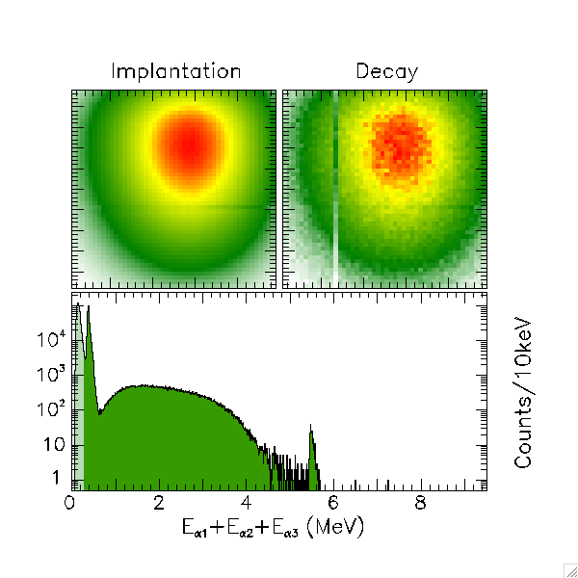
15.11 1⁺
¹²B Q_{beta}=13.37
12.71 1⁺
≈10 0⁺
7.65 0⁺
4.44 2⁺
g.s. 0⁺
¹²C
Notes:
For the implantation experiment the pattern is again the same with the implantation and decay distribution in the top part, and the lower part the decay energy spectrum.
Again we see the feeding to the 1+ state.

Slide 21
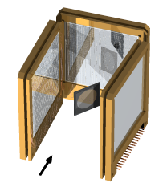

IGISOL Experiment
¹²N/¹²B
C. Diget
(York)
Solveig
Hyldegaard

Slide 22
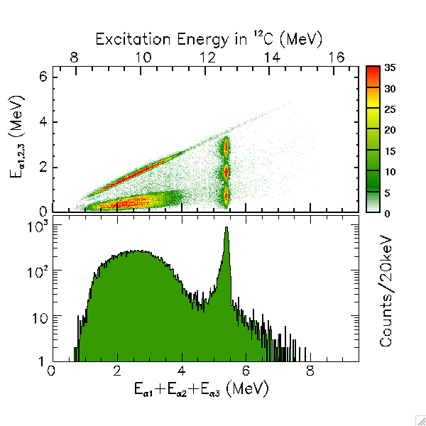
¹²N Q_{beta}=16.32
Natural parity states
15.11 1⁺
12.71 1⁺
≈10
7.65 0⁺
4.44 2⁺
g.s. 0⁺
¹²C

Slide 23
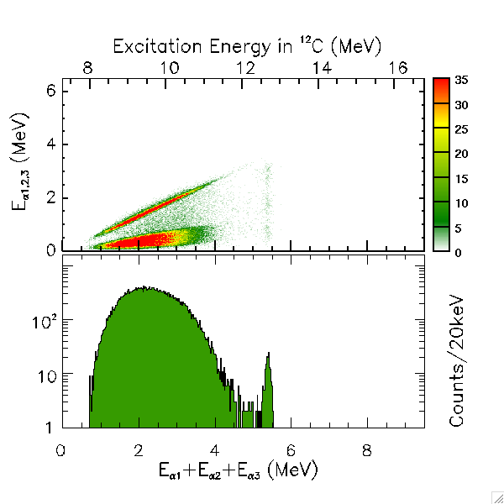
15.11 1⁺
¹²B Q_{beta}=13.37
12.71 1⁺
≈10 0⁺
7.65 0⁺
4.44 2⁺
g.s. 0⁺
¹²C
Notes:
I now present the same series of results for the mirror decay, that of 12B.
First the results from the ISOL experiment at IGISOL, Jyvaskyla.
Due to the lower Q-value in this decay the feeding to the 1+ state is now much less, but other than that the qualitative features are the same.
Note that we now see feeding to the 1+ state in this decay as well.

Slide 24
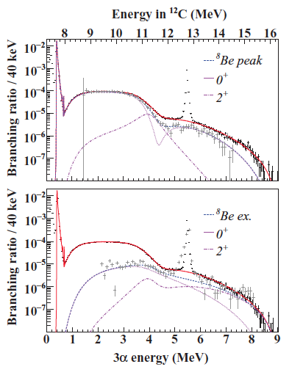
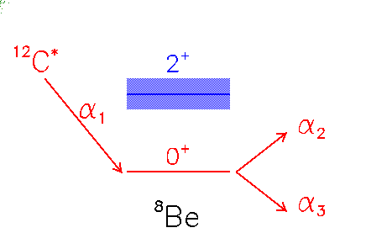
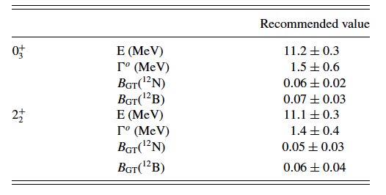
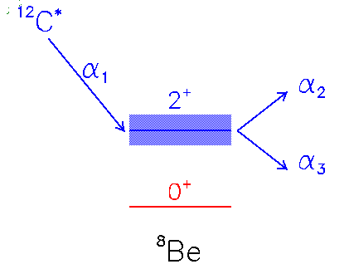
PL B678, 459 (2009)
PR C80, 044304 (2009)
PR C80, 034316 (2009)
PR C81, 024303 (2010)
S. Hyldegaard, C. Diget

Slide 25
How to get selectivity between 0⁺ and 2⁺ ?
×
2⁺
×
Only 0⁺, 1⁺, and 2⁺ states
Only 1⁺, 2⁺, and 3⁺ states

Slide 26
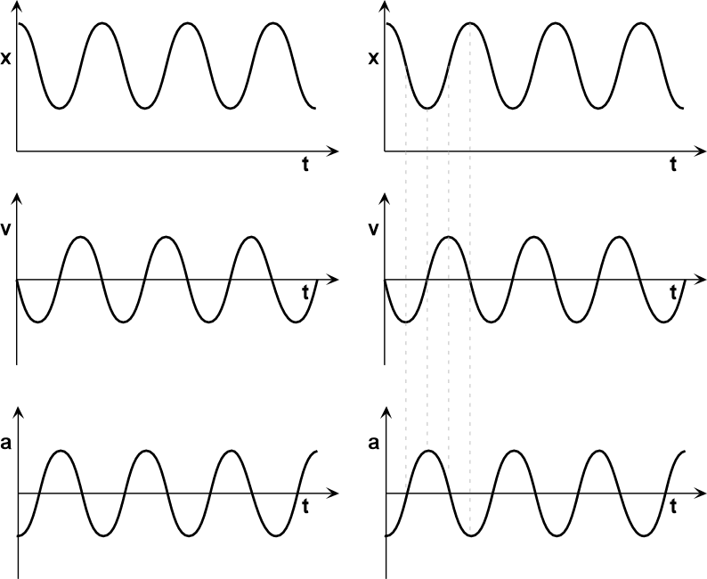

“γ-delayed” 3α breakup
γ
3α
¹²C
Oliver Kirsebom
(Triumf)
Martin Alcorta
(Argonne)

Slide 27
³He+¹⁰B p+¹²C* p+3α @ 4.9 MeV
³He+¹¹B d+¹²C* d+3α @ 8.5 MeV
³He
CMAM, Madrid
M. Alcorta et al., NIM A 605, 318–325 (2009)

Slide 28
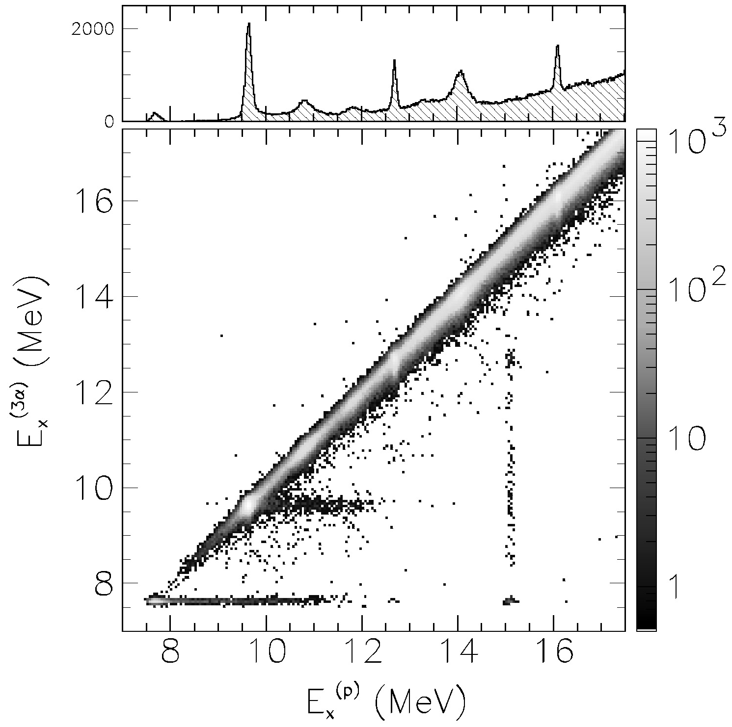
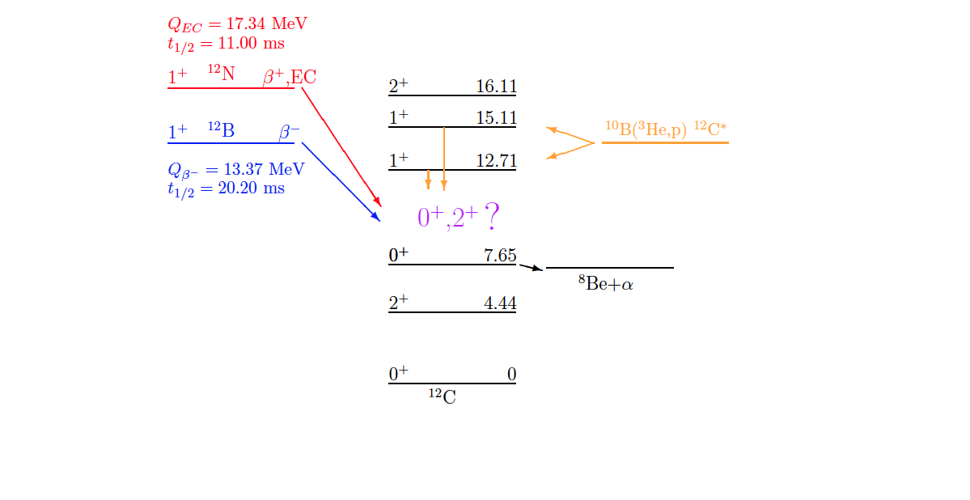
1st case : γ-decay of 1⁺ states (proof-of-principle)
³He+¹⁰B p+¹²C* p+3α
³He
O. S. Kirsebom et al., Phys. Lett. B680, 44-49 (2009)

Slide 29
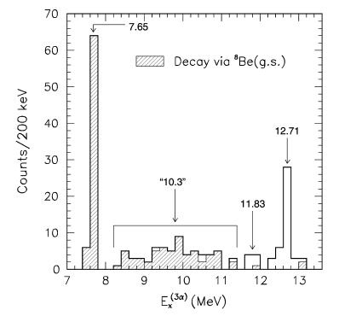
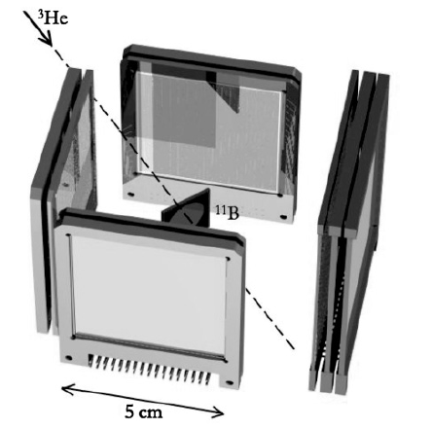
1st case : γ-decay of 1⁺ states (proof-of-principle)
M1 γ-decay ≈ GT β-decay

Slide 30
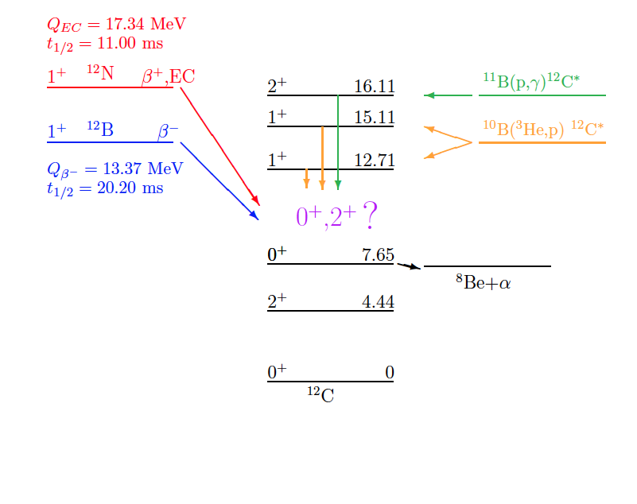
2nd case : γ-decay of 2⁺ T=1 state
+ M1 >> E2 ➔ 1⁺ ,2⁺, 3⁺ no 0⁺ !
− E1 decay populate negative parity ➔ 1⁻ ,2⁻, 3⁻

Slide 31
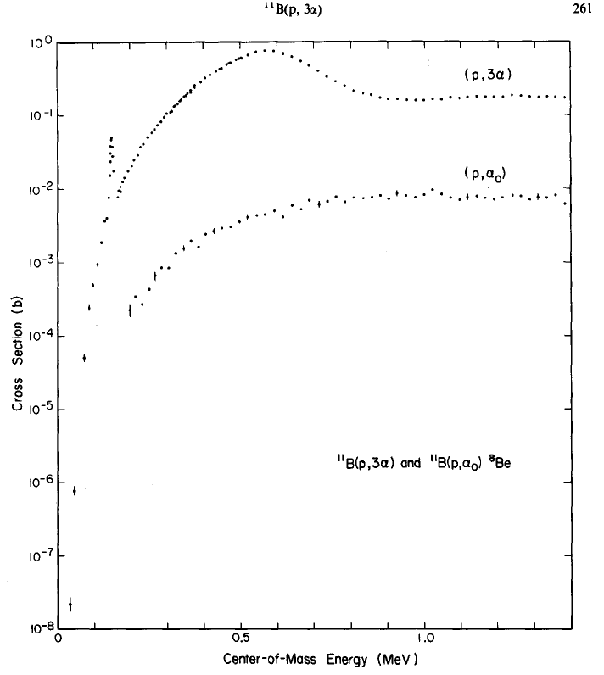
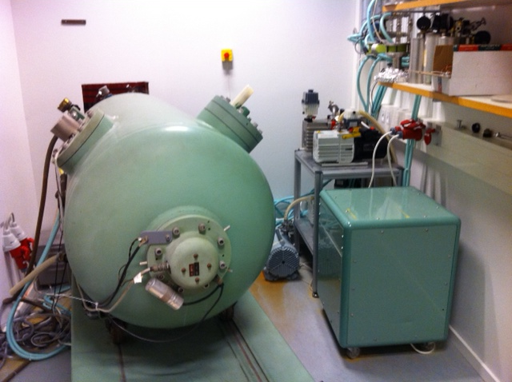
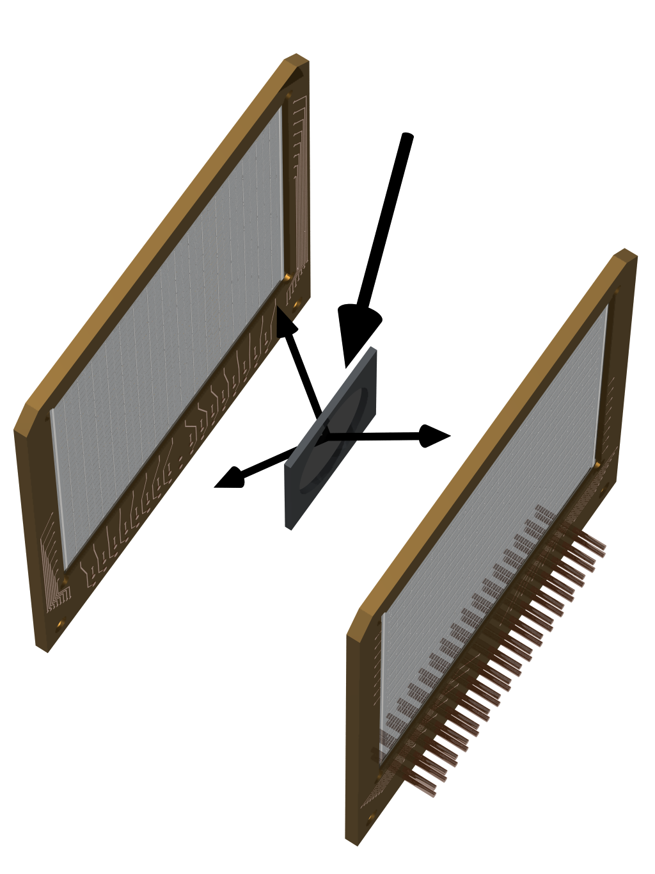

2⁻
¹¹B(p,α)αα
2⁺
1⁻
1⁻
2⁻
400keV van de Graaf
in Aarhus.
2⁺

Slide 32


16.1 2⁺
15.11 1⁺
14.08 4⁺
13.35 (2⁻)
12.71 1⁺
11.83 2⁻
10.84 1⁻
≈10 0,2⁺
9.64 3⁻
7.65 0⁺
7.27
4.44 2⁺
g.s. 0⁺
¹²C

Slide 33


16.1 2⁺
15.11 1⁺
14.08 4⁺
13.35 (2⁻)
12.71 1⁺
11.83 2⁻
10.84 1⁻
≈10 0,2⁺
9.64 3⁻
7.65 0⁺
7.27
4.44 2⁺
g.s. 0⁺
¹²C
240h 1nA @ 165keV

Slide 34

16.6 2⁻
3rd case : γ-decay of 2⁻ T=1 state
16.1 2⁺
15.11 1⁺
14.08 4⁺
13.35 (2⁻)
12.71 1⁺
11.83 2⁻
10.84 1⁻
≈10 0,2⁺
9.64 3⁻
7.65 0⁺
7.27
4.44 2⁺
g.s. 0⁺
¹²C
40h 1nA @ 350keV

Slide 35






C. Zemach, Phys Rev. 133 (1964) 1201 : Decay to 3π
Fynbo et al. Phys Rev C79 (2009) 054009 : Decay to 3α

Slide 36



¹¹B(p,α)αα
2⁻ 16.57MeV
2⁺ 16.11MeV

Slide 37



Outlook
5 MV van de Graaf in Aarhus (HV 1965)
Other case where the method can be used?
⁸Be
¹⁶O
…..
Upgrade of detector setup

Slide 38
Quantity | Value | Error(%)
Q_{3α} | 379.38(20)keV | 1.2
Γ_{rad}/Γ | 4.12(11) ×10⁻⁴ | 2.7
Γ_{e+e-}/Γ | 6.74(62) × 10⁻⁴ | 9.2
Γ_{e+e-} | 52.0(1.4) μeV | 2.7 Crannell 2005
Γ_{e+e-} | 59.6(1.5) μeV | 2.5 Chernykh
Γ(⁸Be)/Γ_{tot} | >0.96 | 4 Freer 1994
Γ(⁸Be)/Γ_{tot} | 0.83(5) | 6 Raduta 2011

Slide 39
Thank you for your attention !

Slide 40
Bonus material…

Slide 41
Natural parity states
Decay channels
15.11 1⁺
The 1⁺ states cannot decay via the ⁸Be ground state because it would require L=1 and therefore a change in parity
12.71 1⁺
α
≈10 0⁺/2⁺
3.03 2⁺
7.65 0⁺
g.s. 0⁺
-0.092
7.27
¹²C
⁸Be+⁴He
⁴He⁺⁴He+⁴He

Slide 42

Data FMD
B(GT)
B(M1)
1⁺,T=1
B(M1)
2⁺,T=1

Slide 43
16.11 2⁺
p+¹¹B
15.96
15.11 1⁺
14.08 4⁺
13.35 (2⁻)
12.71 1⁺
11.83 2⁻
10.84 1⁻
≈10.3 (0⁺)
9.64 3⁻
7.65 0⁺
α+α+α
7.27
4.44 2⁺
g.s. 0⁺
¹²C

Slide 44

Experimental Dalitz plots
16.11 2⁺
p+¹¹B
15.96
15.11 1⁺
14.08 4⁺
13.35 (2⁻)
12.71 1⁺
11.83 2⁻
10.84 1⁻
≈10.3 (0⁺)
9.64 3⁻
7.65 0⁺
α+α+α
7.27
4.44 2⁺
g.s. 0⁺
¹²C

Slide 45

The 13.35 MeV state
16.11 2⁺
p+¹¹B
15.96
15.11 1⁺
14.08 4⁺
13.35 (2⁻)
12.71 1⁺
11.83 2⁻
10.84 1⁻
≈10.3 (0⁺)
9.64 3⁻
X
√
7.65 0⁺
α+α+α
7.27
4.44 2⁺
g.s. 0⁺
¹²C
2–
4–
Notes:
45

Slide 46

The 11.83 MeV state
16.11 2⁺
¹⁾
²⁾
15.96
p+¹¹B
15.11 1⁺
14.08 4⁺
2–
13.35 (2⁻)
12.71 1⁺
11.83 2⁻
³⁾
²⁾
10.84 1⁻
≈10.3 (0⁺)
9.64 3⁻
7.65 0⁺
α+α+α
7.27
4.44 2⁺
1) A.A.Korsheninnikov, Sov. J. Nucl. Phys. 52 (1990)
2) H.Fynbo et al., PRL 91 (2003)
3) R.Alvarez-Rodriguez et al., PRL 99 (2007)
g.s. 0⁺
¹²C
2–
Notes:
46

Slide 47
γ
3.03 2⁺
≈10 0⁺,2⁺
-0.092
g.s. 0⁺
7.65 0⁺
¹²C*
⁴He⁺⁴He
⁸Be
7.27
⁸Be
10⁻¹⁶s
γ
4.44 2⁺
γ
g.s. 0⁺
¹²C

Slide 48
Dalitz plot
¹²C* α₁+ ⁸Be α₁+α₂+α₃
E₁
Momentum conservation
Energy conservation
¹²C
Q_{I}
α_{i}
⁸Be
Q_{II}
2/3Q_{I}
α₂ + α₃
E₃
E₂
E₁ = m₂₃/(m₁+m₂₃) x Q_{I} = 2/3 xQ_{I}
R.H. Dalitz, Philos. Mag. 44, 1068 (1953).
Notes:
Dalitz det. By two things. INDEPENDENT
Since density of final states proportional to dE1dE2, intensity of dalitz plot (decay amplitude) proportional to matrix element squared
First is final state interactions (eg 2 body resonance). If sequential decay, then 1st particle gets 2/3 energy. This gives bands as shown in Figure.
2nd is symmetry constraints…

